Slide 1
USER LEVEL INTERVENTION
ANALYSING HATE SPEECH IN CONVERSATIONAL THREADS

Slide 2
HATE SPEECH
“Any kind of communication in speech, writing or behavior, that attacks or uses pejorative or discriminatory language with reference to a person or a group on the basis of who they are, in other words, based on their religion, ethnicity, nationality, race, colour, descent, gender or other identity factor.”
- UN Strategy and Plan of Action on Hate Speech
UMBRELLA TERMS
Offensive Speech
Toxic Language
Discriminatory Language
For the scope of this research , we have followed a binary marking of hate speech ( a tweet is either hate or not) thereby classifying all the above umbrella terms as hate speech

Slide 3
LITERATURE REVIEW
HATE SPEECH
Hateful Symbols or Hateful People? Predictive Features for Hate Speech Detection on Twitter (Zeerak Waseem and Dirk Hovy. 2016)
Automated Hate Speech Detection and the Problem of Offensive Language (Davidson, Warmsley, Macy, & Weber, 2017)
Large Scale Crowdsourcing and Characterization of Twitter Abusive Behavior (Founta et al., 2018)
A Measurement Study of Hate Speech in Social Media (Mainack Mondal, Leandro Araújo Silva, and Fabrício Benevenuto. 2017)
Analyzing the Targets of Hate in Online Social Media (Silva et al., 2016)
The Datafication of Hate: Expectations and Challenges in Automated Hate Speech Monitoring (Laaksonen et al., 2020)
A Survey on Hate Speech Detection using Natural Language Processing (Anna Schmidt et al., 2017)
DEEP LEARNING FOR HATE SPEECH DETECTION: A COMPARATIVE STUDY (Jitendra Singh Malik et al ., 2023)
Countering Online Hate Speech: An NLP Perspective (Chaudhary et al., 2021)
On Analyzing Antisocial Behaviors Amid COVID-19 Pandemic (Awal et al., 2020)
Peer to Peer Hate: Hate Speech Instigators and Their Targets (Mai ElSherief et al., 2018)
A Measurement Study of Hate Speech in Social Media (Mainack Mondal et al., 2017)
Time of Your Hate: The Challenge of Time in Hate Speech Detection on Social Media (Florio et al., 2020)

Slide 4
LITERATURE REVIEW
COUNTER-SPEECH
Online interventions for reducing hate speech and cyberhate: A systematic review (Windisch et al., 2022)
A Closer Look at the Self-Correcting Crowd: Examining Corrections in Online Rumors (Arif et al., 2017)
Moralized language predicts hate speech on social media (Kirill Solovev & Nicolas Pröllochs , 2022)
Racism is a virus: anti-asian hate and counterspeech in social media during the COVID-19 crisis (Bing He et al., 2021)
Countering hate on social media: Large scale classification of hate and counter speech (Garland et al., 2020)
Hate Speech and Counter Speech Detection: Conversational Context Does Matter (Xinchen Yu et al., 2022)
THE ROLE OF CONTEXT IN DETECTING THE TARGET OF HATE SPEECH (MARKOV & WALTER , 2022 )

Slide 5
LITERATURE REVIEW
INTERVENTIONS
Towards Automatic Generation of Messages Countering Online Hate Speech and Microaggressions (Mana Ashida and Mamoru Komachi , 2022)
Proactively Reducing the Hate Intensity of Online Posts via Hate Speech Normalization(Sarah Masud et al., 2022)
Generating Counter Narratives against Online Hate Speech:Data and Strategies (Serra Sinem Tekiroglu ̆ , 2020)
Generate, Prune, Select: A Pipeline for Counterspeech Generation against Online Hate Speech (Wanzheng Zhu and Suma Bhat , 2021)
CONAN - COunter NArratives through Nichesourcing: a Multilingual Dataset of Responses to Fight Online Hate Speech (Chung et al., 2019)
Thou Shalt Not Hate: Countering Online Hate Speech (Mathew et al., 2019)
Impact and dynamics of hate and counter speech online (Garland et al., 2022)

Slide 6
LITERATURE REVIEW
INTERVENTIONS
Interaction dynamics between hate and counter users on Twitter (Mathew et al., 2020)
Analyzing the hate and counter speech accounts on Twitter (Mathew et al., 2018)
Better Prevent than React: Deep Stratified Learning to Predict Hate Intensity of Twitter Reply Chains (Sahnana et al., 2021)
Predicting Hate Intensity of Twitter Conversation Threads (Meng et al., 2023)
WOULD YOUR TWEET INVOKE HATE ON THE FLY? FORECASTING HATE INTENSITY OF REPLY THREADS ON TWITTER (TANMOY CHAKRABOTY ET AL., 2021)
A Benchmark Dataset for Learning to Intervene in Online Hate Speech (Qian et al ., 2019)
Generate, Prune, Select: A Pipeline for Counterspeech Generation against Online Hate Speech (Wanzheng Zhu and Suma Bhat , 2021)
Generating Counter Narratives against Online Hate Speech:Data and Strategies (Serra Sinem Tekiroglu ̆ , 2020)
Proactively Reducing the Hate Intensity of Online Posts via Hate Speech Normalization(Sarah Masud et al., 2022)
Towards Automatic Generation of Messages Countering Online Hate Speech and Microaggressions (Mana Ashida and Mamoru Komachi , 2022)

Slide 7
STAGES OF THE PROJECT
Literature review AND CuRATING A DATASET :
During this phase we go through and understand all the work that has been done so far in this field and collect and preprocess datasets that shall be used in successive phases.
WORKING ON BUILDING THE MODEL :
Using Deep Learning and Natural Language Processing we shall build a model on the lines of the Research Question
Writing Paper :
Post building the model we shall be deriving conclusions and inferences from our work and systematically document our research paper

Slide 8
PROBLEM STATEMENT
Involves evaluating the effectiveness of various types of counter-speech against different categories of hate speech in online threads or discussions.
Comparative effectiveness of diverse categories of counter-speech in mitigating specific classifications of online hate speech, and to what degree do contextual variables modulate their impact?
STEPS
Categorize different types of Hate and Counter Speech
Use / create a model that looks at the temporal aspect of a twitter conversational thread
Use the above model so as to analyse different pairs of hate speech and counter speech patterns

Slide 9
Datasets
Anti-Social and Anti-Asian dataset (we were not able to extract the threads from the unclear graph structure)
YouTube Comments dataset (No conversational thread)
HASOC-2023 dataset (Has multilingual conversational threads)
Anti Racism dataset (Finalised Dataset)
Reddit and Gab dataset (Finalised Dataset) (However all the annotations made by the turk workers were quite similiar)

Slide 10
Categorisation of Hate and Counter Speeches
Methodology:
Initially we took 100 datapoints and each of us individually went through them and came up with our own categories and classified the 100 Reddit comments into those categories.
Once classified, we arranged a meeting and sat together to discuss the categories that each came up with a common label and the criteria used for that category.
In conclusion to the discussion we finalized the set of categories and rules to classify a given counter speech into
For some of the categories we had a conflict and we reverted back to our mentor for resolution on those

Slide 11
Counter Speech Categories
Suggesting not to use the given the hate speech
- Polite
- Direct
Educating/warning about hate speech
Notifying about inappropriateness and offensiveness
Countering hate speech through facts
Interventive question **
Intervention with a positive tone
Personal verdict (as an interventive message)
Countering hate speech using hate keywords/Phrases
*More information about the categories can be found here*
*Mapping of the categories to Animesh Mukherjee’s paper can be found here*

Slide 12
Hate Speech Categories
Categories | Examples
Race | nigga,blackpeople,whitepeople
Behaviour | Insecure people,sensitive people
Physical | Obese people,beautiful people
Sexual Orientation | gay people, straight people
Class | Ghetto people,rich people
Gender | Pregnant people,cunt,sexist people
Ethnicity | Chinese people,indian people,pak
Disability | Retard,bipolar people
Religion | Religious people , jewish people
Other | Drunk people, shallow people
Analysing the Targets of Hate in Online Social Media (ICWSM 2016)

Slide 13
Temporal Analysis Dataset – Methodology (Step-I)
We work on the Anti–Racism dataset where we try to quantify the hate
Perspective API by Google and Jigsaw is an excellent tool that helps score the intensity of text on attributes like Toxicity, Profanity, Insult, etc. These scores range between 0 and 1(where 0 being null intensity and 1 being highly intense use of that particular attribute).
Using Perspective API we found out perspective scores for each of the initial post/tweet of a thread for all the given attributes (Toxicity, Severe Toxicity, Profanity, Insult, Threat, Identity Attack)
After obtaining the scores for each attribute, we decided to find a threshold above which all tweets would be hateful.
We first worked with Random Sampling to get 500 samples and then verify and update the threshold on another random 500 tweets.
Problem Faced: Random sampling was not the best option and lead to discrepancies in threshold values during verification phase.
As a solution we have used Stratified Sampling.

Slide 14
Below are the threshold’s obtained for all the attributes:
Toxicity – 0.36 (809 Threads)
Severe Toxicity – scores were highly random
Profanity – 0.35
Insult – 0.02
Identity-Attack – 0.313904
Threat – 0.138155
However we have decided to disregard all the other attributes and consider only the Toxicity attribute as it is the most relevant for our work.
The detailed EDA of the dataset and details about the whole sampling process can be found here.

Slide 15
Temporal Analysis Dataset – Methodology (Step-II)
To remove all the threads not starting with hate:
We divided the 809 initial tweets of each thread among ourselves and went through the first round of labelling each tweet as 1(Hateful) or 0(Not-Hateful).
During first round we individually came up with parameters to classify a tweet as hateful or not.
Post the first round of labelling, we arranged a meeting to discuss the parameters and finalized the set of parameters and annotation criteria we would use. It can be found here
We went through another round of labelling, this time based on the parameters we finalized.
Next, we swapped the chunk of tweets we went through with the next person and did another round of labelling. Any differences in labelling were resolved through the opinion of the third person and if it still persisted it was brought to our mentor and resolved.
Through this we finally came up with a dataset of conversational tweet threads that start with hate, and any scope of subjectivity was eliminated through objective parameters and multiple iterations of labelling by different people.

Slide 16
Sticking with our research objectives , we only want to deal with the tweets starting with hate. For that we needed to avoid any false positives and hence from a total of 809 tweets we found 516 tweets starting with hate.
As of now we have decided to go ahead with the 516 threads and discard the other 293.
The final dataset of the whole 809 tweets can be found here

Slide 17
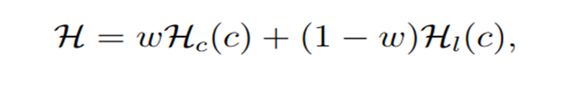
Temporal Analysis Model – Methodology (Step-I)
Now that we have our dataset , we shift our focus onto our working model
For now we have decided to work with the best performing model so far Dragnet++ Model ( as claimed in the paper https://arxiv.org/abs/2206.08406)
Formula used by Dragnet++ model for hate intensity quantification of single tweet:
While going through the model , we have arrived at some shortcomings:
The model doesn’t consider Counter-Speech in the window size as well as in it’s formula. Hence there is a scope for improvement
The model derives it’s main hate intensity *Hc(c)* from the Davidson Model which in-itself has shortcomings.

Slide 18
Problems with Davidson Model
1. 40% of hate-speech is misclassified.
2. Doesn’t consider hate-slurs used in everyday language to be hate-speech and classifies them as normal or non-hateful speech.
3. Classifies “counter-speech with hate slurs” as hate-speech.
Tends to misclassify ‘hateful tweets that don’t contain strongly profane words’ as non-hateful.

Slide 19
Possible Solutions:
Look for Counter-speech lexicon for detecting counter speech and successively modify the formula
Can add another weight to factor in counter speech in the formula.
Can find a possible method to detect and remove counter speech, get the hate intensity score before and after the counter speech for the window and do the temporal analysis of the same.
For Hate Intensity scores, why can’t we use perspective AI score?

Slide 20
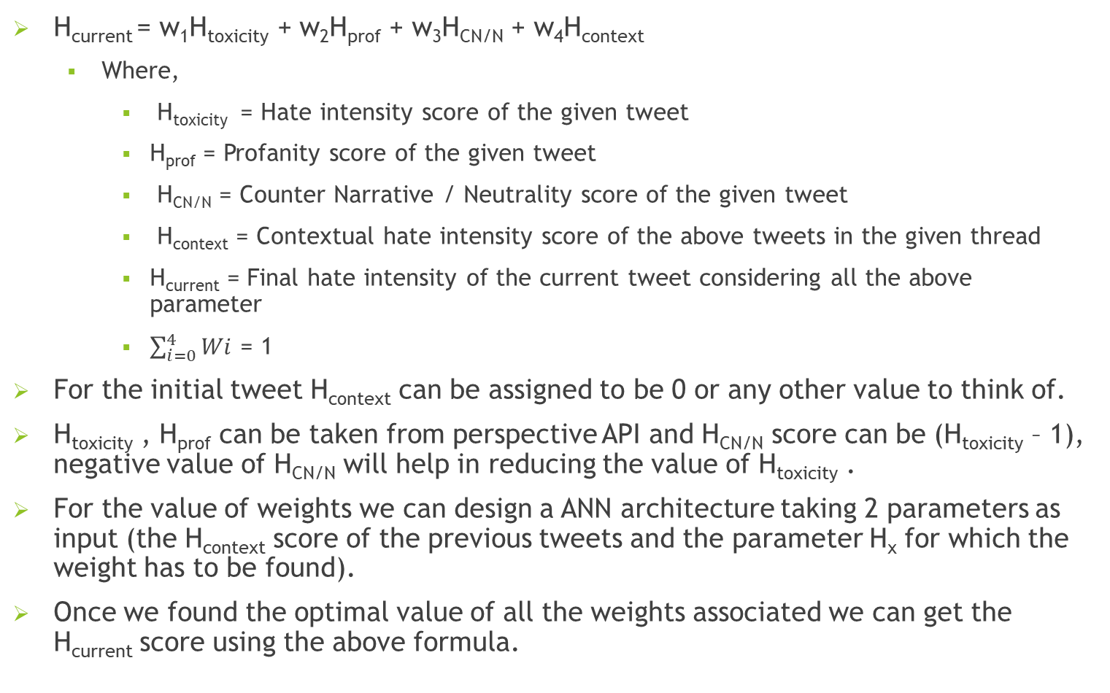
Proposed Solution #1
H_{current} = w₁H_{toxicity} + w₂H_{prof} + w₃H_{CN/N} + w₄H_{context}
Where,
H_{toxicity} = Hate intensity score of the given tweet
H_{prof} = Profanity score of the given tweet
H_{CN/N} = Counter Narrative / Neutrality score of the given tweet
H_{context} = Contextual hate intensity score of the above tweets in the given thread
H_{current} = Final hate intensity of the current tweet considering all the above parameter
$\sum_{i=0}^{4}{Wi}$ = 1
For the initial tweet H_{context} can be assigned to be 0 or any other value to think of.
H_{toxicity} , H_{prof} can be taken from perspective API and H_{CN/N} score can be (H_{toxicity} – 1), negative value of H_{CN/N} will help in reducing the value of H_{toxicity} .
For the value of weights we can design a ANN architecture taking 2 parameters as input (the H_{context} score of the previous tweets and the parameter H_{x} for which the weight has to be found).
Once we found the optimal value of all the weights associated we can get the H_{current} score using the above formula.

Slide 21
Proposed Solution #1
In fact, if we consider the fact that any ANN architecture is a universal function approximator, we can have some layers of perceptron which will take input as the weight found from the previous layers multiplied by its corresponding H_{x} parameter. In this way we get the best functional value of the H_{current} .
How will we train to get the best values of the weights including the above point as well:
H_{current}
Can have multiple layers
w₁H_{toxicity}
w₂H_{prof}
w₃H_{CN/N}
w₄H_{context}
w₁
w₂
w₃
w₄
Can have multiple layers
H_{toxicity}
H_{context}
H_{prof}
H_{context}
H_{CN/N}
H_{context}
H_{context}
H_{context}

Slide 22
Proposed Solution #1
For each tweet in a thread we can have labels based on the context as 0 or 1 using any LLM (can think of fine tuning it or can directly use it), where 0 implies being a Counter Speech/Neutral and 1 being hateful.
At this point we can choose a threshold value H_{threshold} (can check if there is any method to get it or can go for brute force approach) which will segregate any tweet to be hateful if H_{current} >= H_{threshold} and otherwise to be Counter Speech/Neutral tweet.
Now based on H_{threshold} and the labels we can train all the parameters associated with our architecture including the weights for each scores used in the formula.
Advantage:
Scope of addition of any other attribute affecting H_{current} score.
Similarly, Scope of addition of any other attribute affecting the weights (w_{1,} w_{2,} w_{3,} w₄).
Limitation:
We don’t know if the method used to find H_{CN/N} will work. Even if it works we won’t be able to distinguish between a counter speech and a neutral statement.
Brute force method to get H_{threshold} will be resource intensive.
Large labelled dataset is required to train the model.

