Slide 1

Dept. of Computer Science & Engineering
Find Reason of Drug Addiction through Machine Learning Techniques.
Supervised by
Md. Rakib Uddin
Lecturer & Coordinator
Dept. of CSE, City University
1
Name | ID No. | Dept.
Md Azad Hossain | 13334351 | CSE
Bilkiss Ara Sweet | 161412020 | CSE
Notes:
<number>

Slide 2
Content
1. Machine Learning
2. Research Challenges
3. Proposed Method
4. Experimental Analysis
5. Discussion
6. Future Works
7. Conclusion
7. References
07/09/2020
Find Reason of Drug Addiction through Machine Learning Techniques.
.
<number>

Slide 3

Machine Learning
Machine learning: Machine learning (ML) is a category of algorithm that allows software applications to become more accurate in predicting outcomes without being explicitly programmed. The basic premise of machine learning is to build algorithms that can receive input data and use statistical analysis to predict an output while updating outputs as new data becomes available.
Decision Trees
Support Vector Machine (SVM)
K-nearest neighbor (KNN)
Picture courtesy: Machine Learning For Beginners .
towardsdatascience.com
07/09/2020
Find Reason of Drug Addiction through Machine Learning Techniques.
<number>

Slide 4
Research Challenges
Collecting data from different Rehab.
Handling categorical Data.
Train several machine learning model and test.
Analysis outcomes.
07/09/2020
Find Reason of Drug Addiction through Machine Learning Techniques.
<number>

Slide 5
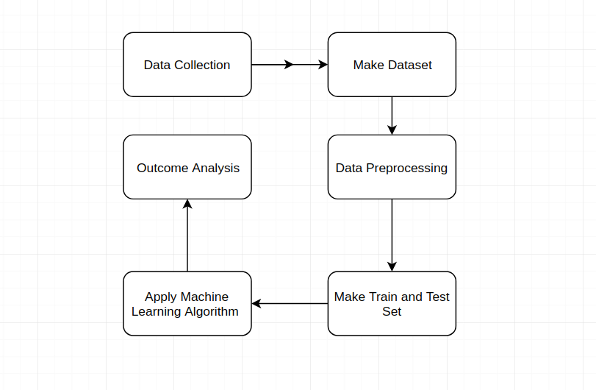
Proposed Method
Collecting real field data from Rehab.
data Preprocessing.
Separating training and testing data.
Apply Machine Learning Techniques
-Decision Trees
-SVM
-KNN
-Logistic Regression
- Random Forest
Find predicting accuracy.
07/09/2020
Find Reason of Drug Addiction through Machine Learning Techniques.
<number>

Slide 6
Experimental Analysis (Con.)
Dataset Description:
Total data | Attribute | Total Addicted | students | businessman | Drivers | Job Holder
327 | 18 | 239 | 130 | 73 | 48 | 39
07/09/2020
Find Reason of Drug Addiction through Machine Learning Techniques..
<number>

Slide 7
Experimental Analysis (Con.)
Accuracy that I got by applying Algorithm in python(Jupyter Notebook).
Algorithm | Python | Matlab
Decision Tree | 82 %
KNN | 90 %
SVM | 97 %
Random Forest | 90 %
Logistic Regression | 84 %
07/09/2020
Find Reason of Drug Addiction through Machine Learning Techniques.
<number>

Slide 8
Experimental Analysis (Con.)
Dataset analysis according to different professions:
07/09/2020
Find Reason of Drug Addiction through Machine Learning Techniques.
<number>

Slide 9
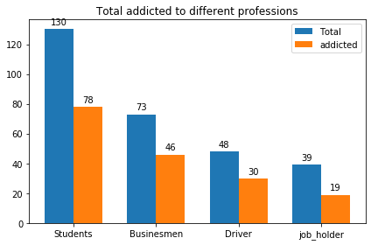
Experimental Analysis (Con.)
Dataset analysis according to different professions:
Fig: Total addicted to different professions.

Slide 10
Discussion
In the above graph, According to different professions, we demonstrate the total number of data. and total addict people in individual professions.
We found student has 130 data and 78 addicts among them and 46 addicted out of 73 who involved with any job..
We also got 30 out of 48 and 19 out of 39 addicts who are involved with driving and job respectively.
07/09/2020
Find Reason of Drug Addiction through Machine Learning Techniques..
<number>

Slide 11
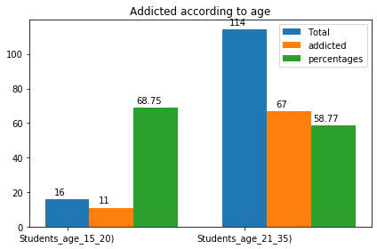
Experimental Analysis (Con.)
Dataset analysis of Students:
Fig: Addicted students according to age.

Slide 12
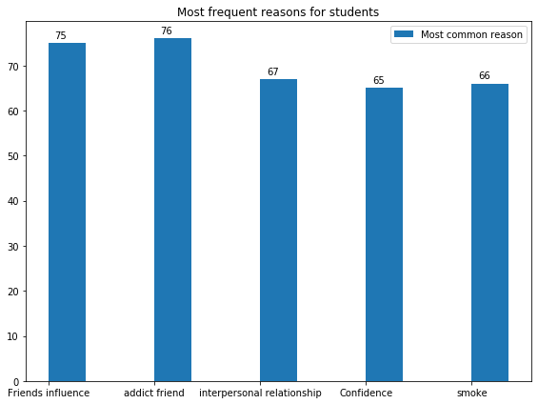
Experimental Analysis (Con.)
Dataset analysis of Students:
Fig: Most common reasons for students.

Slide 13
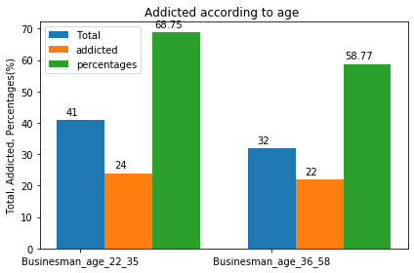
Experimental Analysis (Con.)
Dataset analysis of Businessman :
Fig: Addicted businessman according to age.

Slide 14
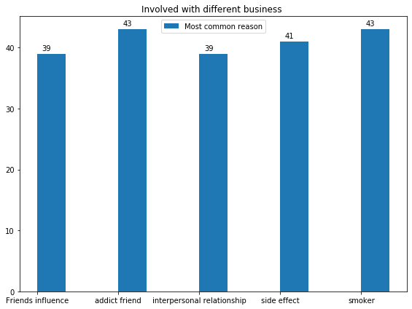
Experimental Analysis (Con.)
Dataset analysis of Businessman :
Fig: Most common reasons for businessman.

Slide 15
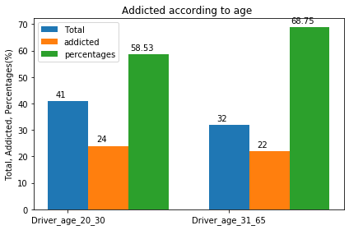
Experimental Analysis (Con.)
Dataset analysis of Drivers:
Fig: Addicted businessman according to age.

Slide 16
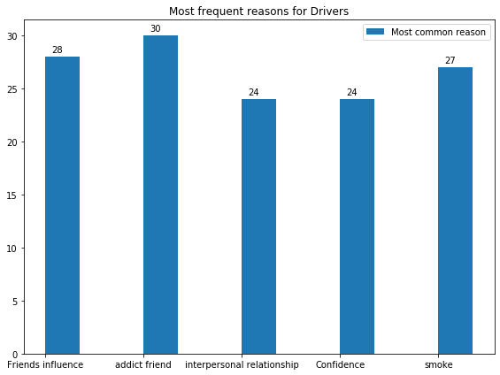
Experimental Analysis (Con.)
Dataset analysis of Drivers:
Fig: Most common reasons for Drivers.

Slide 17
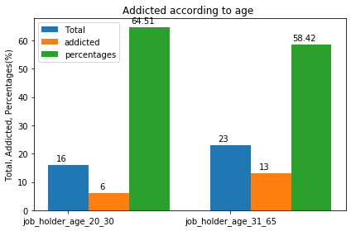
Experimental Analysis (Con.)
Dataset analysis of Drivers:
Fig: Addicted job holder according to age.

Slide 18
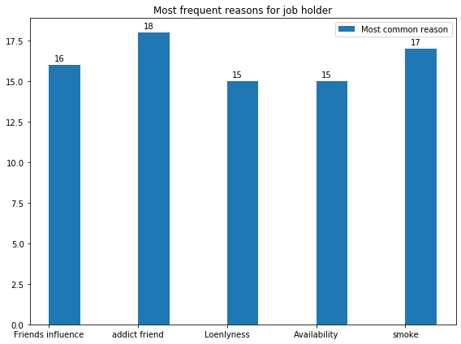
Experimental Analysis (Con.)
Dataset analysis of Drivers:
Fig: Most common reasons for job holder.

Slide 19
Discussion
Drug addiction is one of the most common problems in Bangladesh and this problem increasing day by day. Although many researchers and governments are trying to find out how to diminish the increasing rate of drug addiction. Which reason is the main culprit behind it? So we tried here to find out those reasons for that reason people being addicted. To analyses cause of drug addiction we collected row data and we preprocess data. After that, we used some supervised machine learning algorithms to find out the accuracy. We have applied Logistic Regression, Decision Trees, KNN, SVM, and Random Forest algorithms. We have got the highest 97 % accuracy with the SVM algorithm.
07/09/2020
Find Reason of Drug Addiction through Machine Learning Techniques..
<number>

Slide 20

Future Works
In the future, we will try to apply Deep Learning Approaches to find out the best accuracy.
We will try to extend our dataset.
Picture courtesy: Algo-Vision, weizmann-usa.org
07/09/2020
Find Reason of Drug Addiction through Machine Learning Techniques.
<number>

Slide 21
Conclusion
In this paper we will try to find out who is the main culprit for being a drug addicted person .
Therefore, we will figure out some major reason for being drug addict.
In this research, we have collected 327 data and we have found 73% people are addicted.
The accuracy is between 82% to 97% among the all classifier.
07/09/2020
Find Reason of Drug Addiction through Machine Learning Techniques.
<number>

Slide 22
References
Md. Abdul Ahad 1, Dr. Mitu Chowdhury , Dr. Indrajit Kundu , Nishith Zahan Tanny, Dr. M. Wakilur Rahman “Causes of Drug Addiction among Youth in Sylhet City of Bangladesh”, Volume 22, Issue 5, Ver. 7 (May. 2017) PP 27-31 e-ISSN: 2279-0837.
Minhazur Rahman Rezvi “Influencing Factors of ‘Yaba’ Addiction among the Youth of Bangladesh and Its Effect: A Qualitative Study”, 1-7, 2019; Article no.ARJASS.47877 ,ISSN: 2456-4761.
Sahadat Hossain, Shakhaoat Hossain, Fahad Ahmed, Rabiul Islam, Tajuddin Sikder, Abdur Rahman “Prevalence of Tobacco Smoking and Factors Associated with the Initiation of Smoking among University Students in Dhaka, Bangladesh”, Vol. 6, No. 1 (2017) | ISSN 2166-7403.
07/09/2020
Find Reason of Drug Addiction through Machine Learning Techniques..
<number>

Slide 23

07/09/2020
Find Reason of Drug Addiction through Machine Learning Techniques..
<number>

Slide 24
Thank you , everyone!
07/09/2020
Find Reason of Drug Addiction through Machine Learning Techniques..
<number>

