Slide 1

Dept. of Computer Science & Engineering
Find Reason of Drug Addiction through Machine Learning Techniques.
Supervised by
Md. Rakib Uddin
Lecturer & Coordinator
Dept. of CSE, City University
1
Name | ID No. | Dept.
Md Azad Hossain | 13334351 | CSE
Bilkiss Ara Sweet | 161412020 | CSE
Notes:
<number>

Slide 2
Content
1. Machine Learning
2. Research Challenges
3. Proposed Method
4. Experimental Analysis
5. Discussion
6. Future Works
7. Conclusion
7. References
06/08/2020
Find Reason of Drug Addiction through Machine Learning Techniques.
.
1

Slide 3

Machine Learning
Machine learning: Machine learning (ML) is a category of algorithm that allows software applications to become more accurate in predicting outcomes without being explicitly programmed. The basic premise of machine learning is to build algorithms that can receive input data and use statistical analysis to predict an output while updating outputs as new data becomes available.
Decision Trees
Support Vector Machine (SVM)
K-nearest neighbor (KNN)
Picture courtesy: Machine Learning For Beginners .
towardsdatascience.com
06/08/2020
Find Reason of Drug Addiction through Machine Learning Techniques.
1

Slide 4
Research Challenges
Collecting data from different Rehab.
Handling categorical Data.
Train several machine learning model and test.
Analysis outcomes.
06/08/2020
Find Reason of Drug Addiction through Machine Learning Techniques.
1

Slide 5
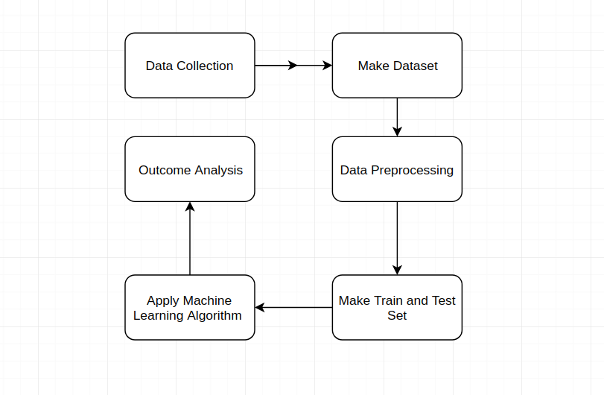
Proposed Method
Collecting real field data from Rehab.
data Preprocessing.
Separating training and testing data.
Apply Machine Learning Techniques
-Decision Trees
-SVM
-KNN
-Logistic Regression
- Random Forest
Find predicting accuracy.
06/08/2020
Find Reason of Drug Addiction through Machine Learning Techniques.
1

Slide 6
Experimental Analysis (Con.)
Dataset Description:
Total Data | Attribute | Addicted number | Percentage
327 | 18 | 239 | 73.09 %
06/08/2020
Find Reason of Drug Addiction through Machine Learning Techniques..
1

Slide 7
Experimental Analysis (Con.)
Accuracy that I got by applying Algorithm in python(Jupyter Notebook).
Algorithm | Python
Decision Tree | 82 %
KNN | 90 %
SVM | 97 %
Random Forest | 90 %
Logistic Regression | 84 %
06/08/2020
Find Reason of Drug Addiction through Machine Learning Techniques.
1

Slide 8
Discussion
Most of the researcher has worked taking social network data such as Facebook, Twitter, etc. and also different working sectors. As Bangladesh is a developing country many garments factory build up here. So, there are many workers work in the garments factory, So, we have tried to diagnosis the mental health condition of the garments factory workers.
At first, we have collected data from garments factory and then we have identified who is mentally ill and who is mentally sick. We have found 193 mentally sick workers among 300 workers.
Therefore, we have tested our dataset by MATLAB R2019a. Here, we have noticed that the Linear SVM has given the highest accuracy and it is 96%.
06/08/2020
Find Reason of Drug Addiction through Machine Learning Techniques..
1

Slide 9

Future Works
In the future, we will try to apply Deep Learning Approaches to find out the best accuracy.
We will try to extend our dataset.
Picture courtesy: Algo-Vision, weizmann-usa.org
06/08/2020
Find Reason of Drug Addiction through Machine Learning Techniques.
<number>

Slide 10
Conclusion
In this paper we will try to find out who is the main culprit for being a drug addicted person .
Therefore, we will figure out some major reason for being drug addict.
In this research, we have collected 327 data and we have found 73% people are addicted.
The accuracy is between 82% to 97% among the all classifier.
06/08/2020
Find Reason of Drug Addiction through Machine Learning Techniques.
<number>

Slide 11
References
Md. Abdul Ahad 1, Dr. Mitu Chowdhury , Dr. Indrajit Kundu , Nishith Zahan Tanny, Dr. M. Wakilur Rahman “Causes of Drug Addiction among Youth in Sylhet City of Bangladesh”, Volume 22, Issue 5, Ver. 7 (May. 2017) PP 27-31 e-ISSN: 2279-0837.
Minhazur Rahman Rezvi “Influencing Factors of ‘Yaba’ Addiction among the Youth of Bangladesh and Its Effect: A Qualitative Study”, 1-7, 2019; Article no.ARJASS.47877 ,ISSN: 2456-4761.
Sahadat Hossain, Shakhaoat Hossain, Fahad Ahmed, Rabiul Islam, Tajuddin Sikder, Abdur Rahman “Prevalence of Tobacco Smoking and Factors Associated with the Initiation of Smoking among University Students in Dhaka, Bangladesh”, Vol. 6, No. 1 (2017) | ISSN 2166-7403.
06/08/2020
Find Reason of Drug Addiction through Machine Learning Techniques..
<number>

Slide 12

06/08/2020
Find Reason of Drug Addiction through Machine Learning Techniques..
<number>

Slide 13
Thank you , everyone!
06/08/2020
Find Reason of Drug Addiction through Machine Learning Techniques..
<number>

