Slide 1
Front page design for
www.sipshark.org

Slide 2
Purpose
Need to make a front page for www.sipshark.org
A pcap sharing cloud free solution

Slide 3
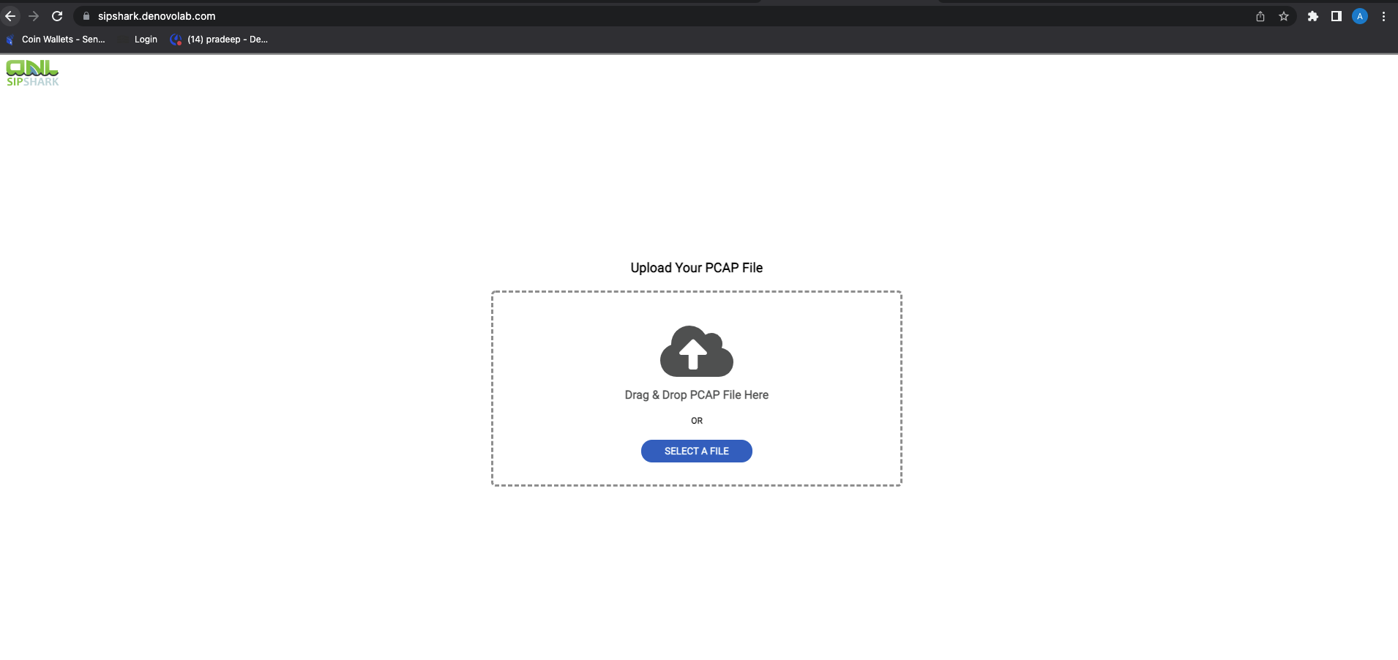
How it looks now

Slide 4

Need to change it like
The easiest way to share SIP pcap files
Need a SIP switch?
Sipshark
The easiest way to share SIP PCAP
About SIPshark.org
SIPshark.org is the fastest way to share a SIP pcap file without needing to download or install anything. It’s designed with your workflow in mind by using only a minimum number of keypresses to share your SIP pcap files.
Copyright 2022 Denovolab Limited

Slide 5
Banner ads content #1
Download Free Community Edition
DNL Class 4 Fusion
www.denovolab.com

Slide 6
Banner ads content #2
Available in AWS and GCP
DNL Class 4 Fusion
www.denovolab.com

Slide 7

Need a plan and about page like this
https://www.file.io/about

