Slide 1
CSE 6247: Large-Scale Data Management
Dr. k. m. Azharul Hasan
Prof. Dept. of cse, kuet
az@cse.kuet.ac.bd

Slide 2
Course Learning Outcome
After successful completion of the course, the students should be able to
Apply MapReduce paradigm for the solution of real life problems
Formulate the key-value pair for data incentive computational paradigms
Design algorithms for parallel environment
Explain the different methods of solutions for multidimensional access methods
Identify and solve big data driven problems.

Slide 3
MapReduce Basics

Slide 4
Introduction

Slide 5
MapReduce
MapReduce is a programming model for expressing distributed computations on massive amounts of data and an execution framework for large-scale data process
MapReduce enjoyed widespread adoption via an open-source implementation called Hadoop
development was led by Yahoo sing on clusters of commodity servers.
Commodity hardware is
affordable and easy to obtain.
Typically it is a low-performance system that is IBM PC-compatible
capable of running Microsoft Windows, Linux, or MS-DOS without requiring any special devices or equipment.

Slide 6
Why?
Many answers to this question, but more focus on two.
First, “big data" is a fact of the world, and therefore an issue that real-world systems must fight with.
Second,
across a wide range of text processing applications,
more data translates into more effective algorithms,
makes sense to take advantage of the huge data that surround us.
Another area user behavior data.
record user activity and in a matter of weeks (or sooner) be drowning in a torrent of log data.
logging user behavior generates so much data that many organizations can not cope with.
loss the opportunity to mine such data.

Slide 7
How much data?
Latency and bandwidth have improved relatively
little: in the case of latency, perhaps 2X improvement during the last quarter century,
bandwidth, perhaps 50X.
Latency = delay.
It’s the amount of delay (or time) it takes to send information from one point to the next.
Bandwidth has to do with how wide or narrow a pipe is
Latency has to do with the contents of the pipe; how fast it moves from one end to the next

Slide 8
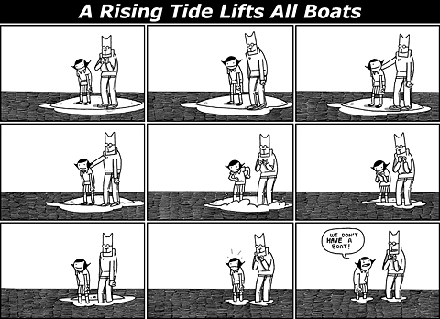

why large data?
The first answer is similar to the reason people climb mountains: because they are there.
The second answer is even more compelling/forces .
Data represent the rising tide that lifts all boats.
More data lead to better algorithms and systems for solving real-world problems.

Slide 9
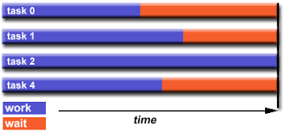
Working in parallel
Due to the rapidly decreasing cost of processing, memory, and communication, it has appeared inevitable for at least two decades that parallel machines will eventually displace sequential ones in computationally intensive domains.

Slide 10
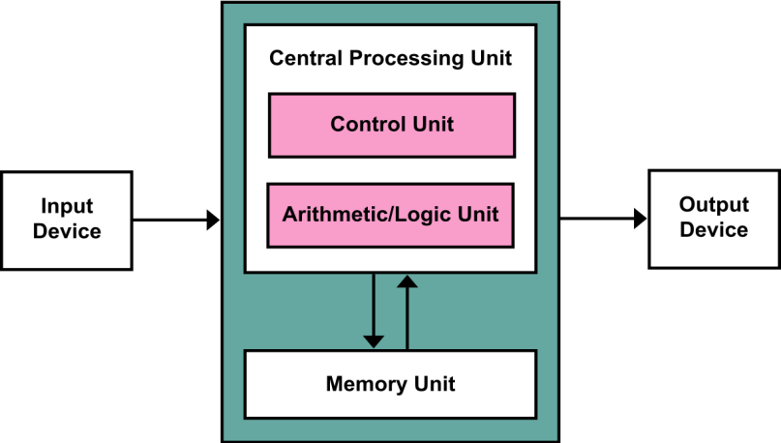
Why is MapReduce important?
It provides a very effective tool for tackling large-data problems.
MapReduce is important in how it has changed the way we organize computations at a massive scale.
MapReduce represents the widely-adopted step away from the von Neumann model that has served as the foundation of computer science over the last half plus century.

Slide 11
Why is MapReduce important?
The feasible approach to tackling large-data problems is to divide and conquer, a fundamental concept in computer science.
The basic idea is to
partition a large problem into smaller sub-problems.
the extent that the sub-problems are independent, they can be tackled in parallel by different workers
threads in a processor core,
cores in a multi-core processor,
multiple processors in a machine, or
many machines in a cluster.

Slide 12
The important issues
How do we break up a large problem into smaller tasks?
More specifically, how do we decompose the problem so that the smaller tasks can be executed in parallel?
Partitioning
How do we assign tasks to workers distributed across a potentially large number of machines
While keeping in mind that some workers are better suited to running some tasks than others, e.g., due to available resources, locality constraints, etc.?
Load balancing
How do we ensure that the workers get the data they need?
Data flow

Slide 13
The important issues
How do we coordinate synchronization among the different workers?
Synchronization/Coordinating
How do we share partial results from one worker that is needed by another?
Merging
How do we accomplish all of the above in the face of software errors and hardware faults?
Managing/Organizing

Slide 14
Advantages of MapReduce
Significant advantages of MapReduce
distributed programming paradigm
it provides an abstraction that hides many system-level details from the programmer.
MapReduce provides
a means to distribute computation without burdening the programmer with the details of distributed computing
Large-data processing by definition requires bringing data and code together for computation to occur

Slide 15
What is MapReduce?
MapReduce is a programming model
Google has used successfully is processing its “big-data” sets (~ 20000 peta bytes per day)
Users specify the computation in terms of a map and a reduce function,
Underlying runtime system automatically parallelizes the computation across large-scale clusters of machines, and
Underlying system also handles machine failures, efficient communications, and performance issues.
-- Reference: Dean, J. and Ghemawat, S. 2008. MapReduce: simplified data processing on large clusters. Communication of ACM 51, 1 (Jan. 2008), 107-113.

Slide 16
The Context: Big-data
Man on the moon with 32KB (1969); my laptop had 16GB RAM (2019)
Google collects 270PB data in a month (2007), 20000PB a day (2008)
2010 census data is expected to be a huge gold mine of information
Data mining huge amounts of data collected in a wide range of domains from astronomy to healthcare has become essential for planning and performance.

Slide 17
The Context: Big-data
We are in a knowledge economy.
Data is an important asset to any organization
Discovery of knowledge; Enabling discovery; annotation of data
We are looking at newer
programming models, and
Supporting algorithms and data structures.
NSF (national science foundation) refers to it as “data-intensive computing (parallel computing)” and industry calls it “big-data” and “cloud computing”

Slide 18
Functional programming and MapReduce

Slide 19
What is Functional Programming?
Functional programming is a programming paradigm that treats computation as the evaluation of mathematical functions and avoids state and mutable data.
A mutable object is an object whose state can be modified after it is created.
It emphasizes the application of functions, in contrast with the imperative programming style that emphasizes changes in state.

Slide 20
Example
Summing the integers 1 to 10 in Java:
total = 0;
for (i = 1; i ≤ 10; ++i)
total = total+i;
The computation method is variable assignment.
20

Slide 21
Example
Summing the integers 1 to 10 in Haskell
sum [1..10]
The computation method is function application.
The Haskell purely functional programming language
Calls function and returns the values which function returns
21

Slide 22
Why is it Useful?
The abstract nature of functional programming leads to considerably simpler programs;
It also supports a number of powerful new ways to structure and reason about programs.

Slide 23
Functional Programming Review
Functional operations do not modify data structures:
they always create new ones
Original data still exists in unmodified form
Data flows are implicit in program design
Order of operations does not matter

Slide 24
Functional Programming Review
fun foo(l: int list) = sum(l) + mul(l) + length(l)
Order of sum() and mul(), etc does not matter
They do not modify l

Slide 25
Functions As Arguments
fun DoDouble(f, x) = f (f x)
A function is called higher-order if it takes a function as an argument or returns a function as a result
The map function found in many functional programming languages is one example of a higher-order function.
It takes as arguments a function f and a list of elements, and as result, returns a new list with f applied to each element of the list.
sorting functions which take a comparison function as a parameter
allowing the programmer to separate the sorting algorithm from the comparisons of the items being sorted

Slide 26
Typical Large-Data Problem
Map
Reduce
Key idea: provide a functional abstraction for these two operations
(Dean and Ghemawat, OSDI 2004)
Iterate over a large number of records
Extract something of interest from each
Shuffle and sort intermediate results
Aggregate intermediate results
Generate final output

Slide 27
Functional Programming Roots
MapReduce has its roots in functional programming, which is exemplified in languages such as Lisp and ML.
A key feature of functional languages is the concept of higher-order functions, or functions that can accept other functions as arguments.

Slide 28
Functional Programming Review
Two common built-in higher order functions are map and fold
Given a list,
map takes as an argument a function f (that takes a single argument) and applies it to all elements in a list

Slide 29
Map function

Slide 30
Reduce function
Given a list
fold takes as arguments a function g (that takes two arguments) and an initial value
g is first applied to the initial value and the first item in the list
the result is stored in an intermediate variable.
This intermediate variable and the next item in the list serve as the arguments to a second application of g
the results of which are stored in the intermediate variable.
This process repeats until all items in the list have been consumed;
fold then returns the final value of the intermediate variable.

Slide 31
map function
map and fold are used in combination
Example
Compute the sum of squares of a list of integers,
one could map a function that squares its argument over the input list,
then fold the resulting list with the addition function using an initial value of zero.
We can view
map as a concise way to represent the transformation of a dataset (as defined by the function f).
fold as an aggregation operation, as defined by the function g.

Slide 32
Introducing parallelism
The application of f to each item in a list (or more generally, to elements in a large dataset) can be parallelized in straightforward manner
since each functional application happens independently.
These operations can be distributed across many different machines
The fold operation, has more restrictions on data locality
elements in the list must be “brought together" before the function g can be applied.

Slide 33
Roots in Functional Programming
Map
f
f
f
f
f
Fold
g
g
g
g
g

Slide 34
MapReduce Basics
Many real-world applications do not require g to be applied to all elements of the list.
To the extent that elements in the list can be divided into groups
the fold aggregations can also proceed in parallel.
The operations that are commutative and associative, significant efficiencies can be gained in the fold operation through local aggregation and appropriate reordering.
a × b = b × a
(a + b) + c = a + (b + c)

Slide 35
MapReduce Basics
The map phase in MapReduce roughly corresponds to the map operation in functional programming, whereas the reduce phase in MapReduce roughly corresponds to the fold operation.
the MapReduce execution framework coordinates the map and reduce phases of processing

Slide 36
Viewed from different angle
MapReduce codifies a generic “recipe“ for processing large datasets that consists of two stages.
a user-specified computation is applied over all input records in a dataset.
These operations occur in parallel and yield intermediate output
then aggregated by another user-specified computation
The programmer does these two types of computations, and the execution framework coordinates the actual processing.
Very loosely, MapReduce provides a functional abstraction.

Slide 37
To be precise
MapReduce can refer to three distinct but related concepts
First, MapReduce is a programming model
Second, MapReduce can refer to the execution framework (i.e., the “runtime") that coordinates the execution of programs written in this particular style.
Finally, MapReduce can refer to the software implementation of the programming model and the execution framework
Many implementations of MapReduce.
targeted specifically for multi-core processors, for GPGPU, for the CELL architecture.

Slide 38
Mappers and Reducers
Key-value pairs form the basic data structure in MapReduce.
Keys and values may be primitives such as integers, floating point values, strings, and raw bytes, or they may be arbitrarily complex structures.
Programmers typically need to define their own custom data types
For a collection of web pages, keys may be URLs and values may be the actual HTML content.
For a graph, keys may represent node ids and values may contain the adjacency lists of those nodes

Slide 39
MapReduce
What’s “everything else”?
Programmers specify two functions:
map (k1, v1) → [k2, v2]
reduce (k2, [v2]) → [k3, v3]
All values with the same key are sent to the same reducer
The execution framework handles everything else…
The convention [: : :] is used throughout this book to denote a list.

Slide 40
MapReduce “Runtime”
Handles scheduling
Assigns workers to map and reduce tasks
Handles “data distribution”
Moves processes to data
Handles synchronization
Gathers, sorts, and shuffles intermediate data
Handles errors and faults
Detects worker failures and restarts
Everything happens on top of a distributed FS (later)

Slide 41
Mappers and Reducers
Mappers are applied to all input key-value pairs, which generate an arbitrary number of intermediate key-value pairs.
Reducers are applied to all values associated with the same key.
Between the map and reduce phases lies a barrier that involves a large distributed sort and group by

Slide 42
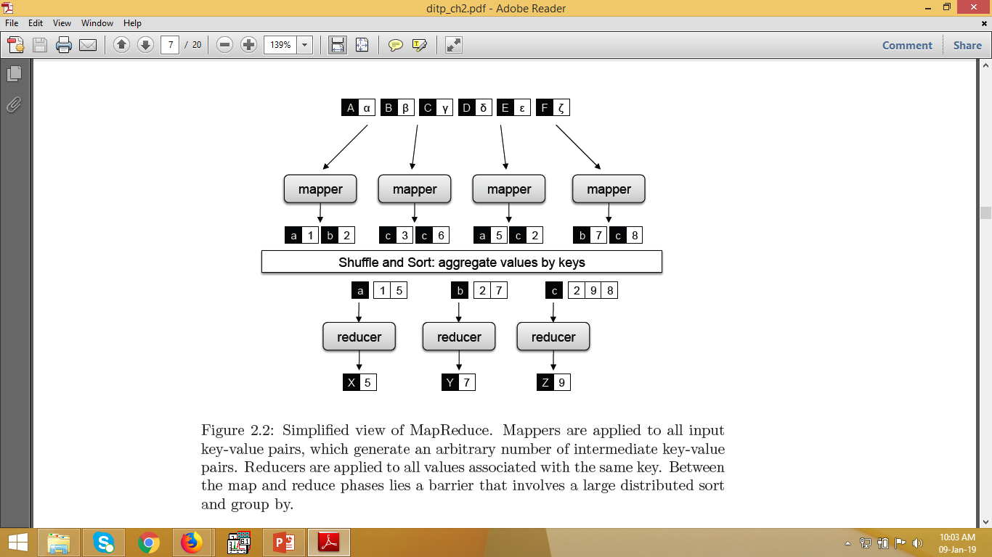
Simplified view of MapReduce

Slide 43
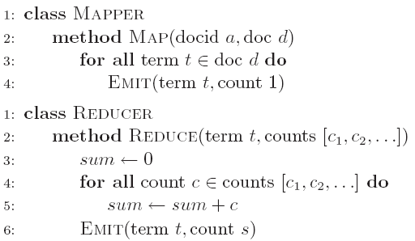
A simple word count algorithm in MapReduce
This algorithm counts the number of occurrences of every word in a text collection, which may be the first step in, for example, building a unigram language model.

Slide 44
Simple word count algorithm
Input key value pairs take the form of (docid, doc) pairs,
the former is a unique identifier for the document,
the latter is the text of the document itself.
The mapper takes an input key-value pair,
tokenizes the document,
emits an intermediate key-value pair for every word
the word itself serves as the key
the integer one serves as the value
The MapReduce execution framework guarantees that all values associated with the same key are brought together in the reducer.

Slide 45
Simple word count algorithm
Therefore, in our word count algorithm, we simply need to sum up all counts (ones) associated with each word. The reducer does exactly this, and emits final key-value pairs with the word as the key, and the count as the value.
Words within each letter will be sorted by alphabetical order, and each letter will contain roughly the same number of words.

Slide 46
Example: Mapper
Reads in input pair <Key,Value>
Outputs a pair <K’, V’>
Let’s count number of each word in user queries (or Tweets/Blogs)
The input to the mapper will be <queryID, QueryText>:
<Q1,“The teacher went to the store. The store was closed; the store opens in the morning. The store opens at 9am.” >
The output would be:
<The, 1> <teacher, 1> <went, 1> <to, 1> <the, 1> <store,1> <the, 1> <store, 1> <was, 1> <closed, 1> <the, 1> <store,1> <opens, 1> <in, 1> <the, 1> <morning, 1> <the 1> <store, 1> <opens, 1> <at, 1> <9am, 1>

Slide 47
Example: Reducer
Accepts the Mapper output, and aggregates values on the key
For our example, the reducer input would be:
<The, 1> <teacher, 1> <went, 1> <to, 1> <the, 1> <store, 1> <the, 1> <store, 1> <was, 1> <closed, 1> <the, 1> <store, 1> <opens,1> <in, 1> <the, 1> <morning, 1> <the 1> <store, 1> <opens, 1> <at, 1> <9am, 1>
The output would be:
<The, 6> <teacher, 1> <went, 1> <to, 1> <store, 3> <was, 1> <closed, 1> <opens, 1> <morning, 1> <at, 1> <9am, 1>

Slide 48
MapReduce
Output Data
Input Data
Worker
write
Output
File 0
local
write
Worker
Split 0
read
Split 1
Worker
Split 2
Output
File 1
Worker
Transfer peta-scale data through network
Worker
remote
read,
sort
Map
Reduce

Slide 49
One more example
Consider a large data collection:
{web, weed, green, sun, moon, land, part, web, green,…}
Problem: Count the occurrences of the different words in the collection.

Slide 50
Word Counter and Result Table
{web, weed, green, sun, moon, land, part, web, green,…}
web | 2
weed | 1
green | 2
sun | 1
moon | 1
land | 1
part | 1
Data
collection

Slide 51

Multiple Instances of Word Counter
web | 2
weed | 1
green | 2
sun | 1
moon | 1
land | 1
part | 1
Data
collection
Observe:
Multi-thread
Lock on shared data

Slide 52
Peta-scale Data
Data
collection
web | 2
weed | 1
green | 2
sun | 1
moon | 1
land | 1
part | 1
KEY | web | weed | green | sun | moon | land | part | web | green | …….
VALUE

Slide 53
Peta Scale Data is Commonly Distributed
Data
collection
Data
collection
web | 2
weed | 1
green | 2
sun | 1
moon | 1
land | 1
part | 1
Data
collection
Data
collection
Data
collection
Issue: managing the
large scale data
KEY | web | weed | green | sun | moon | land | part | web | green | …….
VALUE

Slide 54
Write Once Read Many (WORM) data
Data
collection
Data
collection
web | 2
weed | 1
green | 2
sun | 1
moon | 1
land | 1
part | 1
Data
collection
Data
collection
Data
collection
KEY | web | weed | green | sun | moon | land | part | web | green | …….
VALUE

Slide 55
WORM Data is Amenable to Parallelism
Data
collection
Data
collection
Data with WORM characteristics : yields to parallel processing;
Data without dependencies: yields to out of order processing
Data
collection
Data
collection
Data
collection

Slide 56
Divide and Conquer: Provision Computing at Data Location
One node
For our example,
#1: Schedule parallel parse tasks
#2: Schedule parallel count tasks
Data
collection
This is a particular solution;
Lets generalize it:
Our parse is a mapping operation:
MAP: input → <key, value> pairs
Our count is a reduce operation:
REDUCE: <key, value> pairs reduced
Data
collection
Data
collection
Data
collection

Slide 57
Map Operation
web | 1
weed | 1
green | 1
sun | 1
moon | 1
land | 1
part | 1
web | 1
green | 1
… | 1
KEY | VALUE
MAP: Input data ➔ <key, value> pair
web | 1
weed | 1
green | 1
sun | 1
moon | 1
land | 1
part | 1
web | 1
green | 1
… | 1
KEY | VALUE
Map
Data
Collection: split1
web | 1
weed | 1
green | 1
sun | 1
moon | 1
land | 1
part | 1
web | 1
green | 1
… | 1
KEY | VALUE
web | 1
weed | 1
green | 1
sun | 1
moon | 1
land | 1
part | 1
web | 1
green | 1
… | 1
KEY | VALUE
Split the data to
Supply multiple
processors
web | 1
weed | 1
green | 1
sun | 1
moon | 1
land | 1
part | 1
web | 1
green | 1
… | 1
KEY | VALUE
Data
Collection: split 2
Map
……
…
Data
Collection: split n

Slide 58
Reduce Operation
MAP: Input data ➔ <key, value> pair
REDUCE: <key, value> pair ➔ <result>
Map
Reduce
Data
Collection: split1
Split the data to
Supply multiple
processors
Reduce
Data
Collection: split 2
Map
……
…
Data
Collection: split n
Map
Reduce

Slide 59
Large scale data splits
Map <key, 1>
Reducers (say, Count)
Parse-hash
Count
P-0000
, count1
Parse-hash
Count
P-0001
, count2
Parse-hash
Count
P-0002
Parse-hash
,count3

Slide 60
Reference
Data-Intensive Text Processing with MapReduce
Jimmy Lin and Chris Dyer
University of Maryland, College Park
E book available at
http://www.iro.umontreal.ca/~nie/IFT6255/Books/MapReduce.pdf

Slide 61
Thank you

