Slide 1
12.06.2024
Approaches for Sensor Data Fusion
Supervisor: Prof. Dr. Ondrej Vaculin
Md Fuad Hasan

Slide 2
Motivation and Overview
Approaches for Sensor Data Fusion
What is Sensor Data Fusion?
Various methods for sensor data fusion
Advantages and Challenges
Conclusion

Slide 3
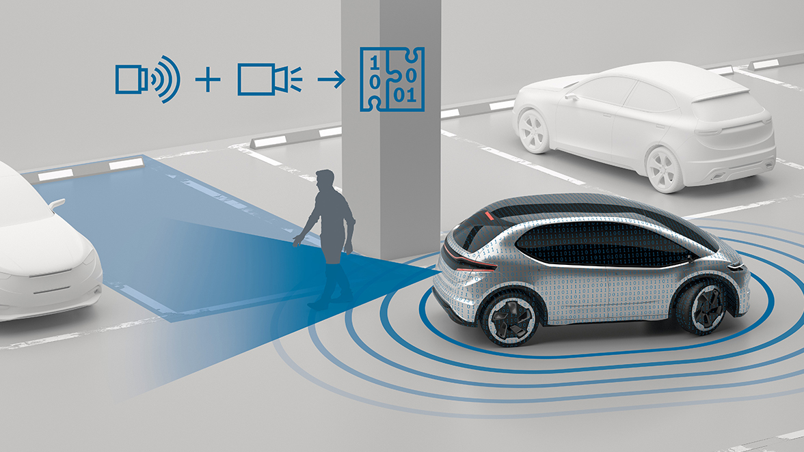
Introduction
Approaches for Sensor Data Fusion
What is Sensor Data Fusion?
Integration of data from multiple sensors.
Enhances accuracy and reliability.
Supports real-time decision-making in dynamic
environments.

Slide 4
Importance and applications of Data Fusion
Approaches for Sensor Data Fusion
Reduces measurement errors.
Enhances system dependability.
Provides robust solutions in dynamic environments.
Human activity recognition
Power optimization in wireless sensor networks
Obstacle detection

Slide 5
Various Fusion Methods
Approaches For Sensor Data Fusion
Data-Level Fusion
Feature-Level Fusion
Decision-Level Fusion
State Estimation and Kalman Filtering
Bayesian Approaches
Fuzzy Logic
Machine Learning Based Fusion

Slide 6
Data-Level Fusion
Approaches For Sensor Data Fusion
Description: Combines raw sensor data without preprocessing.
Techniques:
Adaptive weighting: Real-time error reduction and
Support degree: Reliability through proximity-based measures
Advantages: Enhanced accuracy, noise robustness.
Challenges: High computational overhead, parameter sensitivity.

Slide 7
Feature-Level Fusion
Approaches For Sensor Data Fusion
Description: Extracts features from sensor data and merges them.
Advantages: Noise reduction, scalability.
Challenges: Feature compatibility, dimensionality issues.

Slide 8
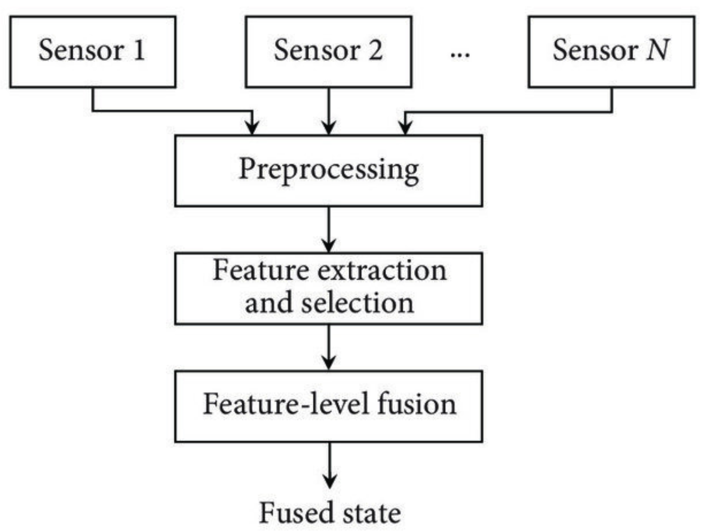
Feature-Level Fusion
Approaches For Sensor Data Fusion
[2] Feature-level fusion based on multi-sensor data. [Online]. Available: https://www.researchgate.net/figure/Feature-level-fusion-based-on-31_fig2_325900553. [Accessed: 14-Dec-2024].

Slide 9
Decision-Level Fusion
Approaches For Sensor Data Fusion
1. Data Acquisition
2. Preprocessing
3. Local Analysis
4. Decision Collection
5. Decision Fusion
6. Final Decision Making
Advantages: Bandwidth efficiency, modularity
Challenges: Dependency on sensor quality, information loss.

Slide 10
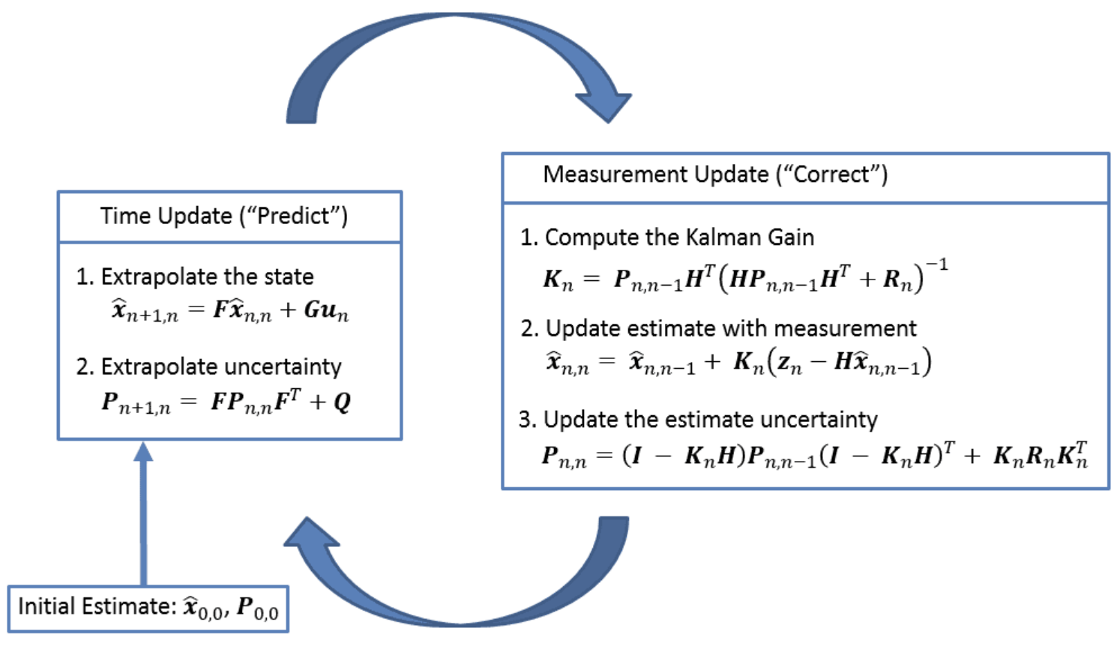
State Estimation and Kalman Filtering
Approaches For Sensor Data Fusion
Description: Combines noisy sensor data with system models to estimate states.

Slide 11
State Estimation and Kalman Filtering
Approaches For Sensor Data Fusion
Key Features:
Recursive updates
Handles Gaussian noise efficiently.
Limitations: Assumes noise is Gaussian, non-optimal for non-linear systems.
Benefits: Performs to find optimal state estimates and easily handle noisy measurements

Slide 12
Bayesian Approaches
Approaches For Sensor Data Fusion
Description: Uses probabilistic methods to manage uncertainty.
Steps:
1) Prior Definition
2) Acquisition of Sensor Data
3) Likelihood Calculation
4) Bayesian Update
5) Fusion of Data
6) State Estimation
7) Iterative Process

Slide 13
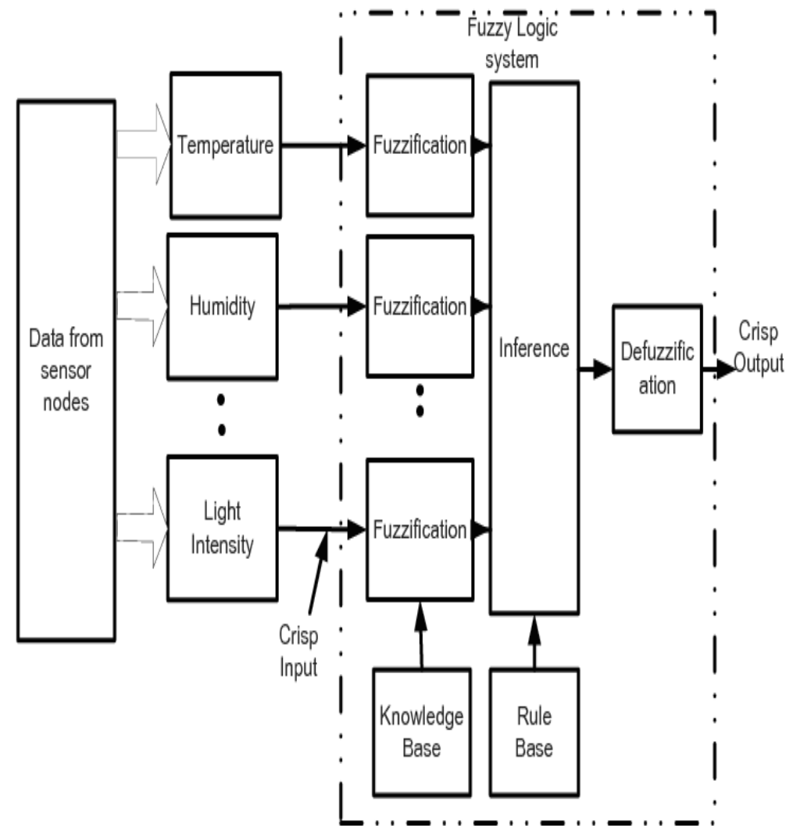
Fuzzy logic
Approaches For Sensor Data Fusion
Description: Mimics human-like reasoning with
degrees of truth.

Slide 14
Fuzzy logic
Approaches For Sensor Data Fusion
Steps:
Fuzzification of input data.
Define fuzzy rules.
Defuzzify to obtain numerical outputs.
Advantages: Handles ambiguous data, robust to noise.
Challenges: Computational complexity for large systems.

Slide 15
Best Approach for Fusion
Approaches For Sensor Data Fusion
For real-time, dynamic systems: Kalman Filtering.
For uncertainty management: Bayesian Approaches.
For ambiguous data: Fuzzy Logic.

Slide 16
Conclusion
Approaches For Sensor Data Fusion
Data fusion is critical for improving system reliability and accuracy.
Various approaches cater to different applications.
Challenges like heterogeneity and scalability need further research.

Slide 17
References
Approaches For Sensor Data Fusion
[1] Bosch Mobility, "Sensor Data Fusion Solutions," [Online]. Available: https://www.bosch-mobility.com/en/solutions/sensors/sensor-data-fusion/. [Accessed: 14-Dec-2024].
[2] Feature-level fusion based on multi-sensor data. [Online]. Available: https://www.researchgate.net/figure/Feature-level-fusion-based-on-31_fig2_325900553. [Accessed: 14-Dec-2024].
[3] R. Groves, "Multisensor Data Fusion: Kalman Filter Summary," [Online]. Available: https://www.kalmanfilter.net/multiSummary.html. [Accessed: 14-Dec-2024].
P. Manjunatha, A.K. Verma, and A. Srividya. Multi-sensor data fusion in cluster based wireless sensor networks using fuzzy logic method. In 2008 IEEE Region 10 and the Third international Conference on Industrial and Information Systems, pages 1–6, 2008.

