Slide 1
Uber Transportation system with all pairs shortest path feature (Floyd Warshall)
Presented by
Pappu Kumar Basak (2015-2-60-051)
Md. Golam Sarowar (2015-2-60-107)

Slide 2
Overview
What Is Shortest Path?
Floyd Warshall’s Algorithm
DEMO For Shortest Route
ALGORITHMS ANALYSIS
WHY WE USE Floyd Warshall
CONCLUSION

Slide 3
Shortest path
shortest path can be the shortest length between two vertices for an unweighted graph:
smallest cost can be lowest cost between two vertices for a weighted graph:
it can be also thought to be shortest time to travel from one place to another.

Slide 4
Floyd Warshall’s Algorithm
Usually all the shortest path algorithms like dijkstra, bellmenford where there’s always appear some constraint which is hard to handle. For the solution of this purpose here the floyed warshall algorithm has been used. This algorithm basically determine all the shortest paths from all the vertices. It also can detect negative edges but not negative cycle.

Slide 5
Applying Floyd Warshall
Let us assume locations as vertices and distances as edges.
Here we have used C++ stl MAP, vector, array, Boolean array for implementing the overall algorithm.
Finding shortest route from every place to all other locations.
Finding shortest route from various path to all other locations

Slide 6
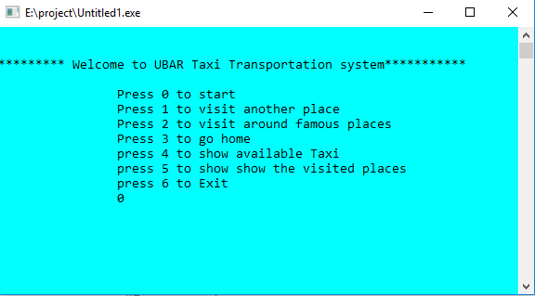
Output of our code

Slide 7
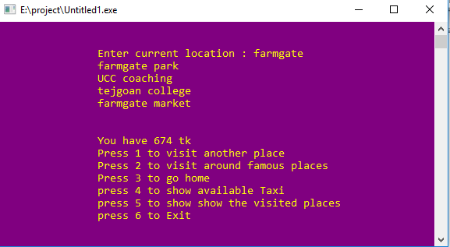

Slide 8
Floyd's Algorithm Using n+1 D matrices
Floyd//Computes shortest distance between all pairs
1. D⁰ ← W // initialize D array to W [ ] 2. P ← 0 // initialize P array to [0] 3. for k ← 1 to n 4. do for i ← 1 to n 5. do for j ← 1 to n 6. if (D^{k-1}[ i, j ] > D^{k-1} [ i, k ] + D^{k-1} [ k, j ] ) 7. then D^{k}[ i, j ] ← D^{k-1} [ i, k ] + D^{k-1} [ k, j ] 8. P[ i, j ] ← k; 9. else D^{k}[ i, j ] ← D^{k-1} [ i, j ]

Slide 9
Complexity Analysis of Floyd Warshal’s Algorithm
The function Floyedwarshall(int) calls both findpath and extract min once for all the vertex. There’s three loop in floyed warshall algorithm to find the all pair shortest distance. Therefore, approximately the time complexity of this algorithm is O(n3)

Slide 10
Future Work
Here in this project we have used few numbers of locations to find the shortest distance. In future we want to develop it for all over Bangladesh. Also we have used the feature of various famous places visiting feature, we will implement 0/1 knapsack there. Also use BFS for finding taxi.

Slide 11
Conclusion
In this project Floyd warshall’s algorithm is used to find out the shortest path in a graph. The proposed algorithm can limit the search in a sub-graph based on the given nodes of the distance between the two nodes. As a result, the calculation for the shortest path has been simplified. So, we need this type of project because, due to the development of this algorithm it is possible to determine the shortest route.

Slide 12

Questions or Suggestions

Slide 13
THANK YOU 

