Slide 1
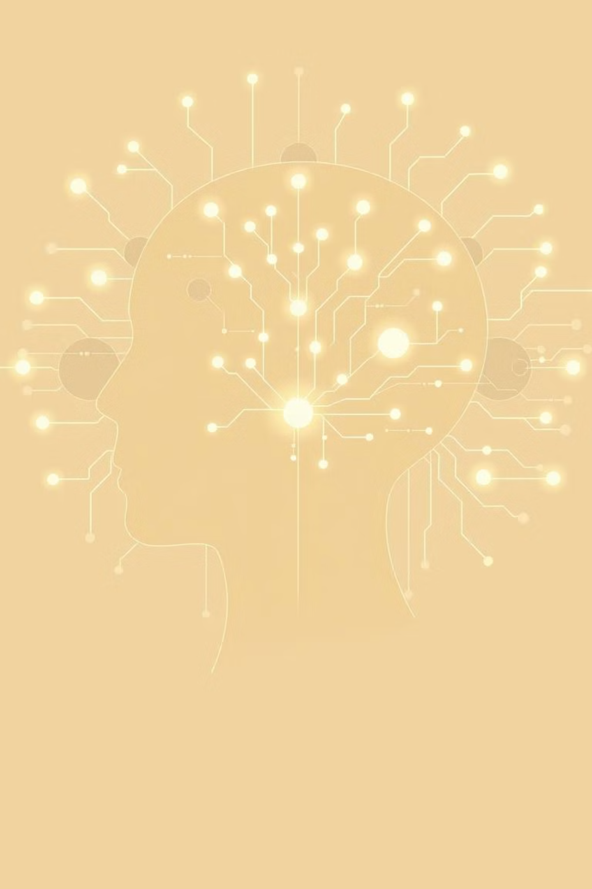
Md. Hasibul Hossain Fahad
Dept. of Fisheries
ID:2501105
AI and Skill Atrophy

Slide 2

The AI Revolution and Its Hidden Cost
Artificial Intelligence has transformed modern life, enabling faster, more accurate task completion. From smart assistants to automated workplaces, AI is ubiquitous. Yet this convenience carries a hidden risk: skill atrophy — the gradual weakening of human abilities through lack of practice.
Everywhere
Convenient
Navigation, smart assistants, automation
Faster, easier, more accurate
Costly
Loss of human skills and abilities

Slide 3

Why Skill Atrophy Happens
1
Over-Reliance on Automation
Routine tasks handled by machines mean humans stop practising. Pilots depending on autopilot lose manual flying skills.
2
Reduced Mental Effort
AI handles thinking and decision-making. Calculators, grammar checkers, and chatbots reduce human cognitive involvement.
3
Decreased Learning
Students and professionals rely on ready-made AI answers instead of analysing and solving problems themselves.
4
Loss of Critical Thinking
Quick AI solutions encourage acceptance without questioning, weakening independent judgment and evaluation.

Slide 4
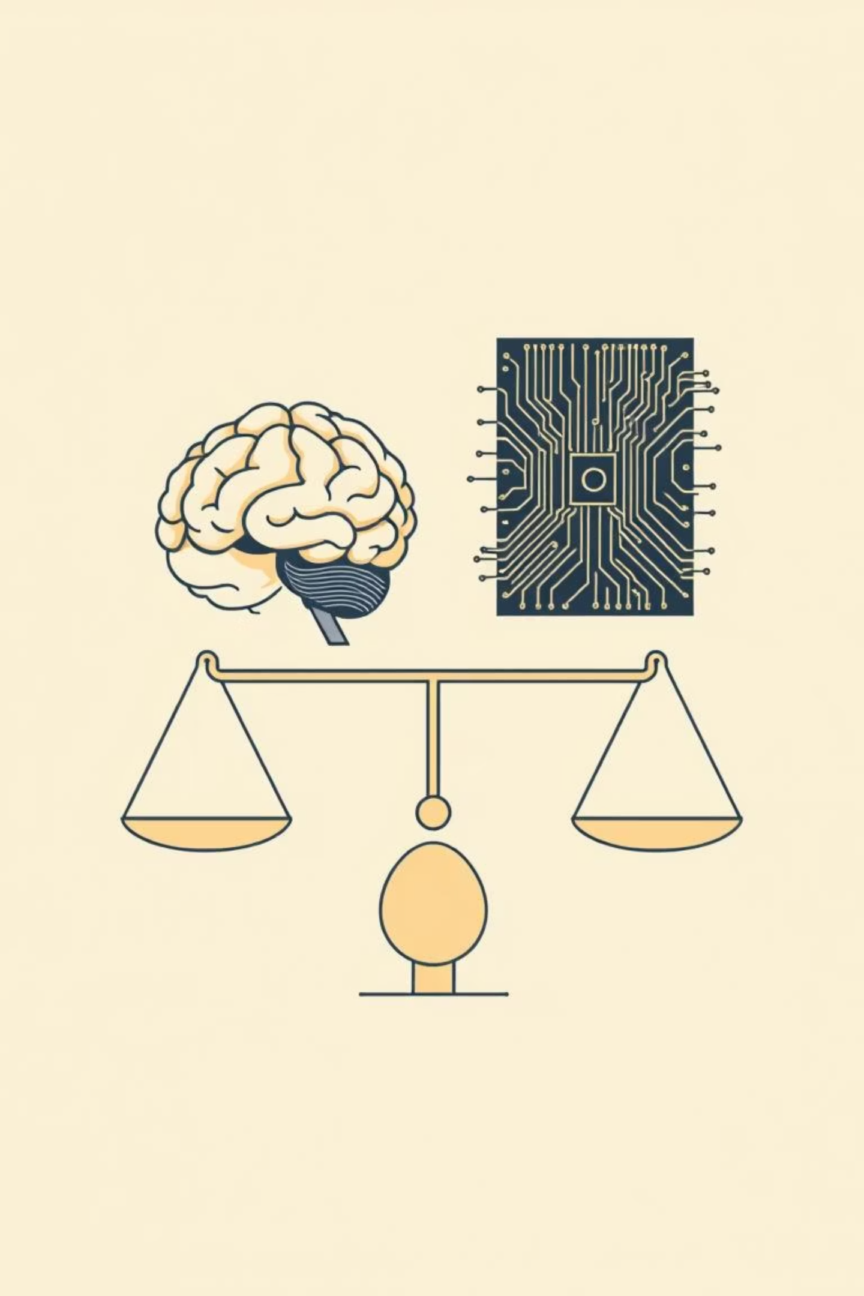

Effects and Solutions
Effects
Solutions
Loss of core technical and creative skills
Use AI as support, not replacement
Reduced creativity and originality
Practise real skills continuously
Weakened decision-making and memory
Maintain human oversight of AI decisions
Professional risks in critical fields like aviation and medicine
Reform education to balance AI literacy with critical thinking
By using AI wisely, we enjoy its benefits whilst preserving our human capabilities.

Slide 5

Thank You
"Artificial Intelligence should empower humans, not replace them."
Any Questions?

