Slide 1
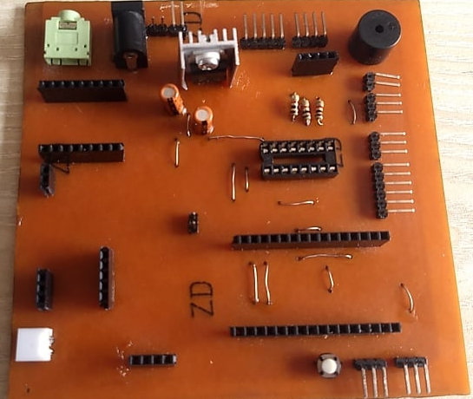
Audio Jack
Input Power
Power Output pair (L>R)(Gnd-Power)
5v Voltage Regulator (L>R) (Power – Gnd - Vcc)
Shift Register Output (L>R)(Serial Out-Latch-Clock-Vcc)
RGB LED Output (L>R) (B-G-Vcc-R )
RGB LED Input (U>D) (B-G-Vcc-R )
Buzzer
Buzzer Output (U>D) (Vcc - Signal)
External Signal Output (U>D) (Gnd – Signal -Vcc)
Shift Register Output (U>D) (Q3 – Q2 - Q1)
Serial Output (U>D) (Rx – Tx – D4 – Gnd – 3v3 – 3v3)
NodeMcu esp8266 (Micro-Usb facing Right)
GND x 3
Vcc x 3
Internal Reset Pin
Short Connector (DF Player( Rx) – Mcu (D8))
OLED (L>R) (Gnd-Vcc-SCL-SDA)
RFID Antenna
RFID Module
Shift Register (IC Notch facing Right)
DF Player (L>R)(SD Card input)
1
2
3
4
5
6
7
8
9
22
10
11
21
12
20
13
19
18
17
16
15
14

