Slide 1

Binary Search Trees
Presented by : Md. Mehedi Hasan Arzu
ID : 2410776121
Course : Data Structure
Dept : Computer Science and Engineering
Institution : University of Rajshahi

Slide 2
Roadmap
  What is a Binary Search Tree (BST) ?
  Why Binary Search Tree instead of Binary Tree?
  Applications of BST.
  Searching in BST.
  Inserting in BST.
  Deleting from BST.

Slide 3

What is a Tree?
●
A tree is a non-linear data structure that consists of nodes connected by edges, arranged in a hierarchical manner.
root
Level 0
5
edge
Level 1
10
12
Level 2
7
leaf
●
Height of the tree = Longest path between root and leaf

Slide 4
What is a Binary Search tree ?
A Binary Search Tree (BST) is a type of binary tree data structure in which each node contains a unique key and satisfies a specific ordering property:
  All nodes in the left subtree of a node contain values strictly less than the node’s value.
  All nodes in the right subtree of a node contain values strictly greater than the node’s value.
This structure enables efficient operations for searching, insertion, and deletion of elements, especially when the tree remains balanced.
struct TreeNode {
}
string data; TreeNode* left; TreeNode* right;

Slide 5
Applications of Binary Search Tree
  fast searching
  Implementing Data Structures, such as
3. Auto-complete and Searching Words
4. Database Indexing to keep data balanced and fast
5. File System Navigation
  Sets
  Maps
  Priority queues

Slide 6
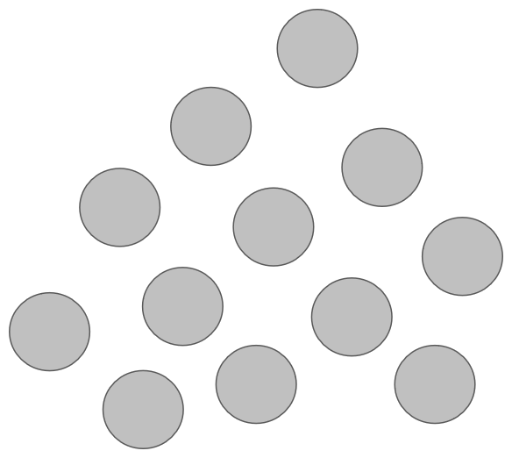

Why Binary Search Tree instead of Binary Tree?
41
166
143
161
108
154
52
110
106
109
107
103
51

Slide 7
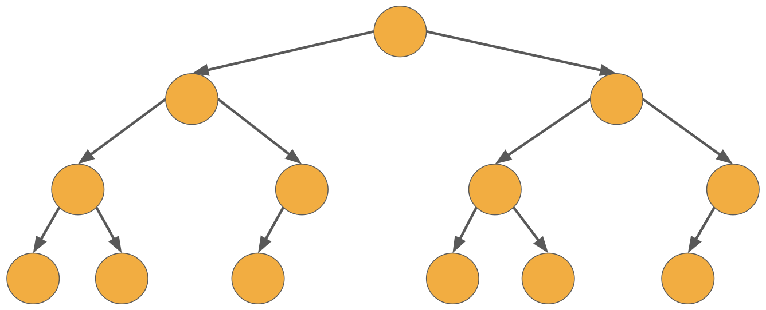
Binary Tree
Search = O(n)
Insert = O(n)
Delete = O(n)
Traversal = O(n)
161
103
106
107
110
51
41
143
52
154
109
166
108

Slide 8
Binary Search Tree
Search = O(log h)
Insert = O(log h)
Delete = O(log h)
Traversal = O(n)
  h = height of the tree
  n = number of nodes in the tree
108
103
154
51
107
110
166
41
52
106
109
143
161

Slide 9
Searching and Inserting
Here ptr is the root and we are searching for node item
BST-Search(ptr , item)
1. while (ptr != NULL) do
2. if (data[ptr] == item) return(“Search successful!”)
3. else if (data[ptr] < item) ptr = right[ptr]
4. else if (data[ptr] > item) ptr = left[ptr]
5. return (“Not found!”)
BST-Insert(ptr , item)
1. if ptr = NULL then goto step 5
2. while (ptr != NULL) do
3. if (data[ptr] < item) ptr = right[ptr]
4. else if (data[ptr] > item) ptr = left[ptr]
5. data[ptr] = item

Slide 10
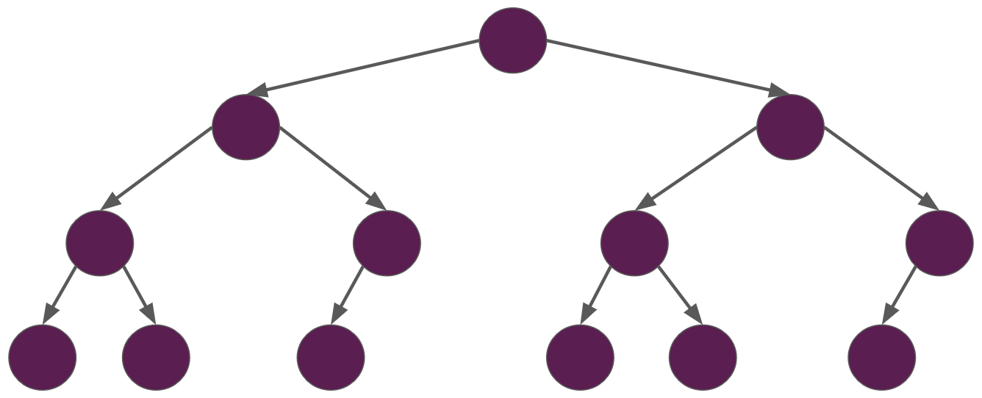
Searching for 106 in the BST :
108
103
154
51
107
110
166
41
52
106
109
143
161

Slide 11

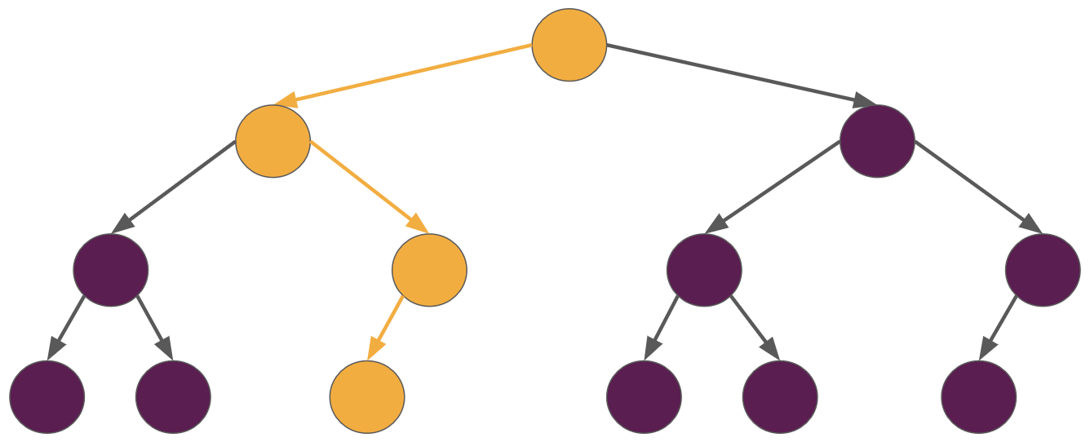
106 < 108 106 > 103 106 < 107
108
103
154
51
107
110
166
41
52
106
109
143
161

Slide 12
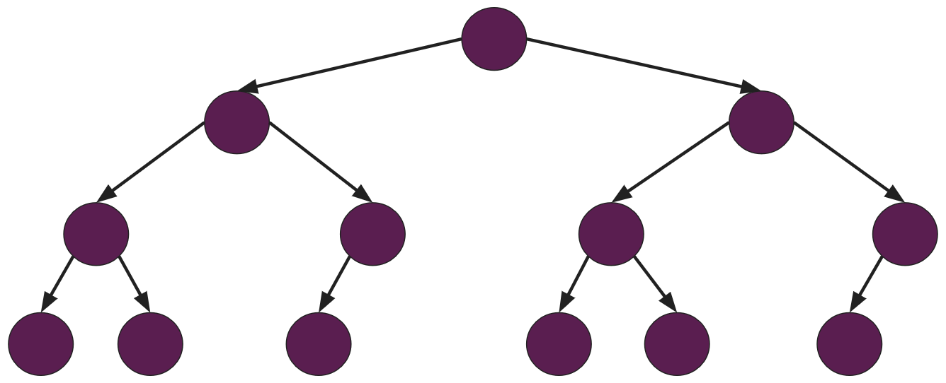
Inserting 200 in the BST :
108
103
154
51
107
110
166
41
52
106
109
143
161
200

Slide 13
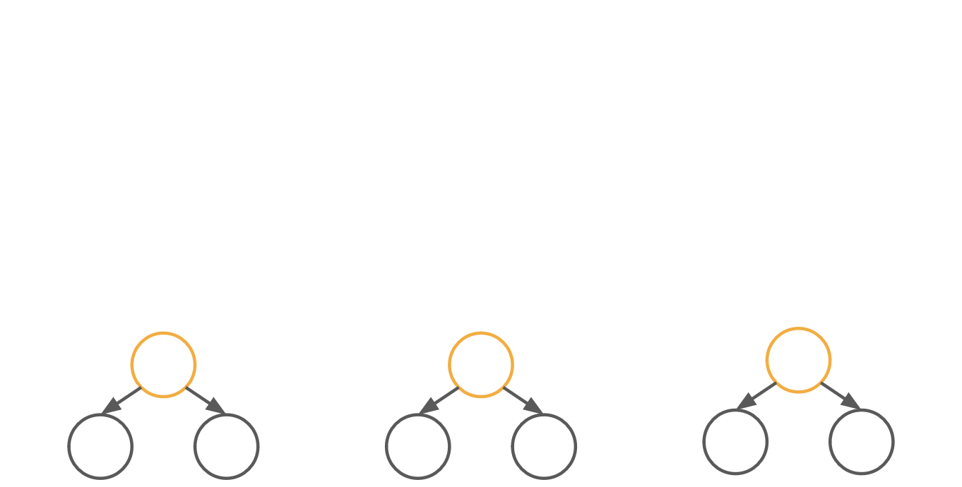
Traversing a tree - recursively!
Pre-order
In-order
Post-order
1.
"Do something" with the current node Traverse the left subtree Traverse the right subtree
1. 2.
Traverse the left subtree "Do something" with the current node Traverse the right subtree
1. 2.
Traverse the left subtree Traverse the right subtree "Do something" with the current node
2. 3.
3.
3.
3
1
3
3
2
4
2
4
2
4
1
1
1
4

Slide 14
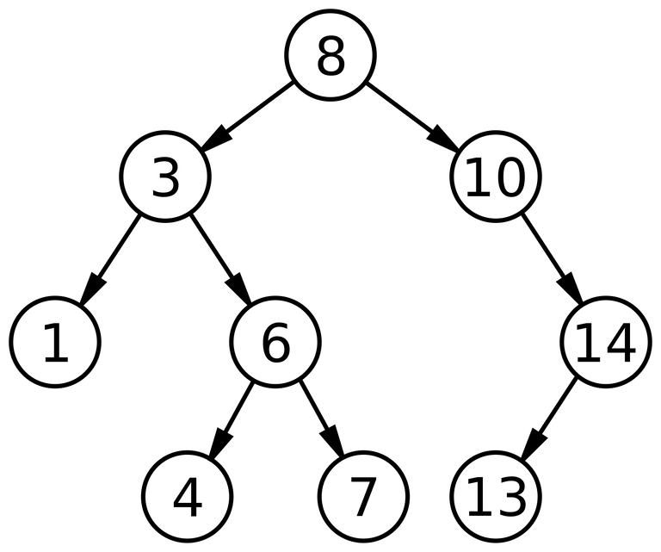
Deleting from Binary Search Tree :
Suppose we want to delete a node ptr.
1. If ptr has no children, then we will just replace ptr by NULL.
2. If ptr has only one child, then we will replace ptr with that child.
3. If ptr has two children, then we will identify it’s smallest successor. Call it x.
Then we will replace ptr with x.
Inorder traversal gives : 1 , 3 , 4 , 6 , 7 , 8 , 10 , 13 , 14

Slide 15


