Slide 1
3D Model Digital Signature System
Using Steganographic Authentication & RSA Cryptography
By Mohammed Mudassir

Slide 2
Problem Statement
Challenges in 3D Content Protection
Piracy & Unauthorized Distribution
Loss of Artist Attribution
Difficulty Detecting Tampering
No Reliable Authentication Method
Need for embedded, tamper-resistant signatures

Slide 3
Proposed Solution
Digital Signature + Steganography
RSA Cryptography (2048-bit keys)
Generate unique digital signatures for each artist
Vertex-Level Steganography
Embed signatures in 3D model geometry (LSB manipulation)
Artist Attribution System
Database-backed profiles with metadata embedding

Slide 4
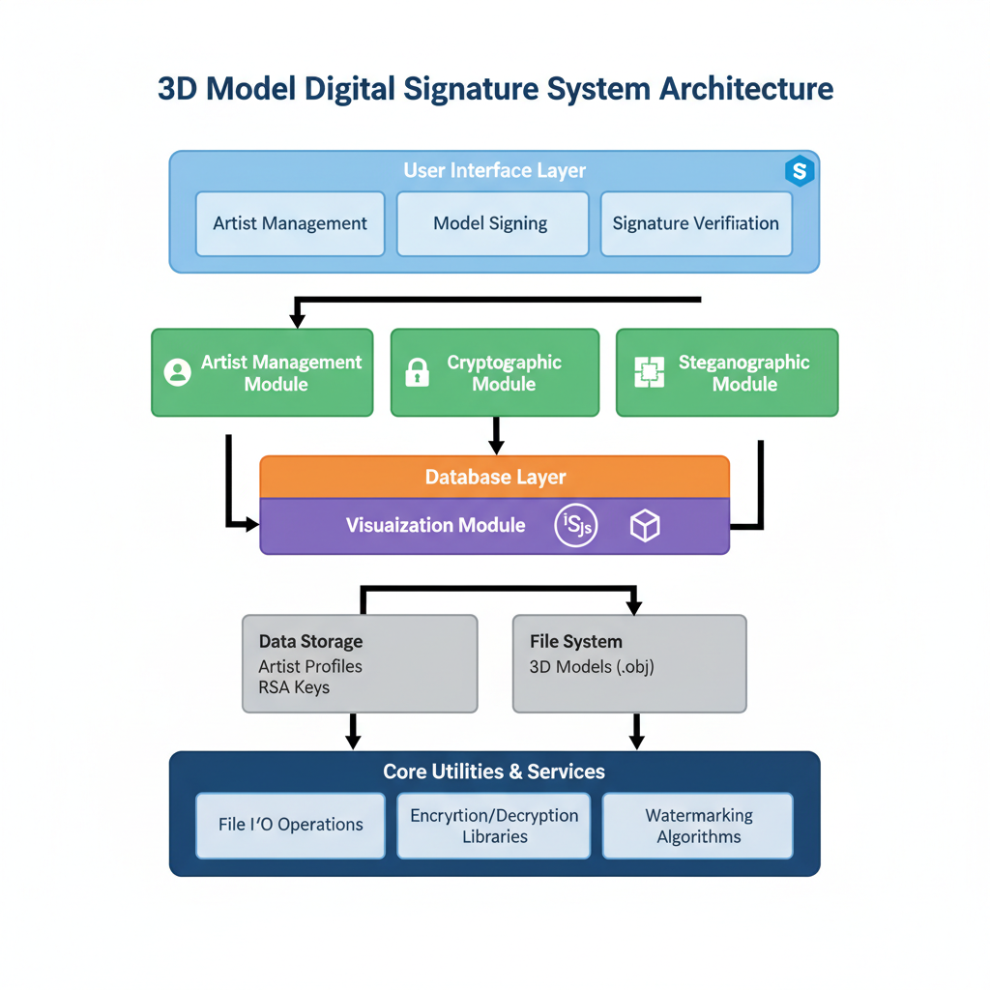

Slide 5
Key Features
🔐 Tamper-Resistant Signatures
Distributed across multiple vertices
👨‍🎨 Multi-Artist Support
Unique cryptographic identity per artist
🚫 Re-Signing Prevention
Protects original artist attribution
✅ Signature Verification
Detect unauthorized modifications
🎨 Visual Quality Preservation
Imperceptible changes to geometry
💾 Database-Backed
Persistent artist profiles in SQLite
🖥️ Interactive 3D Viewer
Black background, white models, enhanced lighting

Slide 6
Technical Implementation
Technology Stack
Python 3.8+: Core implementation language
Streamlit: Web application framework
cryptography library: RSA-PSS with SHA-256
SQLite: Artist profile database
Three.js: 3D model visualization
OBJ Format: Widely-supported 3D file format

Slide 7
Steganographic Algorithm
Embedding Process
1. Parse OBJ file and identify all vertices
2. Convert signature to binary representation
3. Split each byte into four 2-bit pairs
4. Modify z-coordinates using LSB manipulation
5. Embed artist metadata in Base64 format
6. Add authentication marker to file header
Extraction: Reverse process to reconstruct signature

Slide 8
Security Features
Multi-Layer Protection
Cryptographic Integrity
RSA-PSS with 2048-bit keys, SHA-256 hashing
Tamper Detection
Signature verification detects any modifications
Re-Signing Prevention
Blocks attempts to override existing signatures
Artist Verification
Embedded metadata confirms original creator
Duplicate Prevention
No duplicate artist names in registry
Distributed Storage
Signature spread across multiple vertices

Slide 9
Conclusion & Future Work
Achievements
✓ Robust authentication system for 3D models
✓ Imperceptible steganographic embedding
✓ User-friendly interface for creators
✓ Strong tamper-resistance mechanisms
Future Enhancements
• Support for FBX, STL, and other 3D formats
• Blockchain-based verification system
• Cloud storage for artist profiles
• Batch processing capabilities
• Industry standardization efforts

