Slide 1

A DATA-DRIVEN ANALYSIS OF IMDb RATINGS
DATA ANALYSIS SUMMER INTERNSHIP - 2023
BATCH: 90
Md. Nusrath Shariff | 20551A4231
U. Dharani | 20551A4252
K. Mahesh | 20551A4229
Aisha Maryam | 21551A4202
MENTORS:
K. Narmada Mani, APSSDC
K. Meenakshi, APSSDC
College:
GODAVARI INSTITUTE OF ENGINEERING AND TECHNOLOGY, AP

Slide 2
PROBLEM STATEMENT
SYSTEM REQUIREMENTS
ARCHITECTURE OF THE PROJECT
ADVANTAGES
ANALYSIS & VISUALIZATION
CONCLUSION
1
2
3
CONTENT
4
5
6

Slide 3
PROBLEM STATEMENT

Slide 4

STATEMENT:
This project aims to explore the intricate relationship between IMDb ratings and movie gross, unraveling the role of critical acclaim versus content quality in shaping the commercial triumph of films. Through comprehensive data analysis, we seek to provide valuable insights that guide decision-making and contribute to the evolving narrative of the film industry.
BOX
OFFICE
VS

Slide 5
BOX
OFFICE
IMDb is a prominent online database for films and TV shows, offering comprehensive details and user ratings.
IMDb features user-generated ratings and reviews, aiding audiences in making informed viewing choices.
Box office refers to the revenue generated by a movie's theatrical release, reflecting its commercial success.
The box office performance indicates a film's popularity and financial impact within the entertainment industry.

Slide 6
SYSTEM REQUIREMENTS

Slide 7
HARDWARE & SOFTWARE REQUIREMENTS
OPERATING SYSTEM | Microsoft Windows 11 Home Single Language
CPU | Intel(R) Core(TM) i5-10300H CPU @ 2.50GHz, 2496 Mhz, 4 Core(s), 8 Logical Processor(s)
RAM | 16GB
HARD DRIVE | 250GB SSD
SOFTWARE | Jupyter Notebook, Microsoft Excel
PROGRAMMING LANGUAGE | Python

Slide 8
ARCHITECTURE OF THE PROJECT

Slide 9
Data Collection
Data Preprocessing
Exploratory Data Analysis
Data Visualization
Interpretation and Conclusion
Obtained the dataset containing movie details, including IMDb ratings, box office gross, genres, release year, directors, cast, and other relevant information from Kaggle.
Cleaning and preprocessing the dataset to handle missing values, duplicates, and any inconsistencies.
Converting data into appropriate formats for analysis.
Conducted a comprehensive exploration of the dataset to gain insights into its distribution, summary statistics, and characteristics.
Generated visual representations, such as scatter plots, bar charts, and heatmaps, to present key findings and trends effectively.
Summarized the findings from the analysis, highlighting the significance of IMDb ratings in relation to box office success.

Slide 10
LIBRARIES USED…
It is used to efficiently process and manipulate numeric data, laying the groundwork for further analysis.
Pandas is essential for loading, cleaning, and transforming the movie dataset into a structured format, making it a vital tool for exploratory data analysis.
Matplotlib.pyplot is a widely used library for data visualization in Python.
Seaborn is a statistical data visualization library built on top of Matplotlib.

Slide 11
ADVANTAGES

Slide 12
KEY ADVANTAGES
Understanding Movie Success Factors:
Resource Optimization:
Studios can allocate resources more efficiently based on the analysis, focusing on projects that align with audience preferences and have higher chances of commercial success.
Engaging Content:
Correlation aids in creating resonant content.
The project sheds light on the complex dynamics that influence a movie's commercial trajectory.
Competitive Advantage:
Studios and filmmakers who use data to understand audience sentiments can adapt to changing preferences, stay ahead of trends, and create content that resonates with viewers.
Valuable Industry Insights:
Sharing insights with industry professionals fosters collaboration and continuous improvement in the pursuit of cinematic excellence.
Unveiling genre preferences and content attributes that drive success provides a competitive edge in content creation.

Slide 13
ANALYSIS & VISUALIZATION

Slide 14
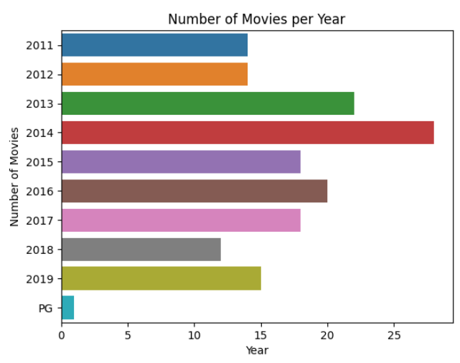
Displaying number of movies released in each year for the last 10 years i.e., (2011-2019).
The number of movies released per year shows an upward trend from 2011 to 2014.
The year 2014 had the highest number of movie releases, with a count of 28 movies.
Sudden decrease in movies in 2015 is due to people exposure to new all kinds of cinema and decreases the remake rate.
The data suggests that the movie industry experienced growth and increased production over the years, with a peak in 2016.
Notes:
sb.barplot(data—ye.reset_index(), y— "Released Year", x— "Movie_Name ")
mp.xlabel(' Year ')
mp.ylabel(Wumber of Movies ')
mp.title('Number of Movies per Year')
np.show()

Slide 15
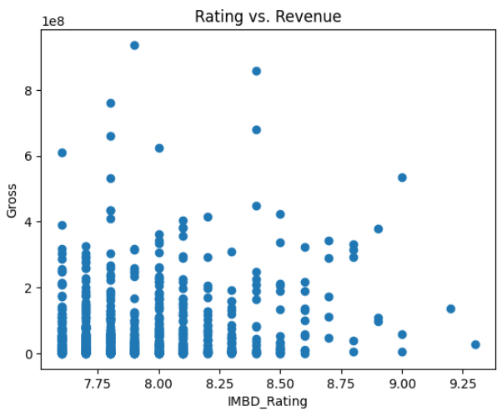
DOES RATING EFFECT THE REVENUE?
SCATTER PLOT
A correlation coefficient of 0.125 suggests a positive but weak correlation between the movie's rating and its revenue. Hence, we can say that rating does not greatly affect the revenue of the film.
correlation
CORRELATION VALUE

Slide 16
CONCLUSION

Slide 17
Interpretation and Conclusion…
As we have taken the IMDb dataset for analyzing top grosser films over past 100 Years.
In summary, our analysis indicates that reviews have limited direct impact on box office outcomes.
Instead, our findings emphasize the crucial role of captivating content in attracting audiences.
Compelling genres, narratives, and performances appear to be more influential in driving box office success.
“This underscores the significance of engaging storytelling and content quality in shaping audience preferences and cinematic triumph”

Slide 18
THANK YOU !!!

