Slide 1
Emotion Detection System
Presented By-
Md Rasel Uddin
ID: 1914551116
Batch-45, Section-B
Supervised By-
Ferdaus Anam Jibon
Assistant Professor,
University of Information Technology and Sciences (UITS)

Slide 2
Outline
Background Study
Technical Discussion
Problem Statement
Output/Result
Motivation/Objective
Discussion
Methodology
Conclusion

Slide 3
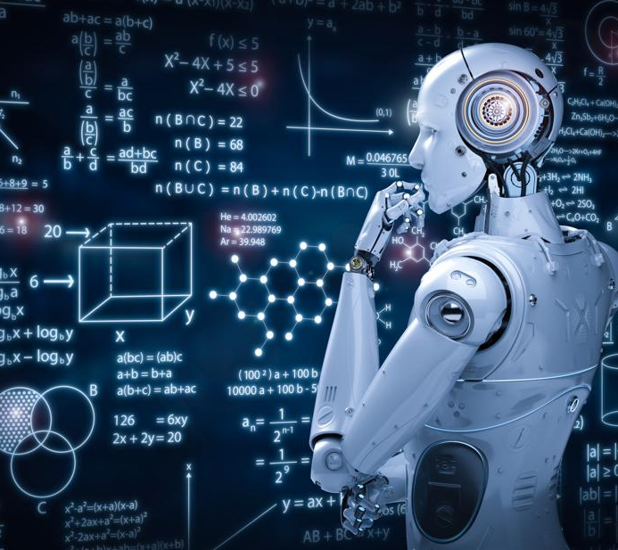
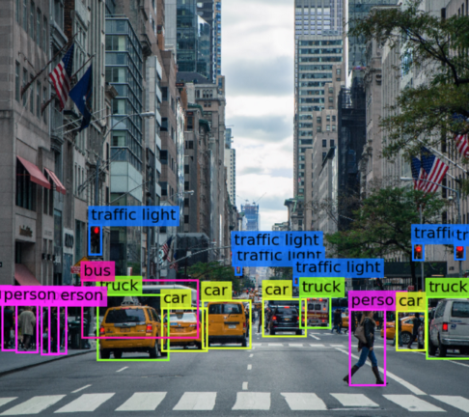

Artificial Intelligence
Machine Learning
Computer Vision
Natural Language Processing
Stock Market Price Prediction
Disease Prediction
Etc.
Object Detection
Disease Prediction
Face Detection
Etc.
Language generation
Spam Detection
Sentiment Analysis
Etc.

Slide 4
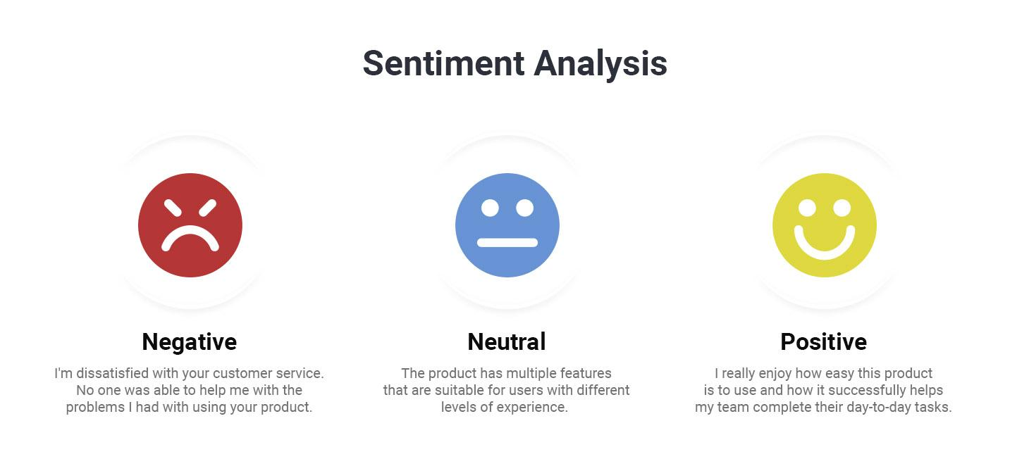
Problem Statement
Researchers are making machines to mimic humans. Machines are mimicking human objects such as object detection, prediction and so on. Machines also need to understand human languages also and should also have capability to understand human emotion. But Most of the systems have some limitations, such as:
Can detect only positive or negative emotion
Very rare systems exists who works with social media post
Retrieving social media post such as twitter post

Slide 5
Project Objective
Objective
In this project, we have several objectives to fill the gap:
The main purpose of this software is to detect emotion from Twitter posts. This detection will help user to understand the mental condition of any Twitter user through the post.
This software allows users to view the emotion of twitter of user or any particular person. This software user can retrieve tweet almost 5000 of any Twitter user.
1
3
2
This will contribute in many tasks, such as to reduce the suicide rate. This software will detect the emotion sentiment of twitter post which user post on social media.
4
The admin can also see page view history of this software and can track detection history.

Slide 6
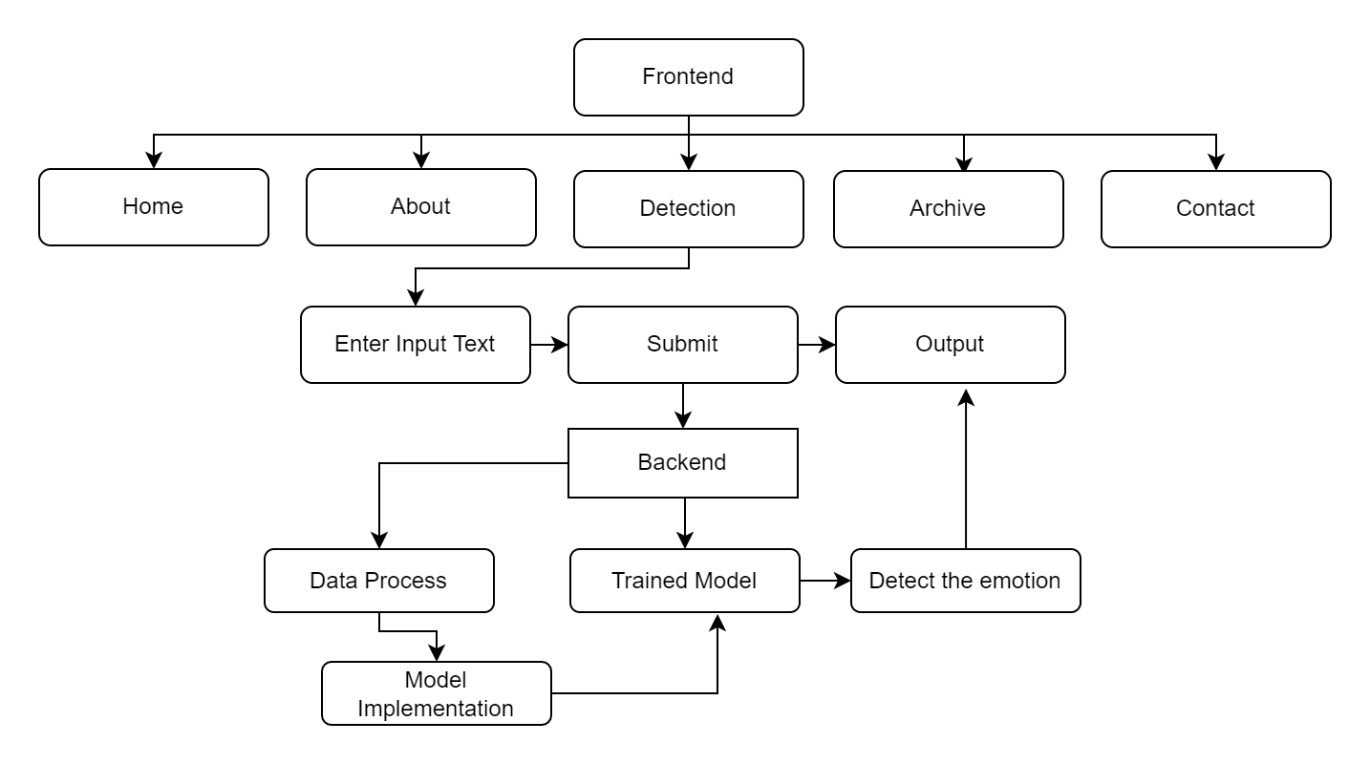
Methodology
Our model have 2 parts:
Frontend
Backend
In frontend, the user will see the home page. Here, the user will get the tweet of the user from tweet page and predict the emotion from that tweet using NLP techniques in detection page.
Fig: Working methodology of the EDS system

Slide 7
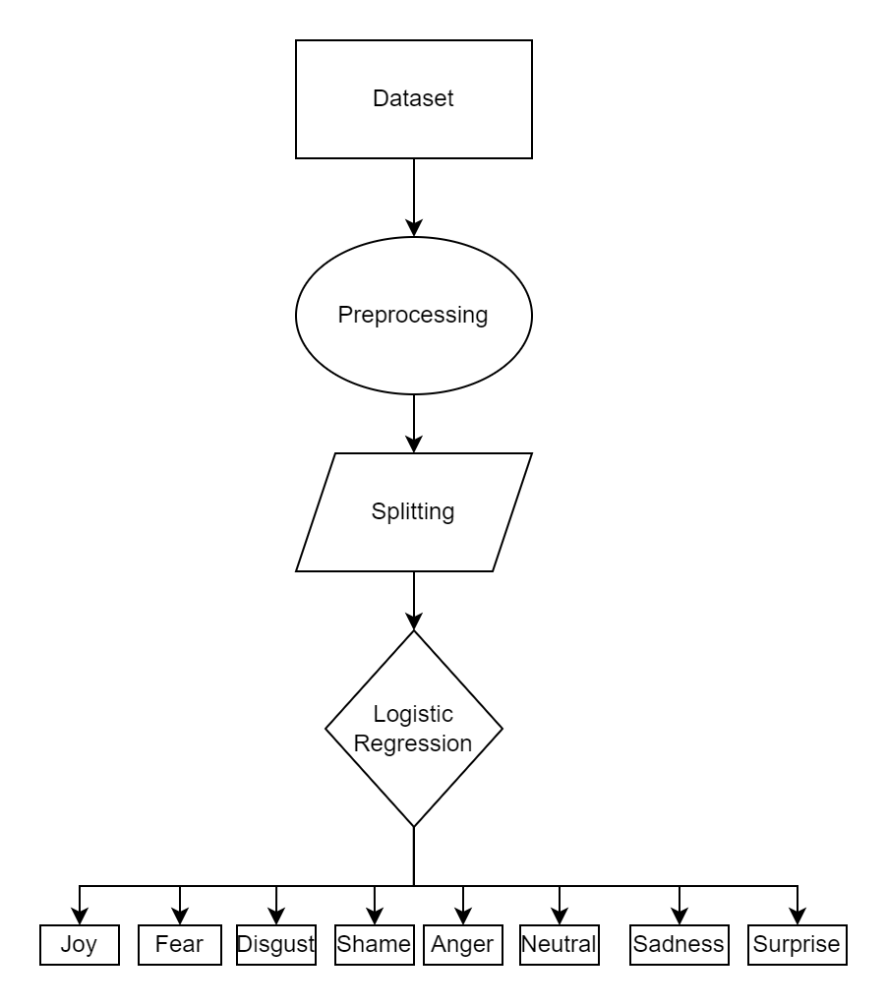
Backend
Basically, backend is also consists of two segments:
App development segment
Model Training segment
App development segment
2. Model Training segment
Streamlit
HTML
CSS
Python
SQLite database
Model trained by logistic regression
Pretrained model with transformers
Fig: NLP trained model using logistic regression

Slide 8
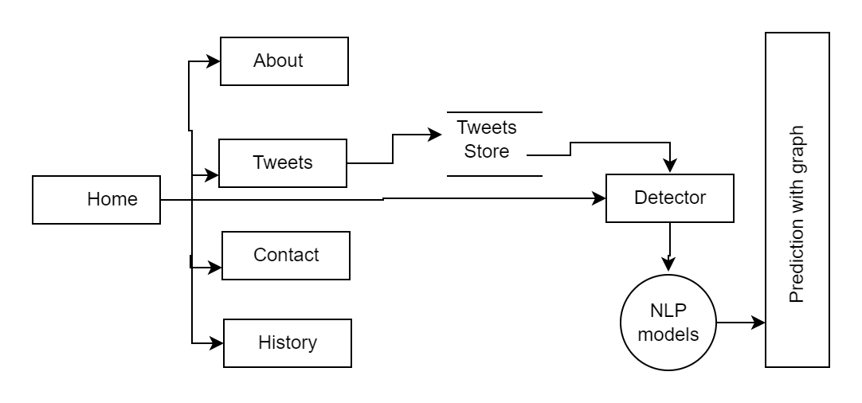
Technical Discussion
Used Technology:
Frontend:
HTML
CSS
STREAMLIT
Backend:
Python
Machine Learning
NLP
Transformers
Hugging Face
Fig: Simple representation of the system

Slide 9




Frontend
Frontend:
HTML
CSS
STREAMLIT
This project is mainly developed with streamlit framework. We have added HTML, CSS to the project manually for some extra features.
Streamlit is an open-source app framework for Machine Learning and Data Science teams to deploy models into applications.

Slide 10
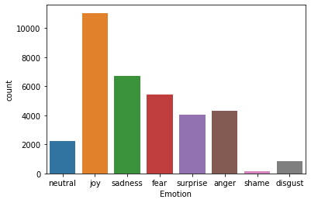
Backend
The whole project is based on python. Streamlit is used for developing the project. We have used machine learning algorithms to develop classification models. The model is coded in google colab. Besides, we have also used pre-trained model pipeline to detect sentiment using transformers from hugging face.
Python, Machine Learning, SQLite
NLP, Transformers
Have used 2 trained model:
Algorithm: Logistic Regression
Dataset: 34792 rows × 2 columns
Split: 70:30
Accuracy: 0.62
Fig: Number of data of each classes

Slide 11
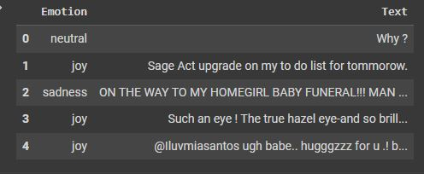
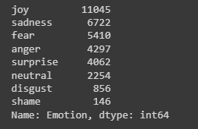
Below is the representation of the dataset which is used to train the model.

Slide 12
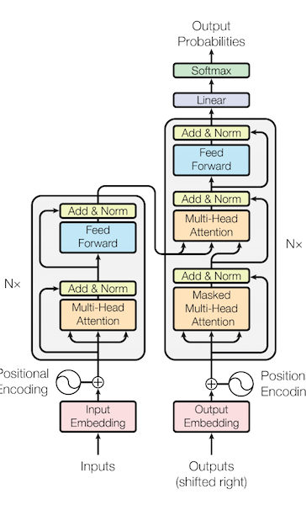


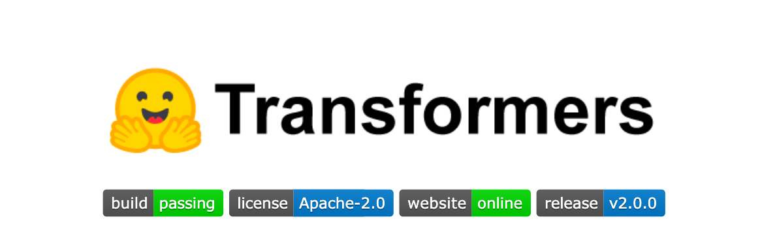
Transformers
from transformers import pipeline, AutoModelForTokenClassification, AutoTokenizer
model= pipeline("sentiment-analysis")
01 | Better detection than logistic model
02 | better accuracy
03 | Flexible and easy to use

Slide 13
Database
Technical Discussion
In this project, we have used SQLite database for storing our project data.
We have stored data like:
Detection history
Page view history
Tweet post
Created database name:
Data.db
Two Tables:
pageTrackTable2
emotionclfTable3

Slide 14
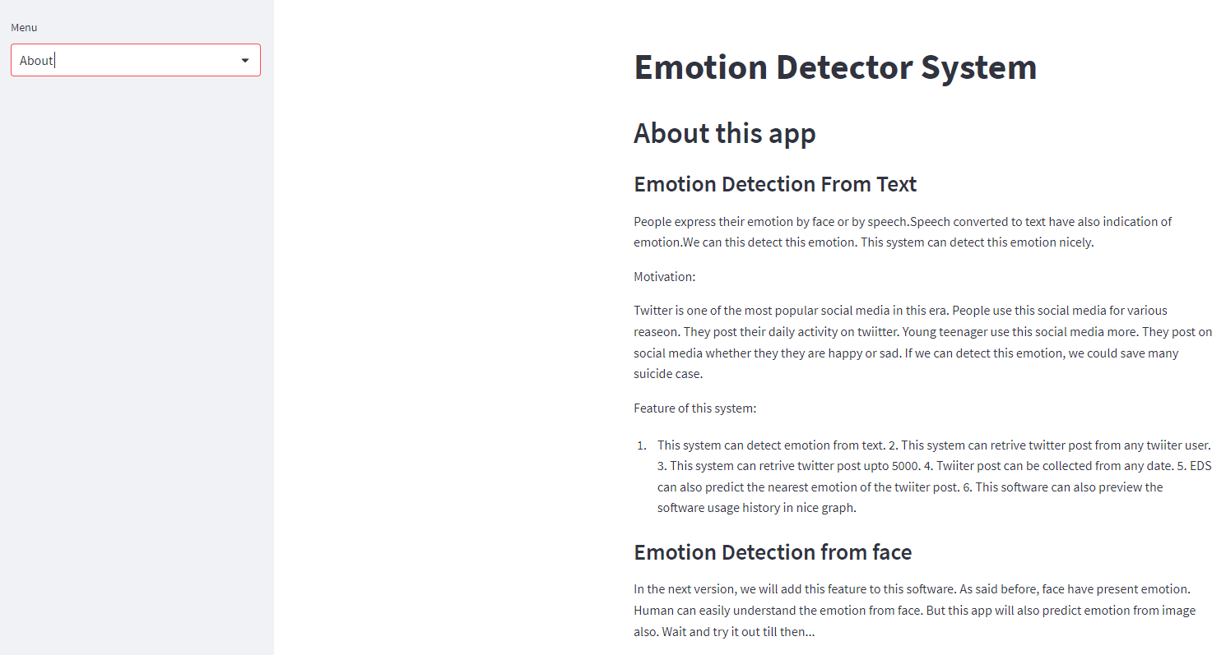
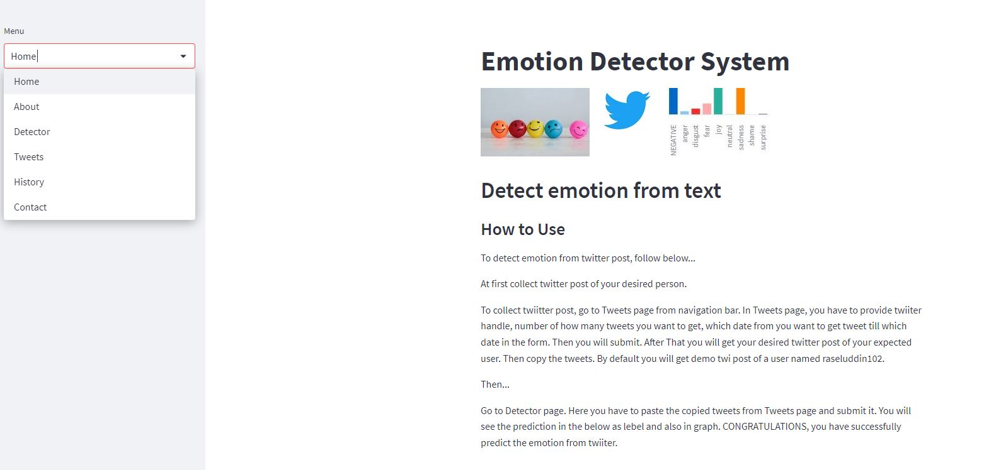
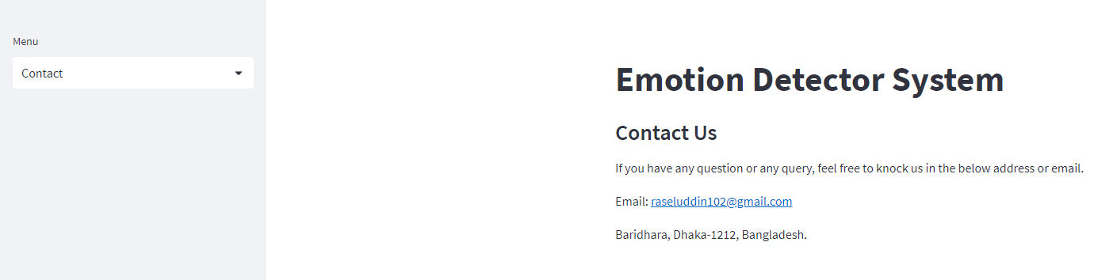
Output
Output
CEO
CFO
Sales Director
Berry Books
Vinny Viewer
Wendy Writer

Slide 15
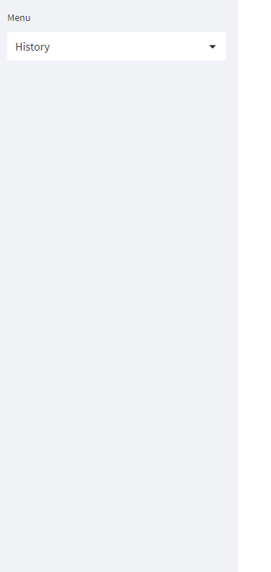
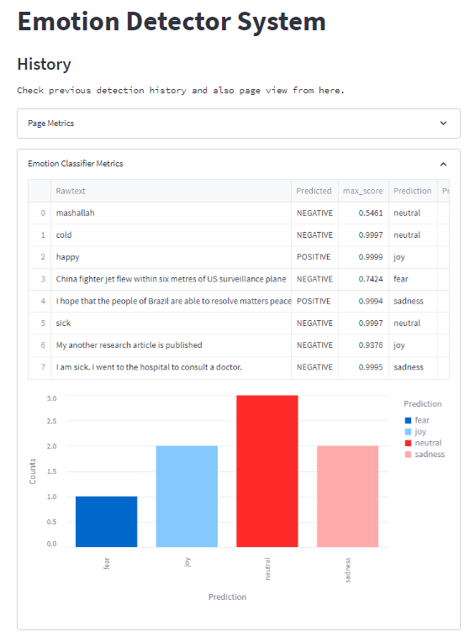
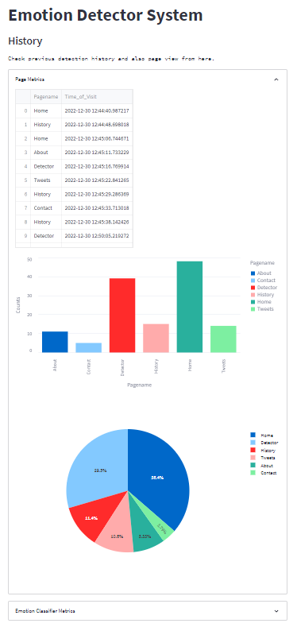
Output

Slide 16
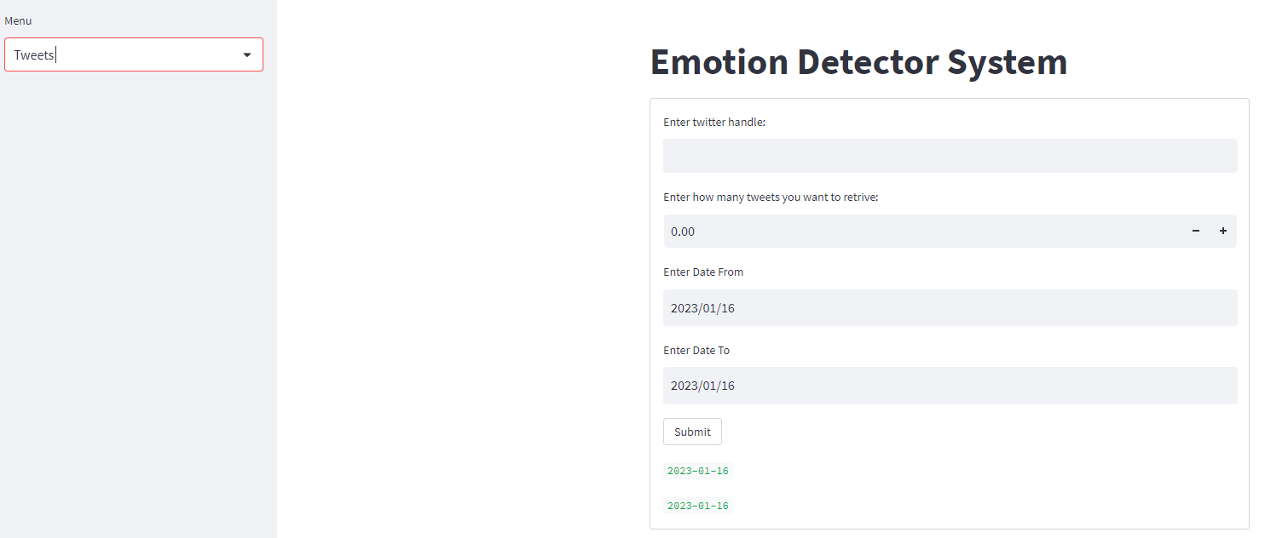
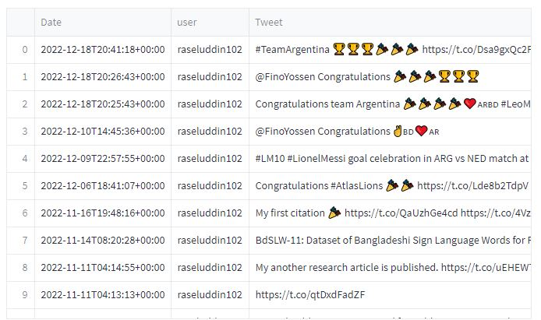
Output
This is the visual representation of the tweet page of the system. Here, user have to provide twitter handle to get tweets of any particular user.

Slide 17
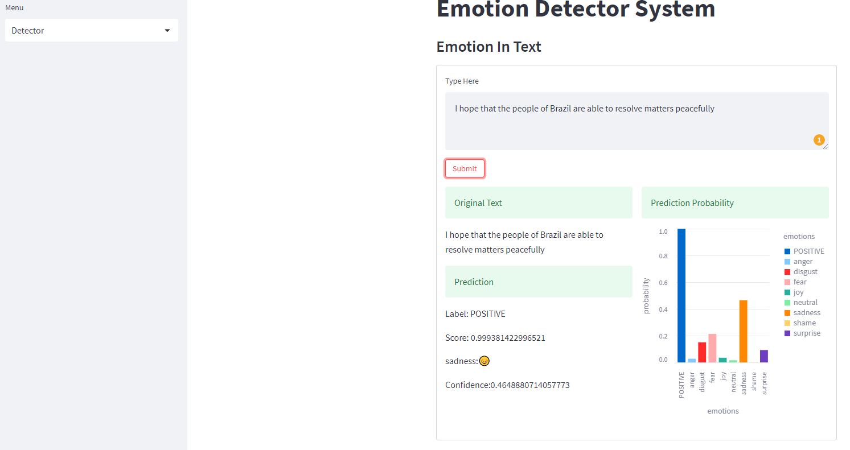
Output

Slide 18
Limitation:
Limitation
This software requires an internet connection. Users of the system should be compatible with English as it is in English and should have basic knowledge in computers. Users have to copy tweets from tweet pages up to 5000 and then detect the emotion as it is not fully automatic yet. In future versions, this will be added.
requires an internet connection
Users of the system should be compatible with English
should have basic knowledge in computers
Users have to copy tweets from tweet pages up to 5000 and then detect the emotion as it is not fully automatic yet. In future versions, this will be added.

Slide 19
Future Features:
Future Features
In future versions, this system will be fully automated.
Emotion detection from face.
Will also be in Bengali Language.

Slide 20
Conclusion
Conclusion
This software is very important for the modern era. This can be used in many areas such as detecting emotion of social media post and informing guardian accordingly which can prevent suicide. This system can also be integrated in various companies to detect emotion of customer reviews. This system is very beneficial for modern business and human lives.

Slide 21
Thank You

