Slide 1
DATA ENGINEERING · WEEK 2
Agile, Scrum & Kanban
Data engineering och Agila metoder — IT Högskolan
Agile, Scrum & Kanban · Week 2
1

Slide 2
What is Agile?
A set of values, not a specific process. Scrum and Kanban are two ways of putting it into practice.
– Deliver early and often — small, working increments instead of one big plan
– Responding to change over rigidly following a plan set months ago
– Continuous feedback from real users, not just a stakeholder sign-off at the end
The Agile Manifesto's four values
• Individuals & interactions over processes & tools
• Working software over comprehensive documentation
• Customer collaboration over contract negotiation
• Responding to change over following a plan
Agile, Scrum & Kanban · Week 2
2

Slide 3
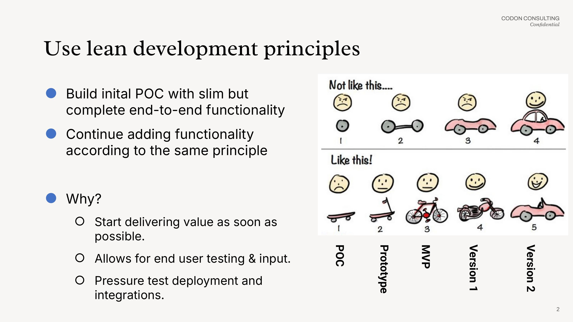
Lean development principles
This is the mindset behind Agile: build the smallest thing that actually works, then grow it.
Source: Codon Consulting
Agile, Scrum & Kanban · Week 2
3

Slide 4
Scrum: a framework you adopt
– Prescribed roles, events, and a fixed cadence — you reorganise around it
– Work happens in time-boxed sprints (1–4 weeks) — a protective container
– Scope is locked once the Sprint Goal is set — no mid-sprint scope injection
Roles
• Product Owner, Scrum Master, Developers
Events
• Sprint Planning, Daily Scrum, Sprint Review, Retrospective
Agile, Scrum & Kanban · Week 2
4

Slide 5
Kanban: a method you overlay
– Start from your current process, make the work visible, improve incrementally
– Continuous flow — no fixed iterations to wait for
– WIP limits per column — the core mechanic that keeps flow healthy
– Pull work when there's capacity, rather than pushing it onto people
– Has its own cadences (replenishment, delivery planning) — decoupled from a fixed sprint length
Agile, Scrum & Kanban · Week 2
5

Slide 6
Scrum vs. Kanban
Same underlying values, two different ways of handling new, urgent work.
S
Scrum
K
Kanban
– Protects the current sprint
– New urgent work waits for the sprint boundary
– Best when the team needs focus and predictability
– Can reprioritise on any given day
– Work flows continuously, one card at a time
– Best when priorities shift often and fast
Agile, Scrum & Kanban · Week 2
6

Slide 7
TODAY
Put this week on a board.
– Set up a GitHub Projects board for your team
– Write a one-sentence Definition of Done
– Put this morning's real work on it
Agile, Scrum & Kanban · Week 2 · Data engineering och Agila metoder
Agile, Scrum & Kanban · Week 2
7

