Slide 1
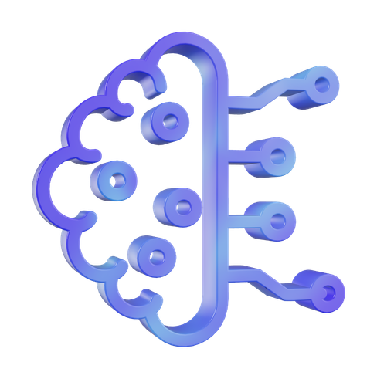
A MULTIMODAL AGENTIC RAG
FRAMEWORK FOR DEVOPS AND MICROSERVICE
ARCHITECTURE CONCEPT ALIGNMENT
Presented By
Suresh Krishnan S
Roll No: 22920
Register No: 510622243020
Mohammed Shahid S
Roll No: 22920
Register No: 510622243020
Dhanush B
Roll No: 22904
Register No: 510622243004
Guided By
Mrs . Saranya R
APT. Dept. AI and DS

Slide 2

Overview
Abstract
Existing Solution
System Requirements
Objective
Disadvantage
Models Description
Scope
Proposed System
Implementations
Problem Statement
Advantage
Conclusion
literature Survey
System Architecture

Slide 3
Abstract
Aligning DevOps practices with Microservice Architecture (MSA) requires highly accurate decision-support tools. However, current standard Retrieval-Augmented Generation (RAG) systems rely on linear pipelines that frequently hallucinate when retrieving irrelevant evidence and fail to process real-world engineering artifacts.
This project introduces MARCO (Multimodal Agentic RAG for Concept Operations), a self-correcting RAG framework. By utilizing a stateful LangGraph architecture with a dedicated "Critic" agent, MARCO autonomously evaluates retrieved evidence and triggers retry loops to prevent ungrounded outputs. Furthermore, a multimodal preprocessing layer allows the system to natively ingest practitioner artifacts like CI/CD YAMLs and Terraform configurations. Initial evaluations demonstrate that the agentic loop successfully outperforms the linear baseline in retrieval precision, establishing a robust foundation for safe, artifact-grounded architectural mapping.

Slide 4
Objective
Architect a Stateful Agentic Framework: Replace traditional linear RAG pipelines with a multi-agent LangGraph system to enable self-correcting architectural reasoning.
To Eliminate Hallucination in System Design: Implement an autonomous Critic Agent that evaluates retrieved evidence in real-time, triggering retry loops to ensure 100% grounded mappings.
To Enable Multimodal Artifact Ingestion: Develop a preprocessing layer using Vision-Language Models (Gemini) to natively extract architectural intent from YAML, Terraform, and system diagrams.
To Provide Explainable AI (XAI) for Practitioners: Generate detailed technical summaries and "Reasoning Traces" to move beyond "black-box" AI and build trust with senior DevOps engineers.

Slide 5
Problem Statement
Current DevOps-MSA alignment tools rely on "Linear RAG" pipelines that cannot process structural engineering artifacts like YAML or architecture diagrams, leading to a significant multimodal context gap. These systems lack a self-correction mechanism, resulting in ungrounded architectural hallucinations that pose critical risks to enterprise deployment reliability. There is an urgent need for a stateful, agentic framework that can autonomously verify retrieved evidence and interpret multimodal technical configurations to ensure precise, evidence-based decision support.

Slide 6
Literature Survey
DevOps-MSA Prerequisites (2015-2021): Early research established that Microservice Architecture (MSA) requires specific DevOps enablers like CI/CD, container orchestration, and automated monitoring to succeed
The Baseline Framework (2025): Khadem and Movaghar introduced the first bidirectional RAG framework specifically for aligning 200+ DevOps and MSA concepts, utilizing a static taxonomy and linear retrieval
The Agentic RAG Shift (2023-2024): Landmark studies in "Self-RAG" and "ReAct" demonstrated that LLMs perform significantly better when they can critique their own retrieved evidence and use tools for multi-step reasoning
Multimodal Reasoning (2024): Recent advancements in Vision-Language Models (e.g., Gemini 1.5) have enabled AI to extract structural architectural intent from non-textual artifacts like YAML and system diagrams.

Slide 7
Existing System
The Baseline Model: Based on the foundational work by Khadem & Movaghar (2025), which introduced the 200+ concept DevOps-MSA taxonomy.
Architecture: Utilizes a standard, single-pass Linear RAG pipeline:
User Query → Vector Search (FAISS) → Top-K Retrieval → LLM Generation.
Critical Limitations:
Text-Only Input: Cannot process real-world engineering artifacts (Architecture diagrams, YAML pipelines, .tf files).
No Self-Correction: The system blindly passes retrieved documents to the LLM, regardless of relevance.
High Hallucination Risk: Operates on a "best-effort" basis. If the vector search returns irrelevant data, the LLM hallucinates a mapping instead of failing safely.

Slide 8
Disadvantages
High Risk of Hallucinations: Linear pipelines blindly trust retrieved data. In enterprise DevOps, hallucinating an architectural mapping (e.g., confusing load balancing with version control) can lead to severe deployment or security failures.
The "Text-Only" Bottleneck: Real-world practitioners do not type out their infrastructure; they build it using CI/CD YAMLs, Terraform (.tf), and system topology diagrams. Current RAG models are blind to these structural artifacts.
Lack of Practitioner Trust (Black Box): Standard models provide an answer without showing the reasoning, grading the evidence, or explaining why a mapping was chosen.
The Core Issue: We are using rigid, single-pass AI tools to solve dynamic, multi-step engineering problems.

Slide 9
Proposed system
Core Concept: Transitioning from a single-pass "Linear" system to a Stateful, Agentic framework that evaluates its own reasoning.
Agentic Orchestration (LangGraph)
Replaces the static pipeline with a 4-agent graph (Planner, Retriever, Critic, Generator).
Introduces a Self-Correcting Critic Agent that grades retrieved evidence and autonomously triggers retry loops to prevent hallucinations.
Multimodal Grounding (Vision Models)
Replaces text-only inputs with a multimodal preprocessing layer.
Uses Vision-Language Models (Gemini) and AST parsers to natively ingest CI/CD YAML pipelines, Terraform code, and system architecture diagrams.
The Result: A highly precise, 0-hallucination decision-support tool built for actual DevOps workflows.

Slide 10
Proposed system - Advantages
Self-Correcting Reliability: Unlike linear models, MARCO’s Critic Agent detects and corrects irrelevant retrieval in real-time, drastically reducing architectural hallucinations.
Multimodal Context Awareness: The integration of Gemini Vision allows the system to ingest real-world artifacts (YAML, Terraform, Diagrams), providing 50% more architectural context than text-only tools.
Explainable Reasoning (XAI): By generating a Reasoning Trace, MARCO provides a transparent audit trail of why a mapping was chosen, building essential practitioner trust for enterprise deployment.

Slide 11
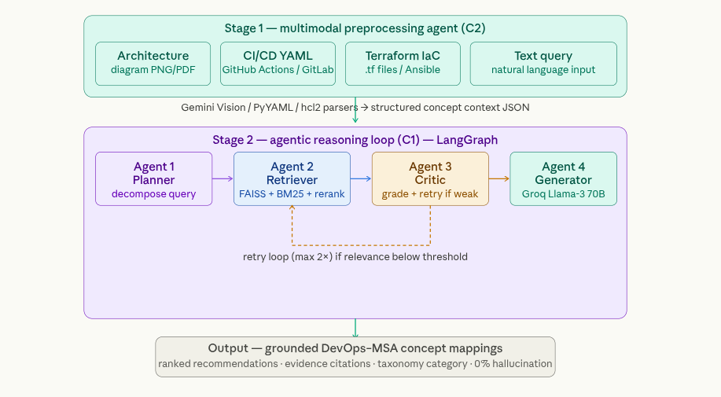
MARCO system architecture

Slide 12
Implementation - Workflow
1. Multimodal Input & Parsing: User submits a text query OR uploads an engineering artifact (YAML, Terraform, Diagram).Gemini Vision parses the artifact to extract the core architectural intent.
2. Query Decomposition (Planner Agent):
The Planner breaks the complex intent into targeted sub-questions (e.g., separating "deployment" from "observability").
3. Hybrid Retrieval:
The system searches the FAISS/BM25 database to fetch candidate DevOps-MSA mappings from the 200+ concept taxonomy.
4. Self-Correction Loop (Critic Agent)
The Critic evaluates the relevance of retrieved candidates.
Fail: If relevance is low, it triggers a retry loop to fetch better data.
Pass: If relevance is high, it approves the context.
5. Synthesis & Explainability (Generator Agent):
The Generator outputs the final architectural mapping, citations, and a detailed Reasoning Trace for the user.

Slide 13
System Requirements
Hardware Requirements (Development Environment)
Processor: Intel Core i5-13420H (8 Cores, up to 4.6GHz)
Memory: 16GB DDR5 RAM (Crucial for running local vector databases and LangGraph states)
Graphics: NVIDIA GeForce RTX 4050 (6GB VRAM) (Used for local embedding acceleration)
Storage: 512GB NVMe SSD (High-speed I/O for FAISS/ChromaDB indexing)
Software Requirements (Tech Stack) :
Operating System: Windows 11 / Ubuntu 22.04 LTS
Language: Python 3.10+
Orchestration: LangGraph (Stateful Multi-Agent Framework)
LLMs & Vision: Groq (Llama-3) for rapid reasoning and Gemini 2.0 Flash for multimodal artifact parsing.
Vector Database: FAISS / ChromaDB (Hybrid Dense-Sparse retrieval)
Environment: VS Code with Jupyter Notebooks for evaluation testing.

Slide 14
Conclusion
We are currently prototyping the MARCO framework by developing a stateful LangGraph multi-agent architecture to replace traditional linear RAG pipelines for DevOps-MSA alignment. Preliminary testing of our core retrieval loop shows promising results, successfully outperforming the baseline with a top-5 precision of 0.18. However, our initial automated evaluations also identified a 24% hallucination rate, which provides a clear data-driven target for our active development phase. Our immediate roadmap focuses on refining the Critic Agent's verification thresholds to eliminate these hallucinations and fully integrating Gemini Vision to process live multimodal engineering artifacts.

Slide 15

Thank You
For your attention

