Slide 1






PRESENTATION TITLE -
AN EFFECTIVE ANALYSIS ON FACE MASK DETECTION USING CNN MODEL
Presented To -
Presented By -
Ratri Datta
Lecturer, Dept. of CSE
UITS.
Md. Mehadi Hasan, ID : 2125051003
Maheru Tabassum Ohana, ID : 2125051015
Sowrobh Bhuiyan, ID : 2125051026
Mofidul Haque Nibir, ID : 2125051020

Slide 2


BORCELLE
Introduction
The COVID-19 pandemic underscored the need for technologies to enforce mask-wearing. Deep learning-powered face mask detection systems provide accurate, efficient, and scalable solutions for real-time public safety.
Page 01

Slide 3

BackGround
COVID-19 made mask-wearing essential for public health.
Manual enforcement was difficult, driving the need for automation.
AI advancements enabled real-time mask detection using CNN.
Challenges: Limited datasets, mask interference, and computational efficiency.
Solutions: CNN-based models for improved accuracy.
Applications: Used in public transport and surveillance for compliance.
Page 02

Slide 4
Methodology
Dataset: Kaggle’s Face Mask Dataset (images of masked and unmasked people).
Preprocessing: Resized images, applied augmentation, and normalized pixel values.
01
02
Model: Built a CNN for binary classification (Mask vs. No Mask).
Evaluation: Test & Train split of 20% & 80%, Epochs : 12
03
04
Page 03

Slide 5
Result
Accuracy: 93.4%
Precision: 94.8%
Recall: 91.6%
Robustness: High performance across varying lighting, angles, and demographics.
Page 04

Slide 6
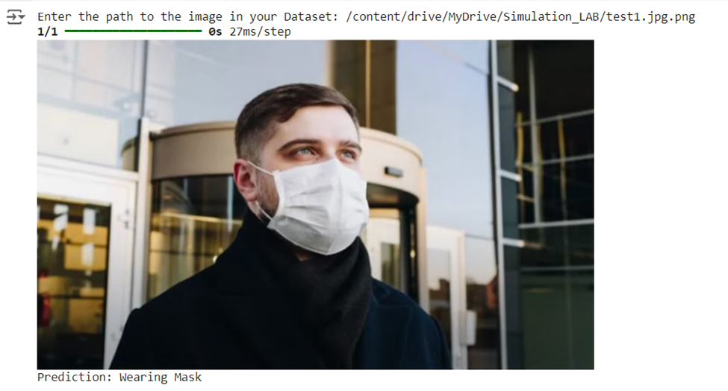
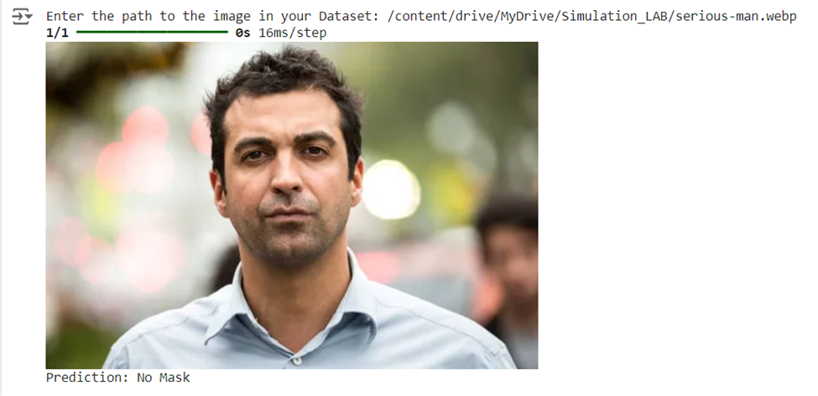
Output
Page 04

Slide 7

Limitations
Small Dataset: Limited image variety may affect model generalization.
Class Imbalance: Slight bias in mask vs. no-mask images.
Image Quality: Poor lighting or resolution impacts accuracy.
Environmental Factors: Variations in background and lighting reduce detection reliability.
Face Mask Types: Difficulty detecting different mask types or incorrect usage.
Detection Accuracy: Performance depends on face detection quality.
Resource Intensive: Requires high computational power for training.
Page 05

Slide 8
BORCELLE
Future Work
Expand Dataset: Include diverse images.
Improve Detection: Handle different mask types and misuse.
Real-Time Detection: Optimize for video streams.
System Integration: Link with security/health systems.
Optimize Model: Reduce size and improve efficiency.
Page 07

Slide 9
BORCELLE
Conclusion
This face mask detection system effectively identifies mask usage in images using CNNs, contributing to public health safety. The model demonstrates strong accuracy and can be further improved with diverse datasets and real-time detection capabilities. Future advancements could expand its application in various sectors, ensuring better health compliance and monitoring.
Page 08

Slide 10
References
P. Nagrath, R. Jain, A. Madan, R. Arora, P. Kataria, and J. Hemanth, "SSDMNV2: A real-time DNN-based face mask detection system using single shot multibox detector and MobileNetV2," ScienceDirect, vol. 81, pp. 14999-15015, Dec. 2020, doi: 10.1016/j.jnca.2020.103184. Available: https://www.sciencedirect.com/science/article/pii/S2210670720309070.
"A real time face mask detection system using convolutional neural network," Springer Link, vol. 81, pp. 14999-15015, Feb. 25, 2022. Available: https://link.springer.com/article/10.1007/s11042-022-12166-x.
T. A. Kumar, R. Rajmohan, M. Pavithra, S. A. Ajagbe, R. Hodhod, and T. Gaber, "Automatic face mask detection system in public transportation in smart cities using IoT and deep learning," Electronics, vol. 11, no. 6, pp. 904, 2022. doi: 10.3390/electronics11060904. Available: https://www.mdpi.com/2079-9292/11/6/904.
K. Bhambani, T. Jain, and K. A. Sultanpure, "Real-time face mask and social distancing violation detection system using YOLO," in Proc. IEEE, 2020. Available: https://ieeexplore.ieee.org/abstract/document/9297902.
Page 09

Slide 11
BORCELLE
THANKS
FOR YOUR ATTENTION

