Slide 1


INTRODUCTION
Name: Md.Shamim Khandakar
Department: Computer Science and Engineering
Student ID:20CSE013
Session:2020-2021

Slide 2

Introduction to the Communication App(ChatBredge)
This app aims to integrate the best communication features of Telegram and Discord, making it easier and more efficient for users who juggle between the two platforms.
Purpose of the App
Target Audience
User Experience Focus
Making communication easier by combining Telegram and Discord in one app."
Users switch between who frequently Telegram and Discord.
Making one simple interface to improve the user experience

Slide 3

Reasons for Developing This App
Too Many Apps to Switch Between :Users often have to jump between Telegram and Discord to check messages.
One Place for Both Platforms: ChatBridge makes it easier by showing both Telegram and Discord messages in one app.
Time-Saving: It saves time by reducing the need to open and manage two separate apps.
Focus on Bot Communication: Helpful for developers who use bots on both platforms and want to test or monitor them quickly.

Slide 4
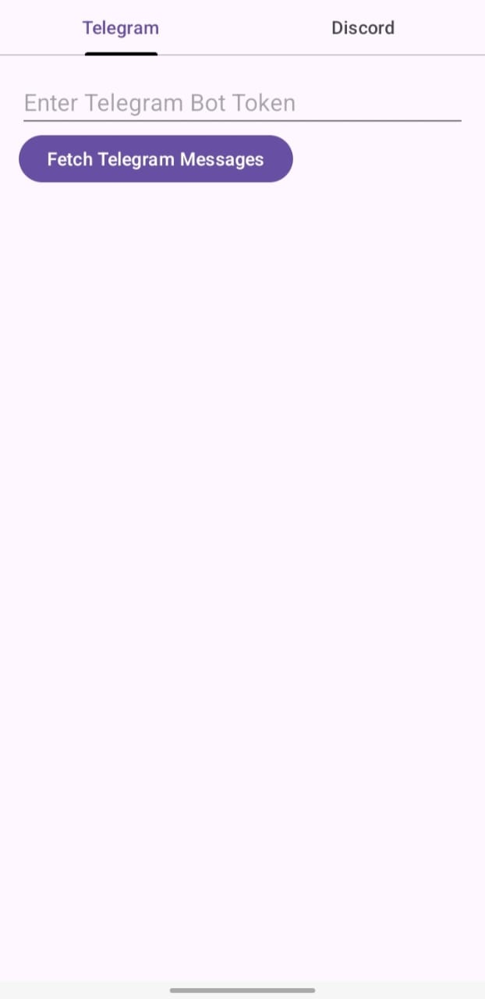
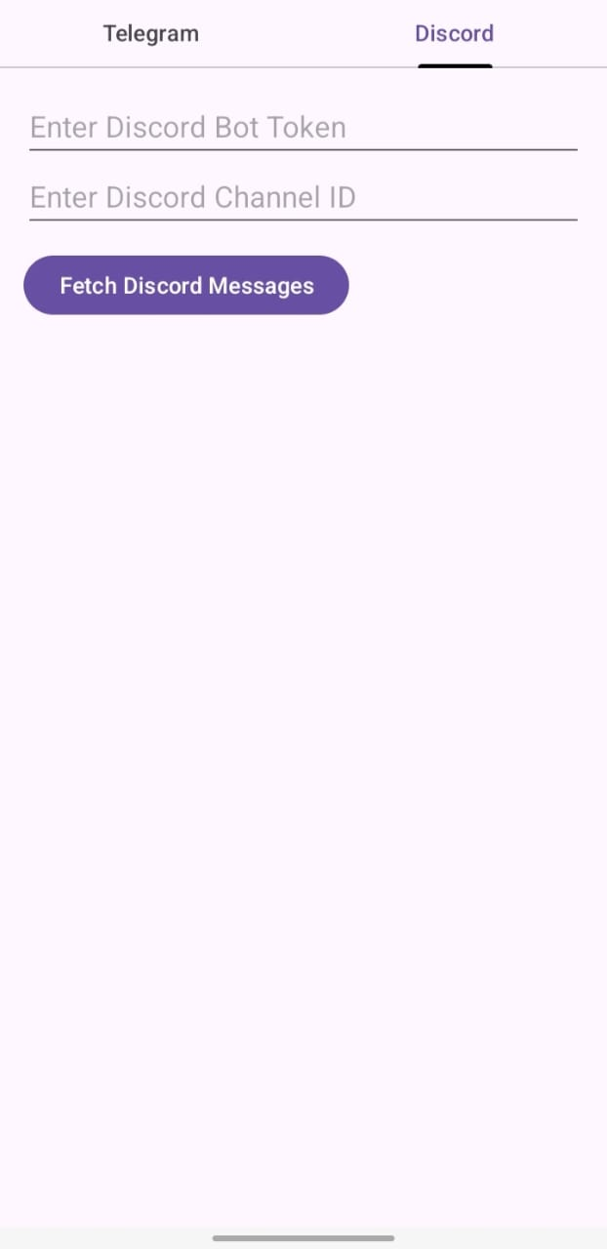
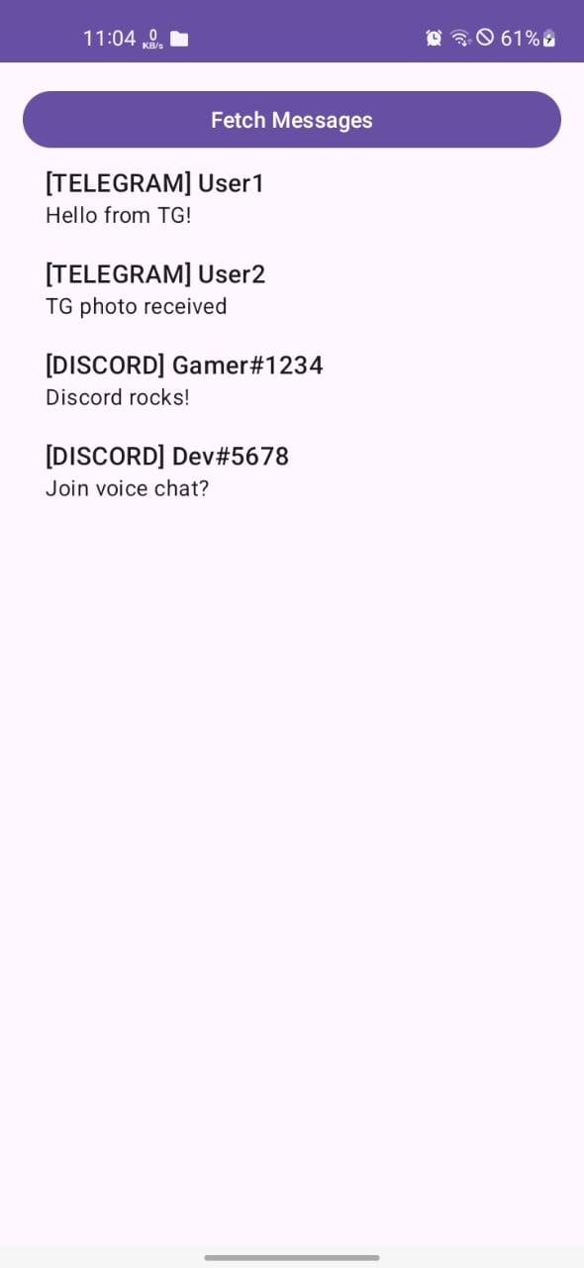
About the App
On the Discord side, users input both their Bot Token and the Channel ID they want to fetch messages from. Then they tap ‘Fetch Discord Messages
On the Telegram side, users enter their Bot Token, then tap ‘Fetch Telegram Messages’ to load messages from their Telegram bot.

Slide 5
The Drawbacks of My App
Platform API Limitations : The app depends heavily on the Telegram and Discord APIs, which may have rate limits, permission restrictions, or future policy changes that could affect functionality.
Token Security Risk : Manual entry of bot tokens may pose security concerns.
No End-to-End Encryption : While WhatsApp uses strong encryption for privacy, ChatBridge doesn’t have built-in encryption yet.

Slide 6
Conclusion
ChatBridge brings Telegram and Discord together in one easy app. It helps users see messages from both places without switching apps. Right now, it works with bots and has some limits, but it’s a good start. In the future, it can become even better with more features and real-time updates.

Slide 7
THANK YOU

