Slide 1

WELCOME TO OUR PRESENTATION

Slide 2
BANK MANAGEMENT SYSTEM

Slide 3


Problem Description
The bank management system is an application for maintaining a person’s account in a bank . The system provides the access to the customer to create an account ,deposit/withdraw the cash from his account , also to view reports of all accounts present.

Slide 4
Sign up
Verification
User/Client
New Account Create
System
login
Manage Account
Name/Pin/Deposit Amount
‹#›
‹#›
‹#›

Slide 5
METHODS :
Open New Account
Deposit Amount
Withdraw Amount
Balance Enquiry
Show Customer Detail’s
Close An Account
Exit

Slide 6
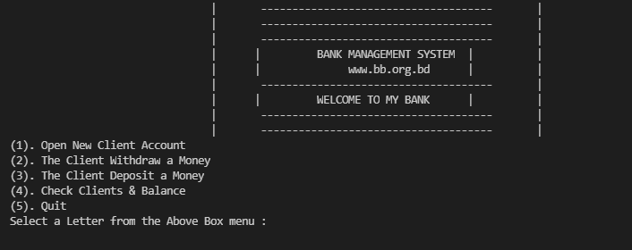
OUTPUT

Slide 7
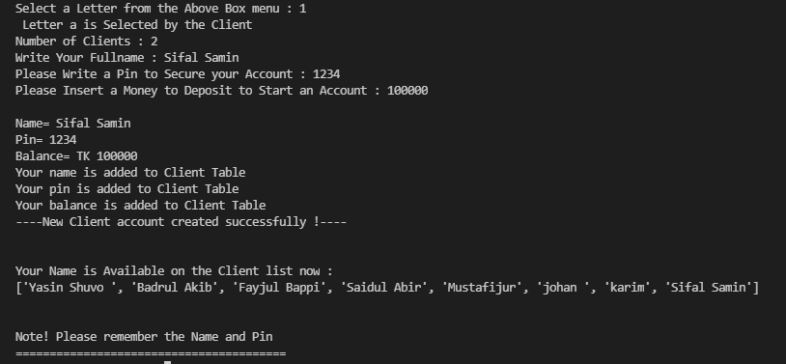
Client account created
‹#›

Slide 8
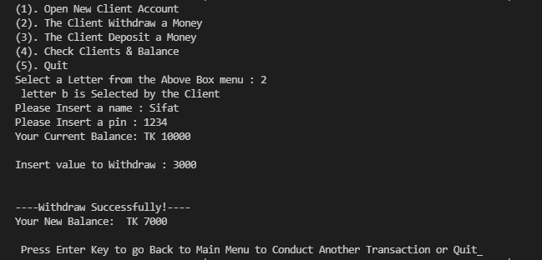
Withdraw Money
‹#›

Slide 9
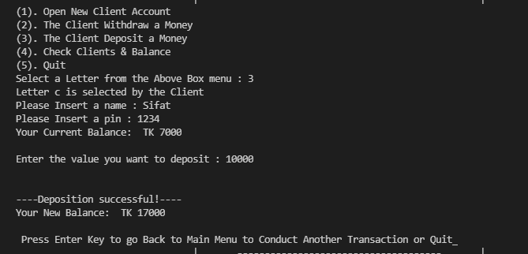
Deposit Money
‹#›

Slide 10
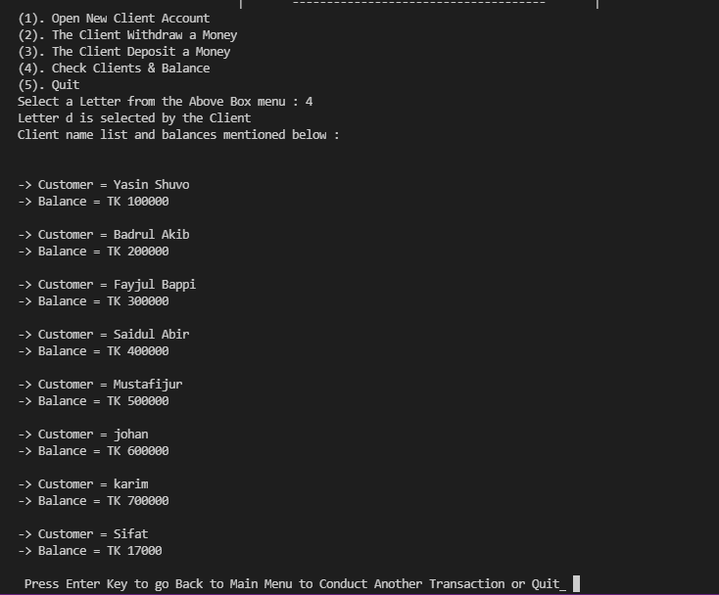
Check Client’s Balance
‹#›

Slide 11
EXIT!!

Slide 12
THANKS!
Any questions?

