Slide 1

Regulated Power Distribution System
Intelligent Active Monitoring and Control
Project Team
Md. Yousuf - Roll: 2310023
Topu kumar Mondol - Roll: 2310003
Anandita Sarkar Arni - Roll: [2310029]
Department of Electrical and Computer Engineering
Rajshahi University of Engineering and Technology (RUET)

Slide 2
What is Our Project?
An intelligent, active power monitoring and distribution system.
Utilizes an STM32 Blue Pill microcontroller as the central processing unit.
Gathers real-time telemetry (voltage and current) via an INA219 I2C sensor.
Dynamically controls a power rail using a low-side IRLZ44N MOSFET based on strict, programmed software thresholds.

Slide 3
The Problem We Are Solving
Hardware Vulnerability: Sensitive electronic components are easily destroyed by sudden over-voltage spikes or under-voltage brownouts.
Dumb Power Supplies: Standard unregulated power sources cannot adapt to dynamic loads or shut themselves down during a fault condition.
Our Solution: A programmable, automated safety fail-safe that monitors bus voltage in real-time and physically cuts the circuit in milliseconds if the power exits the safe operating window.

Slide 4
System Flow Logic
The operational pipeline from raw power to safely controlled output:

Slide 5
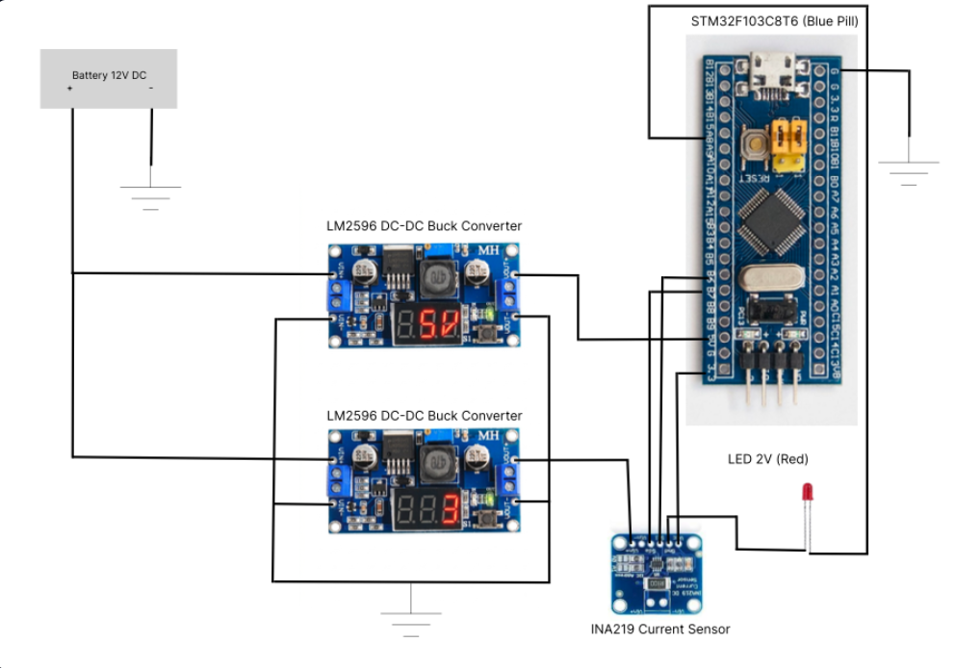
Circuit Design & Hardware Demonstration
The physical routing maps the high-voltage load path independently from the 3.3V logic path.

Slide 6
STM32 Code & Logic Explanation
Initialization: The MOSFET pin (PA8) is forced LOW instantly at boot to prevent floating-pin misfires while the sensor initializes.
The Core Loop:
float loadVoltage = ina219.getBusVoltage_V();
if (loadVoltage >= 3.5 && loadVoltage <= 4.00) {
// Voltage is safe -> Open Gate
digitalWrite(mosfetPin, HIGH);
Serial.println("STATUS: SAFE -> OUTPUT ENABLED");
} else {
// Out of bounds -> Close Gate
digitalWrite(mosfetPin, LOW);
...
}

Slide 7
Where Can We Use It?
Battery Management Systems (BMS): Protecting Li-ion cells from over-discharge or over-charging scenarios.
Industrial Automation: Creating intelligent fail-safes for sensitive automated machinery.
Custom Test Benches: Providing regulated, fault-proof channels for lab testing.
Smart Home Infrastructure: Automated cut-offs for solar or alternative energy storage systems.

Slide 8
CEP Justification (ECE 2100_23S)
This project directly demonstrates core concepts from our curriculum:
Real-time Sensor Data Acquisition: Utilizing the I2C protocol to interface microcontrollers with external digital ADCs.
Power Electronics Integration: Practical application of DC-DC step-down conversion (Buck converters) and low-side switching (N-Channel MOSFETs).
Programmable Logic Control: Translating physical hardware constraints into strict C++ conditional software logic.
Circuit Isolation: Successfully separating a high-power distribution rail from delicate logic-level control circuitry.

Slide 9
Thank You
Questions & Demonstration

