Slide 1
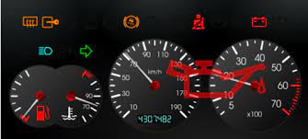
INSTRUMENT CLUSTER
PRESENTED BY,
Ravi Chandran
Rutuja Harpale
Shyam Rajapur
Waseem Khan

Slide 2
Requirement ID | Type | Object Text | Status | Task ID | Review ID | Remarks
 | Heading | Instrument cluster functionality |  | 1
 | Definition | IC is one of the node in CAN bus | Proposed | 1
 | Comments | purpose of IC is to indicate /Inform the vehicle status to driver | Proposed | 1
 |  | CAN tranceiver message has warning lamp request bit from another node | Proposed | 1
IC_0x01 | Requirements | IC ECU will recieve the warning lamp status based on CAN data received from (OCS and CC) | Proposed | 1
IC_0x02 |  | CAN Message format shall be as per CC and OCS requirement. | Proposed | 1
IC_0x03 |  | IC node works normally for 8-16 Volts and maximum current 2 Amps. | Proposed | 1
IC_0x04 |  | IC node will switch on system warning lamp based on message received from (CC, OCS) | Proposed | 1
IC_0x05 |  | If Warning lamp status is received from CC, then hardware warning lamp shall in ON state //to indicate that message receive from CC | Proposed | 1
IC_0x06 |  | If Warning lamp request is not received from CC then hardware warning lamp shall OFF state | Proposed | 1
IC_0x07 |  | If message id (0x75) is transmitted from CC on CAN bus. | Proposed | 1
IC_0x08 |  | The (0x75) message id transmitted by CC that is cruice controller ON/OFF status is Stored in byte1, and display the led status if message status received (LED ON )else led is OFF state | Proposed | 1
IC_0x09 |  | store the received data from CC in EEprom using (EEPROM read) and (EEPROM write) funtion | Proposed | 1
IC_0x10 |  | If Warning lamp status is received from OCS , then hardware warning lamp shall in ON state //to indicate that message receive from OCS | Proposed | 1
IC_0x11 |  | If Warning lamp request is not received from OCS then hardware warning lamp shall be in OFF state | Proposed | 1
IC_0x12 |  | If message id (0x99) is transmitted from OCS on CAN bus.(Air bag status ) | Proposed | 1
IC_0x13 |  | The (0x99) message id transmitted by OCS that is occupant classification system airbag ON/OFF status is Stored in byte3, and display the led status if received (blink led continous for time period )else led is ON state. | Proposed | 1
IC_0x14 |  | store the received data from OCS in EEPROM using (EEPROM read) and (EEPROM write) funtion | Proposed | 1
 | Heading | ON Default staus +Last status |  | 2
IC_0x15 | Definition | ON Default status is to display all the components connected with dashboard | Proposed | 2
IC_0x16 | comments | indicating the components of dashboard to driver | Proposed | 2
IC_0x17 | Requirements | ON default when power supply is ON both CC , OCS status will be displayed on IC . | Proposed | 2

Slide 3
CAN OUTPUT
CAN
INPUT
CANH
CANL
On default status +Last status
INSTRUMENT CUSTER
Cruise Control ECU
Hardware warning lamps status
Occupant Classification ECU
H/W OUTPUT
OCCUPANT CLASSIFICATION
LED
System BLOCK DIAGRAM

Slide 4
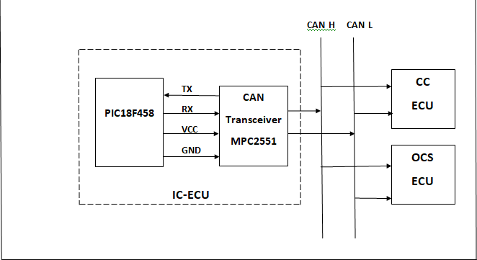
HARDWARE BLOCK DIAGRAM

Slide 5
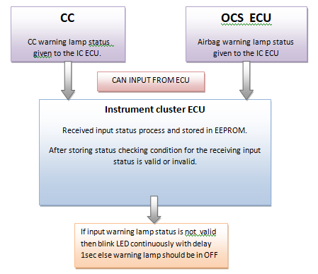
functional BLOCK DIAGRAM

Slide 6
Flow chart of instrument cluster
START
Receiving Message from
Input CC & OCS
IF VALID MESSAGE IS RECEIVED -?
NO
LED WILL BE OFF state
YES
LED WILL BE ON state
STOP

Slide 7
YES
START
INITIALIZING SYS_INIT()
CAN_INIT()
BR_INIT()
MASK_FILTER INIT()
FILTER_INIT()
Valid
Message
Received?
NO
LED should be ON state
LED OFF state
Message
Identifier meets a
Filter Criteria
Is
RXFUL = 0 Move Message into RXB0
STORE THE DATA IN EEPROM
STOP

Slide 8
TC ID | PRE-CONDITION | TC STEPS | EXPECTED OUTPUT | OBTAINED OUTPUT | VERDICT(PASS/FAIL)
IC_01 | 1)Connceting ECU to CAN BUS 2)Connection of LED 3)Connecting Power supply | 1)Checking CAN bus is Connected properly or NOT 2)Checking CC input message status is receiving or NOT 3)If Message received from CC 4)If Message not received from CC 5)In message ID perticular data is received 6)In message ID perticular data is not received 7)Received data is Stored in EEPROM | 1)CAN bus is must be connected 2)Checking message status 3)Warning lamp ON 4)Warning lamp OFF 5)CC is ON(LED ON) 6)CC is OFF(LED OFF) 7)Stored data in EEPROM | 1)CAN bus is connected message status 3)Warning lamp ON 4)Warning lamp OFF 5)CC is ON 6)CC is OFF 7)Stored data in EEPROM | PASS PASS PASS PASS PASS PASS PASS
IC_02 | 1)Connceting ECU to CAN BUS 2)Connection of LED 3)Connecting Power supply | 1)Checking CAN bus is Connected properly or NOT 2)Checking OCS input message status is receiving or NOT 3)If Message received from OCS 4)If Message not received from OCS 5)In message ID perticular data is received 6)In message ID perticular data is not received 7)Received data is Stored in EEPROM | 1)CAN bus is must be connected 2)Checking message status 3)Warning lamp ON 4)Warning lamp OFF 5)Airbag status is ON(LED blink ) 6)Airbag status is OFF(LED ON) 7)Stored data in EEPROM | 1)CAN bus is connected message status 3)Warning lamp ON 4)Warning lamp OFF 5)CC is ON 6)CC is OFF 7)Stored data in EEPROM | PASS PASS PASS PASS PASS PASS PASS
IC_3 | 1)Connceting ECU to CAN BUS 2)Connection of LED 3)Connecting Power supply | 1)Power supply connected | 1)LED should blink 3 times then in OFF state | 1)LED should blinking 3 times then in OFF state | PASS
Test case

Slide 9
THANK YOU

