Slide 1



MASTER’S DEGREE in DATA SCIENCE for MANAGEMENT
Presenters: Muhammad Hassan Ali
Syed Muhammad Zaffar
Academic Year 2020- 2021

Slide 2
DATA SET

Slide 3
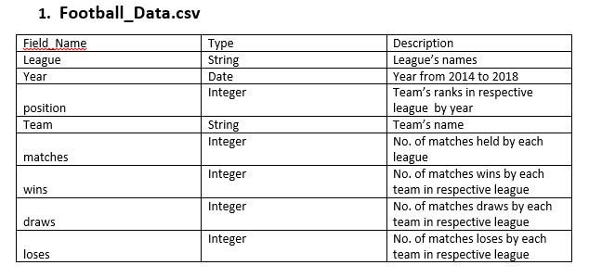
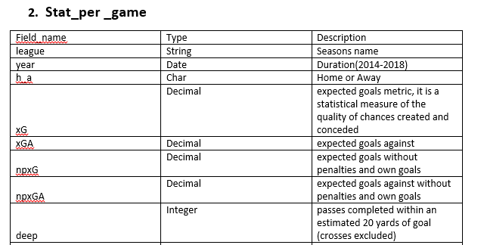
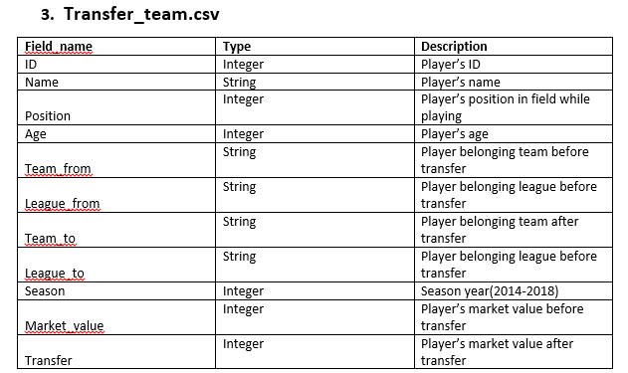
The dataset contains statistical summary of seasonal football matches that played from 2014 to 2018 among five big Leagues of Europe:
La Liga
English Premier League
BundesLiga
Serie A
Ligue 1
From the data source
https://www.kaggle.com/ogrofratesi/football-data , three tables in "csv" format have been selected:
Football_Data.csv (484 record): Contains data about each game.
stats_per_game.csv (1000 record): Contains information for every team match.
Transfer_team.csv (935 record): Contains data with the information about transfers of each team.

Slide 4
Business Questions

Slide 5
Following are the business questions that are proposed according to our data set and to which the report aims to answer them:
Which team won the most league titles in Europe’s top 5 leagues from 2014 to 2018?
Which team won league title with the highest points?
Which team has scored most goals in Europe top 5 leagues since 2014?
Which team has spent most on transfers since 2014?
Which team has earned most from transfers since 2014?
Which team wins most away and home matches?
Which team conceded less yellow and red cards/ Team with fair played award?
Which team conceded most yellow and red cards?
Which team conceded most fouls since 2014?

Slide 6
Dimensional Fact Model DFM

Slide 7
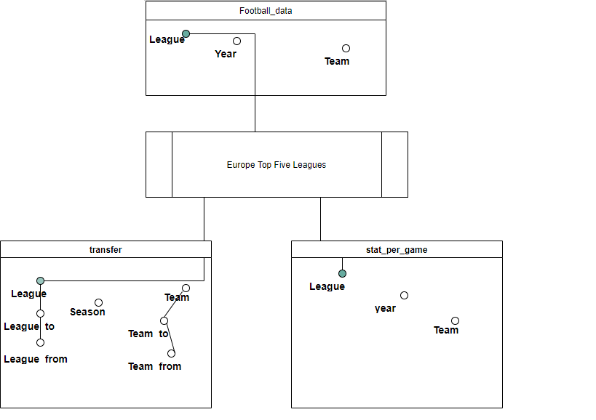
The following attributes have been defined for each hierarchy:
● Transfer_team → Season → year
● Transfer_team → Team → Team_to →Team_from
● Transfer_team → League → League_to → League_from

Slide 8
ETL Process

Slide 9
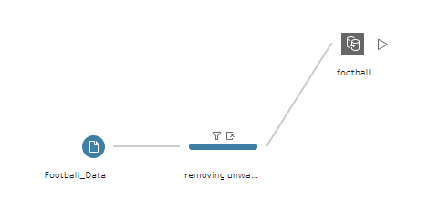

Cleaning
1. Football_Data
2. Stat_per_game

Slide 10
Charts & Dashboards

Slide 11
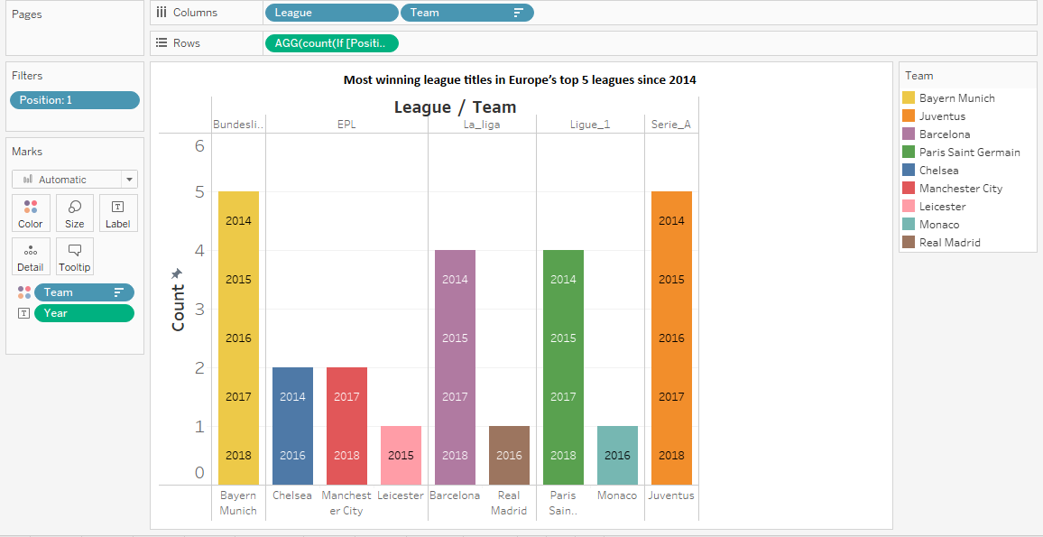
Count(If[Position]=1
then[Team]END)
For each Team broken down by League.
Color shows details about Team.
The marks are labeled by Year. The data is filtered on Position, which keeps 1.

Slide 12
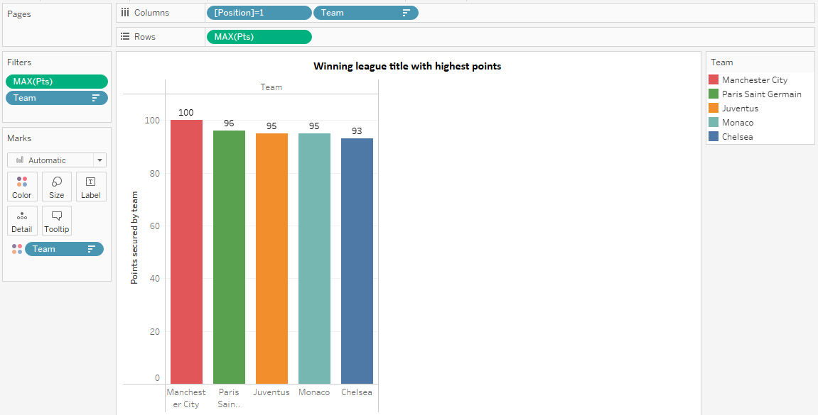
Sum of Scored for each League broken down by Team.
Color shows details about Team.
Details are shown for Team.
The view is filtered on sum of Scored.

Slide 13
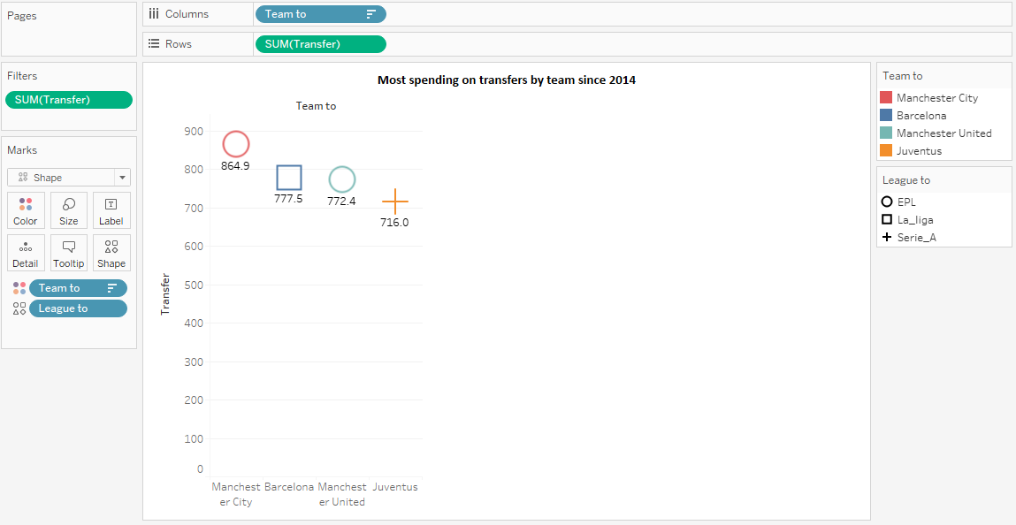
Sum of Transfer for each Team_to.
Color shows details about Team_to.
Shape shows details about League_to. The view is filtered on sum of Transfer.

Slide 14
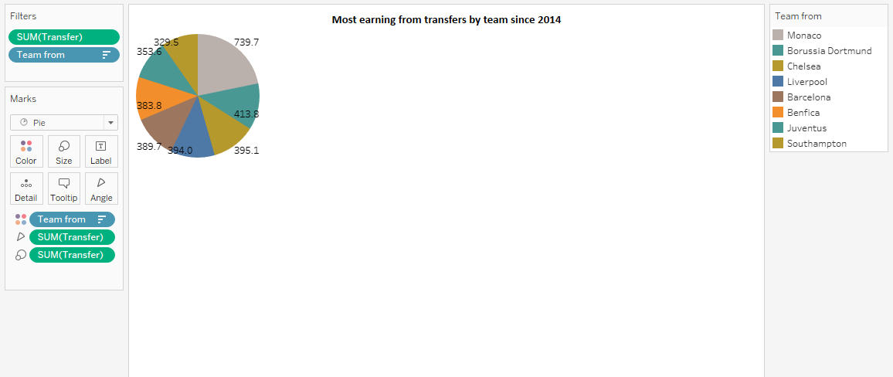
Team_from (color) and sum of Transfer (size).
The view is filtered on sum of Transfer and Team_from.

Slide 15
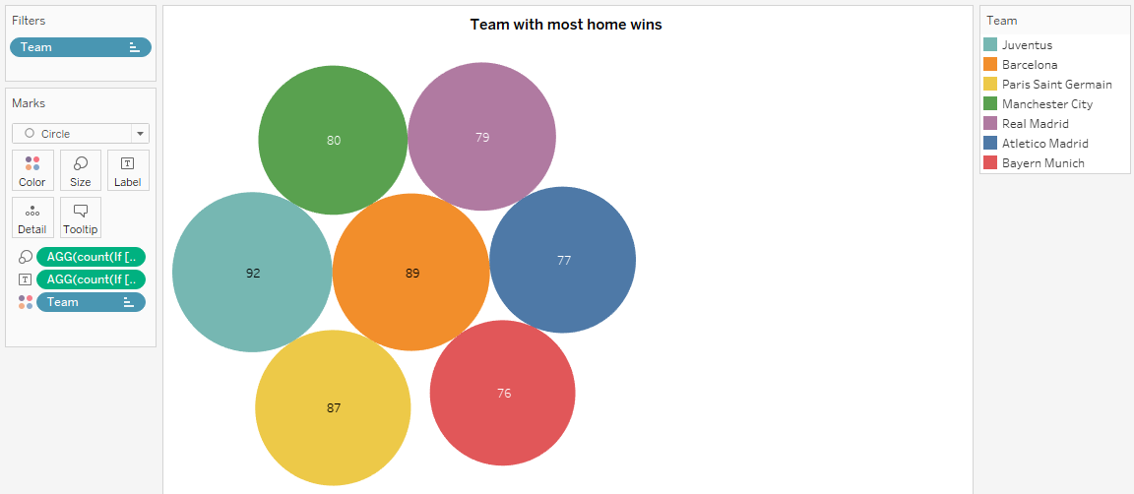
Count(If [Result]='w‘
AND [Home&Away]='h‘
then [Team]END).
The view is filtered on Team, which keeps 7 of 168 members.

Slide 16
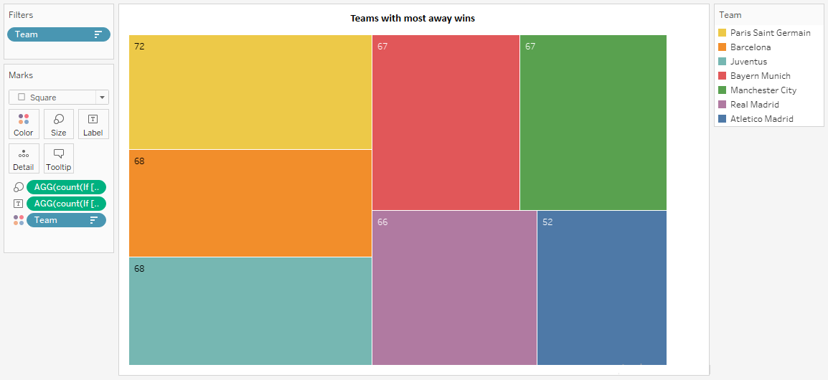
Count(If[Result]='w‘ AND[Home&Away]='a‘ then[Team]END)
The view is filtered on Team, which keeps 7 of 168 members

Slide 17
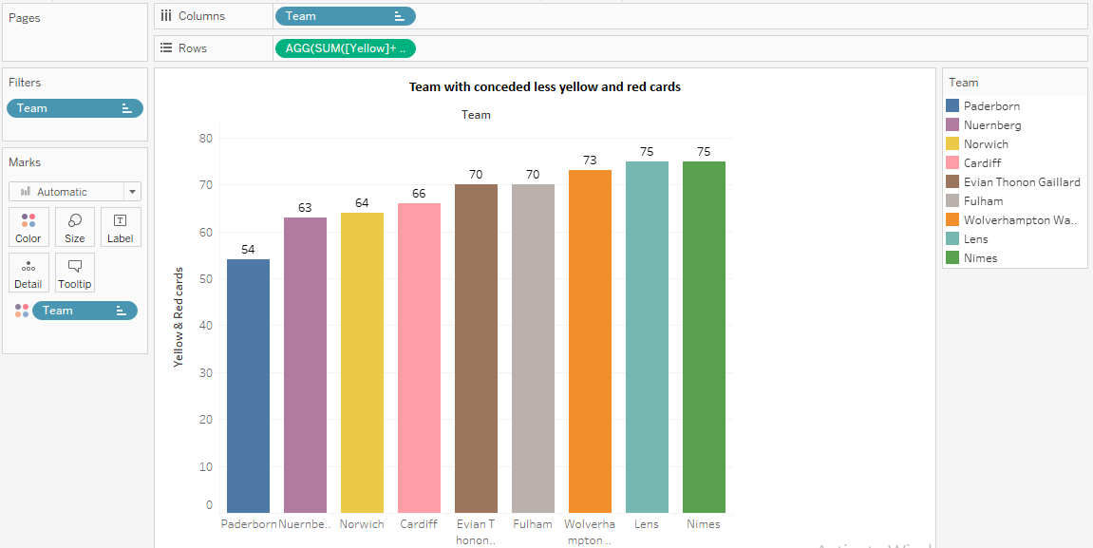
SUM([Yellow]+[Red]) for each Team.
Color shows details about Team.
The view is filtered on Team, which keeps 9 members.

Slide 18
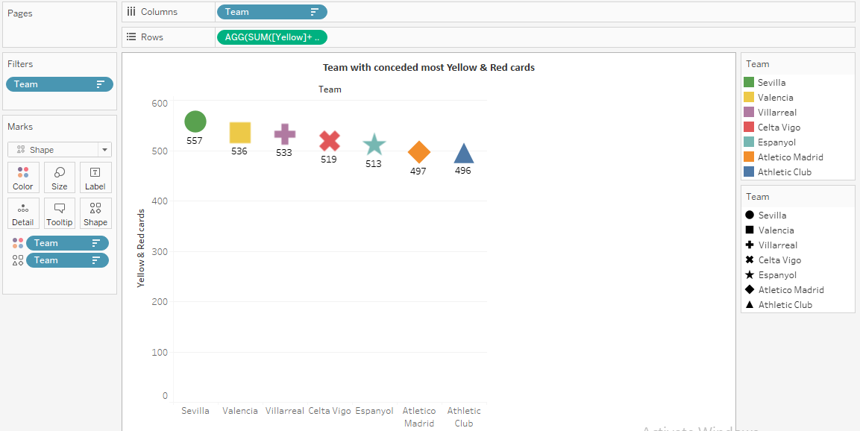
SUM([Yellow]+[Red]) for each Team.
Color shows details about Team.
Shape shows details about Team.
The view is filtered on Team, which keeps 7 members

Slide 19
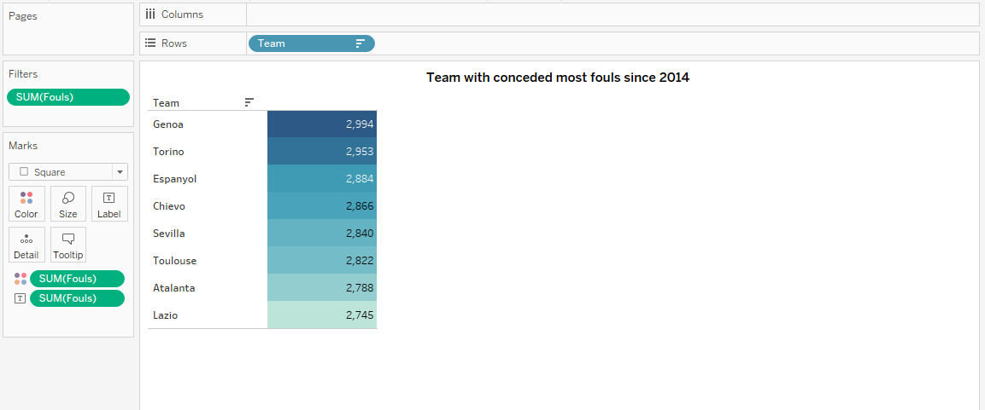
Sum of Fouls broken down by Team.
Color shows sum of Fouls.
The marks are labeled by sum of Fouls.
The view is filtered on sum of Fouls

Slide 20
Final result

Slide 21
After report analysis we concluded that;
Since 2014, both Bayern Munich and Juventus have won the most league titles out of all the teams in Europe's top five leagues.
Since 2014, Manchester United has won the league titles with the most points among all of the Europe's top five leagues.
Between 2014 and 2018, Team Barcelona (la liga league) scored the most goals in the top five Europe’s leagues.
Team Manchester City has spent the most money on transfers through all the seasons since 2014.
Since 2014, Team Monaco has made the most money through transfers across all seasons.

Slide 22
Since 2014, Juventus has won the most home matches in the Europe’s top five leagues.
Since 2014, the team Paris Saint-Germain (PSG) has won the most home matches in Europe’s top five leagues.
Team Paderborn played most fair matches by conceded the less yellow and red cards throughout all the seasons matches since 2014.
Team Sevilla played mostly unfair matches by conceded most yellow and red cards throughout all the seasons matches since 2014.
Since 2014, Genoa has been the team that has conceded the most fouls in all of its matches.

Slide 23
Thank you!

