Slide 1
Splay Trees

Slide 2

What is the purpose of this class?
Data storage
  Speed
Trees
  Binary search tree
    Expected runtime for search is O(logn)
    Could degenerate into a linked list O(n)
  AVL tree
    Operations are guaranteed to be O(logn)
    But must do rotations and maintain balance information in the nodes

Slide 3

Splay Tree
Similar to AVL tree
  Uses rotations to maintain balance
  However, no balance information needs to be stored
    Makes it possible to
    create unbalanced trees
    Splay trees have a self-
    adjusting nature (despite
    not storing balance
    information!)

Slide 4
So what is the runtime?
Search could still be O(n) in the worst case
  Like a binary tree
However, the total time to perform m insert, delete, and search operations is O(mlogn)
  We call this the amortized cost/analysis
  This is not the same as average case analysis
    An adversary could only force bad behavior once in a while
    On average splay tree runtime is O(logn)

Slide 5
Motivation for Splay Trees
Problems with AVL Trees
  extra storage/complexity for height fields
  ugly delete code
Solution: splay trees
  blind adjusting version of AVL trees
  amortized time for all operations is O(log n)
  worst case time is O(n)
  insert/find always rotates node to the root!
Splay Trees
CSE 326 Autumn 2001 <number>

Slide 6
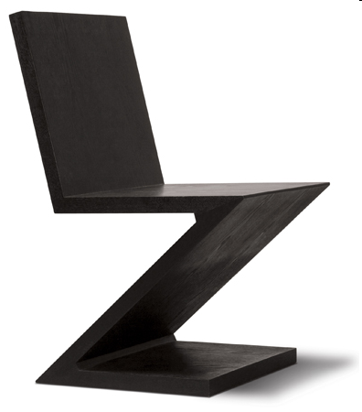
The splay operation
splay(node,Tree): brings node to the root of the tree
  Perform binary search for node
  Then perform one of four possible rotations
    Zig-zag case
    Zig-zig case

Slide 7
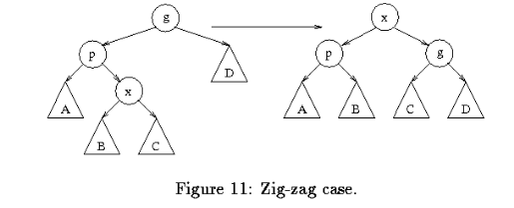
Zig-zag case
If node is the left child of a right child, or
If node is the right child of a left child;
Perform double rotation to bring node up to the top

Slide 8
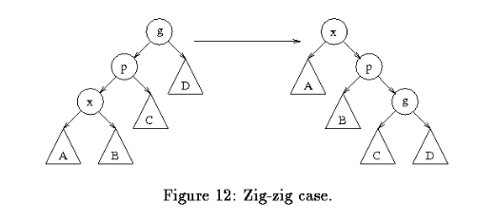
Zig-zig case
Node is the left child of a left child, or
Node is the right child of a right child;
Perform new kind of double rotation

Slide 9
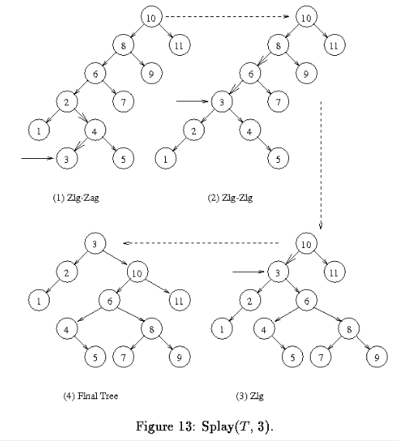
Example
Splay(3,t)

Slide 10
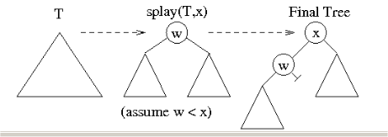
How is splay used?
Search: simply call splay(x,T)
Insert: call to splay(x,T)
  If x is in tree, ERROR
  Else the root is the closest value to x after the splay operation; make x the new root

Slide 11
Splay Operation
4
R
Splay means "spread"
As you search for an item or after you insert an item we will perform a series of splay operations
These operations will cause the desired node to always end up at the top of the tree
  A desirable side-effect is that accessing a key multiple times within a short time window will yield fast searches because it will be near the top
  See next slide on principle of locality
T
If we search for or insert T…
T
R
…T will end up as the root node with the old root in the top level or two

Slide 12








Splay Cases
6
1.
3.
Root/Zig Case (Single Rotation)
Zig-Zig
P
G
X
d
a
P
R
R
X
c
b
G
a
X
X
c
a
b
c
d
b c a b
Leftrotate of X,R Right rotate of X,R
2.
Zig-Zag
2
P
G
X
G
2
P
X
d
1
P
G
a
G
P
1
a
X
a b c
d
X
d
a b c
d
b
c
b
c

Slide 13
Why Splaying Helps
If a node n on the access path is at depth d before the splay, it’s at about depth d/2 after the splay
  Exceptions are the root, the child of the root, and the node splayed
Overall, nodes which are below nodes on the access path tend to move closer to the root
Splaying gets amortized O(log n) performance. (Maybe not now, but soon, and for the rest of the operations.)
Splay Trees
CSE 326 Autumn 2001 <number>
Notes:
We decided that splaying a node to the root of a search tree would help because we’d do a lot of fixing up if we had an expensive access.
That means we have to fix up the tree on every expensive access.

Slide 14
Splay Operations: Find
Find the node in normal BST manner
Splay the node to the root
Splay Trees
CSE 326 Autumn 2001 <number>
Notes:
So, on find we just splay the sought-after node to the root.

Slide 15
Find(1)
7
6
6
Zig
6
5
7
5
7
1
7
4
4
Zig-Zig
4
3
1
2
5
2
Zig-Zig
2
3
1
3
1
6
Resulting
Tree
4
7
2
5
3

Slide 16
Find(3)
8
1
1
3
6
Zig-Zag
6
1
6
4
7
3
7
2
4
7
2
5
2
4
5
3
Zig-Zag
5
Resulting Tree
Notice the tree is starting to look at lot more balanced

Slide 17
Worst Case
9
Suppose you want to make the amortized time (averaged time over multiple calls to find/insert/remove) look bad, you might try to always access the node in the tree
– Deepest
But splay trees have a property that as we keep accessing deep nodes the tree starts to balance and thus access to deep nodes start by costing O(n) but soon start costing O(log n)

Slide 18
Splay Operations: Insert
Ideas?
Can we just do BST insert?
NO. Because then we could do an expensive operation without fixing up the tree.
Splay Trees
CSE 326 Autumn 2001 <number>
Notes:
What about insert?
Ideas?
Can we just do BST insert?
NO. Because then we could do an expensive operation without fixing up the tree.

Slide 19
Back to Insert
x
split(x)
L
R
L
R
< x
> x
void insert(Node *& root, Object x)
{
Node * left, * right;
split(root, left, right, x);
root = new Node(x, left, right);
}
Splay Trees
CSE 326 Autumn 2001 <number>
Notes:
Now, If we can split on x and produce one subtree smaller and one larger than x, insert is easy!
Just split on x.
Then, hang the left (smaller) subtree on the left of x.
Hang the right (larger) subtree on the right of x.
Pretty simple, huh?
Are we fixing up deep paths?

Slide 20
Insert(11)
10
20
20
20
12
30
12
30
12
30
5
15
25
5
15
25
11
15
25
3
10
3
10
10
8
8
11
5
3
8
Zig-Zig
Zig-Zig
11
10
12
5
20
3 8
Resulting Tree
15
30
25

Slide 21
Insert(4)
11
20
20
20
12
30
12
30
12
30
5
15
25
5
15
25
4
15
25
3
10
3
10
3
5
8
4
8
10
8
Zig-Zig
Zig-Zag
4
3
12
5
20
10
15
30
Resulting Tree
8
25

Slide 22
Insert Example
4
4
6
6
split(5)
1
6
1
9
1
9
2
9
2
7
4
7
7
2
5
4
6
Insert(5)
1
9
Splay Trees
CSE 326 Autumn 2001 <number>
2
7

Slide 23
Splay Tree Supported Operations
13
Insert(x)
  Normal BST insert, then splay x
Find(x)
  Attempt normal BST find(x) and splay last node visited
    If x is in the tree, then we splay x
    If x is not in the tree we splay the leaf node where our search ended
FindMin(), FindMax()
  Walk to far left or right of tree, return that node's value and then splay that
node
DeleteMin(), DeleteMax()
  Perform FindMin(), FindMax() [which splays the min/max to the root] then delete that node and set root to be the non-NULL child of the min/max
Remove(x)
  Find(x) splaying it to the top, then overwrite its value with is successor/predecessor, deleting the successor/predecessor node

Slide 24
FindMin() / DeleteMin()
14
FindMin()
3
20 20
20
3
12
30 30
5
30
5
15
25
5 25
12
25
3
10
12
10
15
10
15
8
8
8
Zig-Zig
Zig
Resulting Tree
DeleteMin()
3
20
20
5
30
5
30
12
25
12
25
10
15
10
15
8
8
Resulting Tree

Slide 25
Digression: Splitting
Split(T, x) creates two BSTs L and R:
  all elements of T are in either L or R (T = L ∪ R)
  all elements in L are ≤ x
  all elements in R are ≥ x
  L and R share no elements (L ∩ R = ∅)
Splay Trees
CSE 326 Autumn 2001 <number>
Notes:
OK, let’s talk about something completely unrelated before we hit insertion.
Splitting a tree just does what you might expect.
Make two trees, one has everything <= x, one has everything >= x.

Slide 26
Splitting in Splay Trees
How can we split?
  We have the splay operation.
  We can find x or the parent of where x should be.
  We can splay it to the root.
  Now, what’s true about the left subtree of the root?
  And the right?
Splay Trees
CSE 326 Autumn 2001 <number>
Notes:
How can we implement this?
We can splay.
We can find x or where x ought to be.
We can splay that spot to the root.
Now, what do we have?
The left subtree is all <= x
The right is all >= x

Slide 27
Split
split(x)
T
splay
L
R
OR
L
R
L
R
  ≤ x
> x
< x
  ≥ x
Splay Trees
CSE 326 Autumn 2001 <number>
Notes:
So, a split just splays x’s spot to the root then hacks off one subtree.

Slide 28
Splay Operations: Delete
x
find(x)
delete x
L
R
L
R
< x
> x
Now what?
Splay Trees
CSE 326 Autumn 2001 <number>
Notes:
OK, we’ll do something similar for delete.
We know x is in the tree.
Find it and bring it to the root.
Remove it.
Now, we have two split subtrees.
How do we put them back together?

Slide 29
Join
Join(L, R): given two trees such that L < R, merge them
Splay on the maximum element in L, then attach R
L
L
R
splay
R
Splay Trees
CSE 326 Autumn 2001 <number>
Notes:
The join operation puts two subtrees together as long as one has smaller keys to begin with.
First, splay the max element of L to the root.
Now, that’s gauranteed to have no right child, right?
Just snap R onto that NULL right side of the max.

Slide 30
Delete Completed
x
T
find(x)
delete x
L
R
L
R
< x
> x
Join(L,R)
T - x
Splay Trees
CSE 326 Autumn 2001 <number>
Notes:
So, we just join the two subtrees for delete.

Slide 31
Delete Example
4
6
6
1
6
1
9
1
9
find(4)
2
9
2
7
4
7
Find max
7
2
2
2
1
6
1
6
Delete(4)
9
9
Splay Trees
7
7
CSE 326 Autumn 2001 <number>

Slide 32
Remove(3)
15
1
1
3
6
Zig-Zag
6
1
6
4
7
3
7
2
4
7
2
5
2
4
5
3
Zig-Zag
5
3
4
1
6
1
6
Resulting Tree
2
4
7
2
5
7
5
Copy successor or predecessor to root
Delete successor (Remove node or reattach single child)

Slide 33
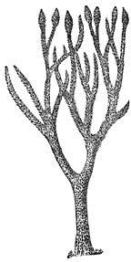
Top Down Splaying
16
Rather than walking down the tree to first find the value then splaying back up, we can splay on the way down
We will be "pruning" the big tree into two smaller trees as we walk, cutting off the unused pathways

Slide 34





Top-Down Splaying
17
1.
Zig (If Target is in 2nd level)
T
Root
T
a
b
R
L
a
R
L
Root
b
2.
Final Step (when reach Target)
T
a b
T
L
R
L
R
a b

Slide 35





Top-Down Splaying
18
3.
Zig-Zig
Z
c
X
Z
a
X
R
L
Y
c
a
Y
Y
L
R
Y
X
R
L
Z
a
R
L
Z
c
b
b
X
b c
a b
4.
Zig-Zag
X
X
Z
b
Z
b
Y
c
a
Y
L
R
L
R
L
Z
b
R
L
Z
b
R
a
c
Y
X
X
Y
a
c
a
c

Slide 36
Find(3)
19
L-Tree
R-Tree
L-Tree
1
R-Tree
6
L-Tree
1
R-Tree
6
-
1
-
4
3
Steps taken on our journey to find 3
6
2 5
7
2
4
7
4
7
3
5
2
5
3
Zig-Zag
X
X
Z
b
Z
b
a
Y
Y
c
L
R
L
R
L
Z
b
R
L
Z
b
R
c
a
X
Y
Y
X
a
c
a
c

Slide 37


Find(3)
20
L-Tree
1
R-Tree
3
3
3
6
1
6
1
6
2
4
7
2 4
7
2
4
7
5
5
Resulting tree after find
5
Resulting tree from bottom-up approach
2.
Final Step (when reach Target)
T
a b
T
L
R
L
R
a b

Slide 38
Insert(11)
21
L-Tree
R-Tree
L-Tree
R-Tree
12
-
-
-
5
20
30
3
10
20
12
8
15
30
5
15
25
3
10
25
8
L-Tree
R-Tree
12
10
11
11
5
20
10
12
3
8
15
30
5
20
3 8
Original Resulting Tree from Bottom- up approach
15
30
25
25

Slide 39
Summary
22
Splay trees don't enforce balance but are self- adjusting to attempt yield a balanced tree
Splay trees provide efficient amortized time operations
  A single operation may take O(n)
  m operations on tree with n elements => O(m(log n))
Uses rotations to attempt balance
Provides fast access to recently used keys

