Slide 1
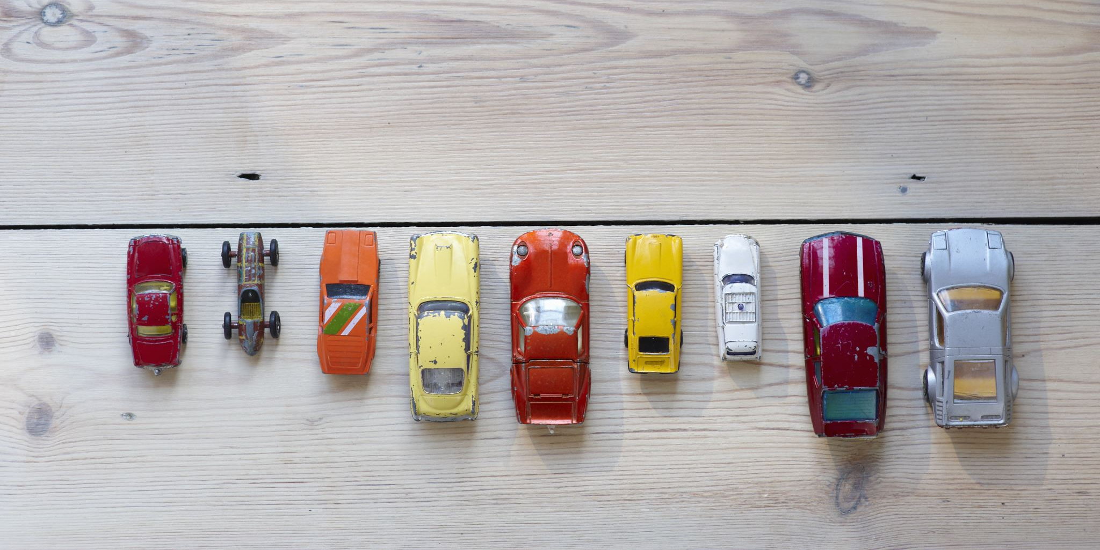

Project Title: CarDekho Used Car Price Prediction

Slide 2
Problem Statement
The primary objective of this project is to create a data science solution for predicting used car prices accurately by analyzing a diverse dataset including car model, no. of owners, age, mileage, fuel type, kilometers driven, features and location. The aim is to build a machine learning model that offers users to find current valuations for used cars.

Slide 3
Tools Used
Data Cleansing and preprocessing
Exploratory Data Analysis
Bivariate analysis
Scikit learn

Slide 4
Approach
Merge the different datasets into a single dataset.
1
Extract different features from the dataset
2
Convert the data into suitable datatype
3
Handle missing values and outliers
4
Perform EDA
5
Build ML model to predict selling price of car
6

Slide 5

EDA insights
Diesel car has highest selling price and LPG has lowest price
If Year of Model of Car(age) is too old, then its selling price is also low and price increases as age decreases
Number of previous owner has significant impact on price of car to be sold
BMW, Kia, Jeep and Mercedes-Benz has higher price than other Brands
Mahindra Renault, Opel and Mitsubishi are very cheaper than other Brands

Slide 6

ML model performance
Linear Regression
Mean Squared Error (MSE) : 18683006096.390682 , Root Mean Square Error (RMSE): 136685.79332319318 , R2 Score : 0.5908029138644408
Decision Tree Regression
Mean Squared Error (MSE) : 13741548378.11481 , Root Mean Square Error (RMSE): 117224.35061929245 , R2 Score : 0.7926773224539788
Random Forest Regression
Mean Squared Error (MSE) : 7345978445.997672 Root Mean Square Error (RMSE): 85708.68360905838 , R2 Score : 0.8702017227962033

Slide 7

ML model performance
Random Forest Regression with Hyper parameter tuning (GridSearch CV)
Best Hyperparameters: {'max_depth': None, 'min_samples_leaf': 1, 'min_samples_split': 5, 'n_estimators': 30}
Mean Squared Error on Test Set: 7412299733.74
Root Mean Squared Error on Test Set: 86094.71
R2 SCore: 0.8689462927010054

Slide 8
Conclusion
We gained insights from the dataset by performing data cleaning, processing and visualization and built a model to predict selling price of car

