Slide 1


Movie Statistics
NAME : MOHAMMED AASIF
ROLL NO :RK21UTB51
REG NO :12108310
SECTION :K21UT
COURSE NAME : INT 353 (EDA PROJECT )

Slide 2
introduction
Welcome to an exciting journey into the heart of the film industry! Today, we embark on a thrilling exploration of the Movie Dataset, unraveling the intricate threads that weave together to define the success of a movie. In a world where cinematic landscapes are constantly evolving, understanding the key factors that contribute to a film's triumph is more crucial than ever.
The Movie Dataset we present is a comprehensive collection of film-related information, encompassing diverse genres, time periods, and production scales. This dataset acts as a treasure trove of insights, allowing us to dissect the anatomy of success in the film industry. From box office numbers and critical reviews to audience reactions and production budgets, we aim to decode the complex tapestry that determines a movie's triumph.
As we delve into the data, we will uncover patterns, trends, and correlations that shed light on what makes a movie resonate with audiences and stand the test of time. Whether you're a filmmaker, industry enthusiast, or simply curious about the magic behind blockbuster hits, this presentation promises to provide valuable insights into the fascinating world of movie success.

Slide 3
ABOUT THE PROJECT
Objectives of Movie Statistics Project:
Box Office Analysis: Explore and analyze the box office performance of movies in the dataset. Identify trends in box office revenue based on genres, release dates, and production budgets.
Genre Trends: Identify popular and emerging genres over different time periods. Analyze the success factors associated with specific genres.
Budget vs. Revenue: Examine the relationship between production budgets and box office revenue. Identify the budget range that maximizes return on investment.
Directorial Impact: Analyze the impact of directors on the success of a movie. Identify directors with consistent success and patterns in their filmmaking styles.

Slide 4
ABOUT THE PROJECT
DOMAIN KNOWLEDGE
Movie titles serve as unique identifiers, contributing to the initial impression on audiences. Production dates allow for the exploration of cinematic trends over time, unveiling shifts in genres and audience preferences. Genres categorize films into distinct styles, influencing production and marketing strategies. The runtime of a movie is a crucial factor, impacting viewer engagement and exhibition logistics. Directors play a pivotal role, with their reputation and style influencing audience expectations. The director's primary profession further delineates their creative contribution. Birth and death years provide historical context, while audience feedback, measured through average ratings and the number of votes, gauges a movie's reception. The Approval Index offers a normalized measure of popularity, balancing critical acclaim and broad audience appeal. Financial metrics, including production budget, domestic gross, and worldwide gross, are vital for evaluating a movie's commercial success. The interplay of these factors forms a comprehensive understanding of the intricate dynamics shaping movie success in the film industry.

Slide 5
ABOUT THE PROJECT
WHY YOU CHOOSE THIS DATASET ?
Diversity of Attributes: Encompasses a wide range of movie-related details, financial metrics, and audience indicators.
Relevance to Industry: Pertains to the dynamic and significant entertainment industry, offering insights into trends and success factors.
Real-world Application: Provides practical applications for marketing strategies, production decisions, and understanding audience preferences.
Availability and Size: A sufficiently large dataset enhances the accuracy of analyses and machine learning models.

Slide 6
STEPS OF EDA
1. Data Import:
- Purpose: Data import involves bringing the raw movie data into your analysis environment (e.g., Python, R). This data can be collected from various datasets.
2. Data Preprocessing:
- Purpose: Data preprocessing is the process of cleaning and organizing the raw data to make it suitable for analysis. It ensures that the data is consistent, complete, and in the right format.
3. Data Manipulation:
- Purpose: Data manipulation involves transforming and structuring the data to extract meaningful insights. It often

Slide 7
STEPS OF EDA
includes aggregating, merging, or reshaping the data.
4. Data Visualization:
- Purpose: Data visualization is a critical step to gain insights from the data and communicate those insights effectively to stakeholders.
Univariate Analysis
The univariate analysis of each column provides a foundational understanding of the dataset, enabling the identification of trends, patterns, and potential areas of interest for further exploration in the movie statistics project EDA.
Bivariate Analysis
Bivariate analysis provides deeper insights into relationships between pairs of variables, contributing to a more

Slide 8
STEPS OF EDA
comprehensive understanding of the dynamics within the cuisine reviews dataset. By examining these relationships, you can uncover patterns and trends that may inform further analyses or business decisions. In bivariate analysis for a movie statistics project, various visualization techniques can be employed to explore relationships between pairs of variables
Multivariate Analysis
Multivariate analysis provides a holistic view of interactions and correlations among multiple variables in the movie statistic dataset. By employing these techniques, you can uncover complex patterns and relationships, leading to a more nuanced understanding of the factors influencing customer reviews.
DISTRIBUTIONS
- PCA helps visualize relationships between multiple numerical variables by projecting them onto a lower-dimensional space.

Slide 9
STEPS OF EDA
- Parallel Coordinates Plot allows for the simultaneous comparison of multiple numerical variables across different cuisines.
- Pair Plot with Hue extends the traditional pair plot to include the variable as a hue, facilitating a multivariate exploration of relationships.
Hypothesis Testing
To conduct hypothesis tests in an EDA for movie statistics, specific hypotheses need to be formulated based on the questions or objectives of your analysis. Hypothesis tests help you assess whether certain assumptions or claims about the data are supported by evidence

Slide 10
dAta collection
Data collection is a crucial step in any project involving Exploratory Data Analysis (EDA), including a movie statistics project. Collecting relevant and high-quality data is essential to ensure the success and reliability of your analysis.
Data Source Selection
Data Access
Data Sampling
Data Cleaning
Feature Selection
Data Integration
Data Preprocessing

Slide 11
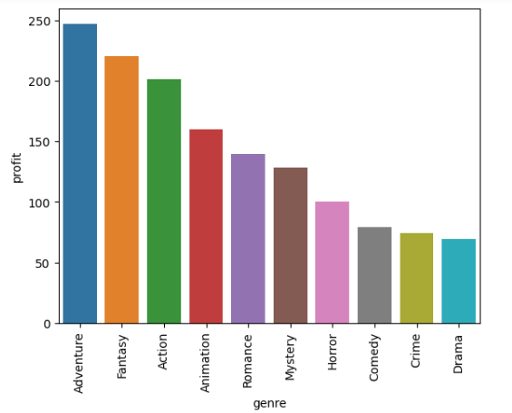
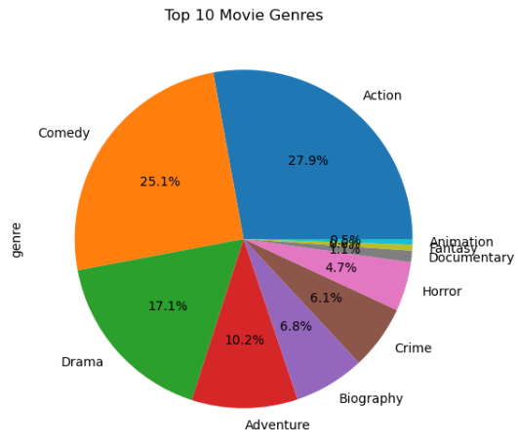
dAta analysis

Slide 12
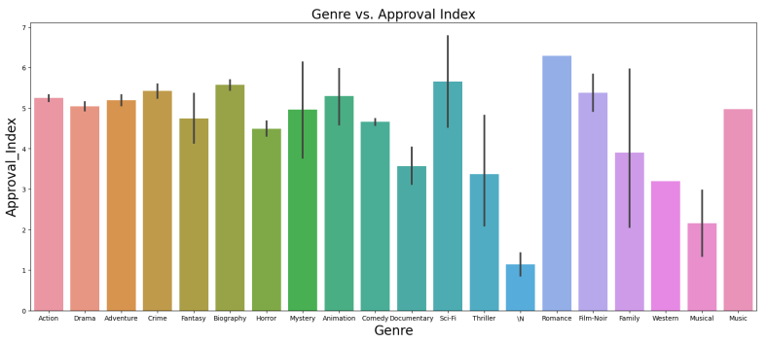
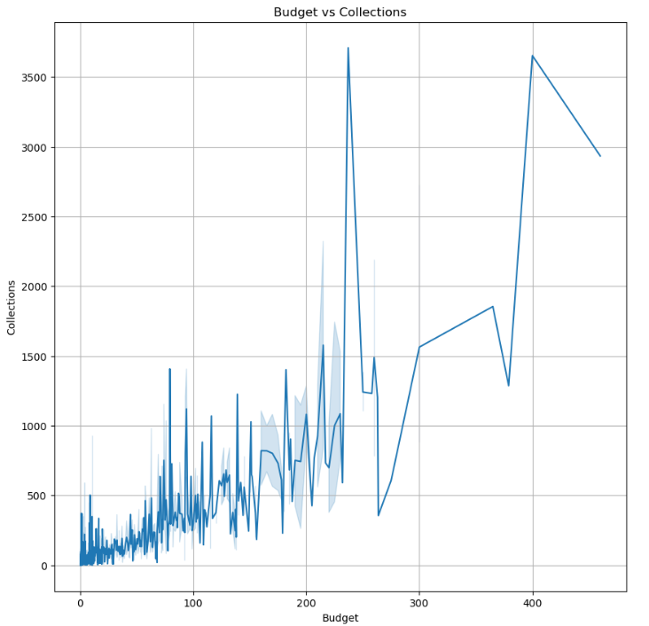
dAta analysis

Slide 13
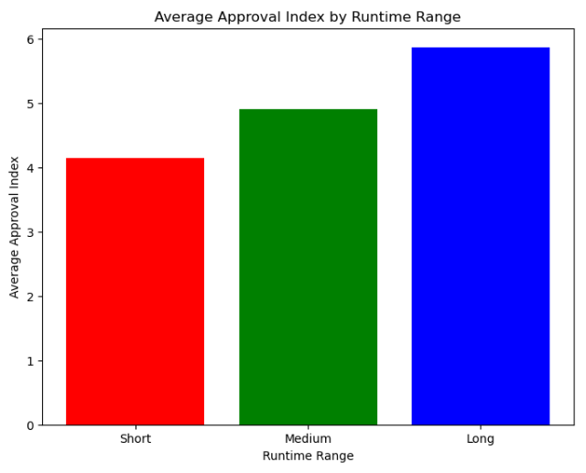
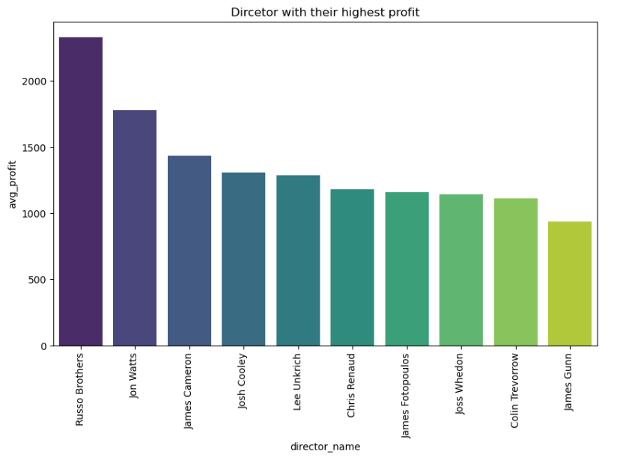
dAta analysis

Slide 14
insights
In this dataset, several interesting insights have been uncovered. First, it was found that the most common movie genres are Action, Comedy, Drama, and Adventure, indicating their popularity among filmmakers. Second, genres such as Film-Noir, Music, Biography, Romance, and Crime tend to have the highest average ratings, suggesting that movies in these genres are generally well received by viewers. Additionally, genres like Biography, Crime, Drama, Mystery, and Action have longer average runtimes compared to others.
When it comes to financial performance, it was discovered that approximately 72% of the movies in the dataset show profits, while the remaining 28% show losses. the success of a movie cannot be determined solely by its profits or average rating. Some movies may have high profits but low ratings, while others may have high ratings but low profits. To accurately measure a movie's success rate, both high profits and high ratings need to be taken into consideration. The Adventure genre stands out as the most profitable, followed by Fantasy, Action, and Animation genres.
Directors such as Steve Kopera, Tim Martin Crouse, and Kiran Natki have received the highest ratings for their movies, reflecting their success in delivering well-received films. Furthermore, genres like Biography, Crime, Drama, and Documentary have the highest success rates based on ratings.

Slide 15
insights
Interestingly, there is a strong correlation between the number of votes a movie receives and its approval index, implying that movies with more votes tend to have higher approval ratings. However, only a small percentage (7.49%) of movies in the dataset have an approval index above 7, indicating that achieving high approval is relatively rare.
When it comes to movie runtime, it was observed that longer movies tend to have higher approval indices, suggesting that viewers appreciate longer films. Additionally, higher movie ratings correlate with higher box office collections, indicating that well-rated movies tend to perform better financially. Finally, the dataset includes the top 10 highest-grossing movies of all time, including titles like "Avatar," "Avengers: Endgame," "Titanic," and "Spiderman: No Way Home.“
In terms of temporal trends, the average runtime of movies has decreased over the years, with older movies generally having longer runtimes than more recent ones. Interestingly, there is a weak correlation between runtimes and budgets, indicating that the length of a movie does not strongly dictate its production budget. Finally, directors in the dataset often have primary professions beyond directing, including producing, acting, cinematography etc.

Slide 16
Limitations and recommendations
Limitations
Sampling Bias:
The dataset might be biased towards certain genres, directors, or time periods, leading to an incomplete representation of the diversity in the film industry.
Data Completeness:
Missing values in any of the columns can limit the comprehensiveness of the dataset. For example, incomplete data on director birth or death years might affect analyses involving director-related trends.
Quality of User Ratings:
The movie ratings and number of votes are based on user-generated content, which may be subject to manipulation or biased opinions. Ratings might not accurately reflect the true quality of a movie.

Slide 17
Limitations and recommendations
Genre-Specific Strategies:
Identify the most successful genres in terms of approval index, average rating, and revenue. Consider developing or investing in movies within those genres. Similarly, evaluate underperforming genres to understand potential areas for improvement or niche opportunities.
Director Collaboration:
Collaborate with directors who consistently produce successful movies. Consider the primary professions of directors to understand if specific backgrounds contribute to higher success rates. This information can be valuable for strategic partnerships.
Budget Optimization:
Analyze the relationship between production budgets and revenue. Identify budget ranges that maximize profitability. This information can guide budget allocation for future movie productions.

Slide 18
conclusion
Key Takeaways from Movie statistics EDA
Viewers and movie enthusiasts can identify the most common movie genres and genres with the highest average ratings. This knowledge can help them choose movies that align with their preferences and expectations.
Aspiring filmmakers and film enthusiasts can identify directors who have received high ratings for their work. This may influence their choices when selecting movies to watch or filmmakers to follow.
The strong correlation between the number of votes and the approval index highlights the importance of viewer engagement in determining a movie's success and popularity.
The insights into the relationship between runtime, budget, and box office revenue can inform discussions about resource allocation and production decisions.

Slide 19
thank you

