Slide 1
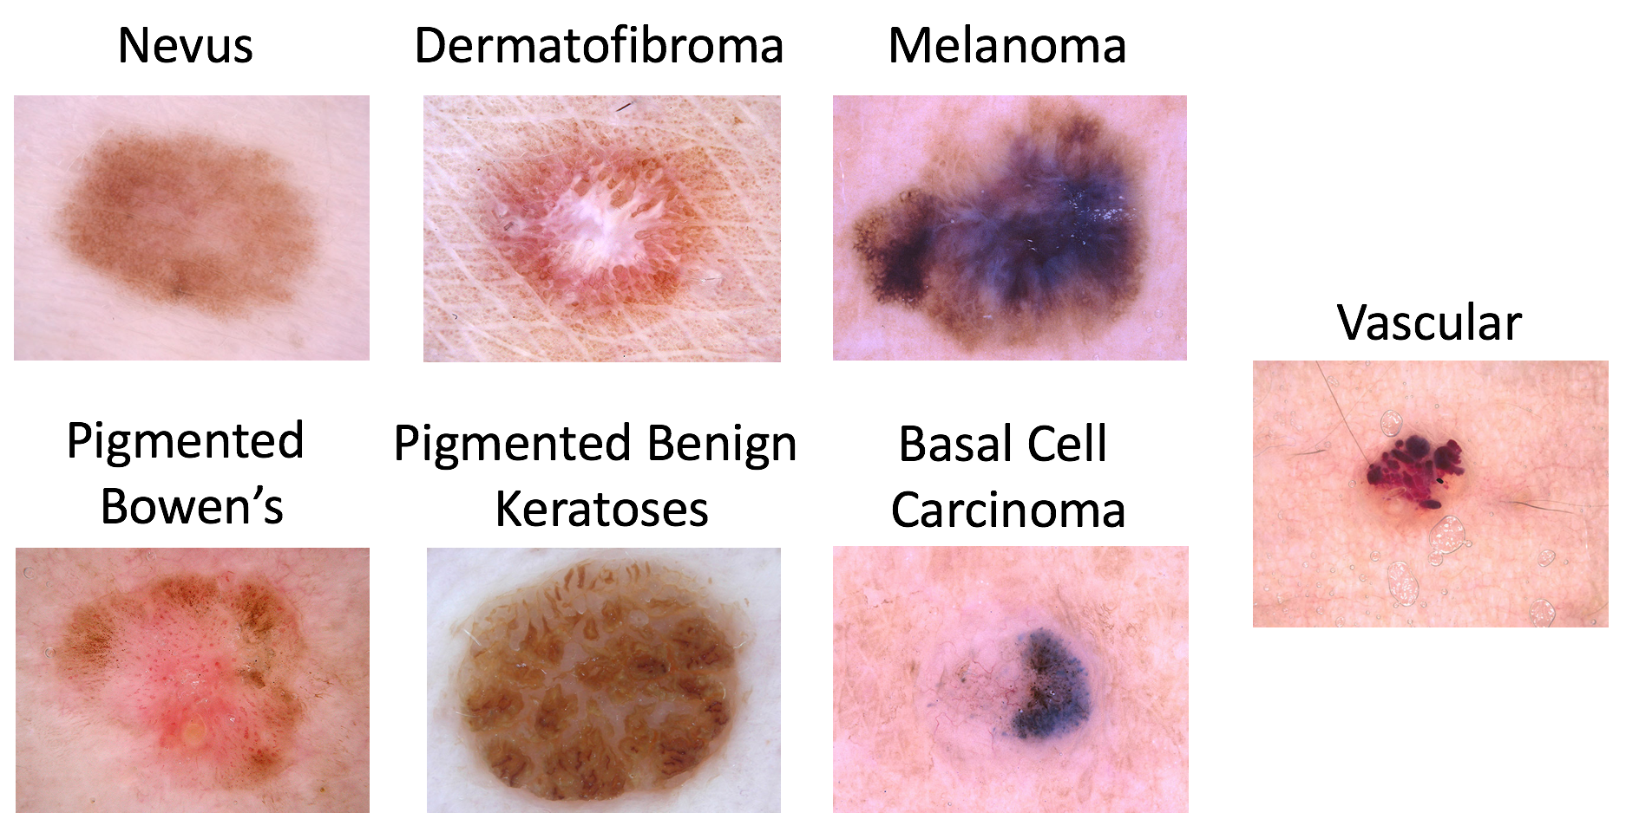
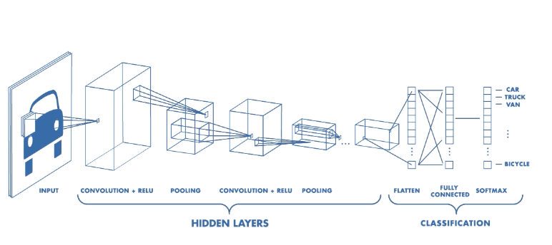
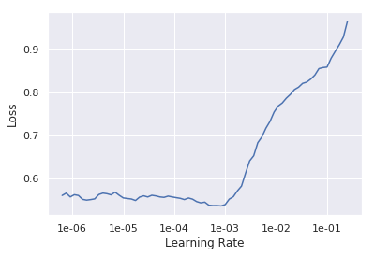
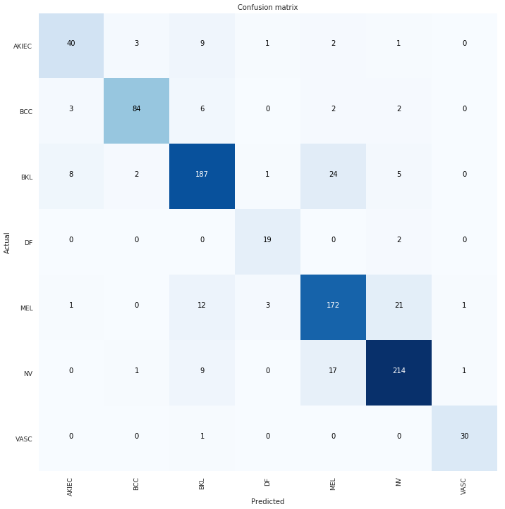
Melanoma Detection Using Deep Learning –
Disease Classification
Luis Estuardo Rivera-Wong
Supervisors: Professor Parvin Mousavi & Professor Neil Glossop
School of Computing, Queen’s University, Kingston, ON, CA, K7L 3N6
1. Introduction
Melanoma is a type of cancer that begins in melanocytes (cells that make the pigment melanin).
High survival rate if caught early.
Although, most patients and general practitioners are not sufficiently trained to be able to distinguish melanomas from benign skin lesions
The objective of this study is to use deep learning as a tool to aid in the differentiation between melanomas and other types of skin lesions. (Figure 1)
2. Methodology
Preprocessing:
Configured dataset to conform to ImageNet format
Used undersampling to address heavily unbalanced dataset. (Figure 2)
Data Modelling:
Used a CNN (Convolutional Neural Network) to classify the images. (Figure 3)
Used ResNet-34 & 50 as a base model for transfer learning. Transfer learning is a technique where you use a model trained on a very large dataset (ex. ImageNet) and then adapt it to your own dataset.
Selection of the learning rate was done experimentally. (Figure 4)
Warning Signs: The ABCDEs of Melanoma
Asymmetry
Border that is irregular
Color that is uneven
Diameter: There is a change in size, usually an increase.
Evolving: The mole has changed over the past few weeks or months.
Figure 3. CNN Architecture
Figure 1. The 7 classifications investigated in this study.
Figure 2. Imbalanced dataset
3. Results
The imbalance in the original dataset played a large role in the correctness of the end product.
The neural network was trained 16 times as the training loss and validation loss were starting to equalize. (Figure 5)
The input dataset was divided into an 80:20 split for training and validation.
The best results were achieved when the dataset was augmented with transformations such as rotation and brightness adjustment.
The best performance metrics of the network were:
Accuracy = 83.5%
Recall (Micro) = 82.5%
The confusion matrix of the final network is shown in Figure 6.
Figure 5. Training Loss vs. Validation Loss over different number of epochs.
Figure 4. Loss vs. Learning Rate. Experimentally finding the best learning rate.
4. Conclusion
Certain diseases are more likely to be misclassified due to their similar characteristics.
A further exploration of this study would be to make use of patient data in conjunction with image data for a more robust diagnosis system.
Figure 6. Confusion Matrix
Sources
Figure 1 – https://challenge2018.isic-archive.com/task3/
Figure 3 – https://www.mathworks.com/videos/introduction-to-deep-learning-what-are-convolutional-neural-networks--1489512765771.html

