Slide 1
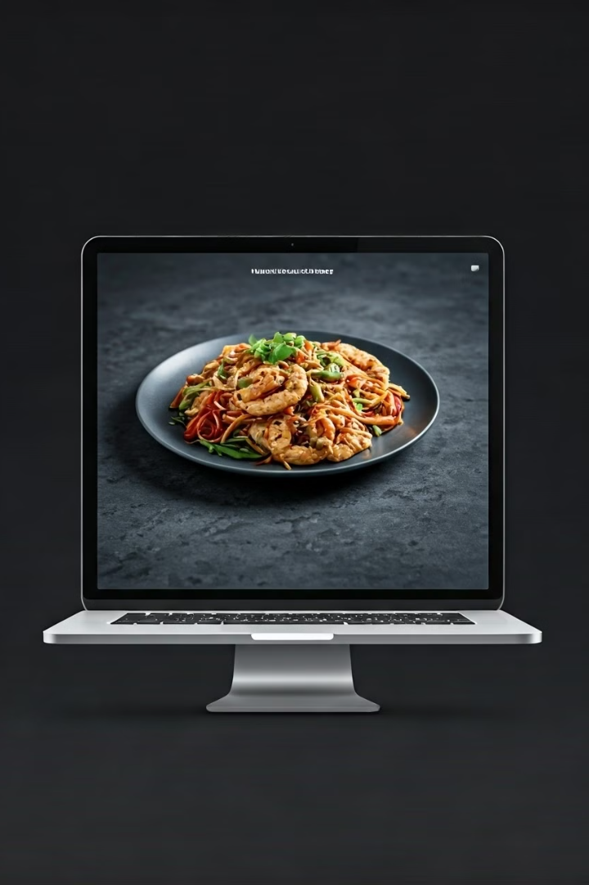
Bring Food
E-commerce Website
Bring Food, an e-commerce website designed to revolutionize the food delivery experience. The project aimed to create a platform that prioritizes user satisfaction by offering a wide selection of fresh food, fast and reliable delivery, and a user-friendly interface.
Md Kawsar
Daffodil Institute of IT
Computer science & engineering

Slide 2
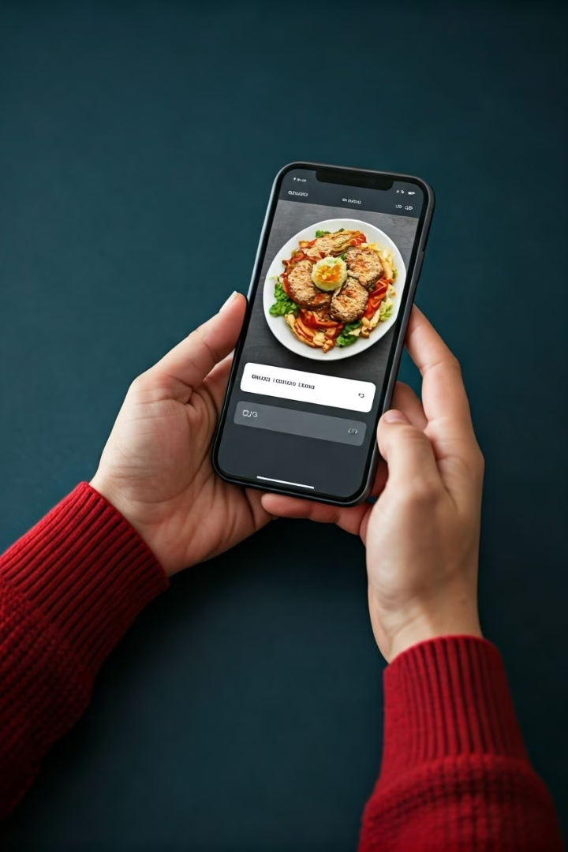
Objective
1
Primary Goal
The primary goal of My Bring Food is to provide users with the best food options, ensuring freshness and quality, while offering fast and reliable delivery service.
2
User Focus
The platform prioritizes user experience by simplifying the online food ordering process through user-friendly, efficient, and secure systems.

Slide 3
Technologies Used
Frontend
Backend
ReactJS
NodeJS
Tailwind CSS
ExpressJS
Redux Toolkit
MongoDB
Other Packages
OTP-based Authentication

Slide 4
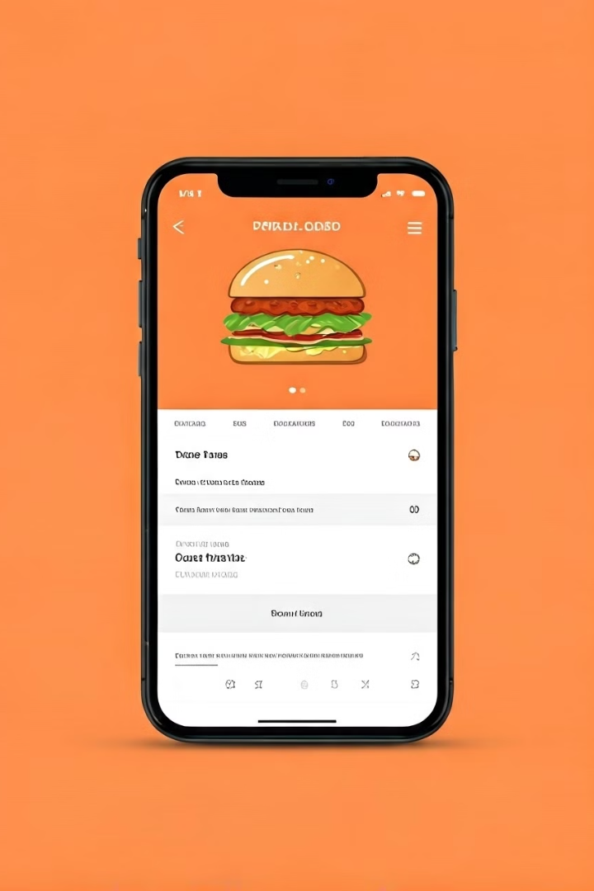
Key Features
1
User Authentication & Authorization
The platform offers secure user authentication and authorization features, allowing users to register, log in, update their profiles, and manage their accounts.
2
Food & Order Management
My Bring Food provides comprehensive food and order management capabilities, enabling users to place, track, and manage their orders seamlessly.
3
Future Enhancements
Future development plans include integrating payment gateways, implementing a personalized recommendation system, and optimizing the platform for search engines.

Slide 5

User Authentication & Authorization
User CRUD
OTP Verification
Users can register, log in, update their profiles, and manage their accounts.
The signup and login process is secured through OTP verification, ensuring user safety and data protection.

Slide 6
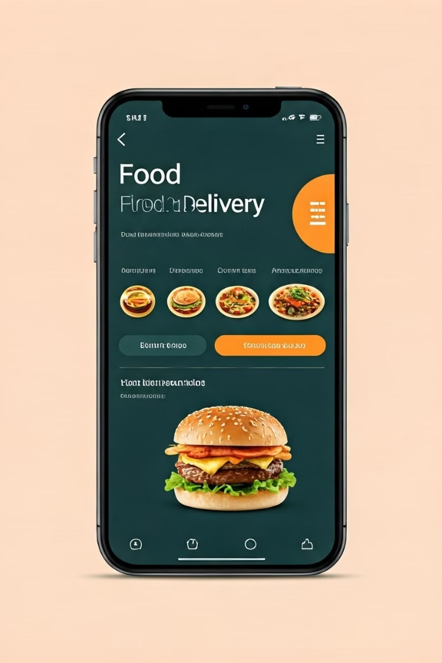


Food & Order Management
Food CRUD Operations
Administrators can add, update, delete, and manage food items, ensuring a diverse and up-to-date menu for users.
Order CRUD Operations
Users can place, track, and manage their orders seamlessly, with real-time updates on order status and delivery progress.

Slide 7




Future Enhancements
Payment Integration
Recommendation System
Faster SEO Optimization
Integrating payment gateways will enable users to make secure and convenient online payments for their orders.
A personalized recommendation system will suggest food items based on user preferences and past orders, enhancing the user experience.
Improving search engine visibility will make the platform more discoverable, attracting new users and increasing platform reach.

Slide 8
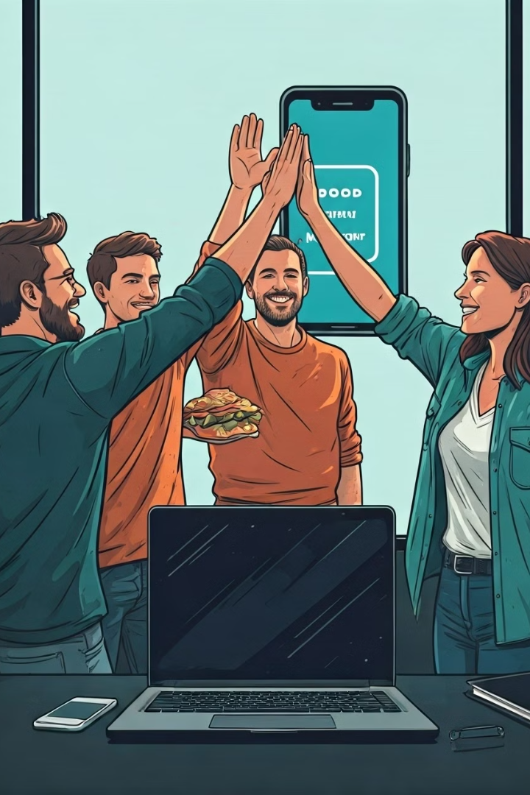
Conclusion
Outcome
My Bring Food leverages modern web technologies to provide users with a seamless and efficient food ordering experience.
Next Steps
Future developments will focus on payment methods, food recommendations, and enhancing SEO for faster and more efficient user acquisition.

