Slide 1
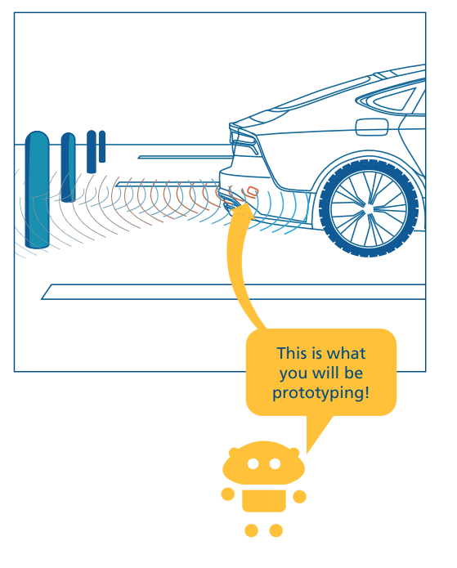
Experiment: Use of Sensor in Arduino
Instructions

Slide 2
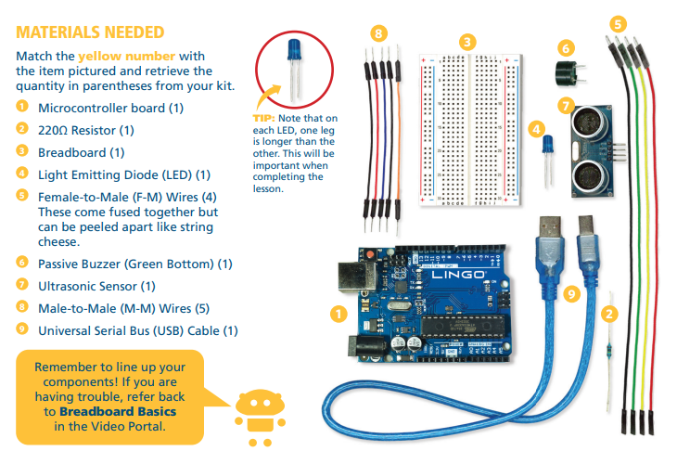
Required Materials:

Slide 3
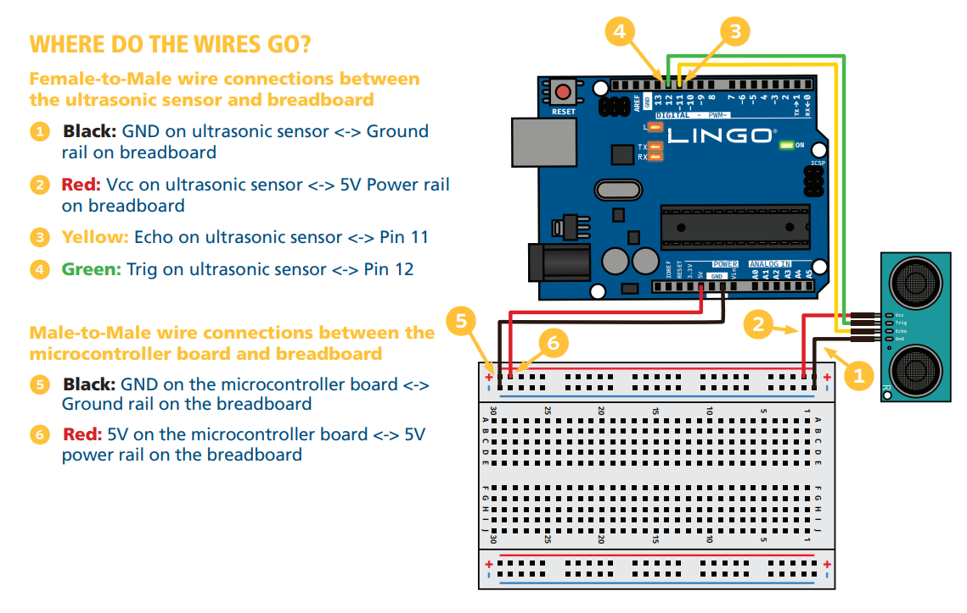
Connect the Wires as directed in the figure below:

Slide 4
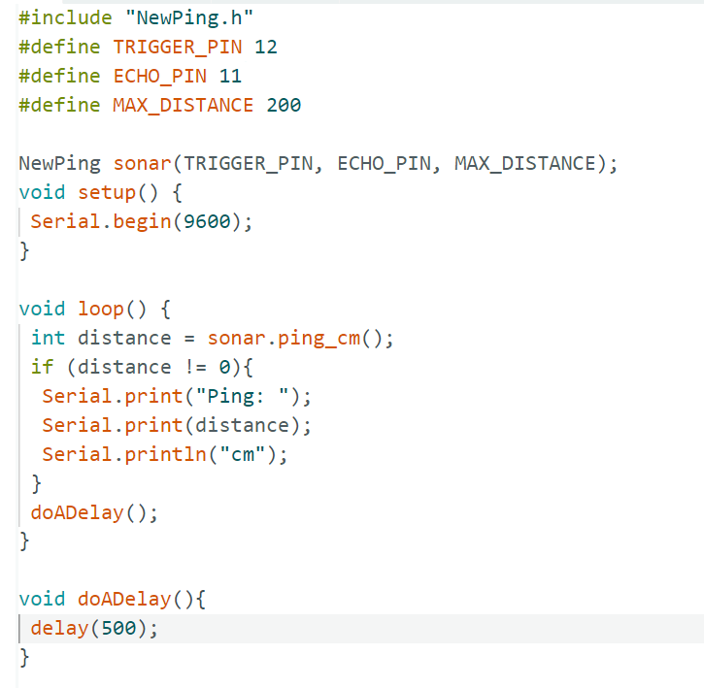
Experiment: Use of Sensor in Arduino
Open the folder 'program1' and type the code below into the sketch 'program1.ino'. (A sketch is the name that Arduino uses for a program.)

Slide 5

Experiment: Use of Sensor in Arduino
Running the Sketch
Connect the microcontroller board to the computer using the USB cord.
The first time that you connect to your board, go to the menu bar and under “Tools” -> “Port” -> select the option with “Uno” in it. Possibly, COM8 (Arduino UNO). Also select the board under “Tools” -> "Board" and select "Arduino AVR Boards"->"Arduino UNO", if not already selected. Ask for help if you face problem.
Verify the sketch by clicking the button at the top left of the Arduino editor window.
This will check your code for errors. If an error is found, it will be described at the bottom
of the window, and the row where the error
was detected will be highlighted. Correct any
errors and click Verify again. Continue until
there are no more errors.
Upload the sketch to your microcontroller board by clicking the button.
Go to “Tools” in the menu bar and select “Serial Monitor”.
You should see the distance calculated by the sensor in the serial monitor! (Obstacle the ultrasonic sensor with your hands)

Slide 6
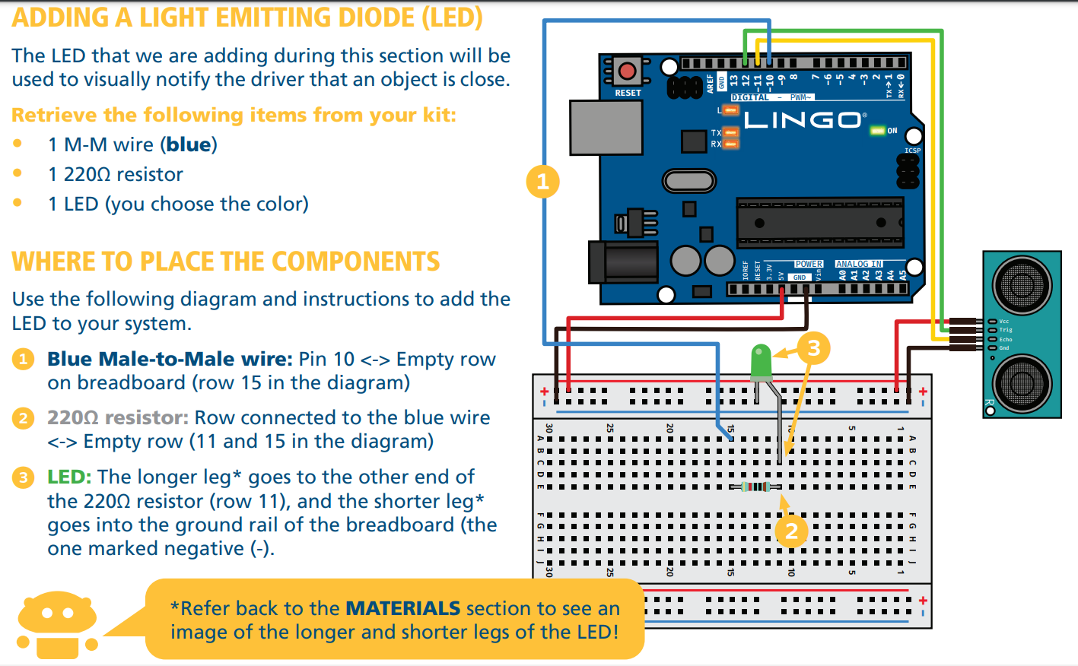

Slide 7
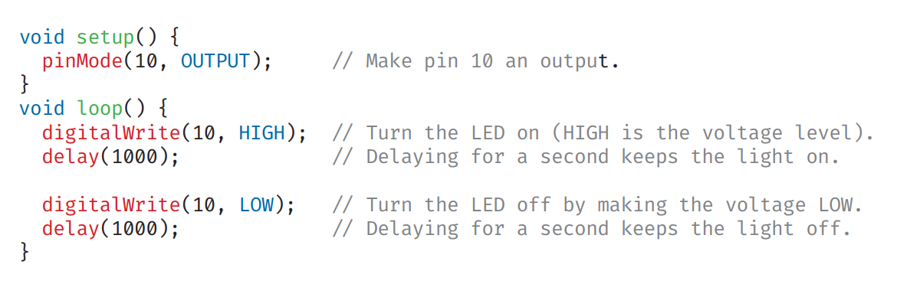
Adding an LED
Copy, verify, and load the following code into 'program2.ino' in the folder 'progam2'. You should be able to see the LED blinking on the breadboard. (Don't forget to select the right board and Port as before)

Slide 8
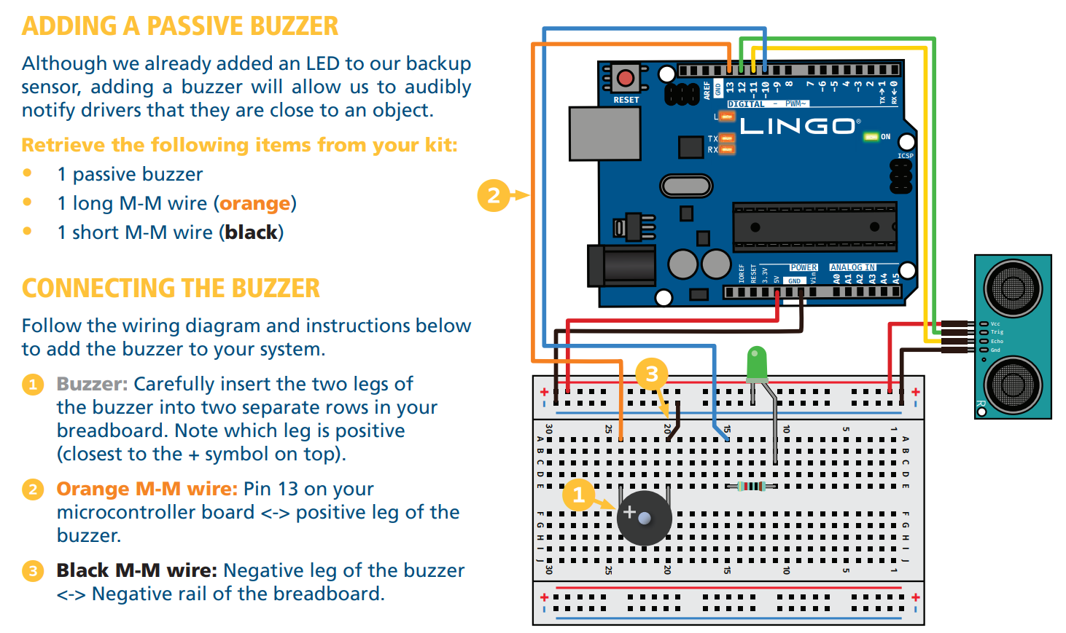

Slide 9
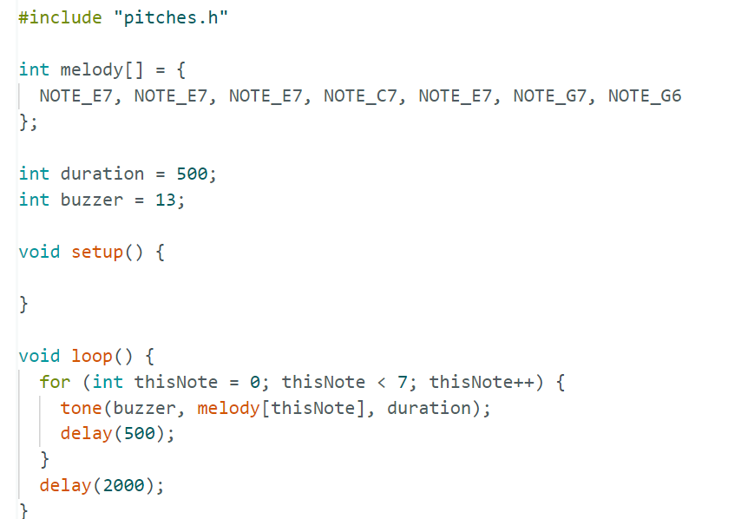
Copy, verify, and load the following code into 'program3.ino' in the 'program3' folder. You should hear the buzzer sing a short melody.

Slide 10
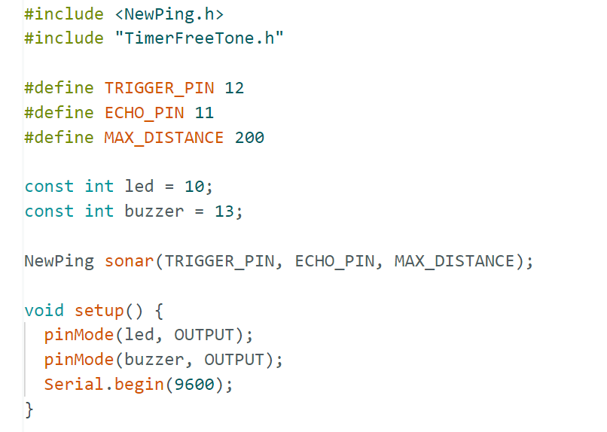
Putting it Altogether
You just need to write this new sketch in 'program4.ino' in the 'program4' folder and upload it to your board.

Slide 11
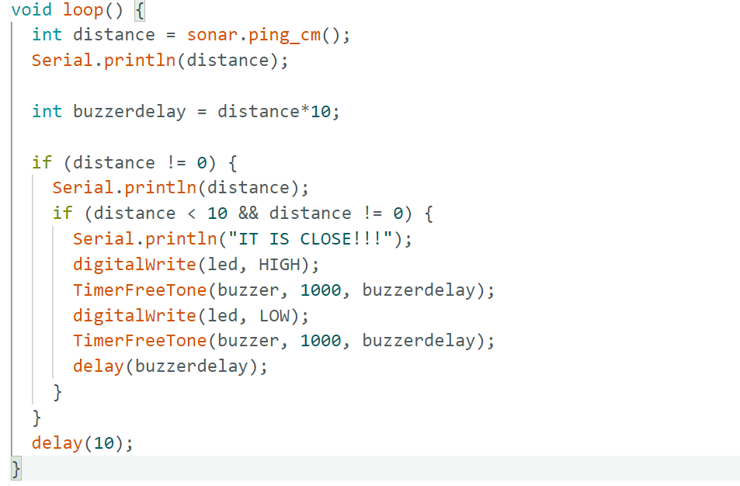

Slide 12
Copy, verify ,and upload the code on the you have just written.
2. When it is loaded onto your board, go to “Tools” in the menu and then select “Serial Monitor.”
You should observe the following when testing your prototype:
• You should see the distance measured by the ultrasonic sensor printed to the serial monitor. You can obstacle the sensor using your hands, just take your hands closer and closer to the sensor.
• When the distance is less than 10cm, you should see the LED flash and “IT IS CLOSE!!!!” displayed on the serial monitor.

