Slide 1

Realistic Activity Recognition using Sensors with Deep Convolutional Neural Network
Heaven’s Light is Our Guide
Course No: CSE 4206
Presented By
Md. Al Siam
Roll: 1603008
Computer Science and Engineering, Rajshahi University of Engineering and Technology
Supervised By
Abu Sayeed
Assistant Professor
Computer Science and Engineering, Rajshahi University of Engineering and Technology

Slide 2
Presentation Outline
Introduction
Motivation
Objectives
Literature Review
Dataset Description
Proposed Methodology
Results
Conclusion
Future Works
References

Slide 3
What is IoT?
The Internet of Things (IoT) describes physical objects (or groups of such objects) with sensors, processing ability, software, and other technologies that connect and exchange data with other devices and systems over the internet or other communications networks.
provides businesses with a real-time look
enables companies to automate processes
reduce labor costs
cuts down on waste and improves service delivery

Slide 4
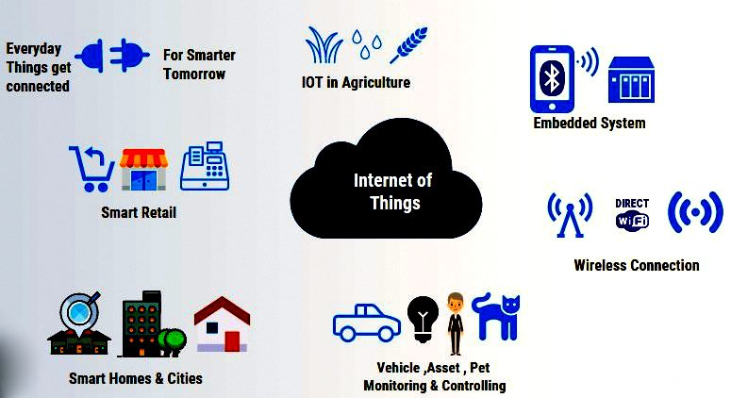
What is IoT?
IoT is getting of the most important technologies of everyday life, and it will continue to pick up steam as more businesses realize the potential of connected devices to keep them competitive.
Fig. 1: Examples of IoT in Daily Life

Slide 5
Sensor and Sensor Data
A sensor is a device, module, machine, or subsystem that detects events or changes in its environment and sends the information to other electronics, frequently a computer processor. Sensors are always used with other electronics.
Sensor data is the output of a device that detects and responds to some type of input from the physical environment.
Generally, sensor data can be represented in tabular form as most of the times they are nothing but some values representing some physical attributes
In recent years, smartphones with in-built sensors have become widely available. Sensor data can be collected and preprocessed as per user requirement by creating a mobile application for the data collection process. Hence, the domain of sensor datasets generated by smartphones is becoming larger day by day.

Slide 6
Motivation
Rapid Growth of IoT Sensors
Increasing Availability of Sensor Data
Using Activity Recognition Methods in Professional Contexts
Scope of Using Sensor Data for Human Activity Recognition

Slide 7
Objectives
Processing Sensor Data with Proper Windowing
Increasing Size of Data with Reasonable Window Overlapping
Using Deep Convolutional Neural Network on Sensor Data
Studying about the Usability of Sensor Data from Real Work Environment

Slide 8
Literature Review
Activity Recognition Using Inertial Sensors
The previous work in HAR based on inertial measurement units (IMUs) has mainly focused on the use of acceleration signals.
Gupta et al. used accelerometer signal data and classified activities with Naïve Bayes and k-nearest neighbor (k-NN) methods which could demonstrate 98% accuracy [1].
Kwapisz et al. collected labeled accelerometer data from twenty-nine users as they performed daily activities such as walking, jogging, climbing stairs, sitting, and standing, and then aggregated this time series data into examples that summarize the user activity over 10- second intervals. They made a predictive model for activity recognition [2].

Slide 9
Literature Review
Activity Recognition Using Inertial Sensors
Liu et al. used an accelerometer signal which was captured from a Wii remote and recognized a predefined set of eight gestures using a DTW-based method [3]
Several studies have depicted that it is possible to classify human gestures from palm-worn devices [4, 5].

Slide 10
Literature Review
Activity Recognition Using Inertial Sensors
The gestures while writing alphabets is a good example of human activity recognition as there are different gestures while writing different letters. The gestures while writing can be captured with sensor devices. Many experiments on writing alphabets has been conducted using sensor data so far.
Writing alphabets can be captured by IMU Sensors like accelerometers, gyroscopes. Wrist worn devices, mobile phones which have sensors built-in have been widely used in the experiments.

Slide 11
Literature Review
Activity Recognition Using Inertial Sensors
Lin et al. investigated the orientations of the surfaces in which users were to write characters, the stabilization (support) point of the hand, and the rotation injection technique for data augmentation which uses a rotation matrix [6]. They obtained a remarkably high accuracy of 99.99% to recognize 62 characters by 10 subjects with a machine-learning-based approach.
Chen et al. investigated real-time fingertip detection in frames captured from smart glasses. They built a synthetic dataset using Unity3D and proposed a modified mask regional convolutional neural network. Their method could detect fingertip for air-writing in a minimal length of time for each frame [7].

Slide 12
Literature Review
Activity Recognition Using Inertial Sensors
Kim et al. experimented with the WiTA dataset, which contains air-writing data for Korean and English alphabets collected by RGB cameras [8].
Abir et al. extensively investigated different interpolation techniques on seven publicly available sensor based air-writing datasets and developed a method to recognize air-written characters using a 2D-CNN model. They interpolated sensor data in order to fit the data in deep 2D-CNN model. They obtained remarkable accuracy compared to the latest experiments regarding all of the datasets they used. [9]

Slide 13
Literature Review
Activity Recognition in Professional Contexts
Recently, very little attention was given to the recognition of activities in professional contexts. Special interest seems to be rising for tracking the activities of medical practitioners, such as doctors and nurses [10] and, in a smaller scale, activities such as cooking [11].
Joshua and Varghese [12] studied masonry activities using accelerometers in a laboratory and small-scale setting. Their study showed up to a 80% classification accuracy in relatively unconstrained environments.

Slide 14
Literature Review
Activity Recognition in Professional Contexts
Akhavian and Behzadan [13], simulated, using only two subjects, a three-class construction activity setup that included sawing, hammering and turning a wrench and loading and unloading activities. Their three-class model obtained accuracies close to 90%, with high variability on users and activities.
The rest of the studies related to construction focused on complementary cases without human focus, such as tracking the activity of particular equipment [14], or machinery [15].

Slide 15
Dataset Description
Used Dataset
VTT-ConIot Dataset: A Realistic Dataset for Activity Recognition of Construction Workers Using IMU Devices
VTT-ConIoT is a publicly available dataset for the evaluation of human activity recognition (HAR) from inertial sensors in professional construction settings.
The dataset contains data from 13 users and 16 different activities, which is collected from three different wearable sensor locations.

Slide 16
Dataset Description
VTT-ConIot Dataset
The participants of working age in a range from 25 to 55 years old
Data was collected from 13 users for 16 different activities performed for a duration of one minute each in an "in-lab" setup that mimics the activities observed at a construction site.
Among the 13 participants, 10 were men and 3 were women, a gender distribution similar to what can be seen in typical construction sites in Europe.
The subjects were wearing sensorized clothes that incorporated three (Inertial Measurement Unit) IMU sensors
One sensor located in the hip, and two other ones located near the shoulder of the nondominant hand of each participant

Slide 17
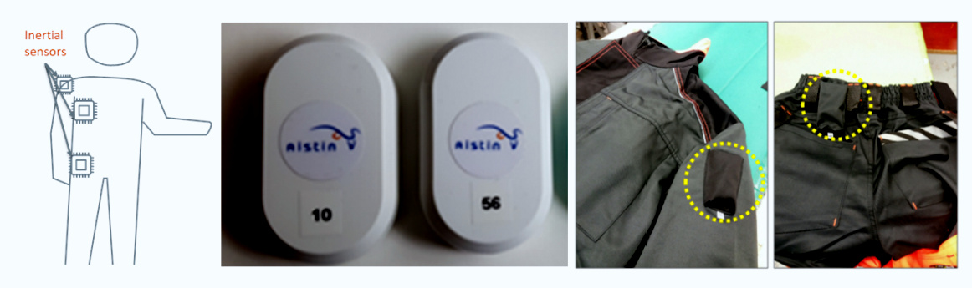
Dataset Description
VTT-ConIot Dataset
Fig. 2. Depiction of the sensor locations. From left to right: planned locations, depiction of the actual sensors and example setup in the working clothes.

Slide 18
Dataset Description
VTT-ConIot Dataset
The sensors provide:
3-axis accelerometer data
3-axis gyroscope data data
3-axis magnetometer data

Slide 19
Dataset Description
VTT-ConIot Dataset
Sampling Rates of the Used Devices
Accelerometer: 103 Hz
Gyroscope: 97 Hz
Magnetometer: 97 Hz
Barometer: 0.033 Hz
After collecting the raw data with the mentioned devices, the gyroscope and magnetometer data was resampled using linear interpolation to synchronise with the accelerometer data. This Interpolated version of data is published and publicly available.

Slide 20
Dataset Description
VTT-ConIot Dataset
There are around 6000 signal samples for each user and each activity in the dataset.
There is lacking of 1 to 2 signal samples in samples per user and activity, which is very negligible
A user refused to perform a activity. This data is missing. This is related to floorwork.

Slide 21
Dataset Description
VTT-ConIot Dataset
Name of the Activities
The activities are classified into 6 major classes and 16 granular classes. They are:
Painting:
Roll-Painting
Spraying-Paint
Leveling-Paint

Slide 22
Dataset Description
VTT-ConIot Dataset
Name of the Activities
Cleaning:
Vacuum-cleaning
Picking-objects
Climbing
Climbing-stairs
Jumping-down
Stairs-Up-Down

Slide 23
Dataset Description
VTT-ConIot Dataset
Name of the Activities
HandsUp
Laying-back
HandsUp-high
HandsUp-low
FloorWork
Crouch-floor
Kneel-floor

Slide 24
Dataset Description
VTT-ConIot Dataset
Name of the Activities
Walking Displace
Walk-straight
Walk-winding
Pushing-cart

Slide 25
Challenges
Increasing samples for small size signal data with window segmentation
Selecting proper window size for making samples
Using proper features that is generally representative to the labels
Usability of CNN for classifying signal data

Slide 26
Proposed Methodology
Dataset (VTT ConIoT)
Preprocessing Data with Proper Window Size and Overlapping
Classification using 2D-CNN

Slide 27
Proposed Methodology
Preprocessing Data with Proper Window Size
and Overlapping
We have a 6000-length signal data for each user and each activity. As the activities are repetitive, we can use segmentation and windowing.
The length of segmentation window (frame size) and overlapping area (hop size) has to be defined considering the repeatitive nature of the corresponding dataset.

Slide 28
Proposed Methodology
Preprocessing Data with Proper Window Size
and Overlapping
Then we get a window which contains an activity level.
As every window has its length (frame size) and a width (number of features taken), it can be regarded as a 2-dimensional image.
Here 2D CNN comes in picture. We will experiment considering each data frame and classify it with 2D CNN.

Slide 29
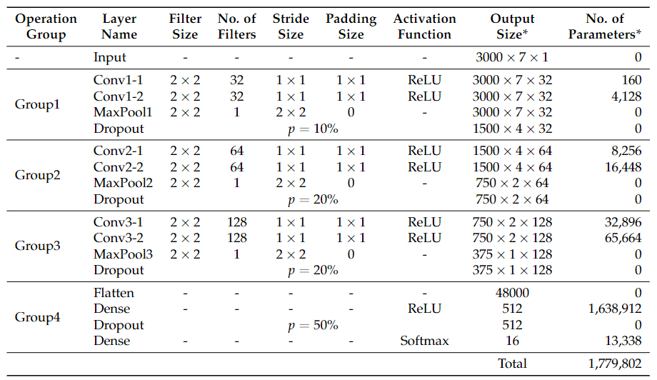
Proposed Model
Fig. 4. Proposed model of 3-D convolutions for HSI classification.
Table 1. Network architecture of the 2D-CNN model for human activity recognition

Slide 30
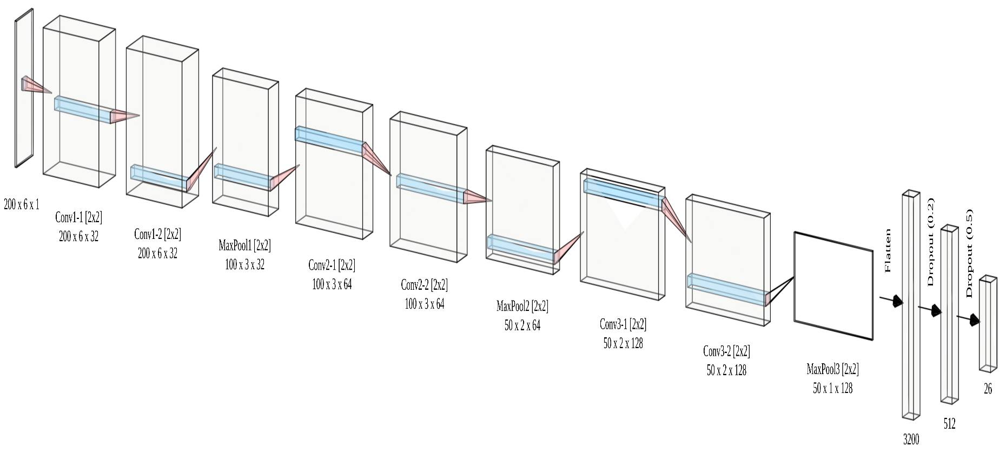
Proposed Model
Fig. 4. Proposed model of 3-D convolutions for HSI classification.
Figure 1. Network architecture of the 2D-CNN model for human activity recognition

Slide 31
Methodology
This is a widely used convention in CNN how we made the groups in our architecture. That is, putting some convolutional layer, followed by some pooling layer, and dropout layer.
In the context of a convolutional neural network, a convolution is a linear operation that involves the multiplication of a set of weights. The CNN technique was designed for two-dimensional input, the multiplication is performed between an array of input data and a two-dimensional array of weights, called a filter or a kernel
The Dropout layer is a mask that nullifies the contribution of some neurons towards the next layer and leaves unmodified all others. Dropout layers are important in training CNNs because they prevent overfitting on the training data. If they aren’t present, the first batch of training samples influences the learning in a disproportionately high manner.

Slide 32
Methodology
Leaving One Subject Out Method
We evaluate all our models using a cross-validation scheme based on LOSO, where for N subjects, N different models are trained. Each model is trained using data from all the subjects except one, which is then used for testing and computing the performance of the model.
Thirteen models per classifier and modality will be evaluated.

Slide 33
Experimental Setup
Experimented on Google Colaboratory
12 GB RAM, GPU Accelereation Facility
Epochs: 50
Learning Rate: 0.001
Early stopping was used to halt the training process when no improvement occurs in the performance

Slide 34
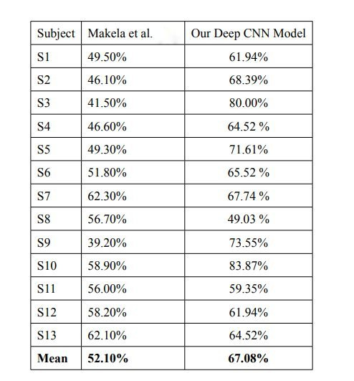
Results
Table: LOSO (per-subject) validation results

Slide 35
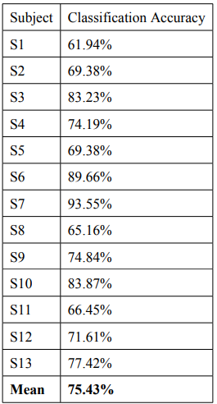
Results
Table: LOSO (per-subject) classification results with the left-out subject data

Slide 36
Performance Analysis
They accuracies of the work of Makela et al. [16] and our work is pretty similar.
This means that machine deep learning based approaches for real time activity recognition are reliable as well as machine learning based methods.

Slide 37
Performance Analysis
The dataset we used to test our model is small. There are 13 users who performed 16 activities each. There are around 6000 signals per subject per activity. Even after using the hopping technique, i.e, overlapping the signals with a move forward of beginning of the corresponding signals of the previous time frame, there was around 2060 samples per subject per activity.

Slide 38
Conclusion
This presentation mainly focused on –
Human Activity Recognition with IoT Sensor Data
Segmentation of IoT Sensor Data
Using CNN on Sensor Data
LOSO approach for evaluation of model

Slide 39
Conclusion
Data from many sensor placements and modalities are included in the dataset. Despite the relative simplicity of the method, our baseline results, which are based on a LOSO evaluation scheme, show that generalization to various people is feasible.
We achieved a classification accuracy of 75.43% with our deep learning based approach, which is very close to the machine learning based approach.
This proves the prospects of deep learning based approaches in construction site based activity recognition problems.

Slide 40
Future Works
Experimentation with Larger Datasets
The dataset we used to test our model is small.
Deep learning models generally learn well when large dataset is fed to the network. If large dataset is fed to the network, there are good number of variant data which helps the model to generalise the characteristics of the classes.
We have mentioned that there are scarcity of dataset about activities which are performed in the working sites, let alone the construction sites. So attempts can be made to make large dataset in working sites or constructions sites.

Slide 41
Future Works
Experimentation with Deeper Models
The model we have experimented with has three groups of sequential convolutional-convolutional-maxpooling-dropout layers. Then there is flatten layer, dense layer, dropout layer and another output dense layer, respectively. The model is, however, not big enough.
Hence, deeper and larger models have always the possibility to perform better. There can be used deeper models, also with another conventions of making deep learning model can be followed rather than construction of our model.

Slide 42
Future Works
Combination of Machine Learning and Deep Learning Based Approaches
Statistical features can be used to feed the model.
Machine Learning based classification and deep learning based classification can be applied and there should be ensembled decision for better classification.

Slide 43
Published Papers
Abir, F.A., Siam, M., Sayeed, A., Hasan, M., Mehedi, A. and Shin, J., 2021. Deep Learning Based Air-Writing Recognition with the Choice of Proper Interpolation Technique. Sensors, 21(24), p.8407.
Hasan, M.A.M., Al Abir, F., Al Siam, M. and Shin, J., 2022. Gait Recognition with Wearable Sensors using Modified Residual Block-based Lightweight CNN. IEEE Access.

Slide 44
References
[1] Gupta, P.; Dallas, T. Feature Selection and Activity Recognition System Using a Single Triaxial Accelerometer. IEEE Trans. Biomed. Eng. 2014, 61, 1780–1786.
[2] Kwapisz, J.; Weiss, G.; Moore, S. Activity Recognition Using Cell Phone Accelerometers. SIGKDD Explor. Newsl. 2011, 12, 74–82
[3Liu, J.; Zhong, L.; Wickramasuriya, J.; Vasudevan, V. uWave: Accelerometer-based personalized gesture recognition and its applications. Pervasive Mob. Comput. 2009, 5, 657–675 .
[4] Cheng, W.; Jhan, D. Triaxial Accelerometer-Based Fall Detection Method Using a Self-Constructing Cascade-AdaBoost-SVM Classifier. IEEE J. Biomed. Health Inform. 2013, 17, 411–419.
[5] Matic, A.; Osmani, V.; Mayora, O. Speech activity detection using accelerometer. In Proceedings of the 2012 IEEE Annual International Conference on Engineering in Medicine and Biology Society, San Diego, CA, USA, 28 August–1 September 2012; pp. 2112–2115.

Slide 45
References
[6] Lin, X.; Chen, Y.; Chang, X.W.; Liu, X.; Wang, X. Show: Smart handwriting on watches. Proc. ACM Interact. Mob. Wearable Ubiquitous Technol. 2018, 1, 1–23.
[7] Chen, Y.H.; Huang, C.H.; Syu, S.W.; Kuo, T.Y.; Su, P.C. Egocentric-View Fingertip Detection for Air Writing Based on Convolutional Neural Networks. Sensors 2021, 21, 4382.
[8] Kim, U.H.; Hwang, Y.; Lee, S.K.; Kim, J.H. Writing in The Air: Unconstrained Text Recognition from Finger Movement Using Spatio-Temporal Convolution. arXiv 2021, arXiv:2104.09021.
[9] Abir, F.A., Siam, M.A., Sayeed, A., Hasan, M.A.M. and Shin, J., 2021. Deep Learning Based Air-Writing Recognition with the Choice of Proper Interpolation Technique. Sensors, 21(24), p.8407.
[10] Inoue, S.; Ueda, N.; Nohara, Y.; Nakashima, N. Mobile activity recognition for a whole day: Recognizing real nursing activities with big dataset. In Proceedings of the 2015 ACM International Joint Conference on Pervasive and Ubiquitous Computing, Umeda, Japan, 7–11 September 2015; pp. 1269–1280.

Slide 46
References
[11] Alia, S.S.; Lago, P.; Takeda, S.; Adachi, K.; Benaissa, B.; Ahad, M.A.R.; Inoue, S. Summary of the cooking activity recognition challenge. In Human Activity Recognition Challenge; Springer: Berlin, Germany, 2021; pp. 1–13.
[12] Joshua, L.; Varghese, K. Accelerometer-based activity recognition in construction. J. Comput. Civ. Eng. 2011, 25, 370–379.
[13] Akhavian, R.; Behzadan, A.H. Smartphone-based construction workers’ activity recognition and classification. Autom. Constr. 2016, 71, 198–209.
[14] Rashid, K.M.; Louis, J. Times-series data augmentation and deep learning for construction equipment activity recognition. Adv. Eng. Inform. 2019, 42, 100944.
[15] Sherafat, B.; Ahn, C.R.; Akhavian, R.; Behzadan, A.H.; Golparvar-Fard, M.; Kim, H.; Lee, Y.C.; Rashidi, A.; Azar, E.R. Automated methods for activity recognition of construction workers and equipment: State-of-the-art review. J. Constr. Eng. Manag. 2020, 146, 03120002.

Slide 47
References
[16] S.-M. Mäkela, A. Lämsä, J. S. Keränen, J. Liikka, J. Ronkainen, J. Peltola, J. Häikiö, S. Järvinen, and M. Bordallo López, “Introducing vtt-coniot: A realistic dataset for activity recognition of construction workers using imu devices,” Sustainability, vol. 14, no. 1, p. 220, 2021.

Slide 48

Any
Query?

