Slide 1
Double-Ended Queue

Slide 2
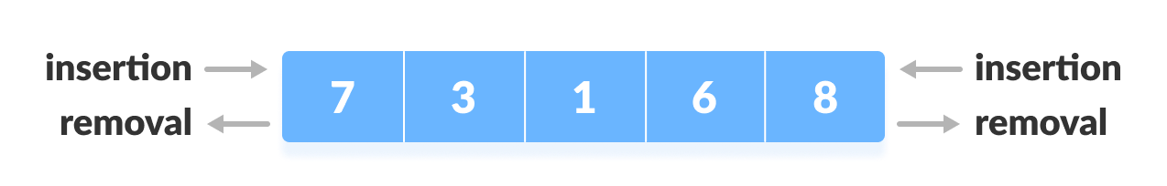
DEQUE
Deque or Double Ended Queue is a type of queue in which insertion and removal of elements can be performed from either from the front or rear.

Slide 3
Types of Deque
Input Restricted Deque In this deque, input is restricted at a single end but allows deletion at both the ends.
Output Restricted Deque In this deque, output is restricted at a single end but allows insertion at both the ends.

Slide 4
Operations on a Deque
circular array implementation of deque. In a circular array, if the array is full, we start from the beginning.
But in a linear array implementation, if the array is full, no more elements can be inserted. In each of the operations below, if the array is full, "overflow message" is thrown.

Slide 5
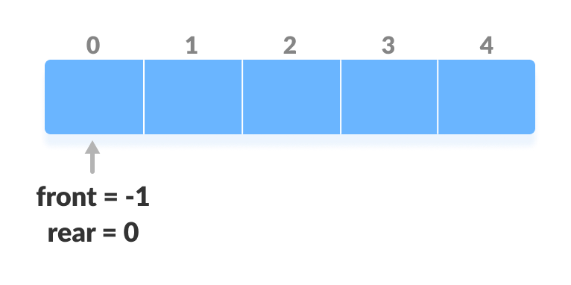
Before performing the following operations, these steps are followed.
Take an array (deque) of size n.
Set two pointers at the first position and set
front = -1 and rear = 0.

Slide 6
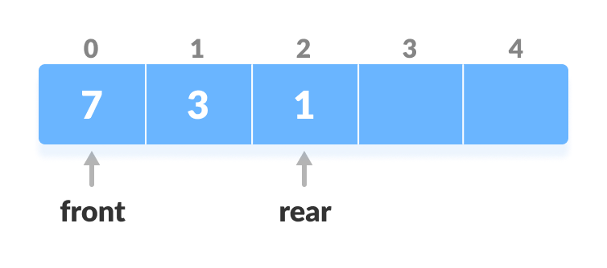
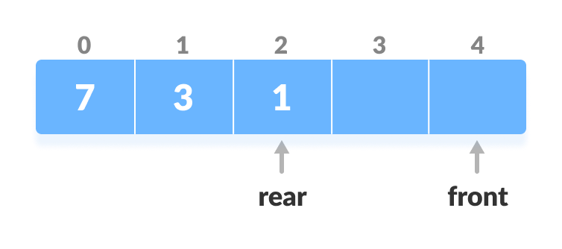
1. Insert at the Front
This operation adds an element at the front.
1.Check the position of front.
2.If front < 1, reinitialize front = n-1 ast index).

Slide 7
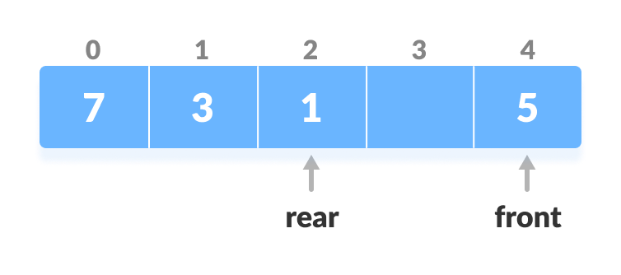
3.Else, decrease front by 1.
4.Add the new key 5 into array[front].Insert

Slide 8
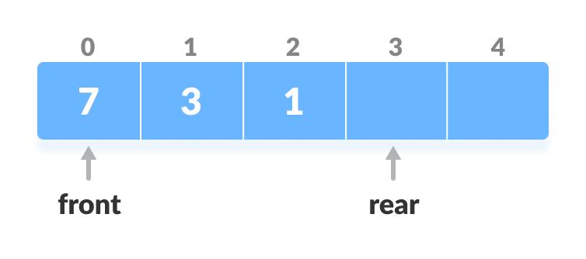
2. Insert at the Rear
1.This operation adds an element to the rear.
Check if the array is full.
If the deque is full, reinitialize rear = 0.
Else, increase rear by 1.

Slide 9
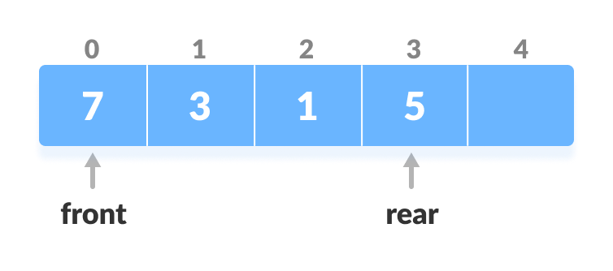
4.Add the new key 5 into array[rear].

Slide 10
3. Delete from the Front
The operation deletes an element from the front.
Check if the deque is empty.
If the deque is empty (i.e. front = -1), deletion cannot be performed (underflow condition).
If the deque has only one element (i.e. front = rear), set front = -1 and rear = -1.
Else if front is at the end (i.e. front = n - 1), set go to the front front = 0.
Else, front = front + 1.

Slide 11
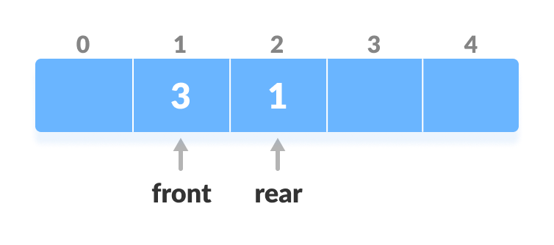

Slide 12
4. Delete from the Rear
This operation deletes an element from the rear.
1.Check if the deque is empty.
If the deque is empty (i.e. front = -1), deletion cannot be performed (underflow condition).
If the deque has only one element (i.e. front = rear), set front = -1 and rear = -1, else follow the steps below.
If rear is at the front (i.e. rear = 0), set go to the front rear = n - 1.

Slide 13
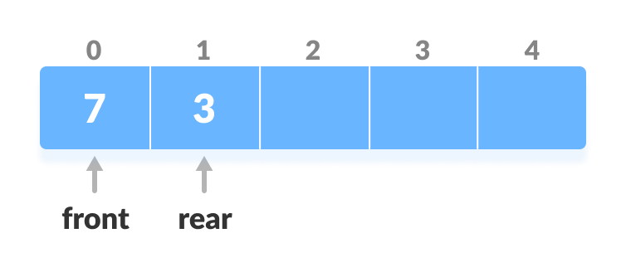
5.Else, rear = rear - 1

Slide 14
5. Check Empty
This operation checks if the deque is empty. If front = -1, the deque is empty.
6. Check Full
This operation checks if the deque is full. If front = 0 and rear = n - 1 OR front = rear + 1, the deque is full.

Slide 15
APPLICATIONS OF DEQUE
1.APPLICATIONS OF DEQUE
2.Undo-Redo operations in Software applications.

Slide 16
Thankyou

