Slide 1

PIZZA SALES ANALYSIS
A SQL Case Study on Orders, Revenue & Customer Preferences
MySQL • Mohammad Ammaar

Slide 2


Project Overview
This project analyzes transactional data from a pizza restaurant using MySQL. The goal is to translate raw order-level data into clear, decision-ready business insights — covering sales volume, revenue, top-performing products, and customer ordering patterns.
Dataset — 4 Relational Tables
O
orders
Order ID, date & time of each order placed
O
order_details
Objective
Line items — links orders to pizzas & quantity
P
pizzas
Answer real business questions using SQL joins, aggregation, and filtering — total orders, revenue, best sellers, and customer size/category preferences.
Pizza ID, size, and price
P
pizza_types
Pizza name, category, and description
Pizza Sales Analysis | SQL Project
2

Slide 3

Database Structure
How the four tables connect through primary and foreign keys
orders
order_details
pizzas
pizza_types
order_id (PK)
order_id, pizza_id (FK)
pizza_id, pizza_type_id (FK)
pizza_type_id (PK)
order_details is the bridge table: each row links one order to one pizza and its quantity, while pizzas links to pizza_types for the pizza’s name, category, and price.
Pizza Sales Analysis | SQL Project
3

Slide 4

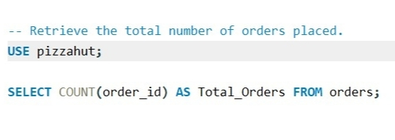

Total Number of Orders Placed
01
SQL QUERY
OUTPUT
Pizza Sales Analysis | SQL Project
4

Slide 5

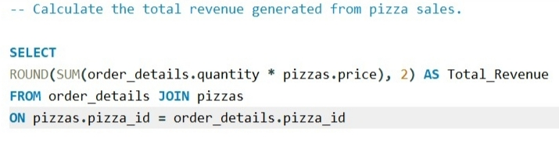

Total Revenue from Pizza Sales
02
SQL QUERY
OUTPUT
Pizza Sales Analysis | SQL Project
5

Slide 6

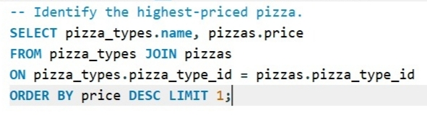

Highest-Priced Pizza
03
SQL QUERY
OUTPUT
Pizza Sales Analysis | SQL Project
6

Slide 7

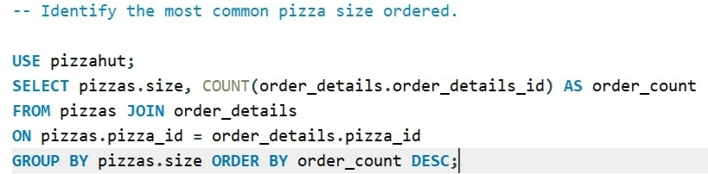
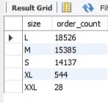
Most Common Pizza Size Ordered
04
SQL QUERY
OUTPUT
Pizza Sales Analysis | SQL Project
7

Slide 8

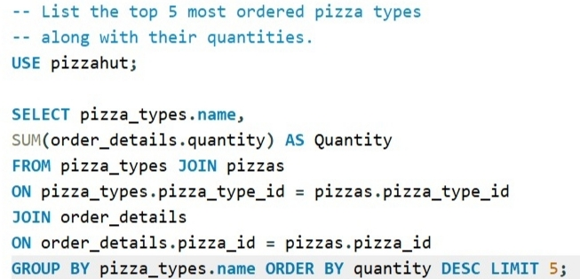
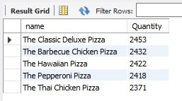
Top 5 Most Ordered Pizza Types
05
SQL QUERY
OUTPUT
Pizza Sales Analysis | SQL Project
8

Slide 9

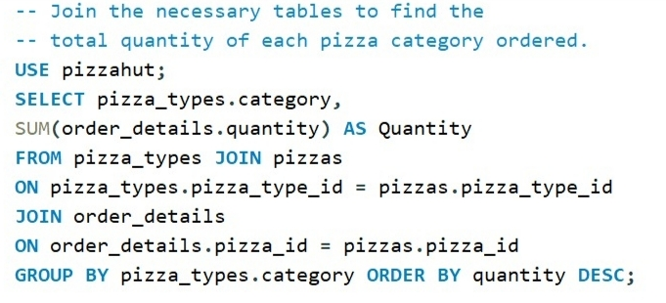
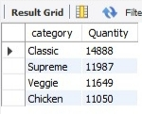
Total Quantity Ordered by Category
06
SQL QUERY
OUTPUT
Pizza Sales Analysis | SQL Project
9

Slide 10






Key Insights
21,350
$817,860.05
$35.95
Total Orders Placed
Total Revenue Generated
The Greek Pizza — Highest Priced
Large (L)
Classic Deluxe
Classic
Most Common Size Ordered
Top-Selling Pizza (2,453 units)
Top Category by Quantity (14,888)
Pizza Sales Analysis | SQL Project
10

Slide 11


Thank You
Full queries, schema & results available on GitHub
View full project on GitHub
mdammaar90@gmail.com
Mohammad Ammaar | Computer Science Graduate

