Slide 1
Design and Build a Computer Architecture Program
Submitted To
Jarin Tasnim Tonvi
Lecturer
Green University of Bangladesh
Submitted By
Md. Anas Khan - 201902037
Md. Shazzad Hossain - 212902073

Slide 2
Table Of Contents
Introduction
Overview of emu8086 Assembler
Flowchart
Project Structure
Input
Operations
Result and Outputs
Connection with computer architecture course.

Slide 3
Introduction
Designing a simple computer architecture.
Program will execute a small set of operations.
Exploring computer architecture provides insights into program execution.
Implementation of these operations using the emu8086 assembler.

Slide 4
Overview of emu8086 Assembler
emu8086 Assembler: Tool for program development.
Simulates x86 processor architecture for execution.
Enables coding and testing of programs.
Offers a user-friendly interface for developers.
Facilitates learning and understanding assembly language.

Slide 5
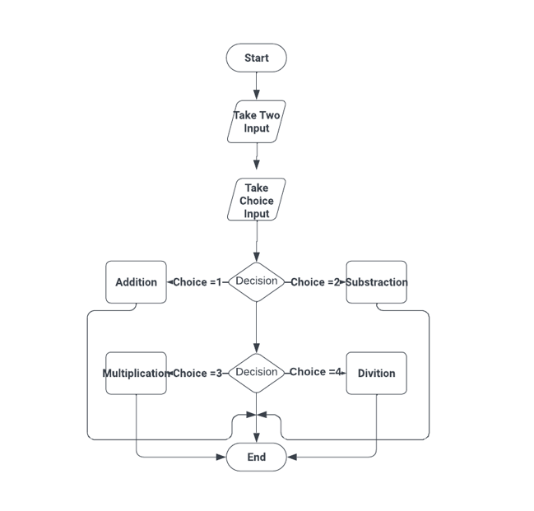
Flowchart
.

Slide 6
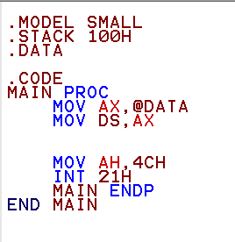
Project Structure
Data section holds program variables.
Code structured into data and instructions.
Instructions section contains program logic.
Facilitates efficient program execution and debugging.

Slide 7

Operations
Addition Operation:
Addition operation performs arithmetic sum.
Adds two integers together for result.
Result is stored in a variable.

Slide 8

Operations
Subtraction Operation:
Subtraction operation calculates the difference.
Subtracts one integer from another.
Result is stored in a variable.

Slide 9

Operations
Multiplication Operation:
Multiplication operation performs arithmetic product.
Multiplies two integers to obtain result.
Result is stored in a variable.

Slide 10
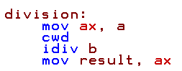
Operations
Division Operation:
Division operation calculates the quotient.
Divides one integer by another.
Result is stored in a variable.

Slide 11
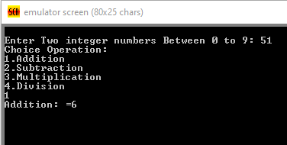
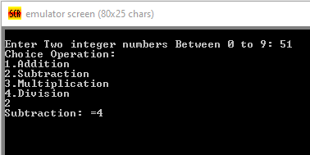
Result and Outputs
.
Addition
Subtraction

Slide 12
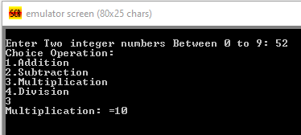
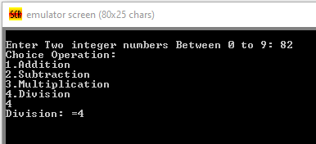
Result and Outputs
.
Multiplication
Division

Slide 13
Connection with computer architecture course
Data representation.
Instruction set.
Control flow.
Memory access.

Slide 14
Thank You
..

