Slide 1
Presentation on Travel Management Analysis
Presented By: Mohammad Areeb Ansari
Last Update: 15th July 2025

Slide 2
AGENDA
Introduction
Objective
Data Gathering
Insights
Conclusion

Slide 3
Objective
Travel management analysis aims to explore booking patterns, customer preferences, and travel behavior to improve decision-making and maximize revenue.
Key Goals:
Understand top destinations and seasonal booking trends.
Analyze traveler ratings and feedback.
Identify key revenue drivers.
Forecast travel demand for better planning.

Slide 4
Data Gathering
Data sourced from internal travel records exported in Excel format.
Cleaned, validated, and transformed using Power Query Editor.
Ensured data types were correct and null values were handled.
Uploaded to Power BI for modeling and visualization.
Raw Data Link: Expanded_Travel_Dataset_with_Ratings.csv

Slide 5
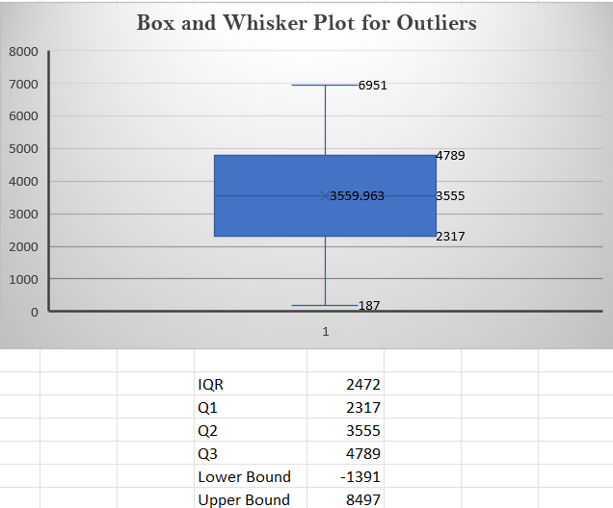
Insights: Finding outliers in Profit
An outlier is a data point that goes far outside the average value of a group of statistics.
In this data, the IQR method has been performed along with a box and whisker chart to detect outliers, checking if there’s a value that stands out from the rest of the data, such as negative values or high values.
The data is slightly skewed towards higher profits.
Outliers, especially low values, could indicate poor-performing products or regions.
Investigating outliers can help improve decision-making and performance analysis.

Slide 6
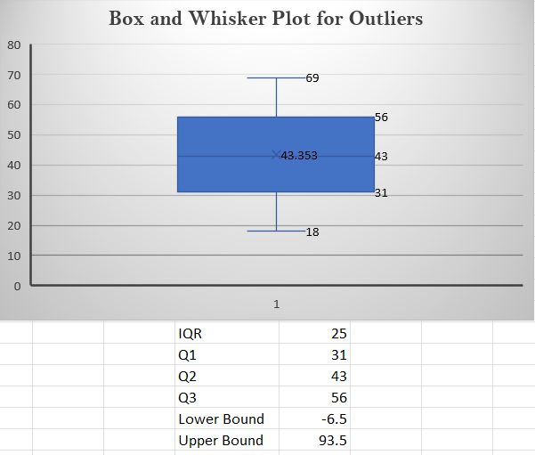
Insights: Finding outliers in Age
All age values in the dataset fall within the acceptable range of -6.5 to 93.5.
No outliers were detected in the Age column.
The age data shows a balanced distribution with most values clustered between 31 and 56.

Slide 7
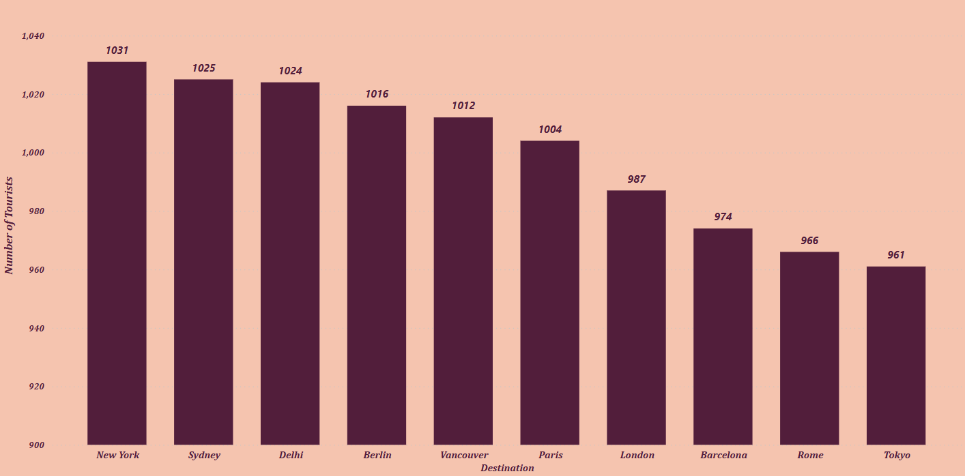
Insights: Top Destinations
New York is the most visited city in the United States based on frequency.
Tokyo is the least visited city in Japan based on frequency.
A stacked column chart is used to highlight hotspots.
Helps in targeting promotional campaigns for high-demand routes.

Slide 8
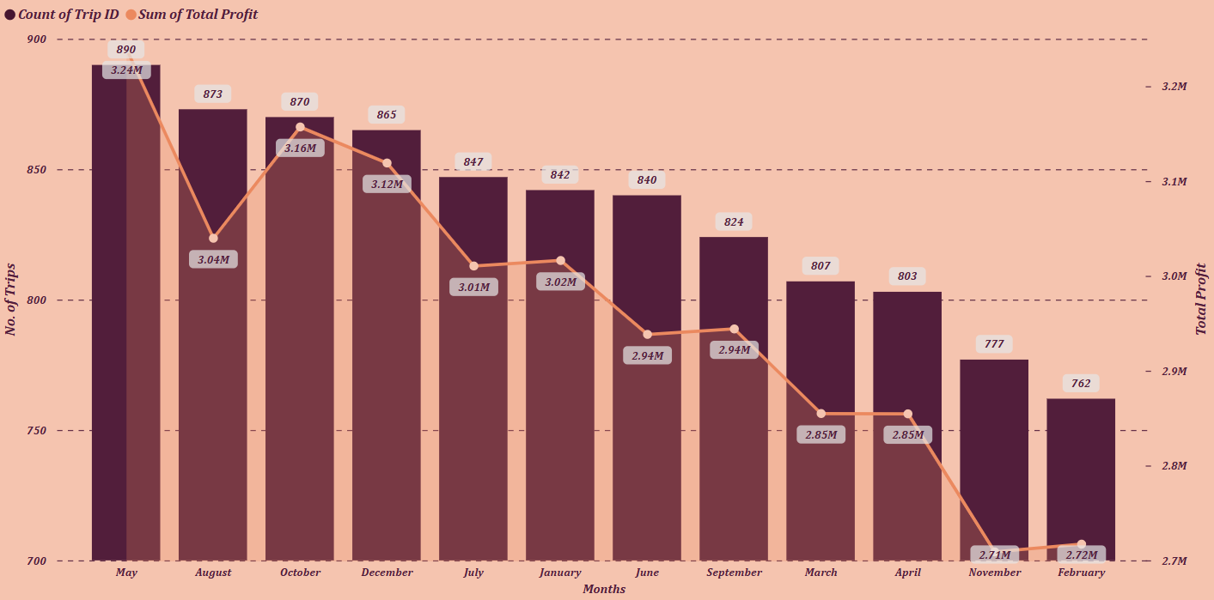
INSIGHTS: TOP SEASONAL BOOKINGS
May recorded the highest number of trips (890) and the maximum total profit (₹3.24M), indicating peak demand and profitability.
October and August also performed strongly, with trips over 870 and profits above ₹3M, marking them as other high-season months.
February and November show the lowest performance, with 762 and 777 trips respectively, and profits close to ₹2.71M–2.72M, indicating off-peak months.
Months like April and March, though not peak, still maintain 800+ trips and ~₹2.85M profit, suggesting potential for targeted promotions to boost them to peak levels.

Slide 9
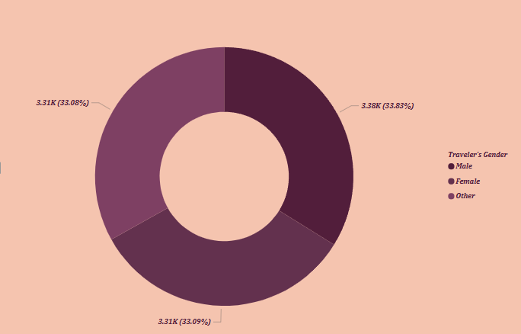
Insights: gender wise tourists distribution
Male travelers lead slightly with 3.38K (33.83%), followed closely by Female (3.31K / 33.09%) and Other genders (3.31K / 33.08%).
The presence of a significant percentage (33.08%) identifying as "Other" suggests that the travel service is inclusive and welcoming to diverse gender identities, which is a positive indicator of social responsibility.
Since no single gender dominates, future marketing campaigns and service offerings should be gender-neutral, appealing equally to all demographic groups.

Slide 10
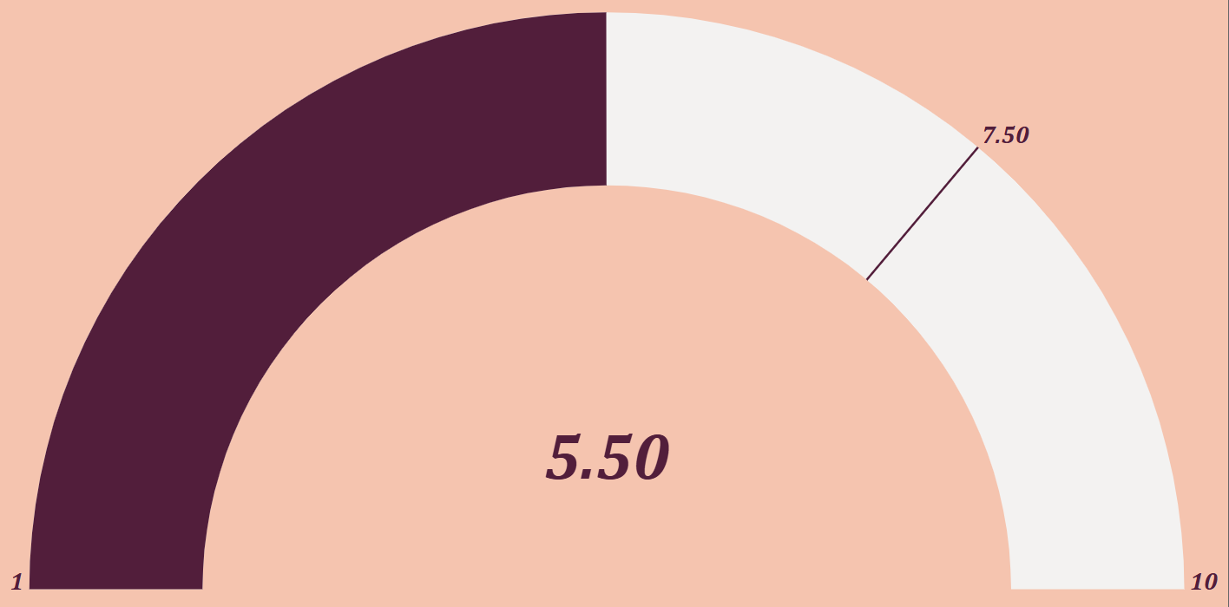
Insights: Rating Analysis
The average tourist rating is 5.50, which indicates a moderate level of satisfaction.
The gauge chart reflects the average rating given by tourists, which is 5.50 out of 10.
The threshold marker at 7.50 indicates the target or expected satisfaction level, which is currently unmet.
This suggests a gap in either service quality, infrastructure, or overall travel experience that needs to be addressed to enhance tourist satisfaction.

Slide 11
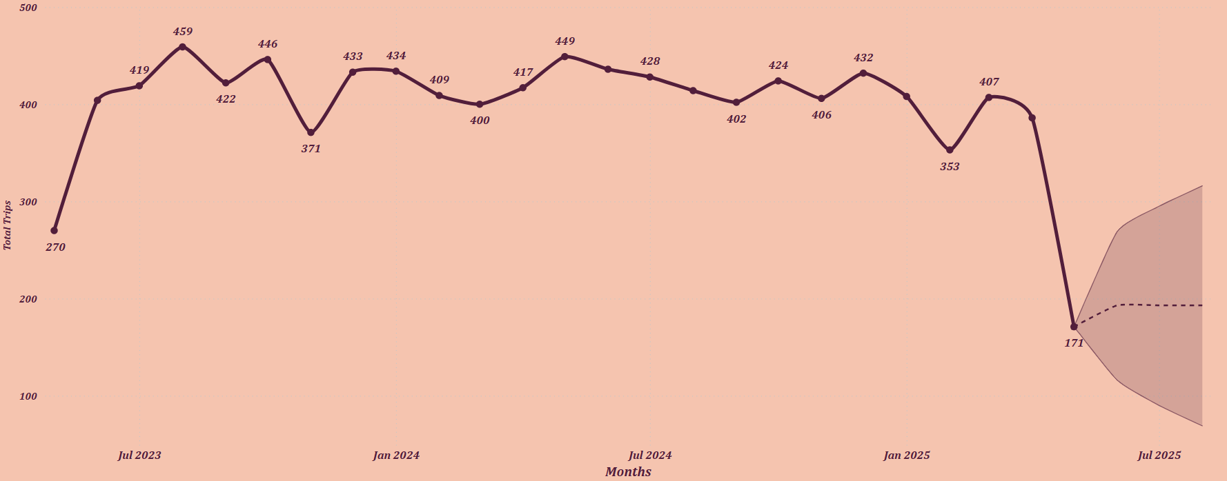
Insights: Monthly Forecasting Travel Demand
Travel demand remained relatively stable over this period, ranging mostly between 400–450 trips per month, with minor dips such as 371 in Dec 2023 and 353 in Mar 2025.
The highest number of trips was observed in Sep 2023 (459 trips) and Jun 2024 (449 trips), suggesting seasonal peaks or successful promotions during these periods.
The forecast suggests a slow and uncertain recovery, with the predicted trend (dotted line) stabilizing near 190–200 trips, but the shaded area indicates high volatility and unpredictability in future demand.
A significant drop in travel demand occurred in June 2025, plunging to 171 trips, the lowest in the dataset. This could be due to external factors such as weather, political events, or economic changes.

Slide 12
Conclusion
Stable Yet Seasonal Travel Demand Travel activity showed a consistent pattern with clear seasonal peaks (May, August, October) and drops (February, November), which can guide future planning and targeted promotions.
Forecast Signals Declining Demand The forecast reveals a sharp decline in future bookings, indicating a potential crisis if not addressed through proactive marketing and service improvements.
Gender Inclusivity in Travelers With nearly equal representation of Male, Female, and Other gender groups, the company demonstrates inclusivity. Future campaigns should continue to cater equally to all demographics.
Tourist Satisfaction Needs Attention The average tourist rating of 5.5/10 falls short of the expected 7.5 threshold, suggesting a need to enhance service quality, comfort, and overall experience.
Outliers Reveal Optimization Opportunities Profit-based outliers show both high-performing and underperforming areas. Addressing low-profit regions and learning from successful ones can drive growth.
Data-Driven Decision-Making The analysis highlights how Power BI and clean data processing help uncover key business trends and support better strategic planning.

