Slide 1

7th International Conference on Intelligent Computing & Optimization 2023, 26-27 October 2023, Phnom Penh, Cambodia
Detection of Cardiovascular Disease using Extreme Learning Machine and Artificial Neural Network
Authors :
Ashraful Reza Tanjil |
Md. Ashraful Hasan |
Fahim Mohammad Adud Bhuiyan |
Ahmed Wasif Reza
Professor
Department of Computer Science and Engineering
East West University

Slide 2
Outline
Introduction
Motivation
Challenges
Related Work
Summary of Observations
Research Objectives
Research Contributions
Materials and Methods
Experiments and Results
Conclusion
References

Slide 3
Introduction
01
Global Impact of Cardiovascular Disease
02
The Significance of Early Detection and Prevention of Cardiovascular Disease
03
The Role of Machine Learning in Cardiovascular Disease Prediction

Slide 4
Motivation
01
Accuracy Enhancement
02
Comparative Analysis
Reduction of Healthcare Costs
03

Slide 5
Challenges
01
02
Data Privacy and Ethical Considerations
Clinical Variability
Handling sensitive patient health data while adhering to strict data privacy regulations
Cardiovascular diseases can manifest differently in patients, and models should account for this clinical variability to be effective across diverse populations

Slide 6
Related Work
Several research papers (e.g., [7], [8], [9]) highlight the application of various machine learning algorithms, including Naive Bayes, Decision Tree, Random Forest, Support Vector Machine, and more, for the prediction of cardiovascular disease. These studies demonstrate the effectiveness of machine learning in diagnosing heart conditions with high accuracy, often exceeding 90%.
The research covers the utilization of diverse datasets, such as the UCI Machine Learning repository and chest X-ray images, to train and test machine learning models. Various classification techniques are explored, and the results vary, but some algorithms, like Random Forest and Decision Tree, consistently achieve high accuracy rates.
The application of the Extreme Learning Machine (ELM) algorithm is noted in some studies (e.g., [13], [14]). ELM is employed to forecast cardiovascular disease, and while it shows promise in achieving accurate predictions, there is a need for further analysis and discussion of the results in these papers.

Slide 7
Summary of observation
Diverse Algorithm Performance
Dataset Diversity
Application of Deep Learning

Slide 8
Research Objective
The primary research objective is to develop and optimize predictive models for the early detection of heart disease using Extreme Learning Machines (ELM) and Artificial Neural Networks (ANN)
The secondary research objective involves conducting a comprehensive benchmarking and comparison of the ELM and ANN models.

Slide 9
Research Contribution
Superior Performance of Deep Learning Model
Suggestions for Model Improvement
Enhancement of Healthcare Decision-Making

Slide 10
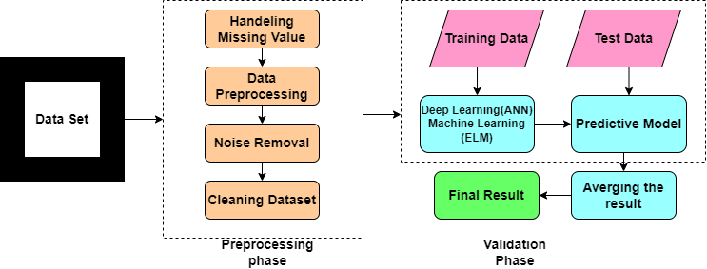
Materials and Methods
Dataset Description
Implemented Models

Slide 11
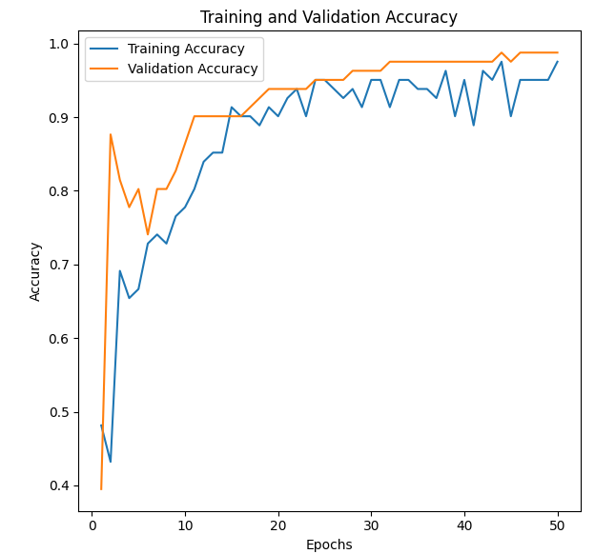
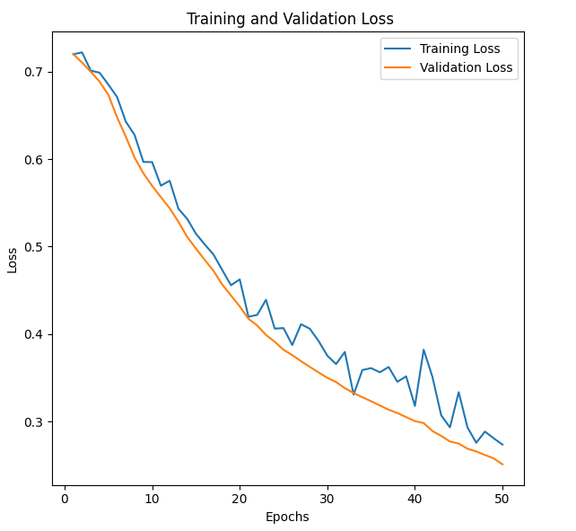
Experiments and Results
ANN Training and Validation Accuracy and Loss

Slide 12
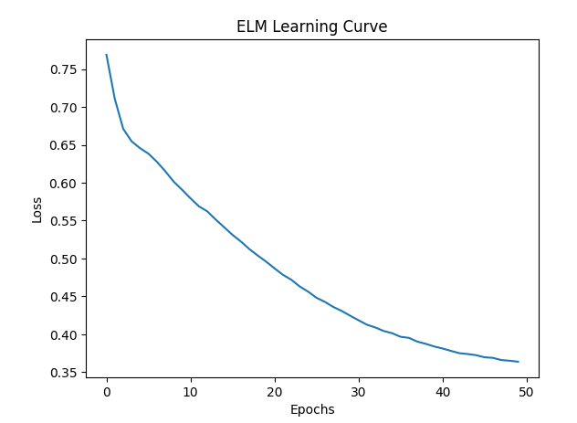
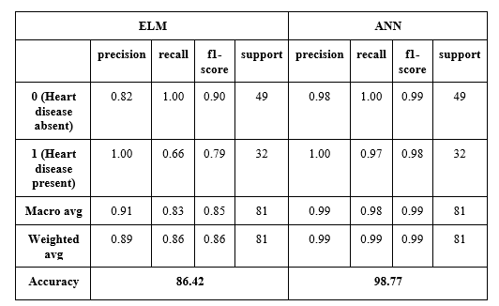
Experiments and Results
ELM Performance Evaluation
Comparison between ELM and ANN

Slide 13
Conclusion
Superiority of ANN in Accuracy
Potential for Model Enhancement
Future Research Directions

Slide 14
REFERENCES
“Estimated and actual percent deaths due to cardiovascular disease worldwide 2019 | Statista.” https://www.statista.com/statistics/1108824/cardiovascular-as-cause-of-death-estimate-and-actual-worldwide/ (accessed Jun. 15, 2023).
MissChaitrali S. Dangare, Dr.Mrs. SulabhaS.Apte, A data mining approach for heart disease prediction using neural networks, International Journal of Computer Engineering and Technology, 2012.
Jayumin Patel, Prof.TejalUpadhyay, Dr.SamirPatel,” Heart Disease Prediction Using Machine Learning and Data Mining Techniques ”, IJCSC, vol 7.No 1-sept 2015-Mar 2016.
Harshit Jindal, Sarthak Agrawal, Rishabh Khera, Rachna Jain, Preeti Nagrath, “Heart disease prediction using machine learning algorithms.” et al 2021 IOP Conf. Ser.: Mater. Sci. Eng. 1022 012072. IOP Conf. Series: Materials Science and Engineering.
Shorewala V, “Early detection of coronary heart disease using ensemble techniques.” Informatics in Medicine Unlocked (2021). https://doi.org/10.1016/j.imu.2021.100655

Slide 15
REFERENCES
Babu, Sarath, “Heart disease diagnosing using data mining technique.” Electronics Communication and Aerospace Technology(ICECA),2017 International conference of vol.1.IEEE,2017.
S. Selvan et al., “An Image Processing Approach for Detection of Prenatal Heart Disease,” Biomed Res Int, vol. 2022, 2022, doi: 10.1155/2022/2003184.
V. Sharma, S. Yadav, and M. Gupta, “Heart Disease Prediction using Machine Learning Techniques,” in Proceedings - IEEE 2020 2nd International Conference on Advances in Computing, Communication Control and Networking, ICACCCN 2020, Institute of Electrical and Electronics Engineers Inc., Dec. 2020, pp. 177–181. doi: 10.1109/ICACCCN51052.2020.9362842.
Najmu Nissa, Sanjay Jamwal, Shahid Mohammad, “Early Detection of Cardiovascular Disease using Machine Learning Techniques an Experimental Study.” International Journal of Recent Technology and Engineering (IJRTE).ISSN: 2277-3878, Volume-X, Issue-X, July 2019.
S. Zhang, Z. Wang, and Y. Li, "Early detection of coronary heart disease using ensemble techniques," in Proceedings of the IEEE International Conference on Bioinformatics and Biomedicine (BIBM), pp. 320-324, Kansas City, MO, USA, Nov. 2018.

Slide 16
REFERENCES
Matsumoto T, Kodera S, Shinohara H, Ieki H, Yamaguchi T, Higashikuni Y, Kiyosue A, Ito K, Ando J, Takimoto E, Akazawa H, Morita H, Komuro I. “Diagnosing Heart Failure from Chest X-Ray Images Using Deep Learning.” Int Heart J. 2020 Jul 30;61(4):781-786. doi: 10.1536/ihj.19-714. Epub 2020 Jul 18. Erratum in: Int Heart J. 2020;61(5):1088. PMID: 32684597
Sadia Arooj, Saif ur Rehman, Azhar Imran, Abdullah Almuhaimeed, A. Khuzaim Alzahrani, Abdulkareem Alzahrani “A Deep Convolutional Neural Network for the Early Detection of Heart Disease” Biomedicines 2022, 10, 2796. https://doi.org/10.3390/biomedicines10112796
Subha R., Anandakumar K., Bharathi A., “Prediction of cardiovascular disease using modified extreme learning machine.” International Journal of Recent Scientific Research Vol. 8, Issue, 11, pp. 21881-21887, November, 2017. DOI: 10.24327/IJRSR.
Salam I., Ali M., and Dharmendra C. “ Using the Extreme Learning Machine (ELM) Technique for Heart Disease Diagnosis.” 2015 IEEE Canada International HumanitarianTechnology Conference(IHTC2015), September 2015, DOI: 10.1109/IHTC.2015.7238043.

Slide 17
REFERENCES
“Heart Disease Dataset | Kaggle.” https://www.kaggle.com/datasets/johnsmith88/heart-disease-dataset (accessed Jun. 15, 2023).
SonamNikahr, A.M.Karandikar, "Prediction Of Heart Disease Using Machine Learning Algorithms", International Journal Of Advanced Engineering, Management, and Science,vol-2, June 2016.
Sadia Arooj, Saif ur Rehman, Azhar Imran, Abdullah Almuhaimeed, A. Khuzaim Alzahrani, Abdulkareem Alzahrani “A Deep Convolutional Neural Network for the Early Detection of Heart Disease” Biomedicines 2022, 10, 2796.

Slide 18
Thank you

