Slide 1

7th International Conference on Intelligent Computing & Optimization 2023
Temperature and Humidity Optimization of Smart Greenhouses: Comparison Between Simulated Annealing and Genetic Algorithm
Authors:
Fahim Mohammad Adud Bhuiyan |
Ashraful Reza Tanjil |
Md. Ashraful Hasan |
Ahmed Wasif Reza
Professor
Department of Computer Science and Engineering
East West University

Slide 2
OUTLINE
Introduction
Motivation
Challenges
Related Work
Summary of Observation
Research Objectives Research contributions
Material and Method
Experiments and Results
Conclusion
References

Slide 3
Introduction
Greenhouse Temperature Challenges
Comparison of Optimization Techniques
Importance of Greenhouse Efficiency

Slide 4
Motivation
Energy Efficiency Crop Yield Enhancement

Slide 5
Challenges
Complexity of Environmental Factors Energy Consumption and Costs

Slide 6
Related Work
Previous research focused on optimizing greenhouse microclimate using a genetic algorithm combined with fuzzy logic control. While it demonstrated improved performance, it lacked a comprehensive evaluation against other optimization methods.
Another study delved into the application of simulated annealing for solving complex optimization problems. It highlighted the algorithm's ability to find near-optimal solutions, even in challenging scenarios, but noted computational expenses for large-scale tasks.
In a different approach, researchers used an improved backpropagation neural network and genetic algorithm to predict greenhouse air temperature and humidity. While effective, the study lacked thorough validation and comparisons with standard practices, presenting room for further exploration

Slide 7
Summary of Observation
Diverse Optimization Approaches
Common Shortcomings
Prediction and Forecasting

Slide 8
Research Objectives
Assess the efficiency of simulated annealing and genetic algorithms in achieving target temperature and humidity settings while considering computational efficiency in smart greenhouse control.
Investigate the feasibility of real-time temperature and humidity control in a smart greenhouse using simulated annealing and genetic algorithms.

Slide 9
Research Contributions
Algorithmic Stability:
The study highlights the stability and consistency of the Genetic Algorithm (GA) compared to Simulated Annealing (SA), showcasing GA's reliability in identifying optimal solutions despite input or parameter variations.
Practical Implications:
The research underscores the potential of optimization algorithms like GA for improving greenhouse agriculture, offering a suitable solution for enhancing crop cultivation and resource utilization in real-world smart greenhouses.
Future Research Directions:
The research suggests potential future research directions, including optimizing algorithm parameters, investigating hybrid strategies combining SA and GA, and comparing their performance against other optimization methods.

Slide 10
Materials and Methods
Data Source and Preprocessing
Optimization Objective
Algorithmic Approach
Performance Metrics

Slide 11
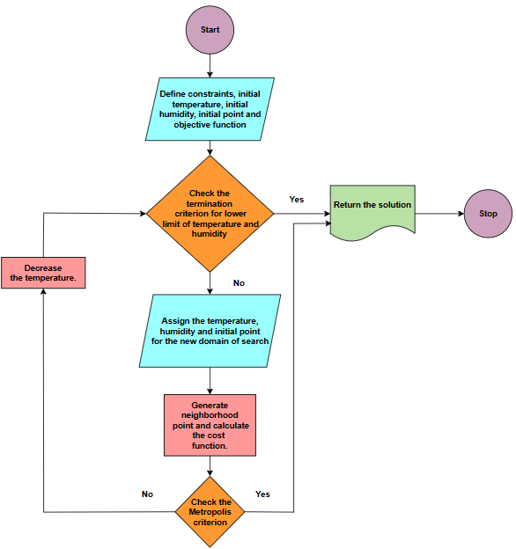
Materials and Methods

Slide 12
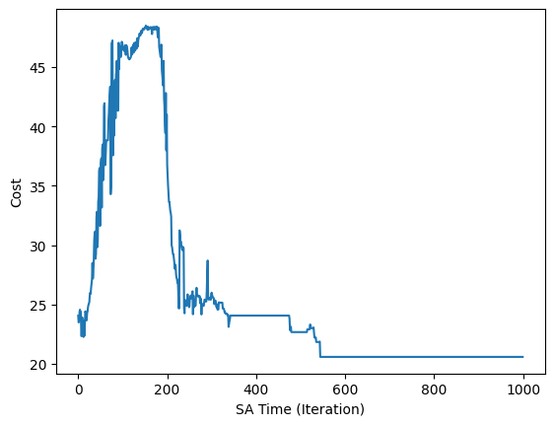
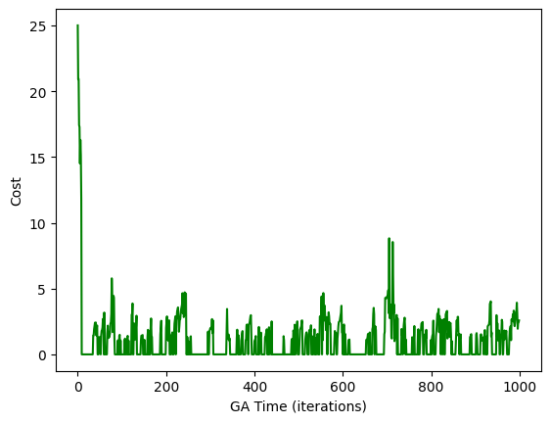
Experiments and Results
Fig1. Simulated Annealing Process
Fig2. Genetic Algorithm Process

Slide 13
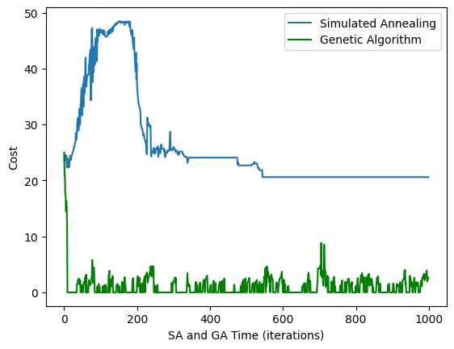
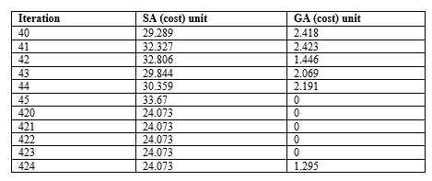
Experiments and Results
Fig3. shows the cost history over time (iterations) for both the simulated annealing and genetic algorithms. This can help to compare the two algorithms' performance and how the cost changes over time and iterations.
Fig4. shows the overall performance of the algorithms. Here, we have taken some cost values for comparison from a randomly taken portion of iteration.

Slide 14
Conclusion
Stability and Consistency
Practical Applicability
Future Research Directions
The conclusion emphasizes the stability and consistency demonstrated by the Genetic Algorithm (GA) in optimizing greenhouse conditions.
The conclusion calls for future research to focus on fine-tuning algorithm parameters, investigating hybrid approaches combining SA and GA, and conducting comprehensive comparisons with alternative optimization methods.
The conclusion suggests that the promising results of this research have practical implications for greenhouse agriculture.

Slide 15
References
J. C. L. Z. H. Z. Fang Xu, Real Coded Genetic Algorithm for Optimizing Fuzzy Logic Control of Greenhouse Microclimate, Springer Link, cilt 344, p. 1, (2006).
D. E. Samir W.Mahfoud, Parallel recombinative simulated annealing: A genetic algorithm, ELSEVIER, cilt Volume 21, no. Issue 1, pp. 1-28, (1995).
C. D. G. J. M. P. V. S. Kirkpatrick, Optimization by simulated annealing, Science, cilt 220, p. 671, (1983).
C. M. H. C. M. Y. C. Fen He, Greenhouse Air Temperature and Humidity Prediction Based on Improved BP Neural Network and Genetic Algorithm, Springer, pp. 571-577, (2006).
Abdelhafid Hasnia, Rachid Taibi, Belkacem Draoui, Thierry Boulard, Optimization of Greenhouse Climate Model Parameters Using Particle Swarm Optimization and Genetic Algorithms, Energy Procedia ·, pp. 371-380, (2010).
R. A. R. M. P. Leonilde Rocha Varela, SIMULATED ANNEALING & FUZZY OPTIMIZATION, içinde Proceedings of the 10th Mediterranean Conference on Control and Automation - MED2002, Lisbon,, (2002).
M. S. Bahareh Pourbabaee, Fuzzy Temperature & Humidity System Optimization by Simulated Annealing, içinde International Conference on Control, Automation and Systems , 2008, (2008).
R. K. Singh, M. H. Rahmani, M. Weyn, and R. Berkvens, “Joint Communication and Sensing: a Proof of Concept and Datasets for Greenhouse Monitoring using LoRaWAN,” Dec. 2021, doi: 10.5281/ZENODO.5793685.

Slide 16
References
A. H. H. V. Nader Barsoum, HYBRID SIMULATED ANNEALING AND GENETIC ALGORITHMS FOR INDUSTRIAL, %1 içinde Power Control and Optimization, Bali Indonesia, (2009).
P. M. ,. X. Z. Fang Zhao, Simulated Annealing–Genetic Algorithm for Transit Network Optimization, Journal of Computing in Civil Engineering, cilt 20, no. 1, 2006
D. Nasr, R. E. Dahr, J. Assaad, and J. Khatib, “Comparative Analysis between Genetic Algorithm and Simulated Annealing-Based Frameworks for Optimal Sensor Placement and Structural Health Monitoring Purposes,” Buildings, vol. 12, no. 9, p. 1383, Sep. 2022, doi: 10.3390/buildings12091383.
R. E. D. Randall S.Sexton, Optimization of neural networks: A comparative analysis of the genetic algorithm and simulated annealing, European Journal of Operational Research, cilt 114, no. 3, pp. 589-601, (1999).
S. M. L.K. Gaafar, Genetic algorithms and simulated annealing for scheduling in agile, International Journal of Production And Research, cilt Vol. 43, p. 3069–3085, (2005).
L. S. J. Eliška Svobodová, Method for Automatic Furniture Placement Based on Simulated Annealing and Genetic Algorithm of Applied Intelligent Systems, IEA/AIE 2021 Kuala Lumpur, Malaysia, July 26–29, 2021, Proceedings, Part I, 34th International Conference on Industrial, Engineering and Other Applications, p. 480, (2021).
P. M. P. Thelma D. Mavridou &, Simulated Annealing and Genetic Algorithms for the Facility Layout Problem: A Survey, Springer Link, p. 111–126, (1997

Slide 17
Thank you

