Slide 1

Course Title:Machine Learning Lab Course code:IT 436 Project Name:BigMart Sales Prediction
Submitted To Md Mynouddin Lecturer,Dept. of IT,UITS
Submitted By Md Ataur Rahman ID:16155032 Dept:IT
Submission Date:01/08/2019

Slide 2
Introduction:
According to the information provided, Bigmart is a big supermarket chain, with stores all around the country and its current board set out a challenge to all Data Scientist out there to help them create a model that can predict the sales, per product, for each store. BigMart has collected sales data . With this information the corporation hopes we can identify the products and stores which play a key role in their sales and use that information to take the correct measures to ensure success of their business.

Slide 3
Select a Performance Measure
Usually for regression problems the typical performance measure is the RootMean Square Error . This function gives an idea of how much error the system makes in its predictions with higher weight for large errors.
Make Assumptions:
After framing our problem and deciding on the performance measure, it is good to make some assumptions on what possible outcomes we might expect from our analysis according to the available data. Therefore, by knowing the goal we should think which possible factors might affect the sales prediction outcome. We can start by diving the process into four levels: Store level, Product level, Customer level and Macro level.

Slide 4
Business Problem
The decision makers of BigBart should be able to analyze the effect of various factors affecting
the sales of the products in their stores. The various factors include weather condition i.e.,
temperature, store size, fuel prices, markdown in prices, unemployment and CPI.
Analytic problem
In this problem we have analyzed sales across different departments by store type and created weekly and monthly dashboard. We have analyzed the effect of various factors such as temperature, store size, fuel prices, markdown in prices, unemployment and CPI to determine which factors have a statistical significance in explaining sales in the stores by using simple and multiple linear regression.

Slide 5
The features we have use
Technology uses
Anaconda(free open source)
Jupyter Notebook
Python 3
Data file:
Train.csv
Fetures.csv
Stores.csv
train.csv: This is the historical training data, which covers to 2010-02-05 to 2012-11-01. Within
this file you will find the following fields:
Store - the store number
Dept - the department number
Date - the week
Weekly_Sales - sales for the given department in the given store
IsHoliday - whether the week is a special holiday week

Slide 6
features.csv: This file contains additional data related to the store, department, and regional
activity for the given dates. It contains the following fields:
Store - the store number
Date - the week
Temperature - average temperature in the region
Fuel_Price - cost of fuel in the region
MarkDown1-5 - anonymized data related to promotional markdowns that Walmart is
running. MarkDown data is only available after Nov 2011, and is not available for all stores
all the time. Any missing value is marked with an NA.
CPI - the consumer price index
Unemployment - the unemployment rate
IsHoliday - whether the week is a special holiday week
We merged the data files to our convenience for analysis which have been uploaded in our github
page.

Slide 7
Algorithm use
Linear regretion
Xbooster
Decision tree
Linear regression:
Input: Dataset with proper input and output labels
Output: Predict sales value and store in csv file Begin
i. Calculate mean, variance for the list of values
Def Mean(values):
Sum(values) divided by Len(values)
Calculate Mean_x, Mean_y
Def Variance (values, Mean):
sum([(values-Mean) ^2])
Calculate Variance_x, Variance_y
ii. Calculate covariance
Covar<=0
Def Covariance (x, Mean_x, y, Mean_y):
For length of x do:
Covar<= Covar + (x[i] - Mean_x) * (y[i] -
Mean_y)
End
iii. Estimate coefficients
B0 <= covariance (x, Mean_x, y, Mean_y) /
variance (x, Mean_x)
B1 <=Mean_y – B0*Mean_x
iv. Predict
For every X in the test set do:
Y <=B0+B1X
End
Store predicted values in CSV file.

Slide 8
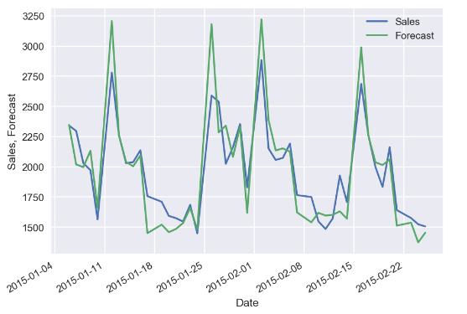
Figure 10.Sales forecasting with long time (2 year) historical data.

Slide 9
Conclusion :
The relationship between the sales and temperature was varying with each and every department. Hence, the above were the insights drawn by the analysis of the sales data of the Walmart.

