Slide 1

SmartFire Car: An Image Processing and Artificial Intelligence-Based Fire Detection and Extinguishing System
Paper ID
45
Indrojit Sarkar, Fazle Rabbi, Md. Ayenul Azim, Md. Ashiqul Haider Chowdhury, Maliha Ferdous and Mohammad Ali
Email: {indro.ij, rabbifazle38, mdayenulazim.jahin, aupurbo392000, mohammadali.kazmi61 }@gmail.com
Department of Electrical and Electronic Engineering, Bangladesh University of Engineering and Technology, Dhaka-1205, Bangladesh

Slide 2
Outline
Introduction
Features of SmartFire Car
Algorithm Workflow
Haar Cascade in Fire Detection
Distance Calculation
Movement Control
System Performance Evaluation
Cost Calculation
Conclusion

Slide 3
Introduction
Global Fire Hazards
-- Death of firefighter
-- Loss of valuable resources
-- Environmental Impact
Challenges in Traditional Methods
-- Analog method & Limitation
-- Sensor-based method : Reliability concern
SmartFire Car as Solution
-- An Image Processing and AI based Fire Detection

Slide 4
Features
Fire detection using Haar Cascade Classifier
Calculation of Optimal Stopping Distance
Movement control of the SmartFire Car and Extinguish system

Slide 5
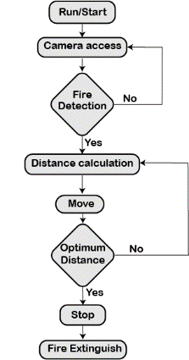
Algorithm Workflow
Five-Phase Workflows: Utilizes image processing and AI for fire detection, distance calculation, tracking, precise vehicle stop, and water spraying
Sequential Functionality: Systematically employs advanced technologies for comprehensive fire detection and extinguishing, ensuring a precise and effective process.
Integrated Intelligence: Each phase plays a pivotal role, emphasizing the integration of image processing and AI for enhanced firefighting capabilities.

Slide 6
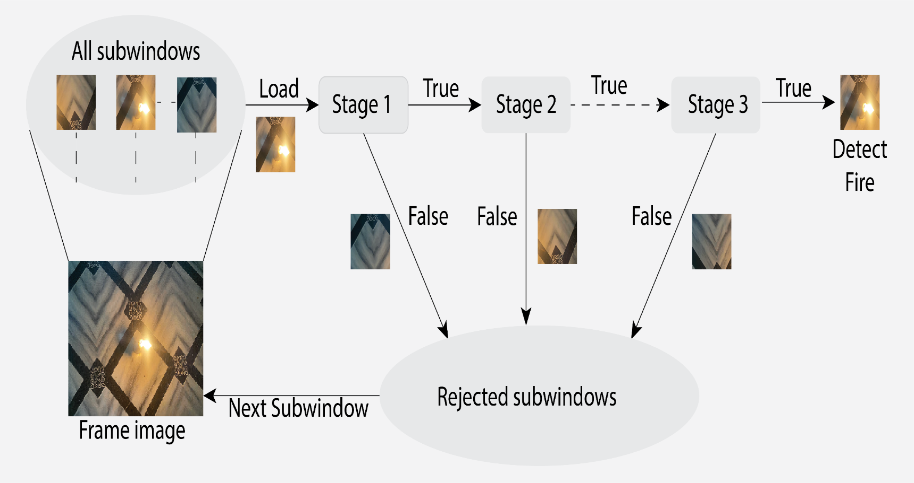
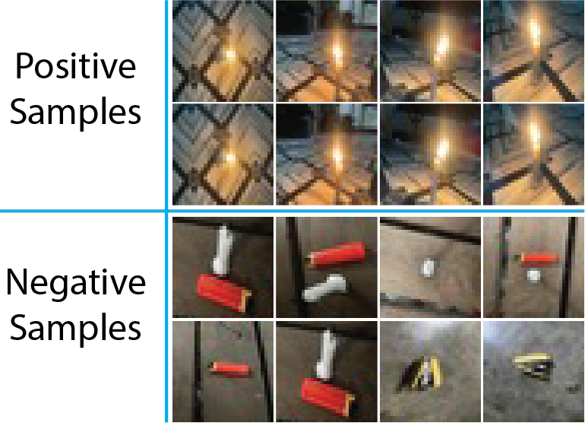
Haar Cascade in Fire Detection
Positive samples illustrating fire instances and negative samples portraying non-fire scenarios, constituting a comprehensive dataset for model training.
The Haar Cascade classifier efficiently evaluates image regions, distinguishing fire from non-fire based on learned Haar-like features, using a sliding window approach for positive fire detection

Slide 7
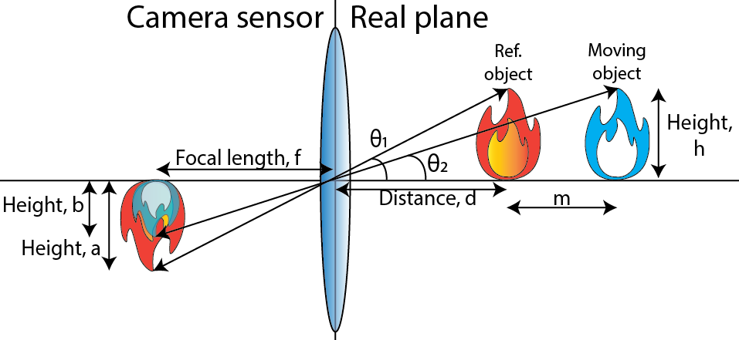


Distance Calculation
Used formulas:
For accurate distance measurement, a reference image with known height and distance from the camera is essential, exemplified in measuring the distance between the fire source and the SmartFire Car.

Slide 8
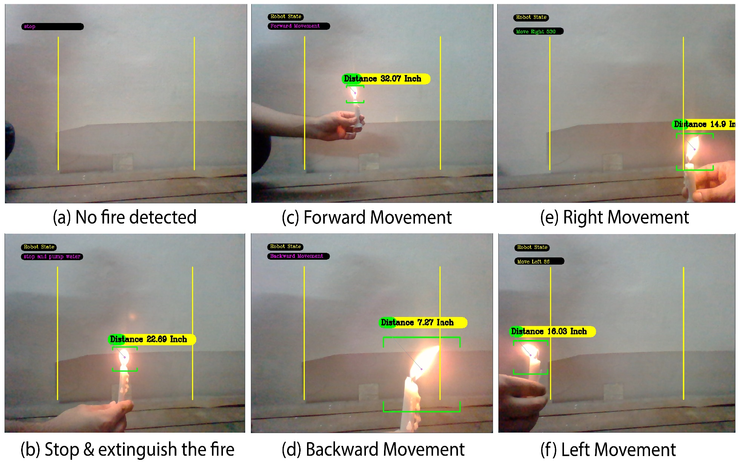
Movement Control
SmartFire's versatile responses to varied fire scenarios: no detection, optimal range activation, long-distance approach, close-proximity safety, and lateral fire locations
Optimal stopping distance is in between 20-30 inches

Slide 9
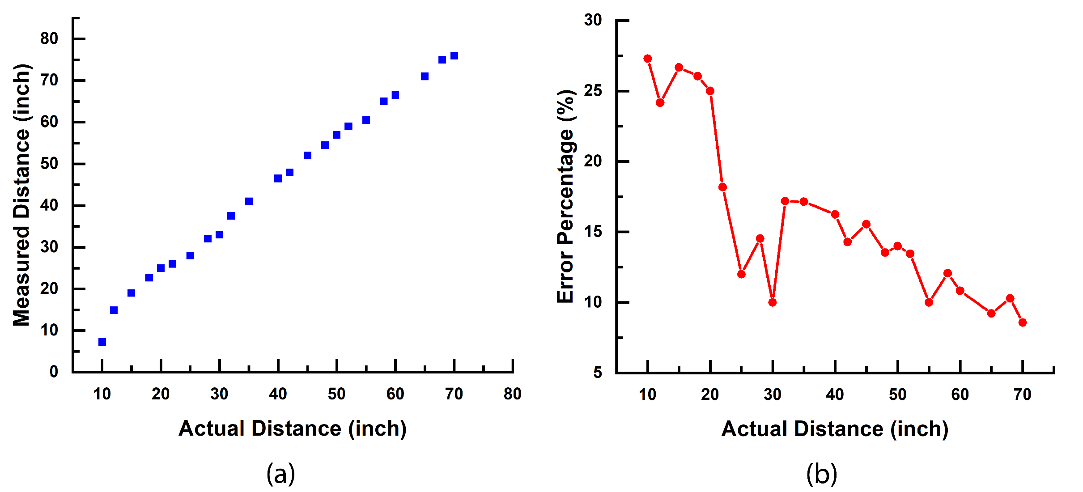
System Performance Evaluation
Case 1: Distance measurement Performance analyses
Observations:
Can detect more distance fire than sensors
Less error-prone in optimal stopping distance

Slide 10
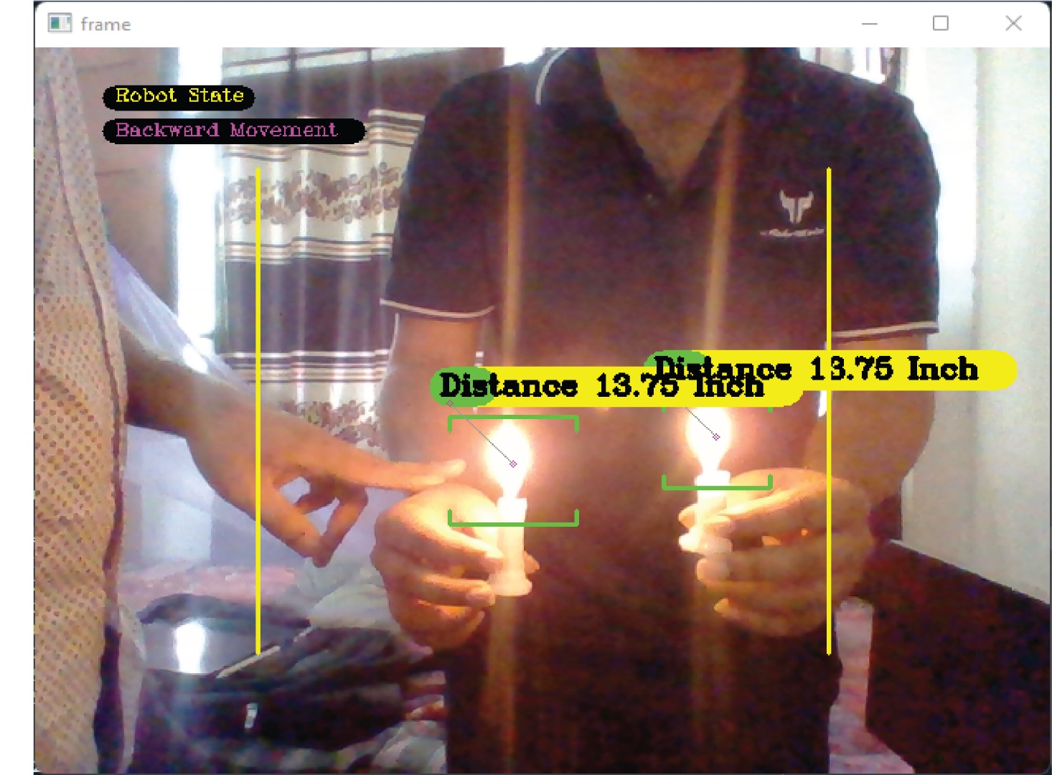
System Performance Evaluation(2)
Case 2: Handling Multiple Fire Sources- Detection and Prioritization
Observation:
Minimum Fire Size for Detection
**Designed for Fires > 0.3% Frame Size

Slide 11
Cost Calculation
Components | Price ( in USD)
Arduino Uno (x2) | $ 20.00
L293D motor shield | $ 1.00
NRF24L01 + wireless transceiver module(x2) | $ 2.00
ESP32 CAM module | $ 5.25
Micro submersible water pump | $ 1.25
Chassis, motors, and wheels | $ 5.00
Battery, connectors, and others | $ 9.50
Total | $ 44.00 ( Approx.)

Slide 12
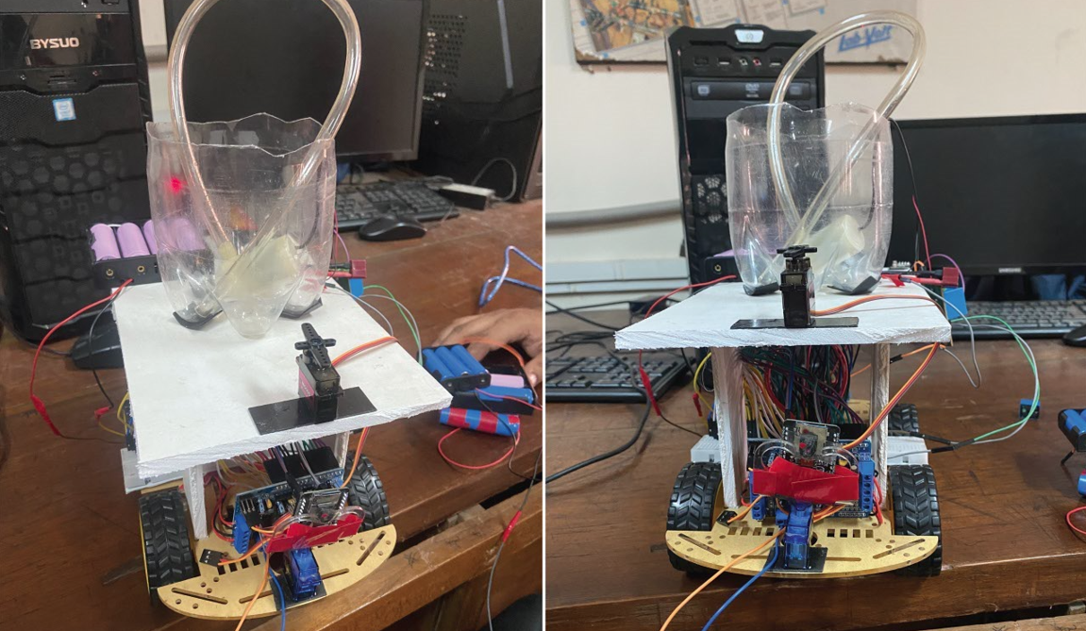
Final Prototype
The developed prototype integrates cutting-edge image processing and artificial intelligence, giving rise to the SmartFire car, a pioneering solution for efficient fire detection and suppression

Slide 13
Conclusion
In 2018, the National Fire Protection Association journal reported 64 recorded fatalities among on-duty firefighters in the United States, emphasizing the substantial risks inherent in their line of duty
Globally, burns contribute significantly to public health challenges, with approximately 180,000 annual deaths reported by the World Health Organization (WHO). This underscores the broader impact of fire-related incidents on human lives worldwide
Deploying the automated SmartFire bot presents a viable solution to tackle these challenges and demonstrates significant effectiveness in fire suppression

Slide 14
Thank you !
Feel free to ask questions about the presentation !

