Slide 1
Course No : EEE 414 Course Title : Electrical Service Design
Md. Ashiqul Haider Chowdhury | 1806086
Fazle Rabbi | 1806087
Md. Ayenul Azim Jahin | 1806089
Indrojit Sarkar | 1806090
Md. Wazih Yeaser Tanzim | 1806079
Abdul Mumin Redhowan | 1806073
Presented by: 1906XXX

Slide 2
Design Steps
Architectural Floor Planning for a Six-Stored Building
Integration of Fittings and Fixtures on Each Floor
Strategic Conduit Layout Planning for Each Floor
Elaborate Switchboard and Distribution Board Diagrams
Thorough Design of Lightning Protection System (LPS)
Presented by: 1906XXX

Slide 3
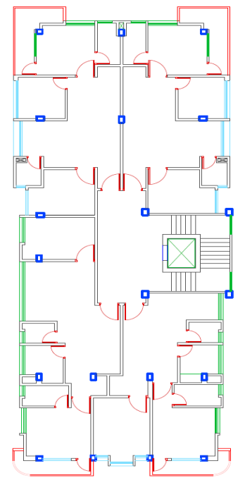
Layout of 6 storied building:
Fig: Layout of first floor​
Presented by: 1906XXX

Slide 4
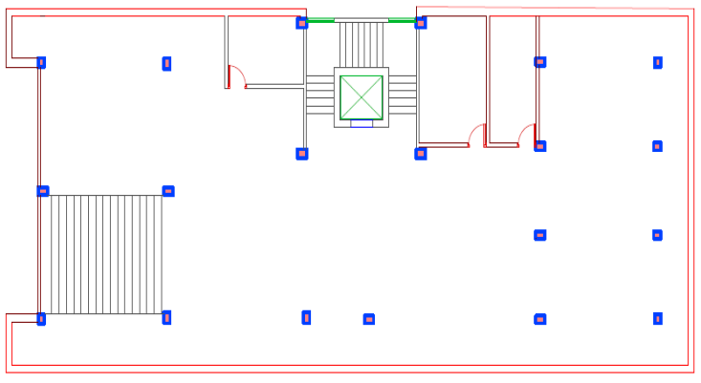
Layout of 6 storied building:
Fig: Layout of first floor​
Presented by: 1906XXX

Slide 5
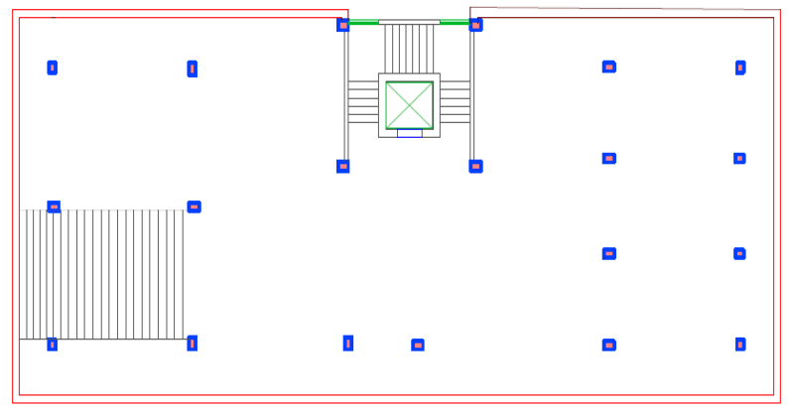
Layout of 6 storied building:
Fig: Layout of first floor​
Presented by: 1906XXX

Slide 6
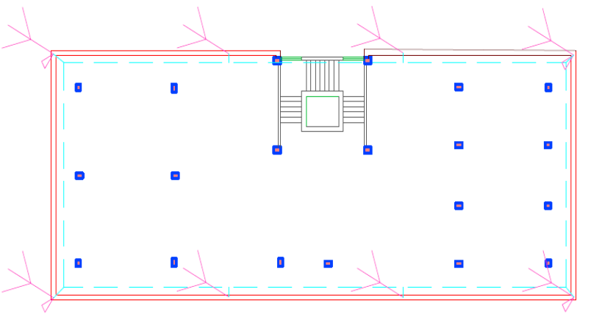
Layout of 6 storied building:
Fig: Layout of first floor​
Presented by: 1906XXX

Slide 7

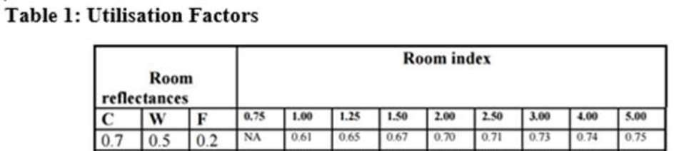
Calculation
Utilization Factor
Mounting height = Luminaire height – Work plane height = 9 ft – 3 ft = 6 ft = 1.828 meter
We also need to know the surface reflectance of ceiling (C), wall (W) and floor
Typically, they are chosen as C = 0.7, W = 0.5 and F = 0.2.
Presented by: 1906XXX

Slide 8

Calculation
Light Requirement
Room length = L (in meters) Room width = W (in meters) N = Number of lights required E = Luminance level required (lux). F = Average luminous flux from each light source (lumen) UF = Utilization factor MF = Maintenance factor
Presented by: 1906XXX

Slide 9
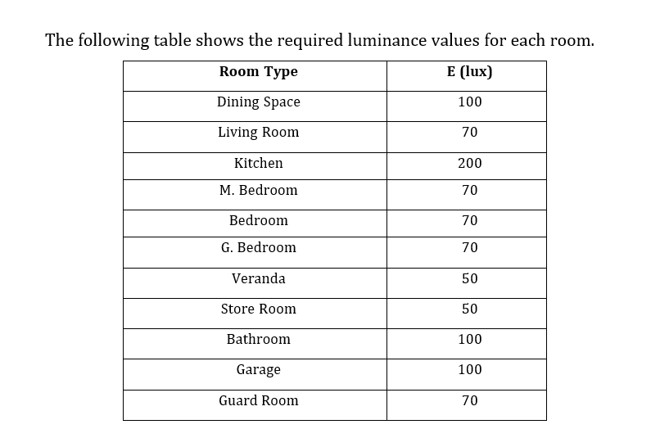
Calculation
Presented by: 1906XXX

Slide 10

Calculation
Fan Requirement
Presented by: 1906XXX

Slide 11
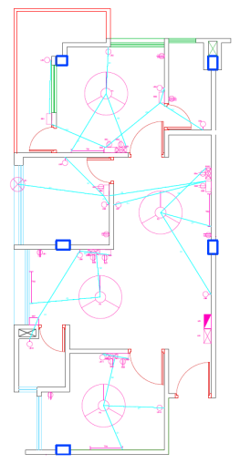
Fittings with conduit connection of Appartment
Fig: Layout of 1st & 2nd appartment​
Presented by: 1906XXX

Slide 12
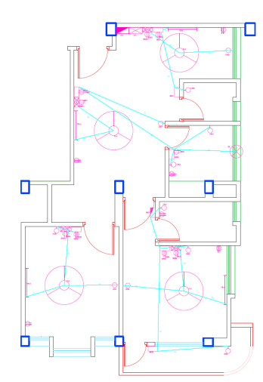
Fittings with conduit connection of Appartment
Fig: Layout of 3rd appartment​
Presented by: 1906XXX

Slide 13
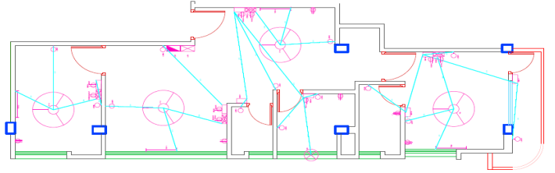
Fittings with conduit connection of Appartment
Fig: Layout of 4th appartment​
Presented by: 1906XXX

Slide 14
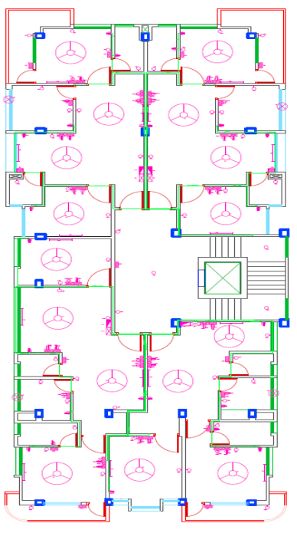
Complete layout with fitting with SDB
Fig: Layout of first floor​ with SDB
Presented by: 1906XXX

Slide 15
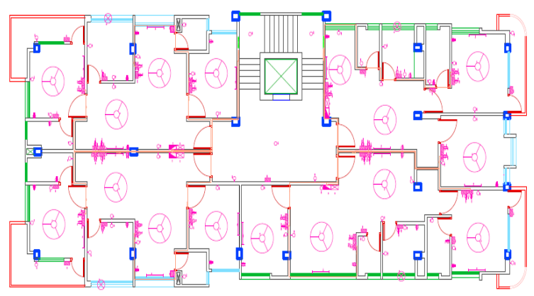
Complete layout with fitting with ESDB
Fig: Layout of first floor with ESDB​
Presented by: 1906XXX

Slide 16
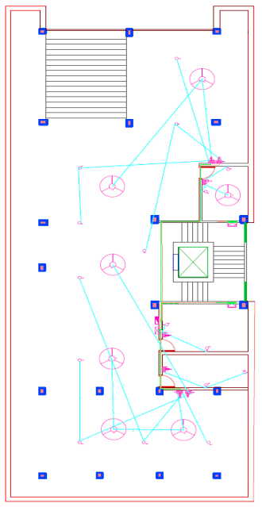
Conduit Layout Planning
Fig: Layout of Ground floor​
Presented by: 1906XXX

Slide 17
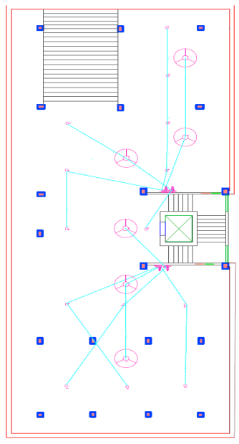
Conduit Layout Planning
Fig: Layout of Basement​
Presented by: 1906XXX

Slide 18
Calculations for Main Distribution Boards
​ (1)EMDB​ 8 person Elevator Load=5000W​ 𝐼 =​ 5000​ 3 × 220 × .7 = 10.822𝐴​ So, 15A SP MCCB is needed from Elevator to EMDB​
Total Load = (336+(658+658+658+658) ⨯ 5+266+5000)⨯ 0.7W​ = 13134 W​
EMDB Current, 𝐼 = 28.4286𝐴
So, 30A TP MCCB is needed from MDB TO EMDB​
A 15kW or 20 KVA Generator is used to supply the EMDB load through an ATS.Generator room​, dimension will be 25 sqm.​
Presented by: 1906XXX

Slide 19
Calculations for Main Distribution Boards
(2)MDB Total SDB Load = ( 9750⨯20+560+770) W = 196330 W Pump Load = 2500 W MDB Load = Total SDB Load ⨯ 0.7 + ( EMDB Load + Pump Load ) ⨯ 0.7 = 196330 ⨯ 0.7 + ( 13134+112+ 2500 ) ⨯ 0.7 W = 148453 W MDB Current, 𝐼 = 148453/(220×.7) = 321.3272𝐴 So, 400A TP MCCB is needed from Main Line to MDB.
Presented by: 1906XXX

Slide 20
Calculation of PFI Plant
Cosx = 0.7 Sinx = 0.714 Q= 3VIsinx = ptanx = 151.422 kVar I = Q/3Vsinx = 482 A So, 500A TP MCCB is req. from PFIto MDB
Calculations for Transformer
S= VI = 220*321.3272 A = 212.075 kVA So, 11/0.415 kV, 50 Hz, 300 kVA, DYN 11, Oil Immersed Transformer with 4- 6% impedence is needed. Transformer room dimension will be 48 sqm.
Presented by: 1906XXX

Slide 21
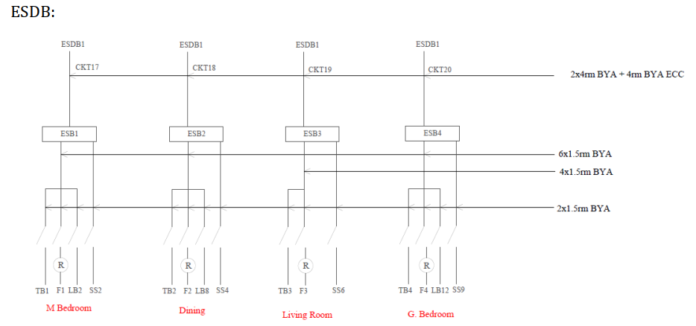
Switchboard Diagram Apt 1
​
Presented by: 1906XXX

Slide 22
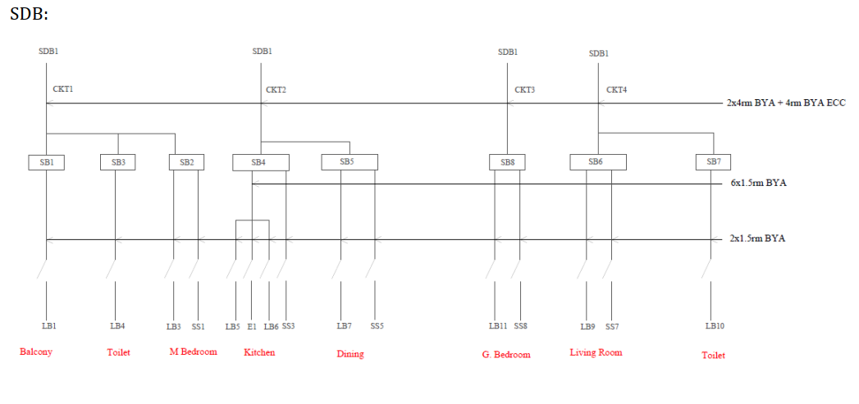
Switchboard Diagram Apt 1
Presented by: 1906XXX

Slide 23
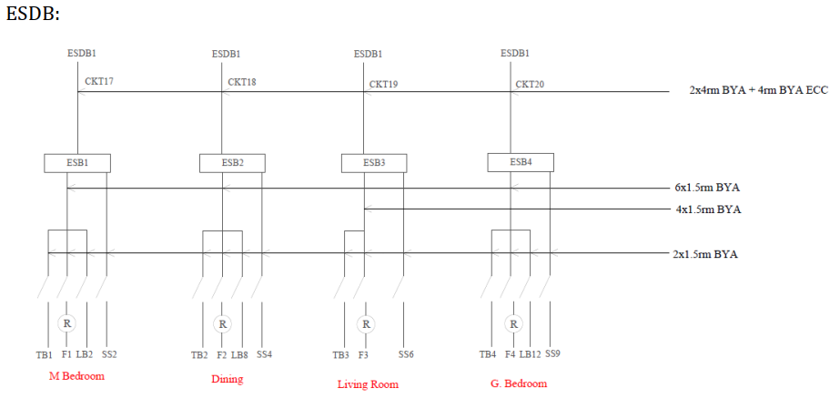
Switchboard Diagram Apt 2
Presented by: 1906XXX

Slide 24
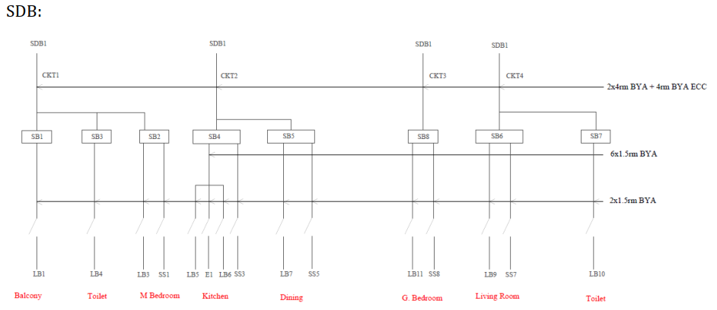
Switchboard Diagram Apt 2
Presented by: 1906XXX

Slide 25
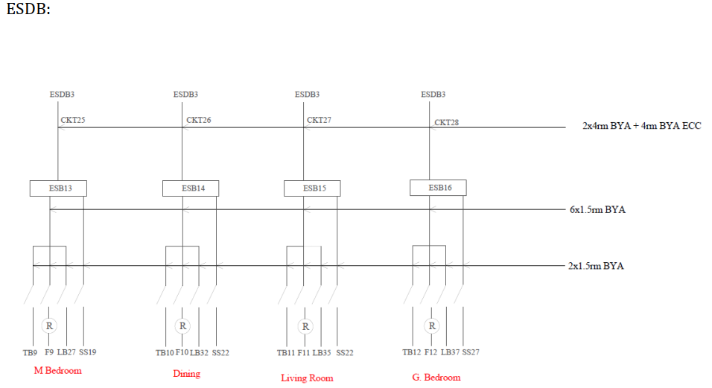
Switchboard Diagram Apt 3
Presented by: 1906XXX

Slide 26
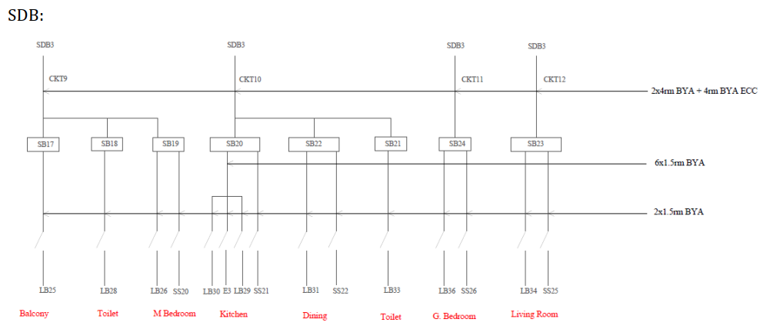
Switchboard Diagram Apt 3
Presented by: 1906XXX

Slide 27
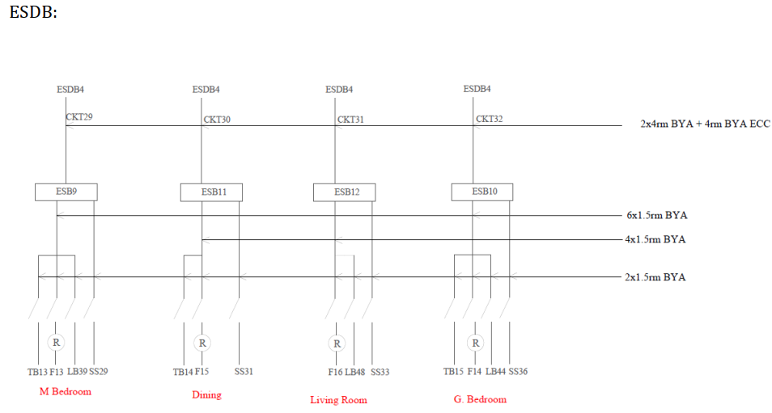
Switchboard Diagram Apt 4
Presented by: 1906XXX

Slide 28
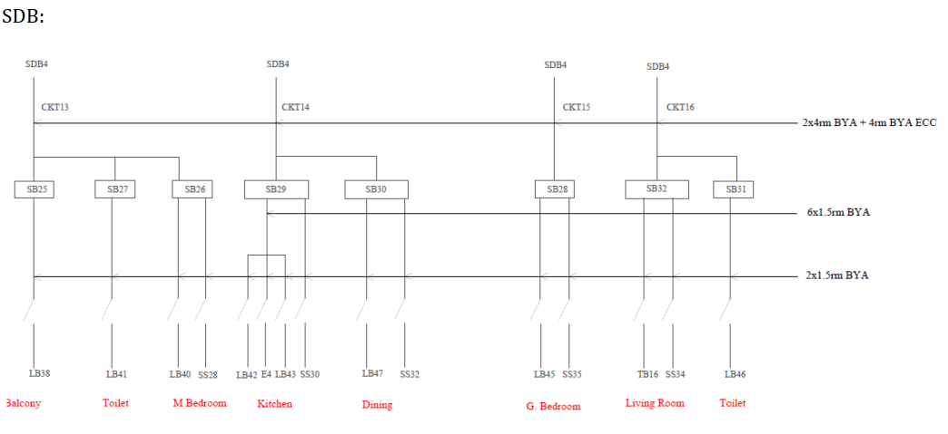
Switchboard Diagram Apt 4
Presented by: 1906XXX

Slide 29
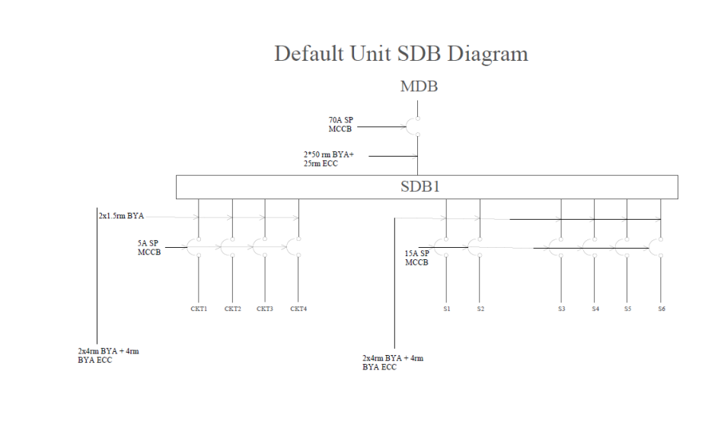
SDB diagram
Presented by: 1906XXX

Slide 30
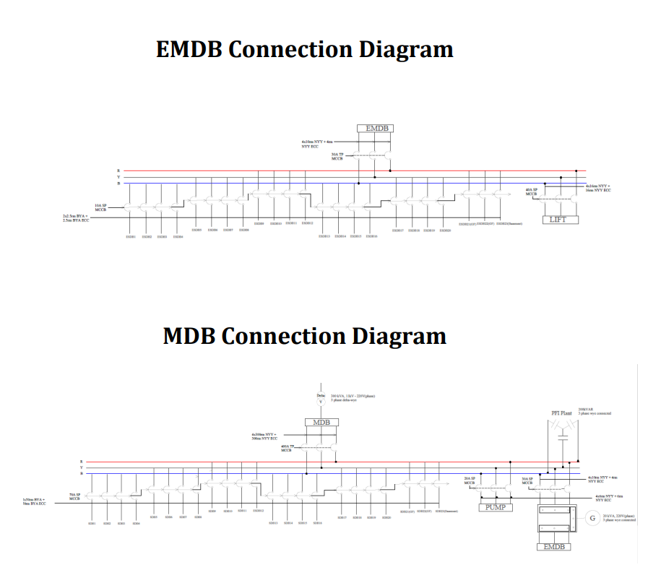
Presented by: 1906XXX

Slide 31
Lighting Protection System:
Total area=313 sqm
Length=90ft
Width=40ft
Lighting arrestor in length =(90/25)
=4
Lighting arrestor in length =(40/25)
=2
Earth down conductor =1(for 80 sqm)+(313-80)/100
=1+3
=4
Presented by: 1906XXX

Slide 32
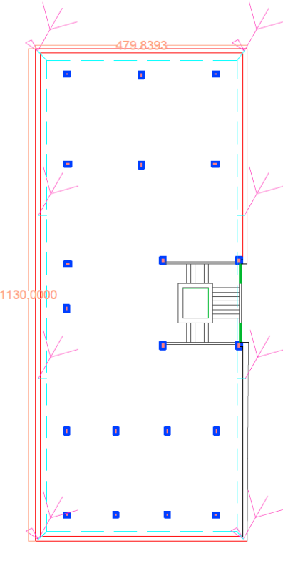
Lightning arrestor at rooftop
Fig: Layout of first floor​
Presented by: 1906XXX

Slide 33
Thank you
Presented by: 1906XXX

