Slide 1
Secure Smart Home System Based on SCiON Athul Vattapilly, Baizil Mulakkampilly Devassy (221544)

Slide 2
Contents
Motivation and Tasks of the Project
Block diagrams
Photoelectric Smoke Detector
Node MCU ESP 8266
MQTT
SCION Network and SCION-IP Gateway (SIG)
Node-Red
Circuit Diagram and Design
PCB Design
Wi-Fi Manager
Battery Consumption Calculation
Node – Red Flow
Conclusion and Future Works

Slide 3
Motivation and Tasks of the Project
Smoke sensors are always used in our homes for our safety, but the conventional one’s were controlled manually. Our motivation is to make normal smoke detection process smart.
To make a conventional smoke detector detect any alarms and to differentiate whether it is a test alarm or smoke alarm.
To establish a communication network in order to inform the user about smoke detector status.

Slide 4
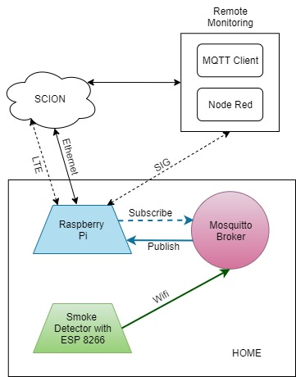
Smart Smoke Detector – Functional Block Diagram

Slide 5
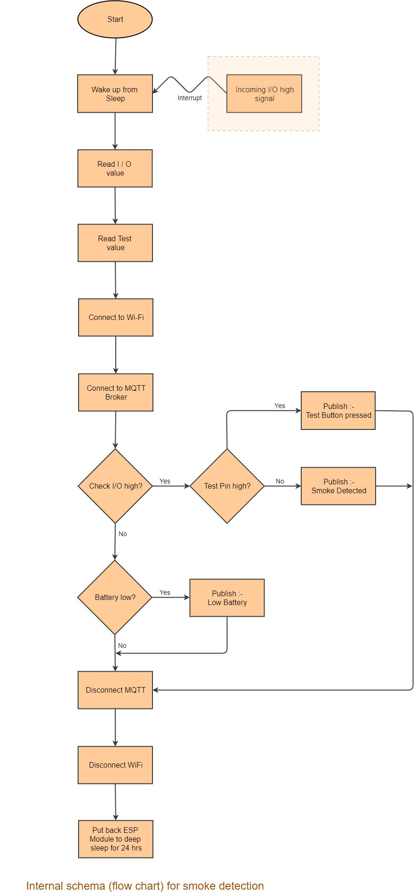
Smart Smoke Detector – Internal Block Diagram

Slide 6
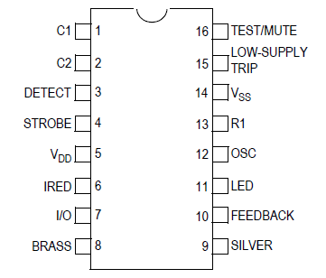
Photoelectric Smoke Detector
Most responsive to smoldering fire
Consists of :-
Light emiting diode
Light sensitive sensor
Located in a sensing chamber
Main circuit based on MC145010 Photoelectric Smoke Detector IC
Very low power circuitry
Detection accomplished by scattered light from smoke particles
16 pin IC each with own purpose
Gives a high output signal for smoke detection
Buzzer which acts as alarm
9V, 1.5A DC power supply

Slide 7
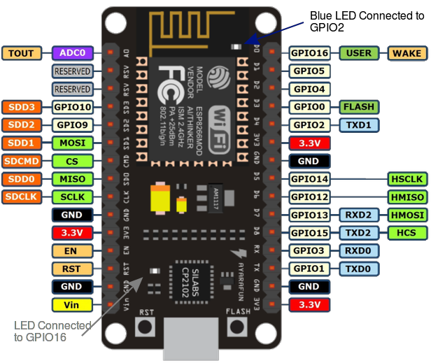
Node MCU ESP 8266
Low cost Wifi microchip TCP/IP stack and microcontroller capability
Peripherals and I/O
10 bit ADC channel
UART
SPI, I2C, I2S interface
Serial Communication
USB-to-UART converter
4.5 Mbps communication speed
Flow Control support
Sleep Modes
Modem sleep
Light sleep
Deep sleep

Slide 8
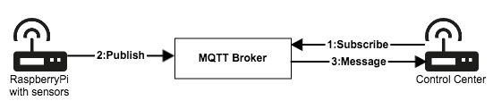
MQTT (Machine to Machine Telemetry Transport)
Lightweight publish/subscribe messaging transport
MQTT Broker
Transmits messages between senders and receivers
Topic is the routing information to the broker
Delivers all messages with the matching topic to the client
MQTT Client
Publishes a message to the broker over a topic
Enables highly scalable solutions without dependencies
Communication between sensor client and control center over MQTT

Slide 9
SCION Network and SCION-IP Gateway (SIG)
Scalable, Control and Isolation on Next Generation Networks (SCION) for communication
SCION IP Gateway (SIG) enables legacy IP applications to communicate over SCION
Takes care of :-
Encapsulation of IP traffic into the SCION one at the sender side
Decapsulating the SCION traffic into the original IP packets at receiver side
Correct routing of the information to right legacy end-host through SCION
Mapping in which SCION AS a certain destination IP address belongs to
SIG design provide a way to mitigate DoS and DDoS attacks

Slide 10
Node-Red
Programming tool for wiring together hardware devices, APIs and online services
Built-in library enables to save useful functions, templates or flows for re-use
For wiring together hardware devices, APIs and online services
Light-weight runtime built on Node.js
Ideal to run at the edge of the network on low-cost hardware

Slide 11
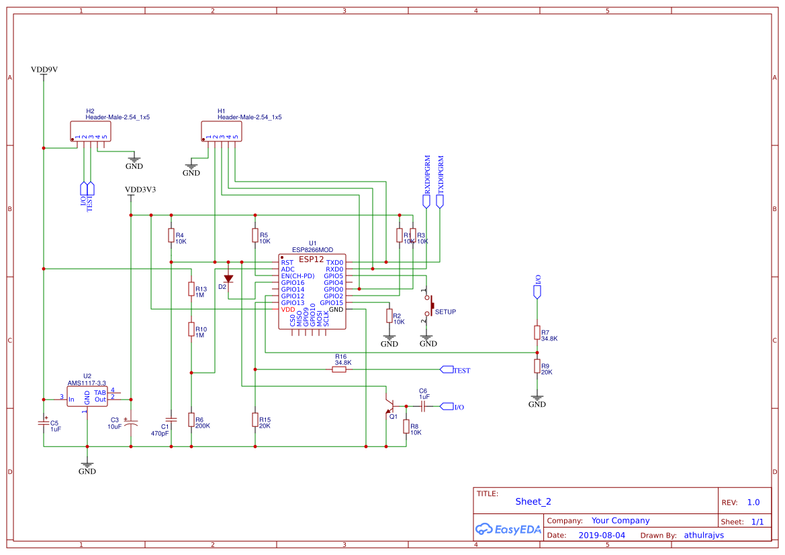
Circuit Diagram and Design
The overall circuit diagram is as below :-

Slide 12
Circuit Diagram and Design
Interconnection between ESP12 chip and smoke detector
To make the circuit compact and fit in the smoke detector, ESP 12F core is removed from the board
Reduces the power consumption to great extend
I/O pin from smoke detector IC is connected to GPIO12 of ESP 12F and Test button trigger to GPIO13
To save power the ESP 12F is run in deep sleep mode and woken up by external trigger
Voltage regulator circuit, ADC, Setup circuit
AMS1117(CD 3.3) Low Dropout Voltage Regulator (LDO) is used
Smoke detector warns when supply voltage goes down below 6V.
Low voltage condition measured with the help of ADC

Slide 13
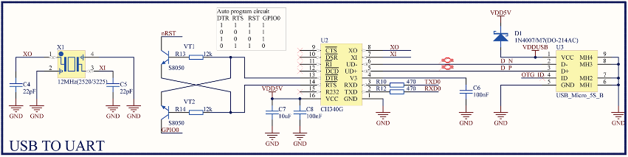
Circuit Diagram and Design
The setup button :-
A push button connceted to the GPIO5 pin of ESP 12 chip
Combined press on Test button and setup button launches configuration mode
Additionally :-
USB to UART converter

Slide 14
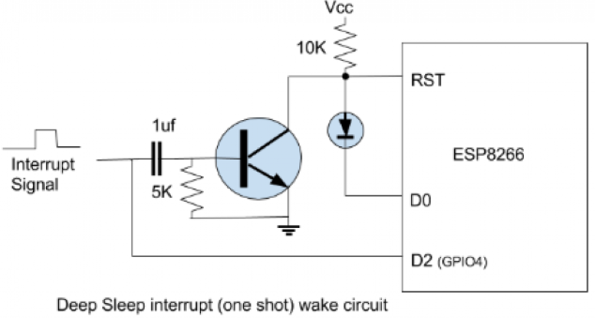
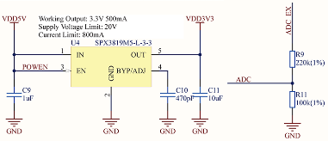
Circuit Diagram and Design
Interrupt circuit to wake up from deep sleep
Voltage regulator circuit, ADC circuit

Slide 15
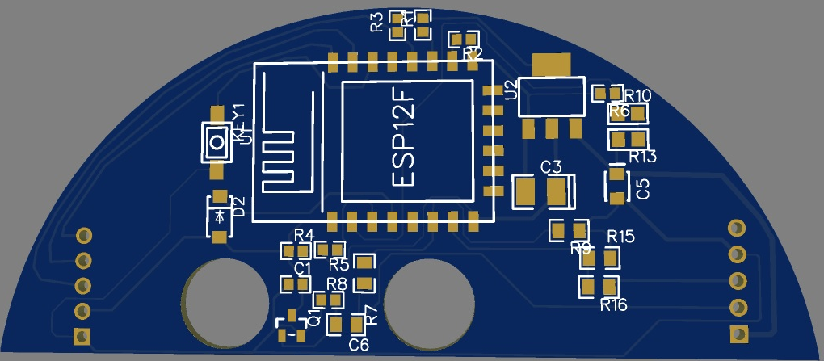
PCB Design
Designed using EasyEDA
Web based Electronic Design Automation tool
Helps to design, simulate circuits, Printed circuit board design etc.
Manufactured at Flextronic, Magdeburg

Slide 16
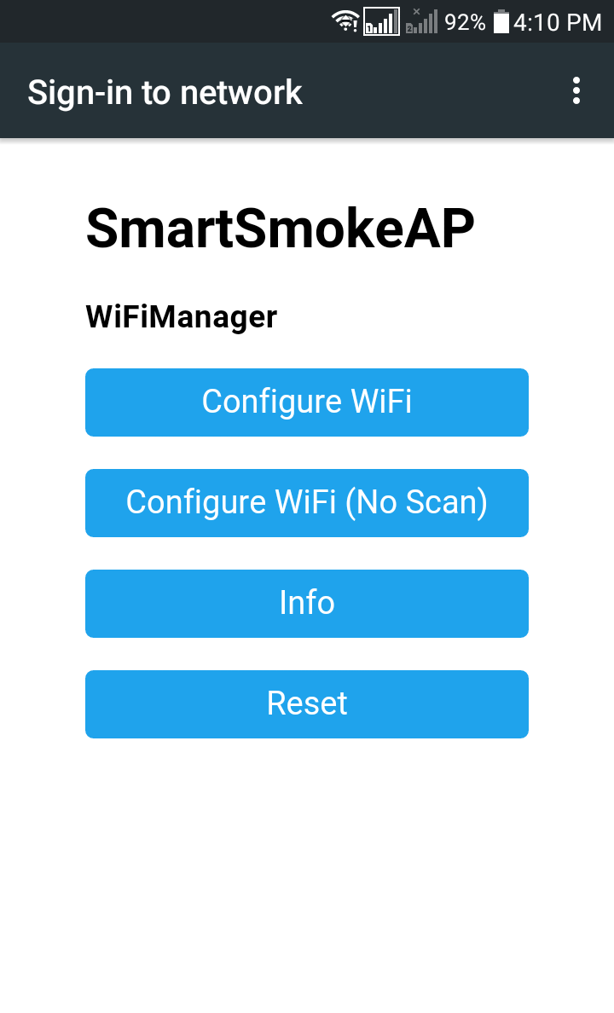
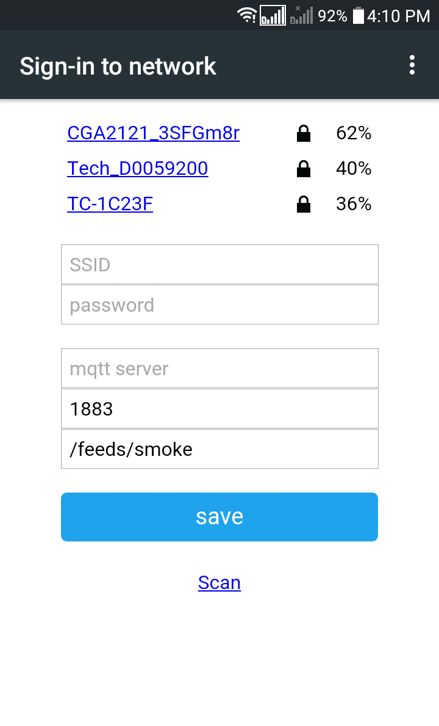
Wi-Fi Manager
When ESP8266 WiFi Connection manager with web configuration portal
It will launch a configuration dialogue to connect to access point
ESP starts in station mode and tries to connect to previously saves access point
If it does not connect ESP is moved into Access Point mode
With the help of Captive Portal and DNS server
A ‘Join to network’ pops up and list several scanned access points
If connection successfull, it transfers the control to the application

Slide 17
Battery Consumption Calculation
Current consumption while ESP wakes up: 180 mA
Current drawn while ESP 12 chip runs in Deep Sleep: 30 µA
Time (seconds) ESP remains woken up: 10 s : 0.0027 hrs
Time (seconds) ESP runs in Deep Sleep a day: 86390 s: 23.9972 hrs
Therefore, current drawn a day can be estimated as:(180 x 0.0027) + (23.9972 x 0.03)= (0.486 + 0.7199)= 1.2059 mAh
Battery capacity: 500 mAh
Days the battery would last: 500 / 1.2059 = 414 days

Slide 18
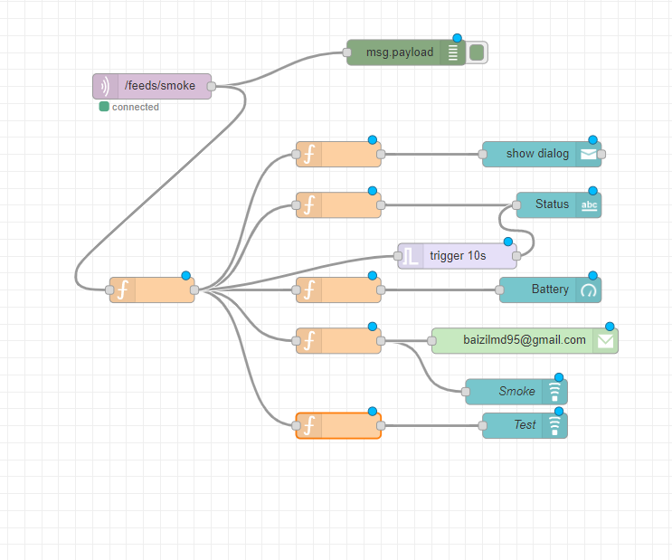
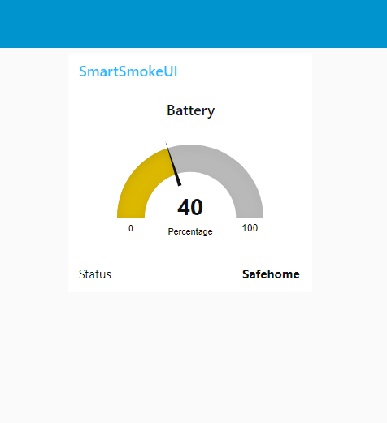
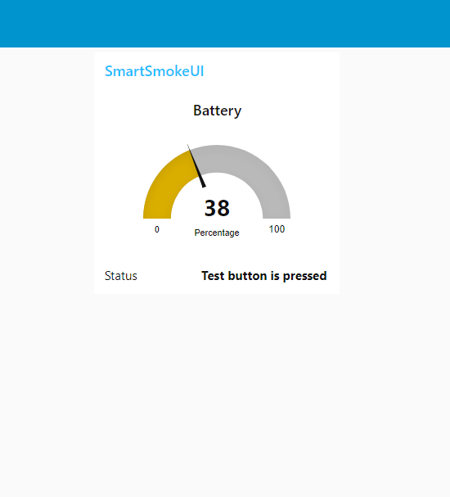
Node – Red Flow
Used her to visualize data received from Smoke Detector
Data handling is done through built in nodes in Node – Red
Data from smoke detector is received through a MQTT- in node
The battery percentage is displayed using a gauge node
Warnings are displayed in the GUI using notification node
Email is sent in to the users mail id through mail node
Node Red Flow
Battery Percentage Calculation

Slide 19
Conclusion and Future Works
Conclusions are that :-
Smart smoke detector was successfully implemented
The smart smoke detector looks same in appearance but smart
Smart automation scenarios implemented over SCION network
Smart Smoke is feasible and value for money with sufficient smart features
Future Work
A future development to this project would be establishing a whole security system for an apartment with similar smoke detectors connected through the scion network.

Slide 20
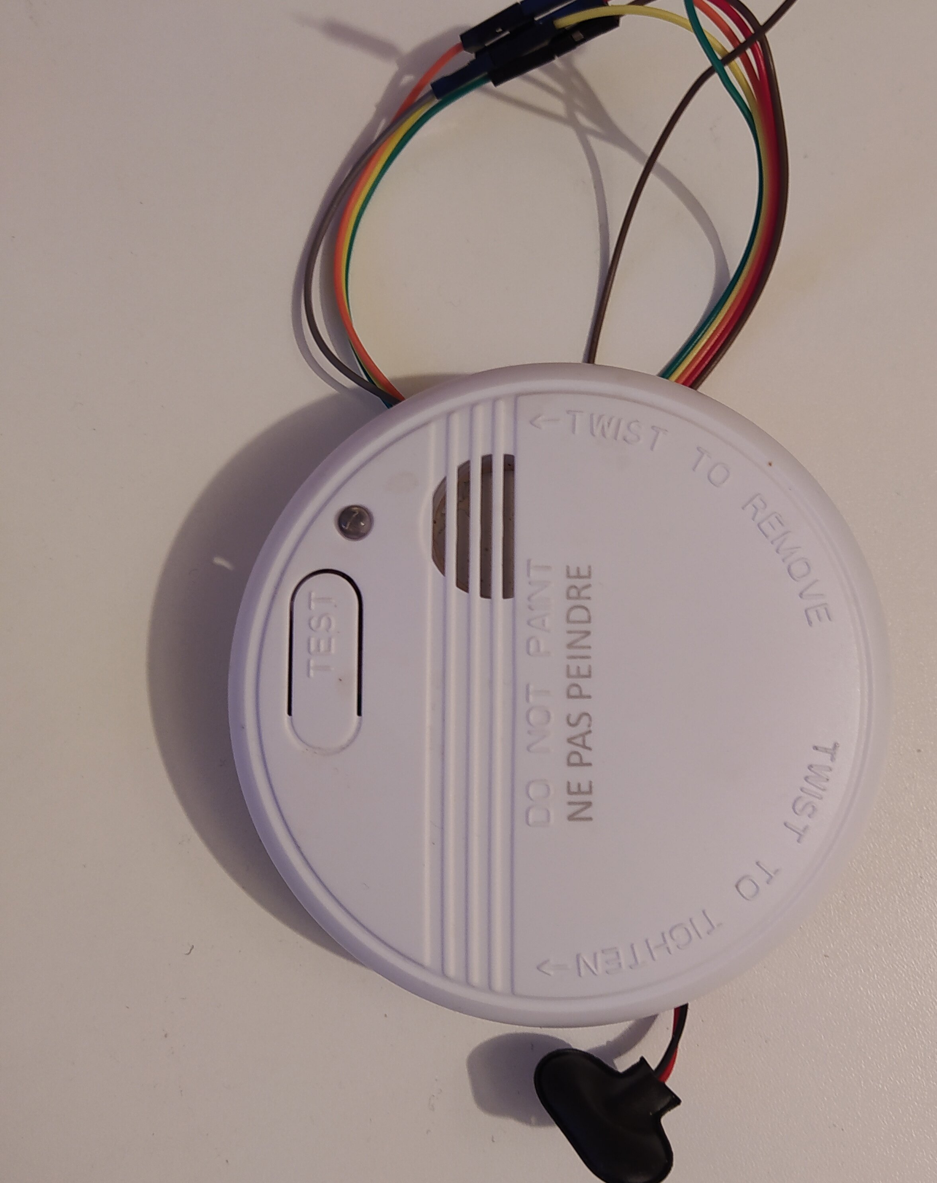
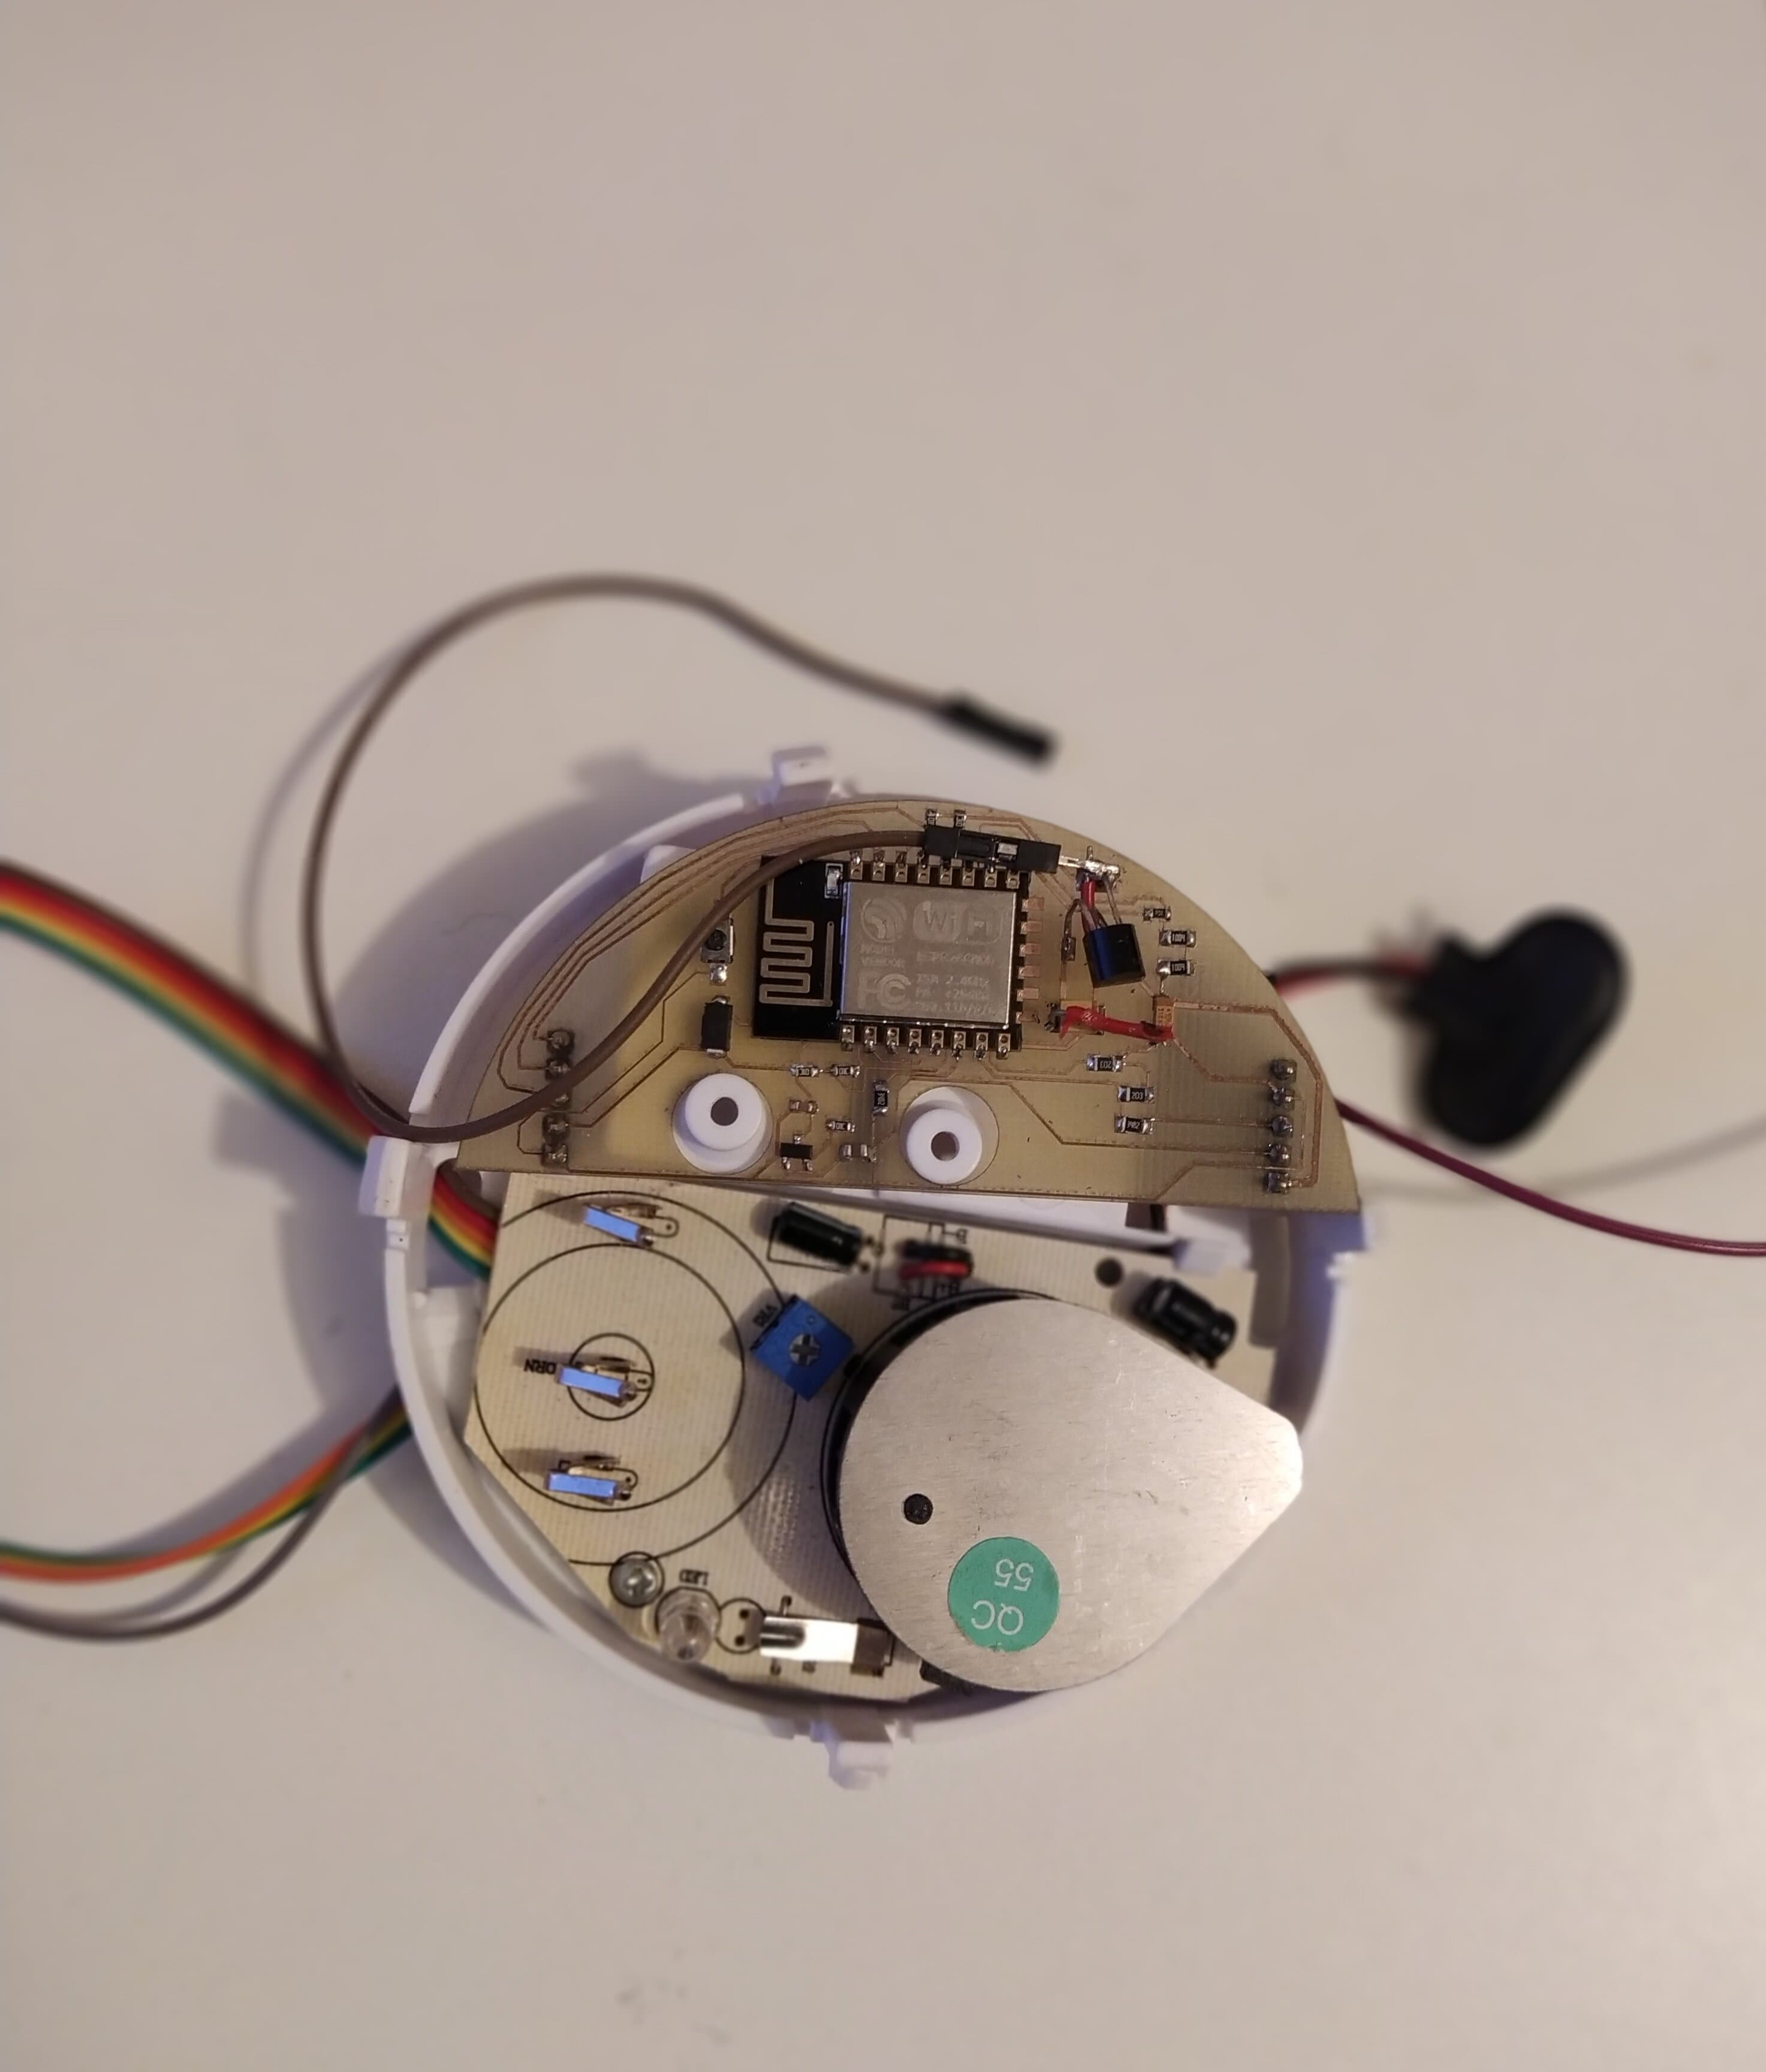
Conclusion and Future Works
Final Product

Slide 21
References
https://www.raspberrypi.org/
https://www.scion-architecture.net/pdf/SCION-book.pdf
https://netsec-ethz.github.io/scion-tutorials/
https://netsec-ethz.github.io/scion-tutorials/install/pkg/
https://www.scionlab.org
https://www.scion-architecture.net/pdf/2017-SCION-CACM.pdf
https://www.raspberrypi.org/products/raspberry-pi-3-model-b-plus/
https://www.raspberrypi.org/downloads/raspbian/
https://github.com/tjohn327/raspberry_pi_ups
http://www.ti.com/lit/ds/symlink/bq25895.pdf
http://www.ti.com/lit/an/slva773/slva773.pdf
http://www.ti.com/lit/ds/symlink/tps61235p.pdf
https://github.com/netsec-ethz/netsec-scion/

Slide 22
Thanks for your attention....

