Slide 1
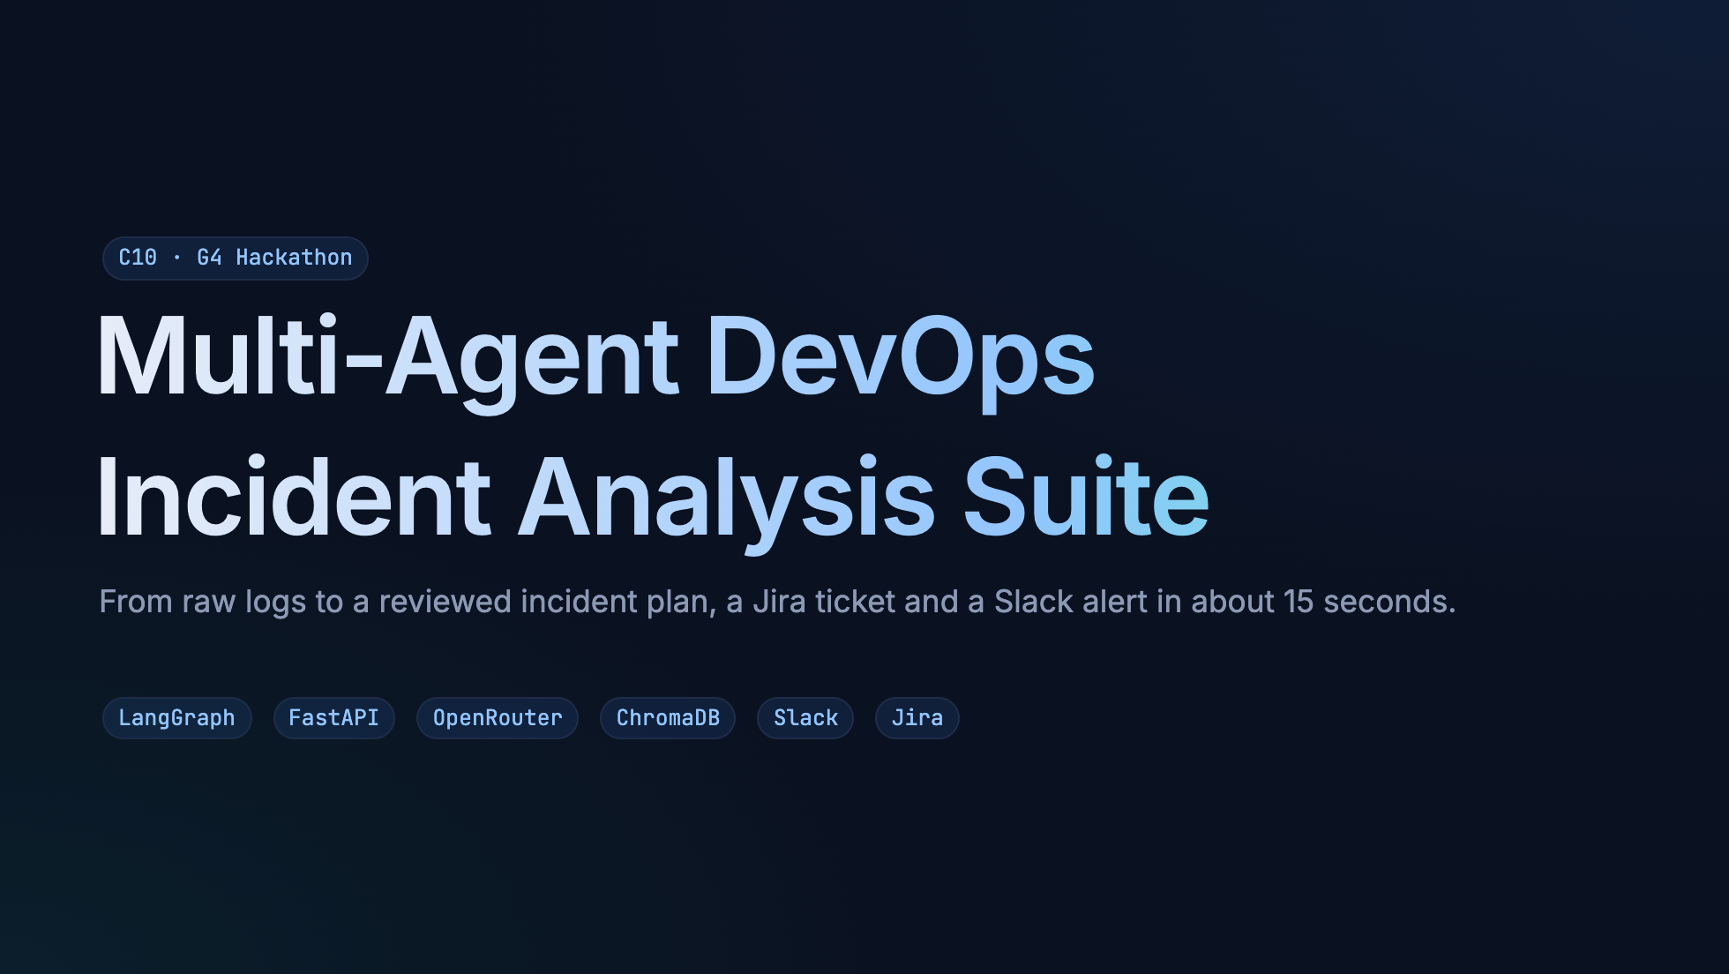
Notes:
Hi everyone, we're group G4. In the next ten minutes we'll show how a team of AI agents turns a messy
log file into incidents, fixes, a checklist, and — only after a human says yes — a Jira ticket and a Slack alert.

Slide 2
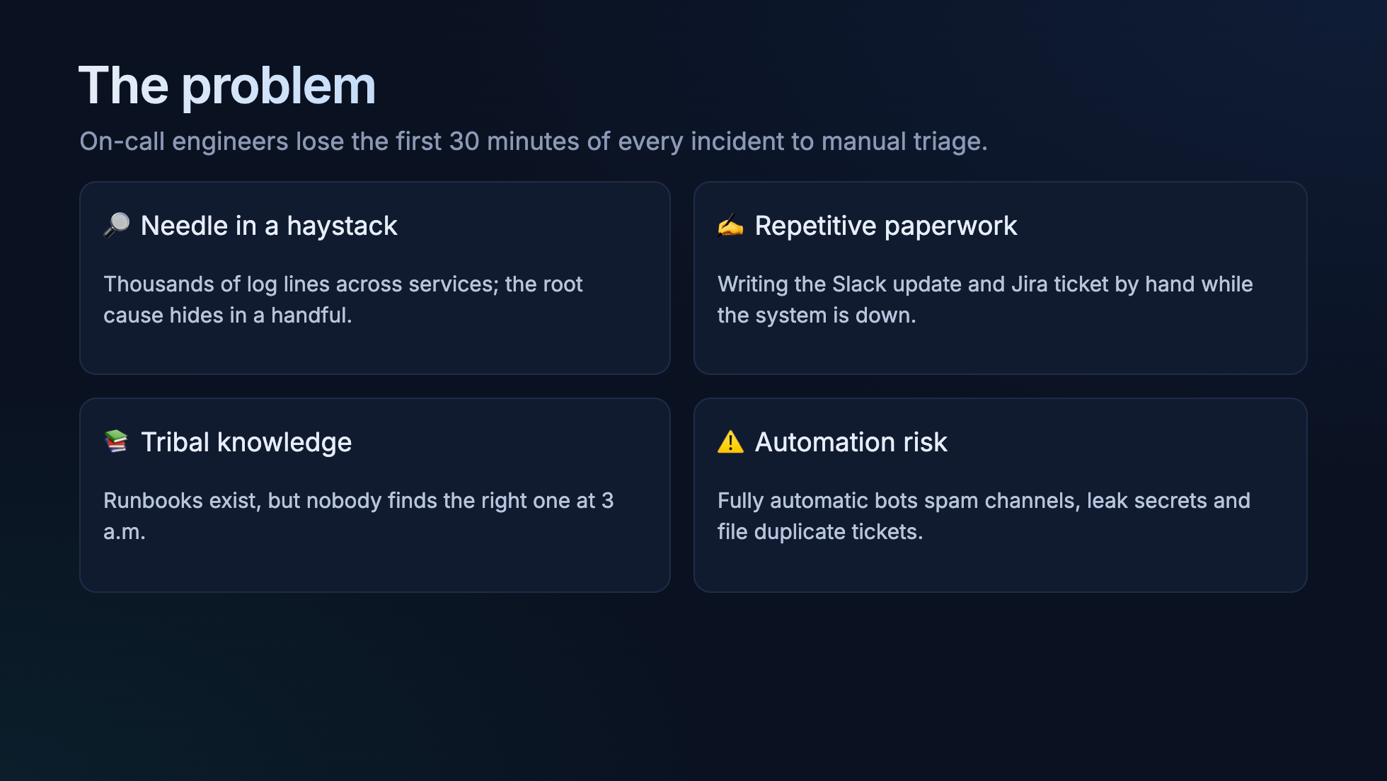
Notes:
Four pains: finding the signal, finding the right runbook, writing the same updates every time,
and the fear that automation will make things worse. Our design answers each one — especially the last:
nothing leaves the system without a human click.

Slide 3
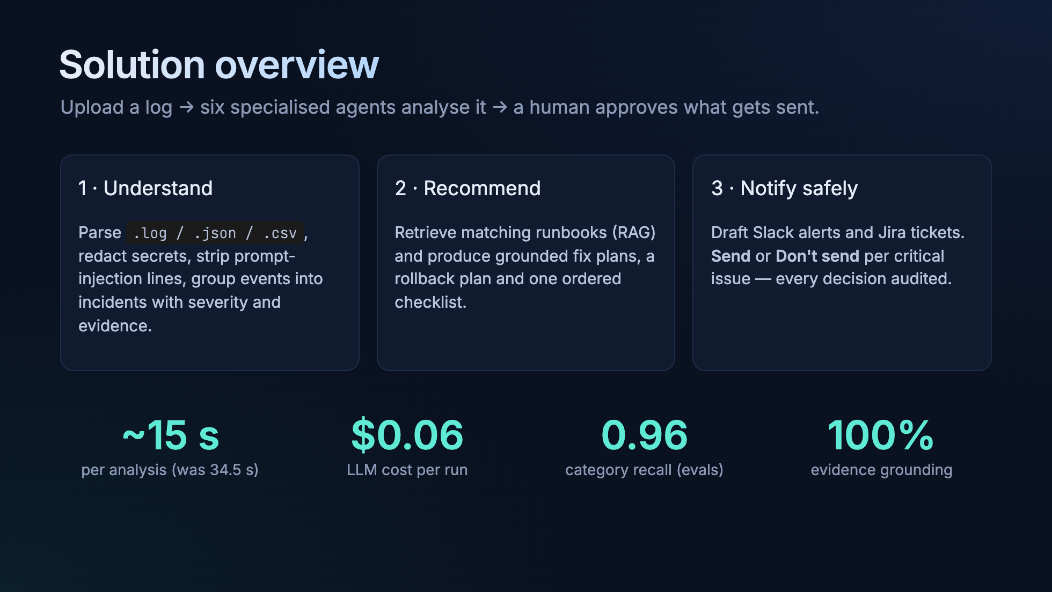
Notes:
Three stages: understand, recommend, notify safely. The numbers at the bottom come from our eval suite
on labelled logs — not from a demo run we picked.

Slide 4
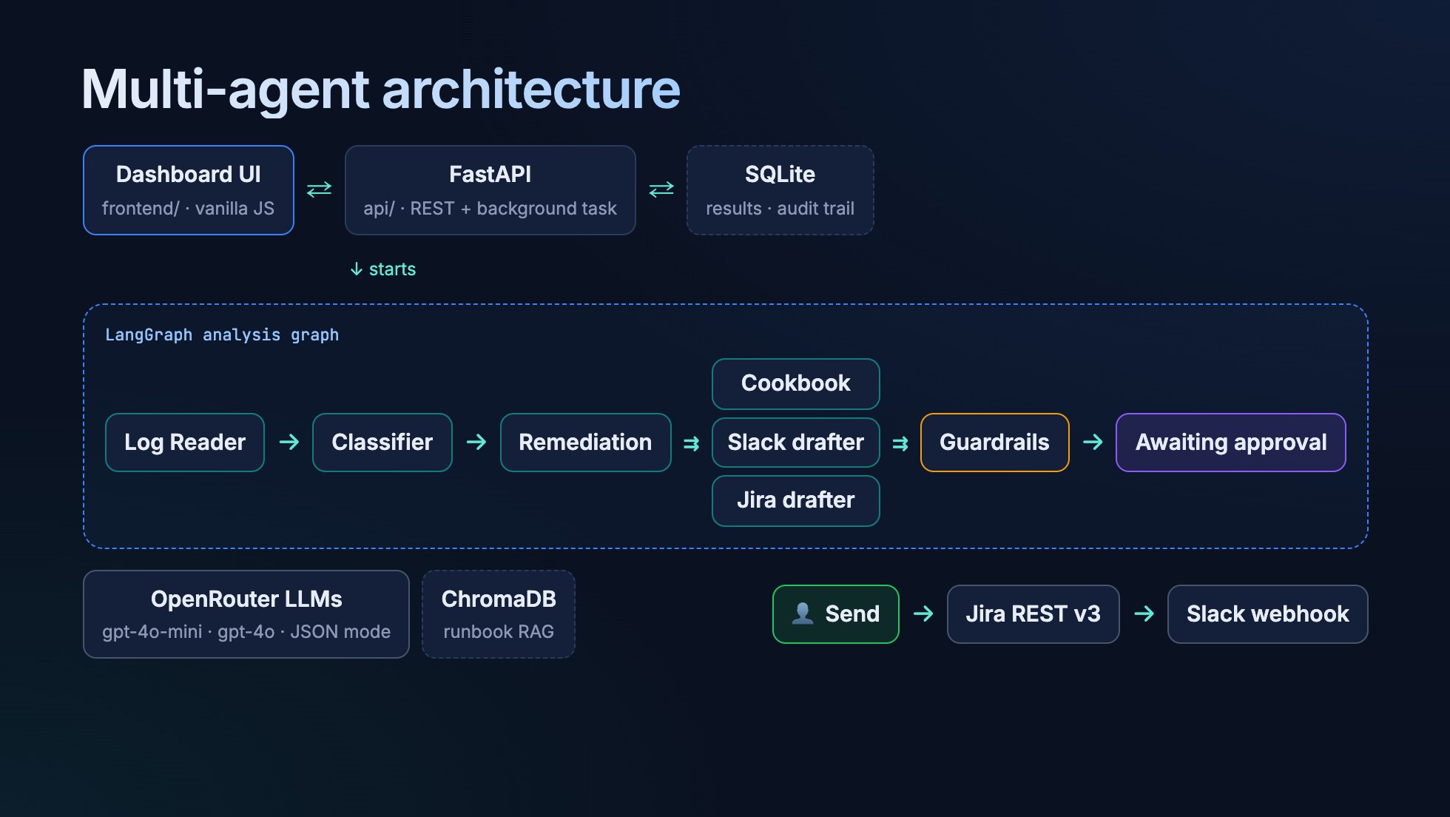
Notes:
The UI only talks to FastAPI, so secrets never reach the browser. FastAPI starts the LangGraph workflow
as a background task. Three drafters run in parallel after remediation, then guardrails check everything,
and the run stops at "awaiting approval". Slack and Jira are only reached from the human Send action.

Slide 5
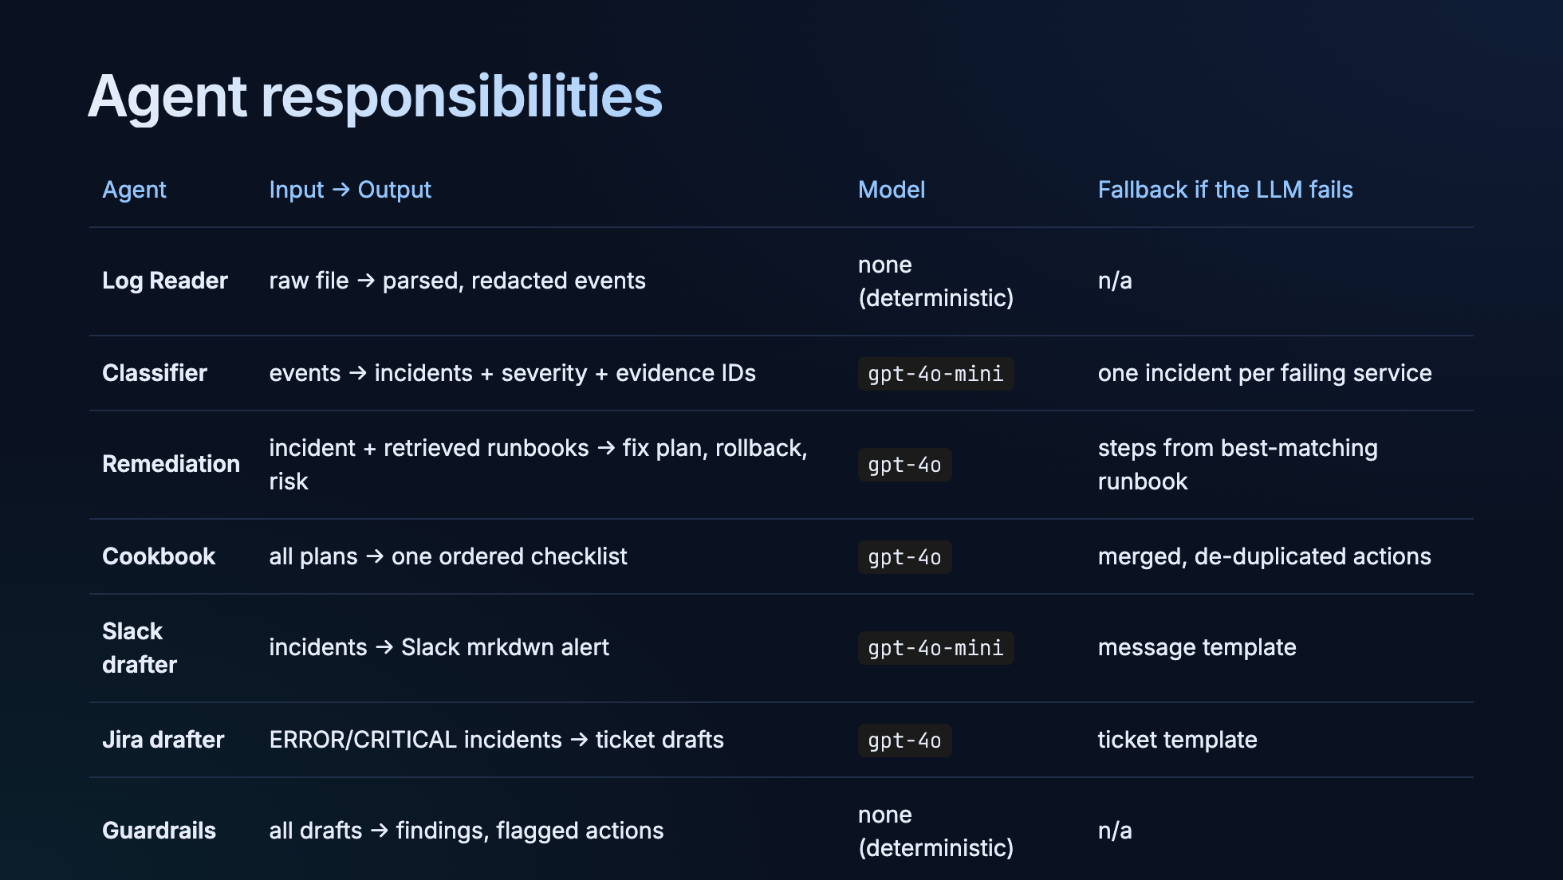
Notes:
Each agent has one job and one backup plan. If OpenRouter is down, the pipeline still finishes with
rule-based output — degraded, but never empty. Two agents use no LLM at all, on purpose.

Slide 6
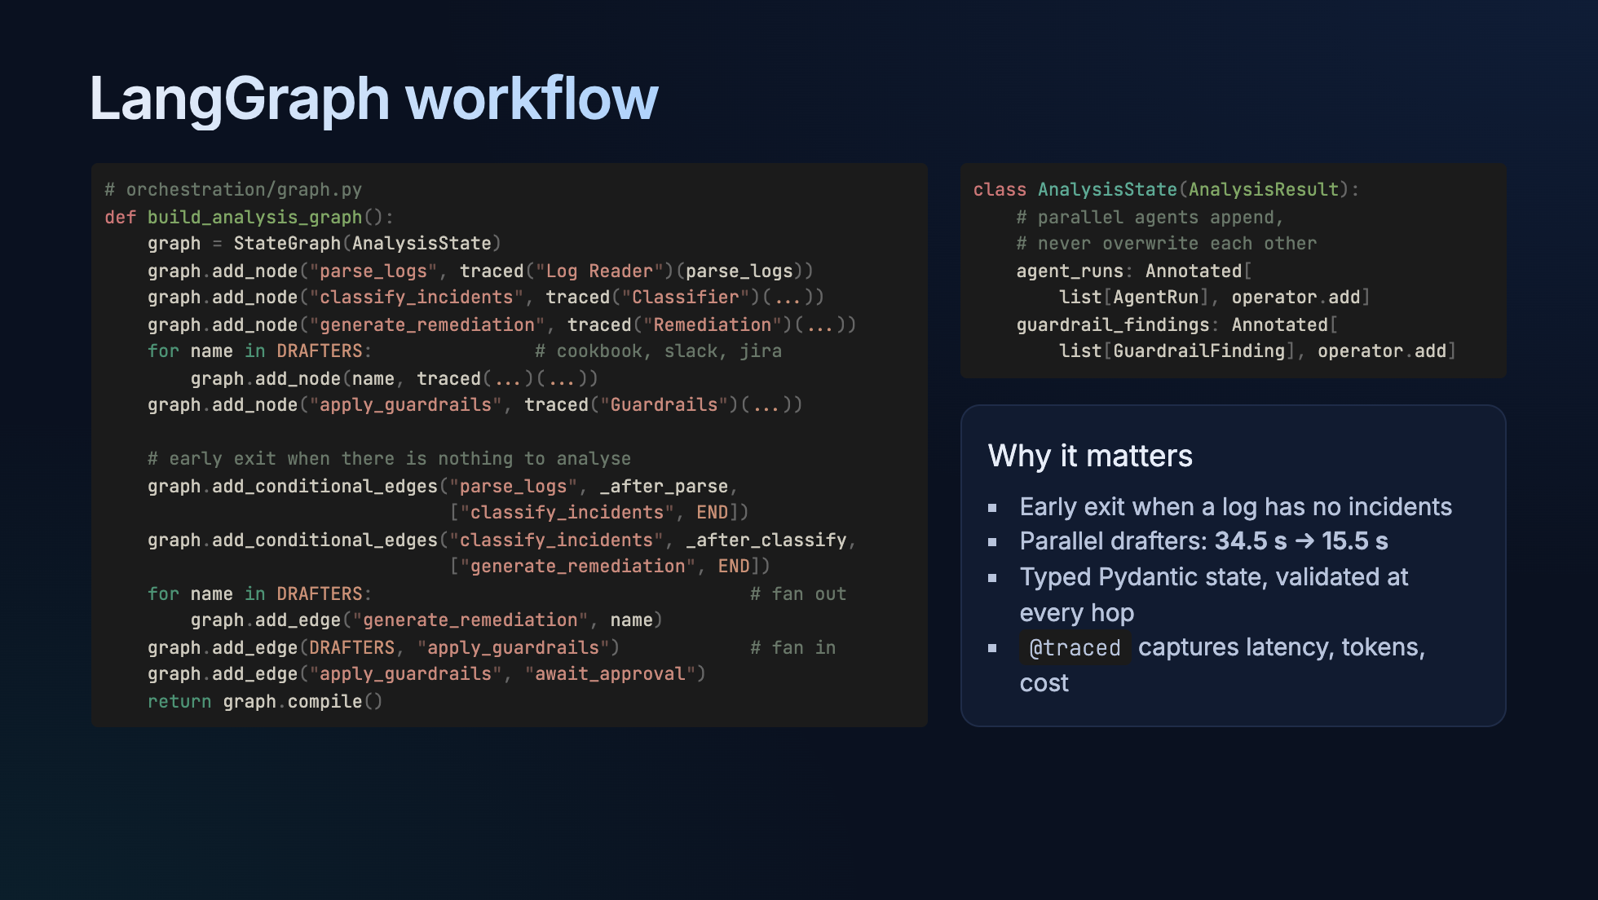
Notes:
Walk top to bottom: the nodes, the conditional edges that end early, the fan-out to three drafters,
and the fan-in. The reducer on the right is what makes parallel agents safe: each appends its trace
instead of overwriting the list.

Slide 7
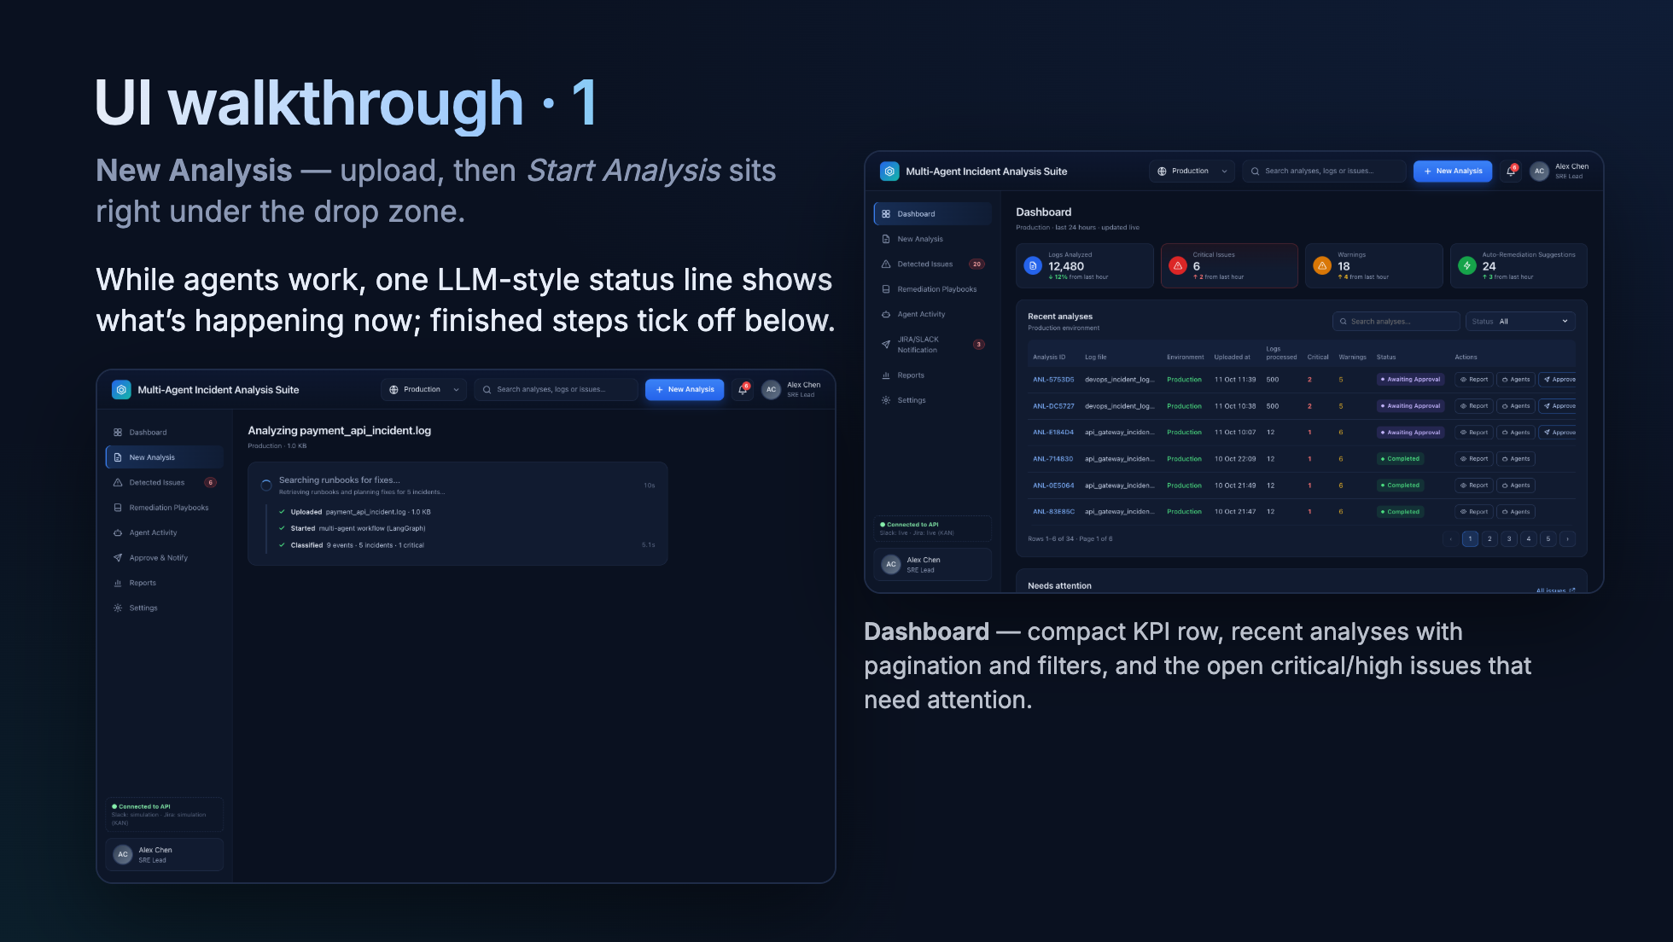
Notes:
Left: the progress view — "Searching runbooks for fixes…" with completed steps underneath, no busy diagram.
Right: the dashboard everyone lands on.

Slide 8
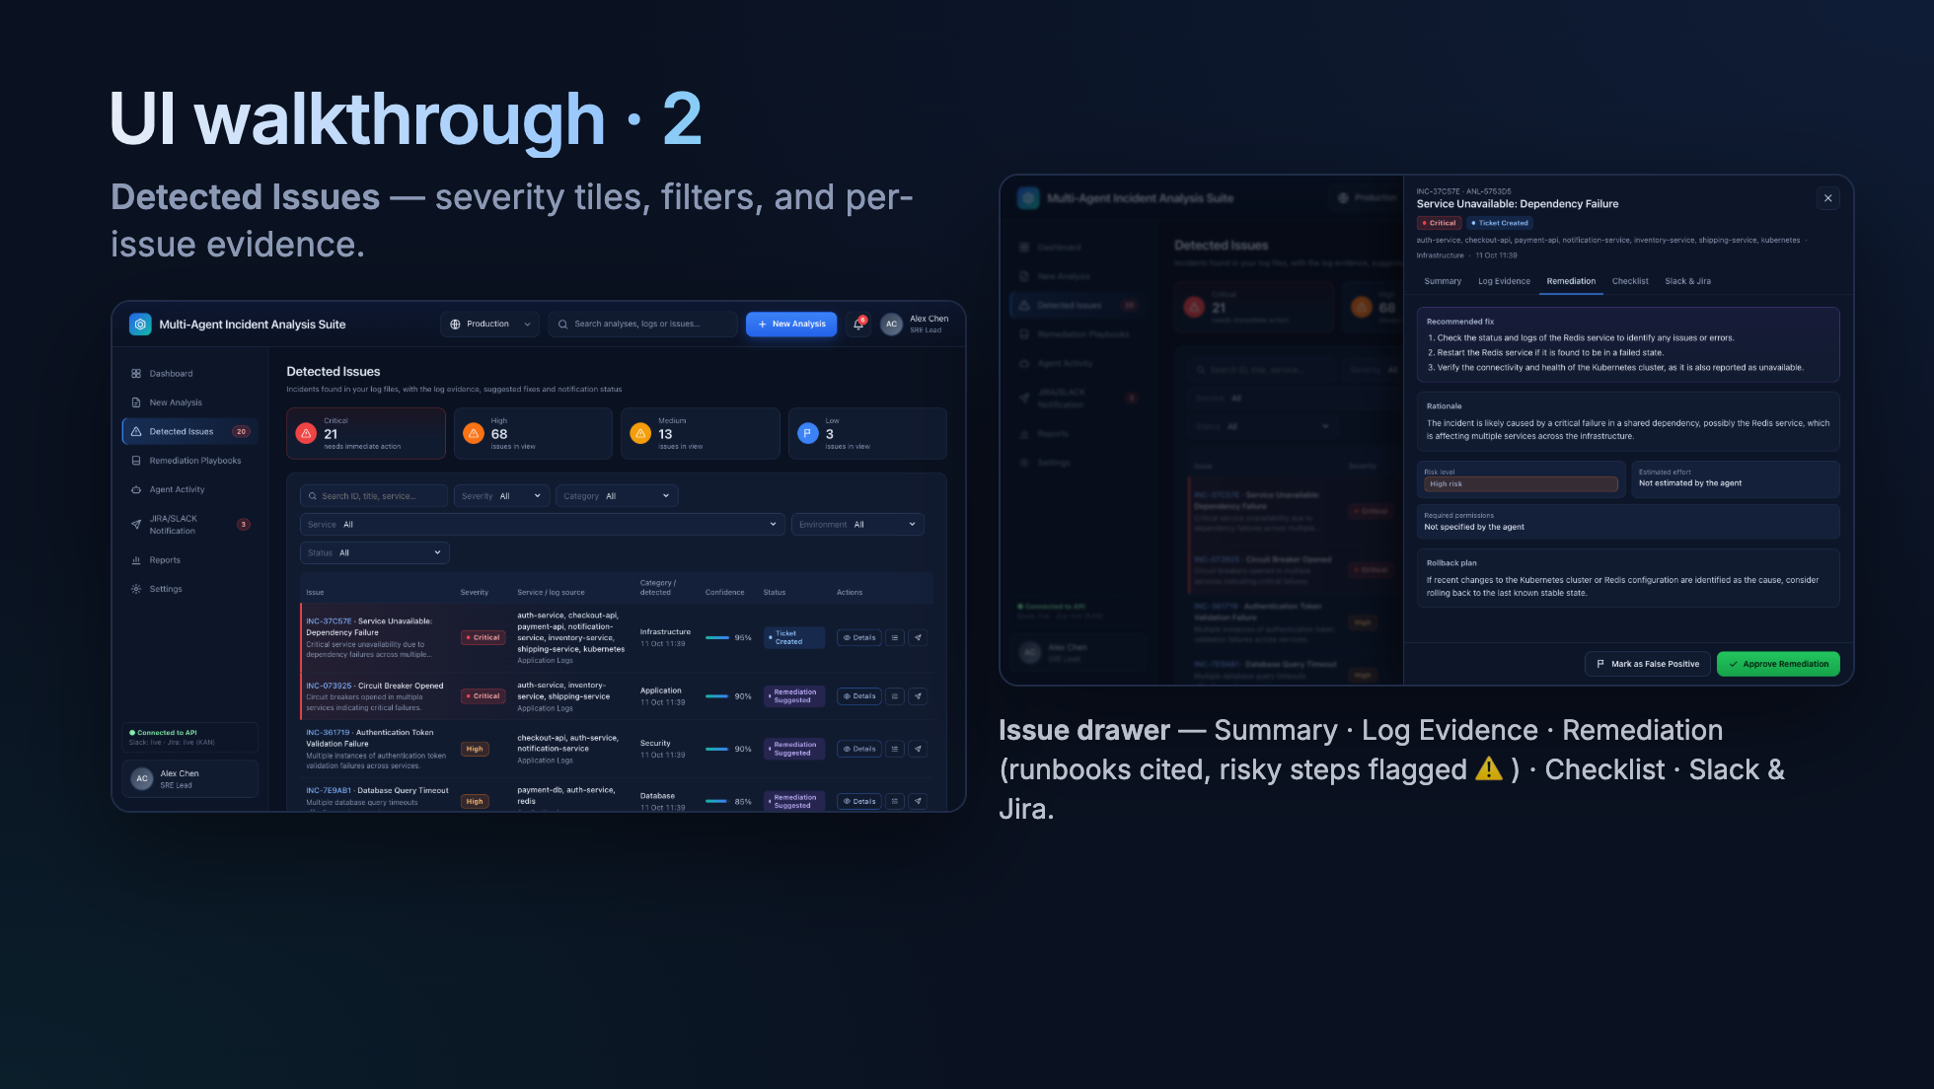
Notes:
Every incident links back to the exact log lines that support it. In the remediation tab, any
destructive step — DROP TABLE, rm -rf, kubectl delete namespace — is flagged "review first".

Slide 9
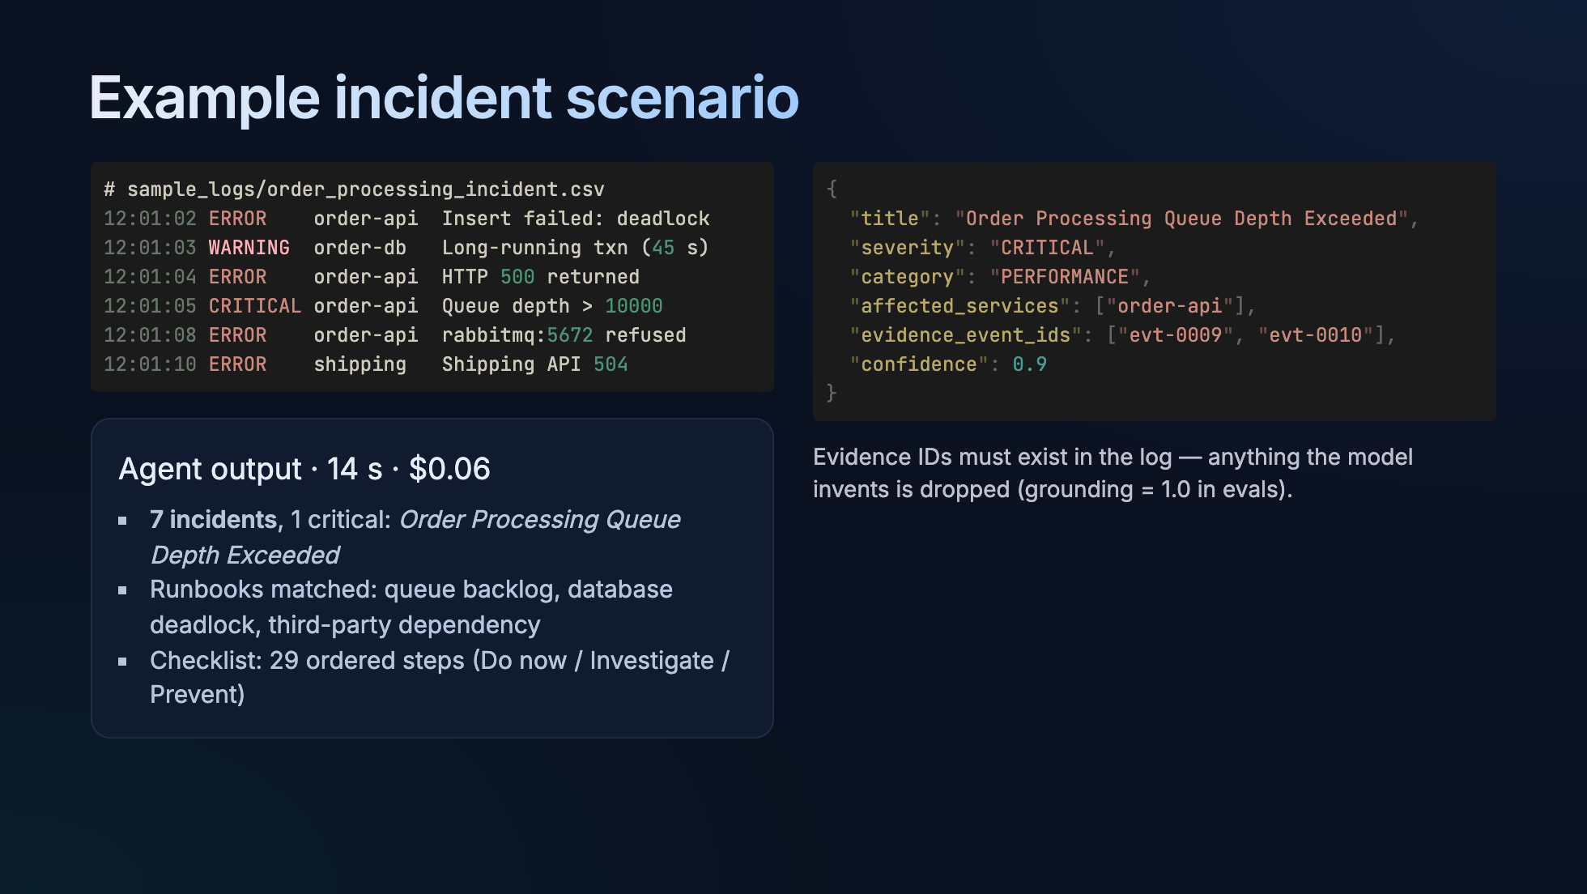
Notes:
This is the real sample from the repo. One critical incident, six supporting ones, every claim tied to
an event ID. If the model cites a line that doesn't exist, the incident is discarded.

Slide 10
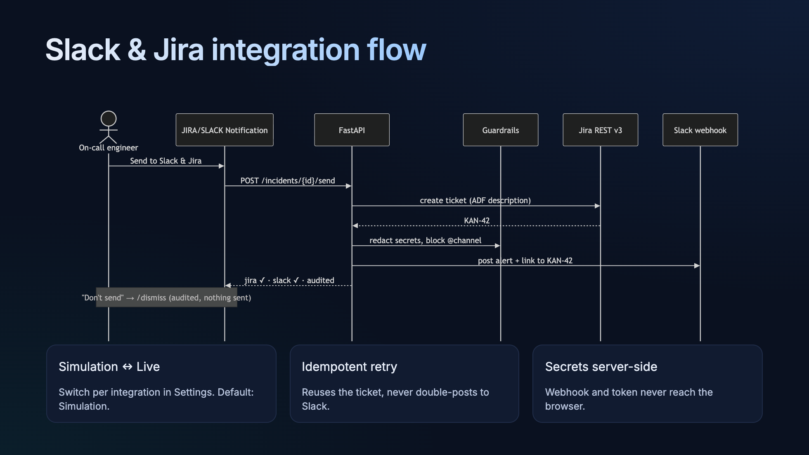
Notes:
One click does both, in a deliberate order: Jira first, so the Slack alert can link to the ticket.
If Jira succeeds and Slack fails, a retry won't create a second ticket. "Don't send" is also an
audited decision — that's the human-in-the-loop requirement.

Slide 11
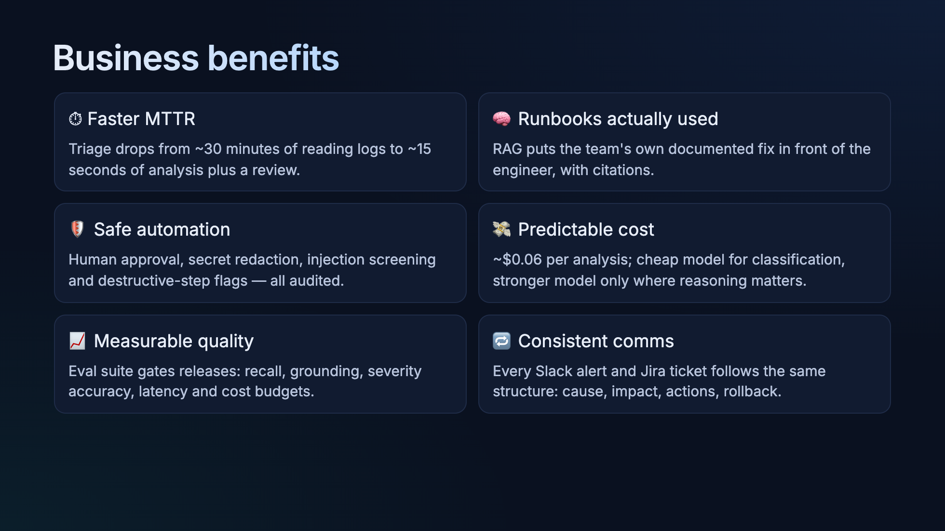
Notes:
The headline is MTTR, but the quieter win is consistency: every incident gets the same quality of
write-up no matter who is on call or what time it is.

Slide 12
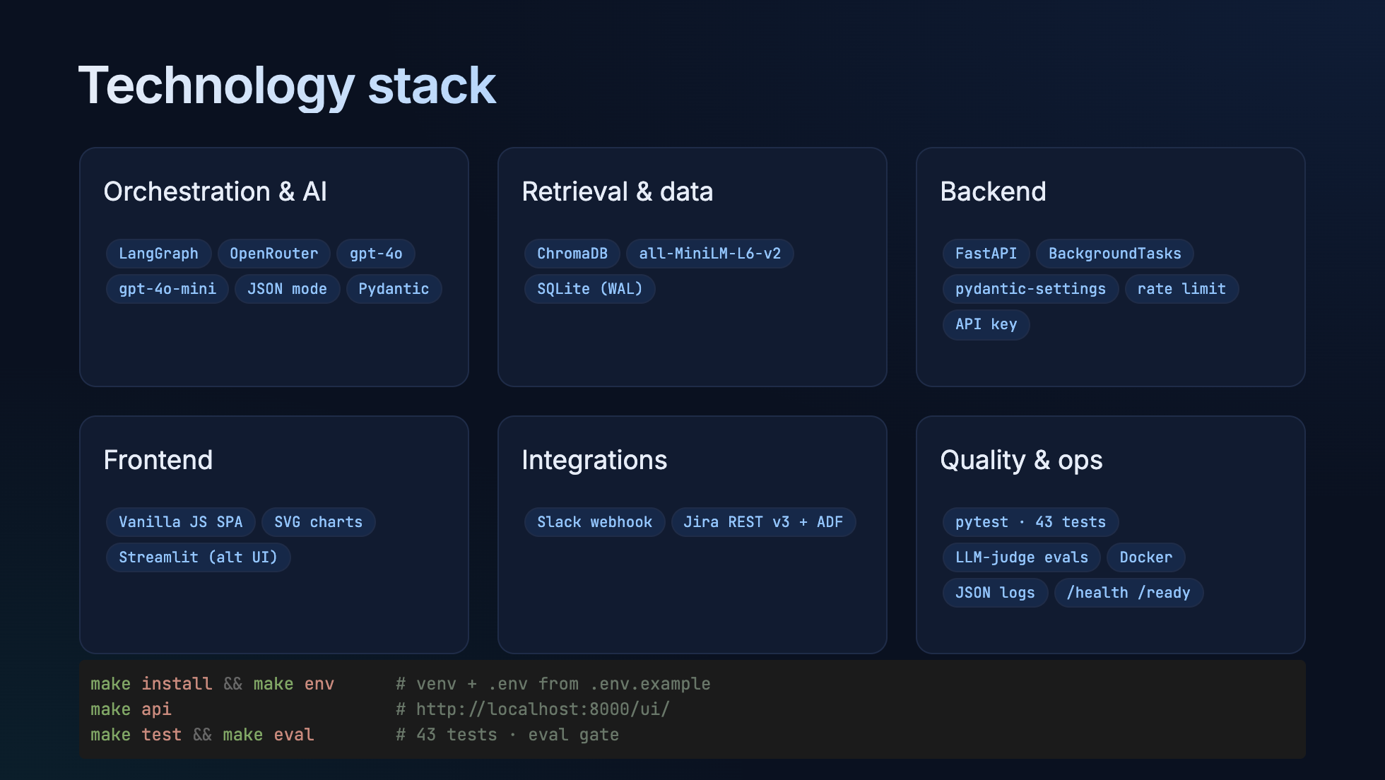
Notes:
Deliberately boring infrastructure — SQLite and in-process tasks — so the interesting part is the
agents. Everything runs locally with three make commands.

Slide 13
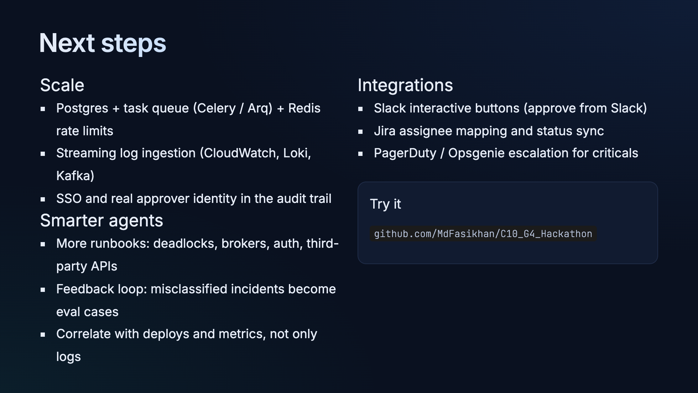
Notes:
The architecture already separates agents from delivery, so each of these is an additive change.
Our first priority would be the feedback loop: every human "Don't send" or edited ticket is a new
labelled example for the evals.

Slide 14
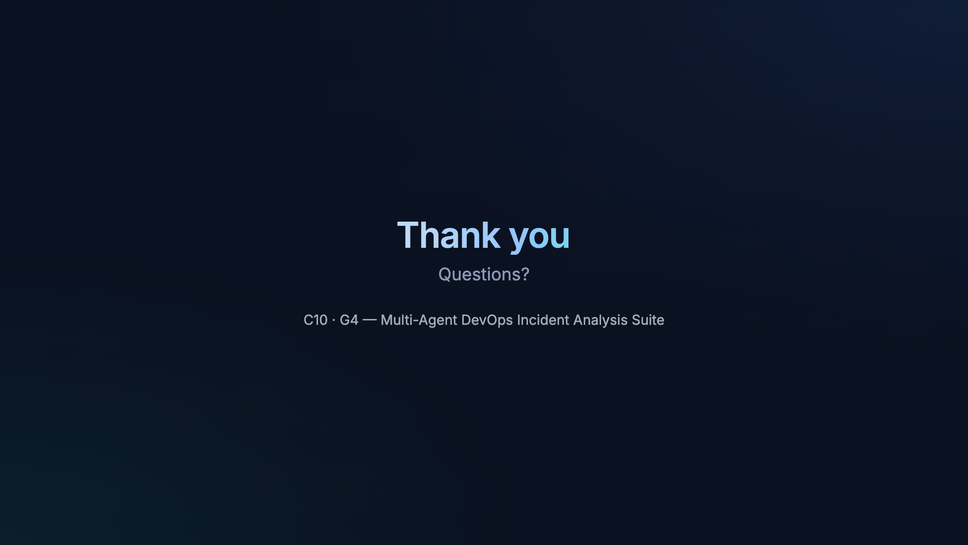
Notes:
Thanks — happy to run a live analysis on any log file you have.

