Slide 1

DATA ANALYTICS PROJECT
36
ElectViz: Election Data
States & UTs Covered
Visualization for Media
27,415
Election Records
Power BI Analytics · Lok Sabha · Vidhan Sabha · Bypoll · 1951–2025
1951–2025
Year Range
TEAM MEMBERS
Hamiz K (Team Lead)
Karishma N
Vennela P
Aman A
Gajavadan T

Slide 2
Problem Statement
Why does the dataset need a unified election analytics system?
🗂
⚠️
📺
🔗
Fragmented Sources
Data Inconsistency
Not Media-Ready
No Unified View
Data spread across 36+ portals, formats, and state archives with no unified access point.
Column names, encodings, and abbreviations differ drastically across elections and years.
Raw CSVs cannot support live broadcast use, real-time filtering, or anchor-friendly views.
Cross-analysis of LokSabha + VidhanSabha + Bypoll is impossible without consolidation into one model.
GOAL:
Build a unified election analytics system that enables fast, accurate insights for media teams — covering all 36 states, all election types, 1951 to 2025.
Raw election data → Broken. We turned it into a unified analytics system.
ElectViz: Election Data Visualization for Media · Infosys Springboard · February 2026
2/182/182/18

Slide 3
System Architecture - Election Analytics Pipeline
DATA SOURCES
DASHBOARD OUTPUTS
ECI Portal
(eci.gov.in)
State Election
Commissions
Historical
Archives
M2: Historical Trends
M3: Real-Time Results
DATA PROCESSING
Data Cleaning
& Pre-processing
Standardization
(14-col Schema)
Party Name
Normalization
M4: Turnout & Demographics
M5: Party & Candidate Tracker
INTEGRATION
Merge 36 States
+ Bypoll + LS/VS
Master Dataset
(CSV)
FINAL OUTPUTS
📁 Master
Dataset CSV
📊 Power BI
Report
📄 Final PPT
Report
🗂️ GitHub
Repository
ANALYTICS LAYER
Power BI
Data Model
(Star Schema)
📺 Media Insights / Analysis Outputs
Feeds into all dashboards →
ElectViz: Election Data Visualization for Media · Infosys Springboard · February 2026
3/18

Slide 4
Project Objectives
End-to-end scope of what this project delivers
1
2
3
4
Data Integration
Multi-Type Coverage
Power BI Dashboard
Trend & Performance
Combine election datasets for 36 States + UTs into one master model with standardised schema.
Integrate Lok Sabha + Vidhan Sabha + Bypoll elections into a single unified pipeline.
Build 5 interactive, filterable dashboard pages for full election coverage analysis.
Analyse party trends, turnout, demographics across all elections from 1951 to 2025.
Project Deliverables
Master Dataset CSV
Power BI Dashboard
Final PPT Report
GitHub Repository
Unified 36-state cleaned dataset
5 interactive pages, full drill-down
16-slide trial + final versions
All scripts, data, docs committed
ElectViz: Election Data Visualization for Media · Infosys Springboard · February 2026

Slide 5
Modules Overview - 5 Milestones
Each milestone maps to an interactive Power BI dashboard page
M1
M2
M3
M4
M5
Data Integration
& Modeling
Historical Trends
Dashboard
Real-Time Results
Dashboard
Turnout &
Demographics
Party & Candidate
Performance Tracker
Merge + clean 36-state master dataset
Year-wise trends, seat distribution
Live-style tally, swing seat alerts
Gender, category, urban/rural
Margins, dominance, re-elections
▶
▶
▶
▶
✅ In Progress
✅ Demo Ready
🔧 Prototype
✅ Demo Ready
✅ Demo Ready
ElectViz: Election Data Visualization for Media · Infosys Springboard · February 2026

Slide 6
Project Milestones - Timeline & Deliverables
M1
M2
M3
M4
M5
Data Integration
& Modeling
Historical Trends
Dashboard
Real-Time Results
Dashboard
Turnout &
Demographics
Party & Candidate
Tracker
Weeks 1-2
Weeks 3-4
Weeks 5-6
Weeks 7-8
Weeks 9-10
✅ Completed
✅ Completed
✅ Completed
✅ Completed
✅ Completed
▸ 14-column schema design
▸ Trend analysis visuals
▸ Live results view
▸ Voter turnout maps
▸ Performance tracker
▸ 36-state data collection
▸ State-wise comparisons
▸ Seat tally board
▸ Urban vs Rural split
▸ Party comparison
▸ Party name standardization
▸ Year-over-year views
▸ Leading candidate tracker
▸ Demographic overlays
▸ Candidate win records
ElectViz: Election Data Visualization for Media · Infosys Springboard · February 2026
6/18

Slide 7
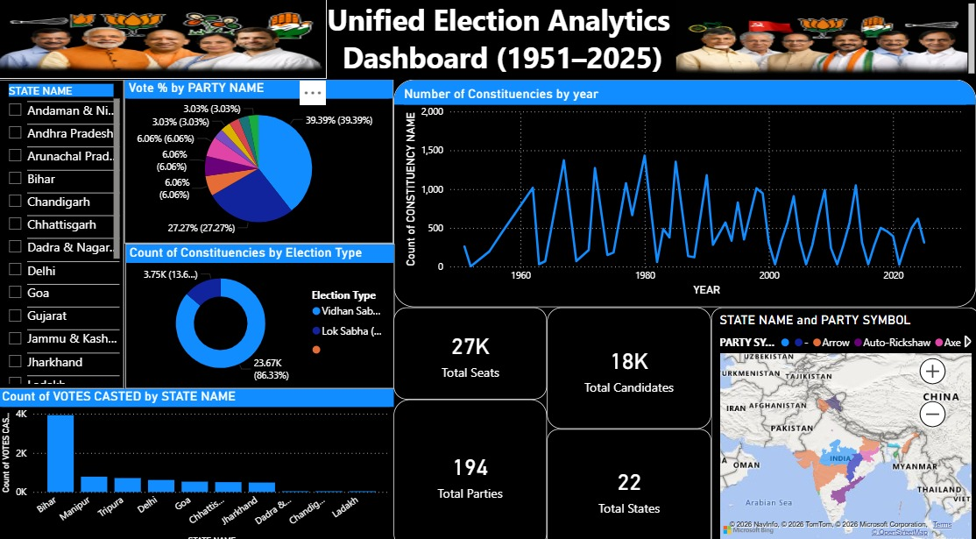
Milestone 1 - Data Integration & Modeling
Merging, cleaning, and standardising 36 state datasets into one master model
✅ Completed — What Was Done
55,646
36 / 36
36 of 36 states merged · 11 by Hamiz, 10 by Karishma, 15 by others
Total Records in Master CSV
States Merged (Phase 1)
LS + VS + Bypoll integration started , all three types in one pipeline
1009
194
Bypoll Records Integrated
Unique Party Codes Standardised
200+ party abbreviations expanded to full standardised names
1951-2025
3
GitHub repository created with per-member contribution folders
Election Year Range
Election Types Covered
Master CSV: 27,415 records · 14 standard columns · ready for Power BI
ElectViz: Election Data Visualization for Media · Infosys Springboard · February 2026

Slide 8
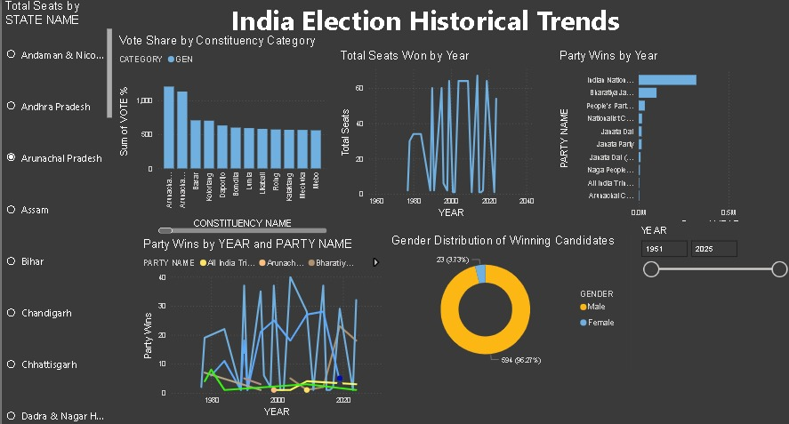
Milestone 2 - Historical Trends Dashboard
Year-wise election trends · Party seat performance · Constituency result patterns
✅ Delivered
Historical Trends Dashboard · Party Performance by Year
Year-wise election trends from 1951 to 2025
YEAR
PARTY WINS — TOP 7
Party-wise seat performance over every decade
1952
Indian National Congress
1962
Bharatiya Janata Party
4,990
Constituency result patterns with drill-down
1977
Independent
1,484
Telugu Desam
1,450
Interactive YEAR slicer and STATE filter
1984
INC (I)
1,004
Vote trend line chart across elections
1991
Janata Party
782
2004
CPI(M)
533
Decade comparison: Lok Sabha vs Vidhan Sabha
2009
2014
2019
2024
WINNING VOTE TRENDS ACROSS ELECTIONS
[ See dashboard image → ]
🎙 This page helps anchors analyse historical swing seats and track how dominant parties rose or fell across decades.
ElectViz: Election Data Visualization for Media · Infosys Springboard · February 2026

Slide 9
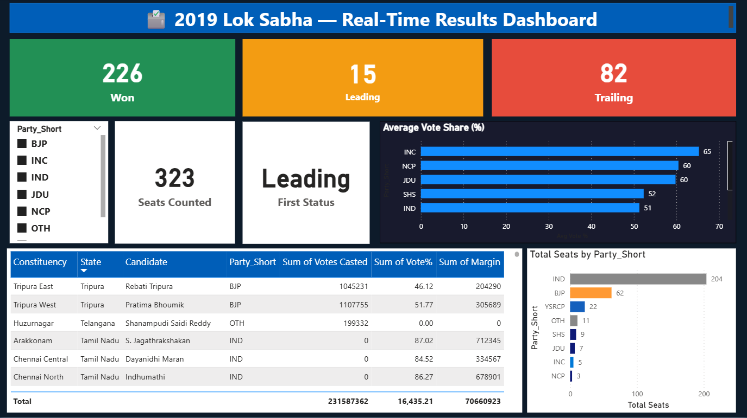
Milestone 3 - Real-Time Results Dashboard
Live-style seat tally · Vote % bars · Party filters · Swing seat identification
🔧 Prototype Stage
LIVE RESULT TRACKER · Party Seat Tally
Live-style seat count updates as results arrive
543
272
INC
BJP
Vote percentage bars per constituency
Total Seats
Majority Mark
Simulated Lead
Simulated 2nd
Party filter slicers
Indian National Congress
310
Swing seat identification (close margins highlighted)
Bharatiya Janata Party
200
Colour-coded leading / trailing party view
Regional / Others
33
State-level tally card - instant overview
CONSTITUENCY RESULT DETAILS
State
Constituency
Leading Candidate
Party
Margin
Andhra Pradesh
Ongole
Maganti M
TDP
12,450
Bihar
Patna Sahib
R S Prasad
BJP
95,210
Delhi
New Delhi
Meenakshi L
BJP
78,300
Gujarat
Gandhinagar
Amit Shah
BJP
557,014
MP
Indore
K Vijayvargiya
BJP
1,043,000
[ See dashboard image → ]
🎙 This page lets anchors stream live constituency results, spotlight swing seats, and filter by party or state on air.
ElectViz: Election Data Visualization for Media · Infosys Springboard · February 2026

Slide 10
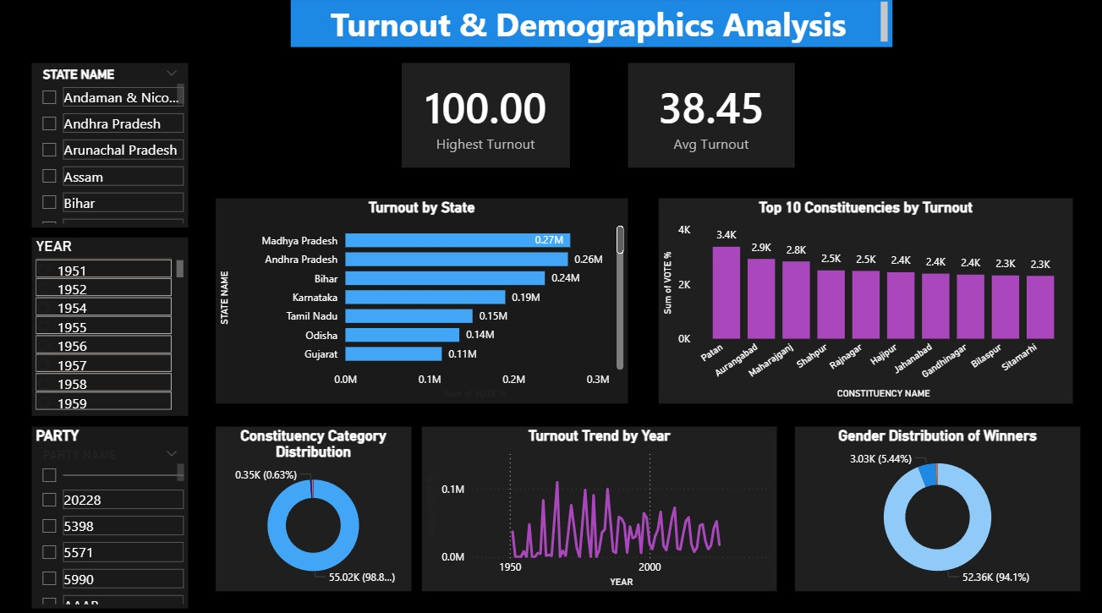
Milestone 4 - Turnout & Demographics
Gender · Category · State turnout · Urban vs Rural classification (in progress)
✅ Delivered
VOTER TURNOUT & DEMOGRAPHICS
Gender winners: Male 94.4% · Female 5.6%
GENDER DISTRIBUTION
CONSTITUENCY CATEGORY
30.03%
Category split: General 74% · ST 15% · SC 10%
General
20,302
Male 94.4%
25,885
ST
4,228
State-wise average voter turnout mapped
Female 5.6%
1,530
Average Voter Turnout
SC
2,771
Highest: Tripura 59.6%
Top 10 constituencies by turnout identified
Decade-wise participation trend chart
AVG TURNOUT % BY STATE
🔧 In Progress
Urban vs Rural tagging using Census 2011
Cross-filter with party performance layer
Tripura
Delhi
Goa
MP
Maha.
Bihar
Megh.
Arunachal
AP
J&K
[ See dashboard image → ]
🎙 This page reveals which states and constituencies have the lowest turnout — critical for newsroom-produced voter engagement stories.
ElectViz: Election Data Visualization for Media · Infosys Springboard · February 2026

Slide 11
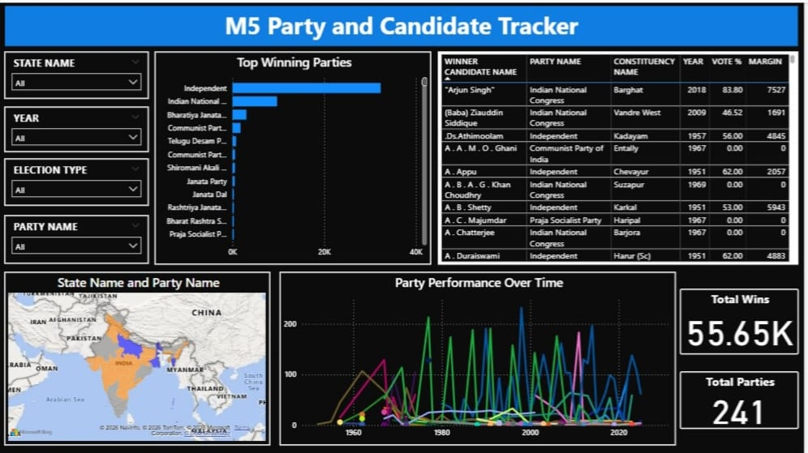
Milestone 5 - Party & Candidate Performance Tracker
State dominance · Win margins · Candidate re-elections · Alliance insights
✅ Delivered in Demo
PARTY & CANDIDATE PERFORMANCE · Top Wins
State-wise party dominance mapping and heatmap
TOP 10 PARTIES BY ALL-TIME WINS
Top 10 winning candidates by vote count
Indian National Congress
10,015
Bharatiya Janata Party
4,990
Win/loss margin analysis per constituency
Independent
1,484
Telugu Desam Party
1,450
Candidate re-election performance tracker
INC (I)
1,004
Alliance-level seat tally insights
Janata Party
782
RJD
568
CPI(M)
533
Janata Dal
529
INC
BJP
Shiv Sena
471
10,015 wins
4,990 wins
TOP CANDIDATES BY VOTES RECEIVED
TDP
INC(I)
Kailash Vijayvargiya
BJP
1,734,313
1,450 wins
1,004 wins
Yogender
BJP
1,480,000
Sushma Swaraj
BJP
1,120,000
Rajnath Singh
BJP
932,000
[ See dashboard image → ]
This page shows which parties dominate which states and which candidates attract the most votes - perfect for election night analysis.
ElectViz: Election Data Visualization for Media · Infosys Springboard · February 2026

Slide 12
Urban vs Rural Constituency Classification
Census 2011 Urban-Rural Population Table · Metro, Semi-urban, Village seat tagging
Method: Map each constituency's district to Census 2011 U-R population ratio · Urban ≥60% · Rural <30% · Semi-Urban in between
🏙️
🏘️
🌾
Urban Constituencies
Semi-Urban Constituencies
Rural Constituencies
Districts with ≥60% urban population
Covers: Delhi, Mumbai, Hyderabad, Bengaluru,
Kolkata, Chennai and metro areas
Higher turnout · Multi-party competition
Districts with 30–60% urban population
Mainly tier-2 cities and district HQs
Classic swing seats — competitive across parties
Often decide state-level majorities
Districts with <30% urban population
Village-dominant, common in SC/ST reserved seats
Strong regional and single-party dominance
Lower turnout variation year on year
Real Examples from Census 2011:
Delhi
Bihar
Maharashtra
97.5% urban urban
11.3% urban urban
45.2% urban urban
→ All 70 Vidhan Sabha constituencies tagged URBAN
→ Majority constituencies tagged RURAL-dominant
→ Mix of Urban (Mumbai) + Rural (Vidarbha) + Semi-Urban
ElectViz: Election Data Visualization for Media · Infosys Springboard · February 2026

Slide 13
Team Responsibilities
Individual contributions and role assignments
H
K
V
A
G
Hamiz K
Karishma
Vennela
Aman
Gajavadan
Team Lead & Data Analyst
Data Analyst
Data Analyst
Data Analyst
Data Analyst
11 states merged, dataset validated
10 states - VS completed
5 states assigned
5 states assigned
5 states assigned
GitHub setup + maintenance
LS collection in progress
VS + LS data collection
Data formatting + cleaning
Data formatting + cleaning
Power BI dashboard development
Bypoll data cleaning
Bypoll for assigned states
Bypoll data mapping
Bypoll data mapping
PPT + final report preparation
Column mapping verification
State-level QC checks
Validation reports
Validation reports
ElectViz: Election Data Visualization for Media · Infosys Springboard · February 2026

Slide 14
Challenges & Solutions
Issues encountered and how the team resolved them
CHALLENGE
SOLUTION
BIGGEST PAIN POINT
Marked for Phase 2 sourcing from ECI portal; removed from demo dataset.
Missing Lok Sabha Data
7 states had no LS files in initial data package.
Data Format Inconsistencies
Built global column mapping + 200+ party abbreviation dictionary applied across all files.
36 source files had different column names and encodings.
Bypoll Dataset Delays
Created dedicated Bypoll CSV pipeline — 346 records now validated and integrated.
Bypoll files stored separately; not integrated initially.
ElectViz: Election Data Visualization for Media · Infosys Springboard · February 2026

Slide 15
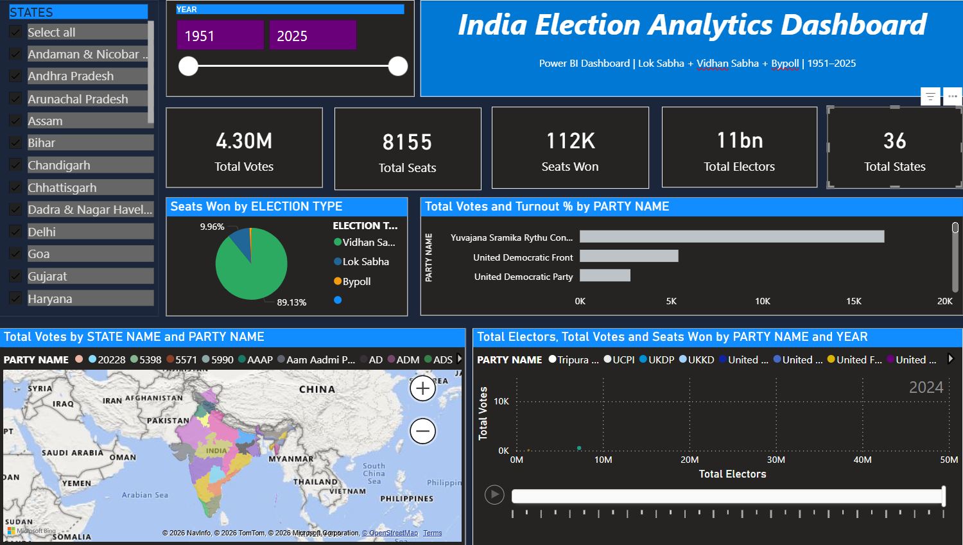
Final Dashboard (with 36 States Completed)
India Election Analytics · Lok Sabha · Vidhan Sabha · 1951–2025

Slide 16
Thank
PRESENTED BY
Hamiz K
Team Lead
You!
Karishma
Data Analyst
Vennela
Data Analyst
Aman
🎤 We'd love to answer your questions!
Data Analyst
Gajavadan
Member
📁 Master Dataset (36 States)
📊 Power BI Dashboard (5 Pages)
📄 Final PPT Report
🗂️ GitHub Repository

