Slide 1
Dual-LM393 Temperature Controller
& Safety Clamp
Electronics Laboratory • Complex Engineering Project
Daffodil International University
Department of Electrical & Electronic Engineering
IDs: 251-33-096 • 251-33-097 • 251-33-099
Course Instructor: Engr. Bijoy Sorker
16 August 2026

Slide 2
Abstract
• Three-stage temperature monitoring and protection system using two LM393 dual comparators.
• Temperature input is simulated with a 10 kΩ potentiometer using the specified TMP36 transfer function.
• 30 °C: warning; 60 °C: alarm and cooling fan; 100 °C: master shutdown.
• An NE555 generates an approximately 1.5 Hz alarm signal, while a 2N2222 controls the fan.
• Experimental testing produced approximately 1.487 V, close to the 1.50 V shutdown reference.
2

Slide 3
Introduction
• Background: excessive temperature can affect normal operation and may damage electronic components.
• Motivation: create a practical automatic warning, cooling, alarm, and shutdown system.
• The design combines threshold detection, visual indication, audible indication, automatic cooling, and safety shutdown.
• The project is implemented and evaluated through circuit design, simulation, and experimental testing.
3

Slide 4
Methodology
LM393 IC2 100 °C Clamp
Master Shutdown
Block diagram and operating stages
Stage 1 Warning
5 V Fan
2N2222 Fan Driver
10 kΩ Temperature Simulator / V_IN
LM393 IC1 Stage 1 & Stage 2
Stage 2 Control
Red LED + Piezo Buzzer
NE555 Astable
4

Slide 5
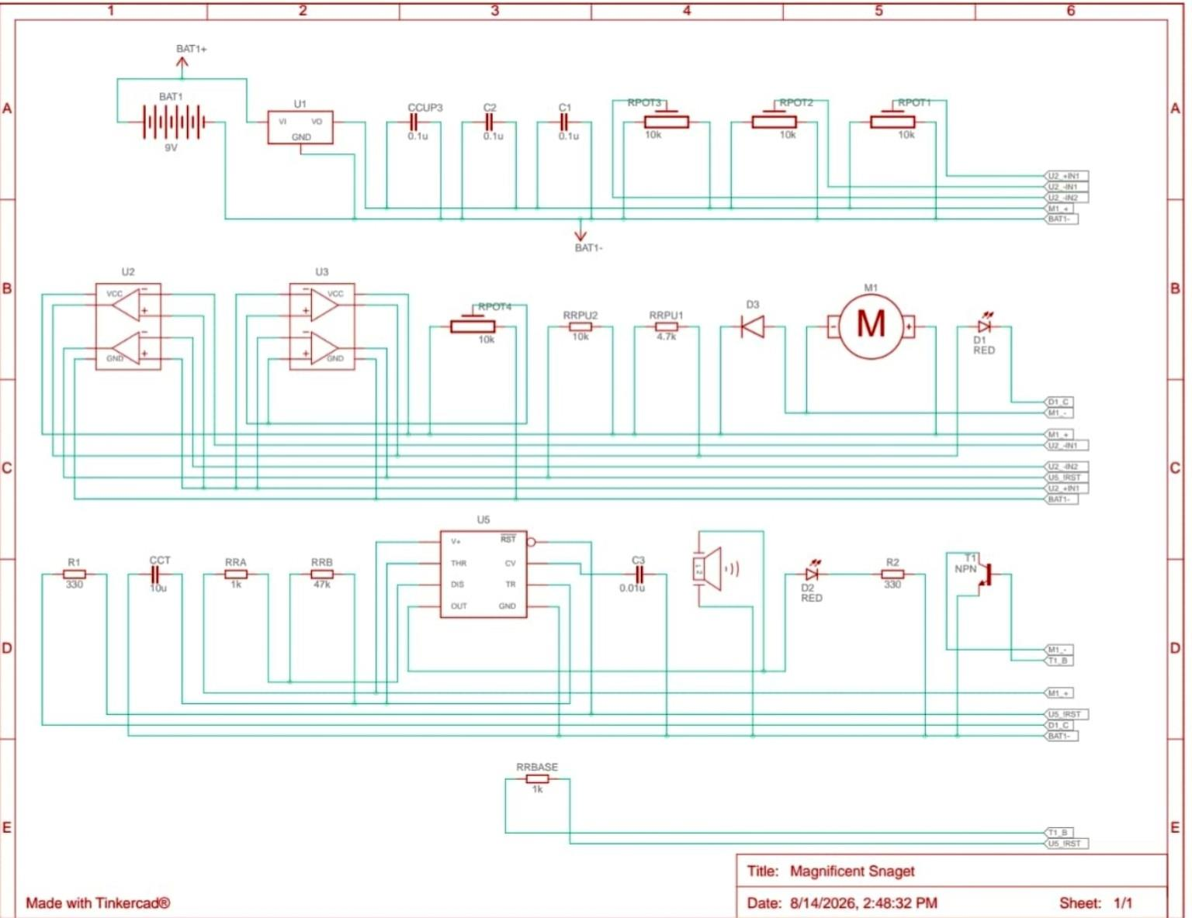
Circuit Diagram
Complete circuit from the project report
Figure 1. Circuit diagram of the temperature controller and safety clamp.
5

Slide 6
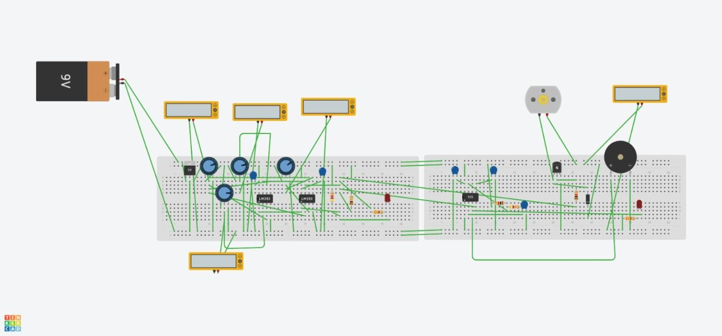
Tinkercad Circuit Implementation
Breadboard / simulation view
Figure 2. Breadboard implementation / simulation view of the temperature-controlled fan and alarm circuit.
6

Slide 7
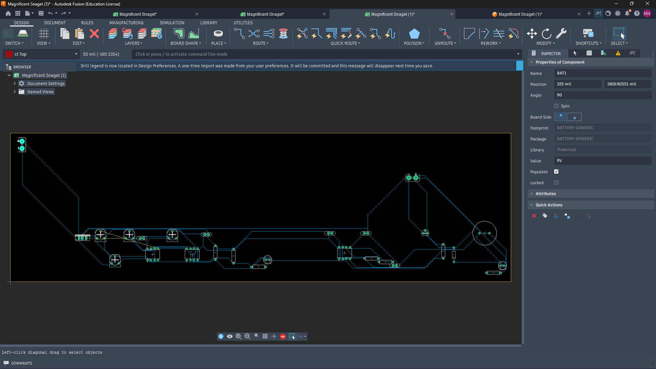
PCB / Simulation Implementation
PCB implementation and simulation view
Figure 3. PCB implementation / simulation view of the temperature-controlled fan and alarm circuit.
7

Slide 8
Working Principle
• V_IN follows V_OUT = 0.50 V + (10 mV/°C × T).
• 30 °C corresponds to 0.80 V; 60 °C to 1.10 V; 100 °C to 1.50 V.
• LM393 IC1 detects the 0.80 V and 1.10 V thresholds.
• LM393 IC2 provides independent 1.50 V master-shutdown clamp channels.
• During Stage 2, the NE555 drives the alarm outputs and the 2N2222 drives the cooling fan.
• At or above 100 °C, the clamp forces the stage-control nodes LOW.
8

Slide 9
Results & Discussion — Calculation Results
• TMP36 threshold mapping: 30 °C → 0.80 V; 60 °C → 1.10 V; 100 °C → 1.50 V.
• NE555: R_A = 1 kΩ, R_B = 47 kΩ, C_T = 10 µF.
• Calculated alarm frequency ≈ 1.5158 Hz ≈ 1.5 Hz.
• Calculated period ≈ 0.6583 s and duty cycle ≈ 50.53%.
• Comparator and transistor current checks in the report support the selected component values.
9

Slide 10
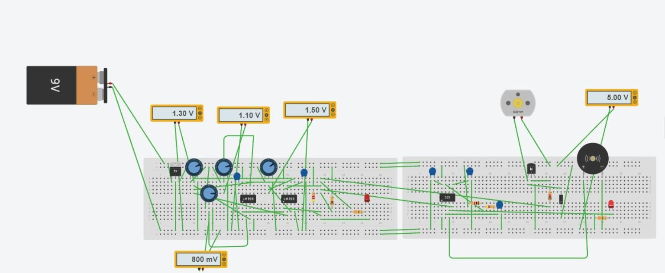
Results & Discussion — Simulation
Simulation result
Figure 4. Simulation result of the temperature-controlled fan and alarm circuit.
10

Slide 11
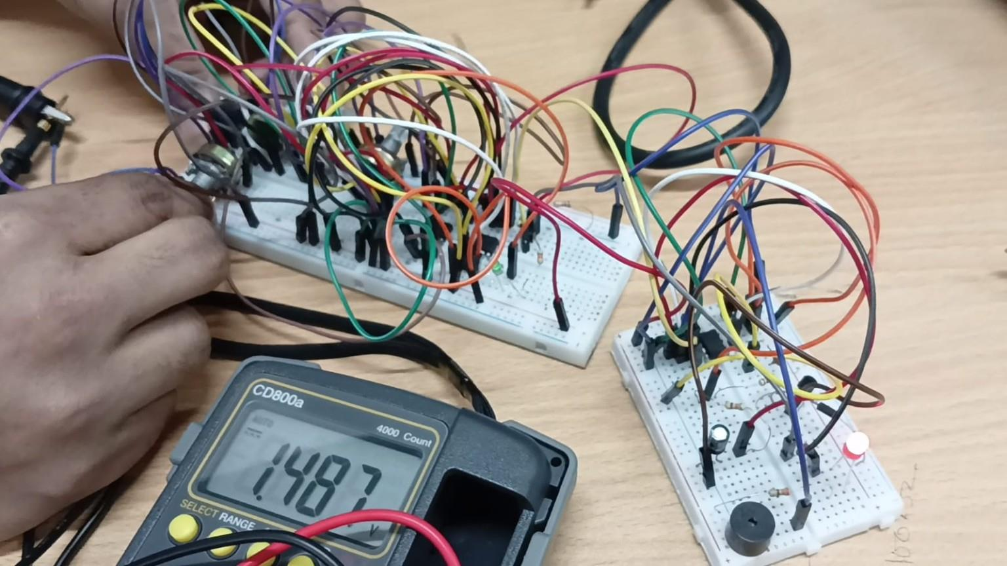
Results & Discussion — Experimental
Physical breadboard implementation and measurement
Figure 5. Experimental setup and measured result; reported measurement ≈ 1.487 V.
11

Slide 12
Operating States
• < 30 °C: Idle — outputs OFF.
• 30–60 °C: Stage 1 — yellow warning LED ON.
• 60–100 °C: Stage 2 — fan ON, red LED blinking, buzzer pulsing.
• ≥ 100 °C: Master shutdown — Stage 2 control is clamped LOW.
12

Slide 13
Conclusion
• The Dual-LM393 Temperature Controller and Safety Clamp successfully demonstrates three-stage temperature monitoring and protection.
• The warning, alarm/cooling, and master-shutdown thresholds are implemented at 30 °C, 60 °C, and 100 °C.
• The NE555 provides the approximately 1.5 Hz alarm signal.
• The experimental measurement of approximately 1.487 V is close to the 1.50 V shutdown reference.
• Overall, the project combines threshold detection, alarm indication, automatic cooling, and safety shutdown.
13

Slide 14
References
• Texas Instruments — LM393 Dual Differential Comparator, product information and datasheet.
• Texas Instruments — NE555 Precision Timers, product information and datasheet.
• Analog Devices — TMP36 Voltage Output Temperature Sensor, product information and datasheet.
• onsemi — 2N2222A Small Signal Switching Transistor, datasheet.
14

