Slide 1


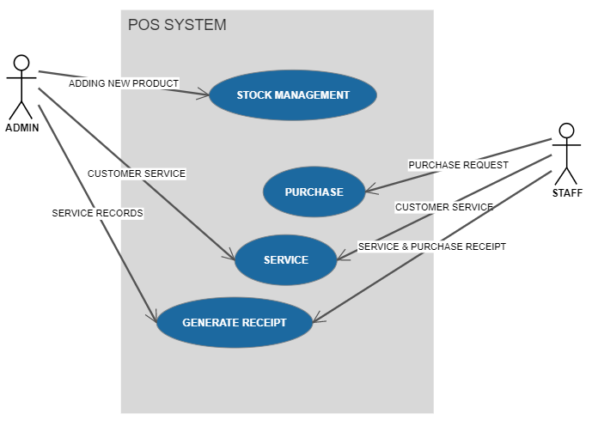
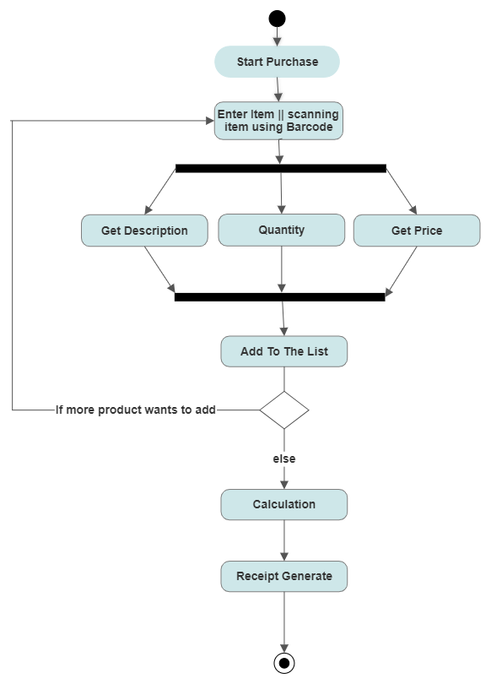

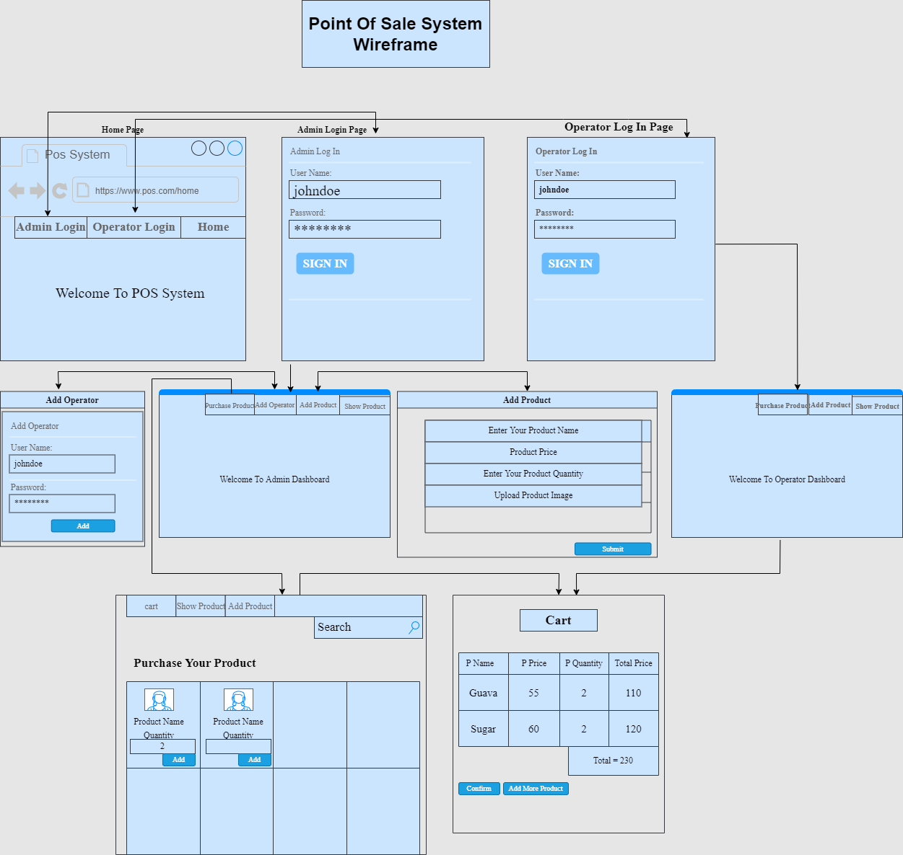
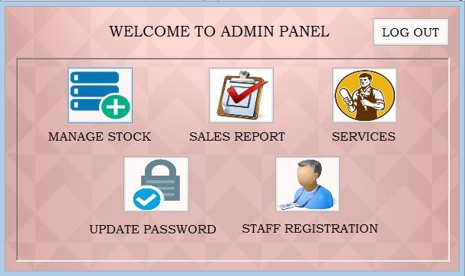
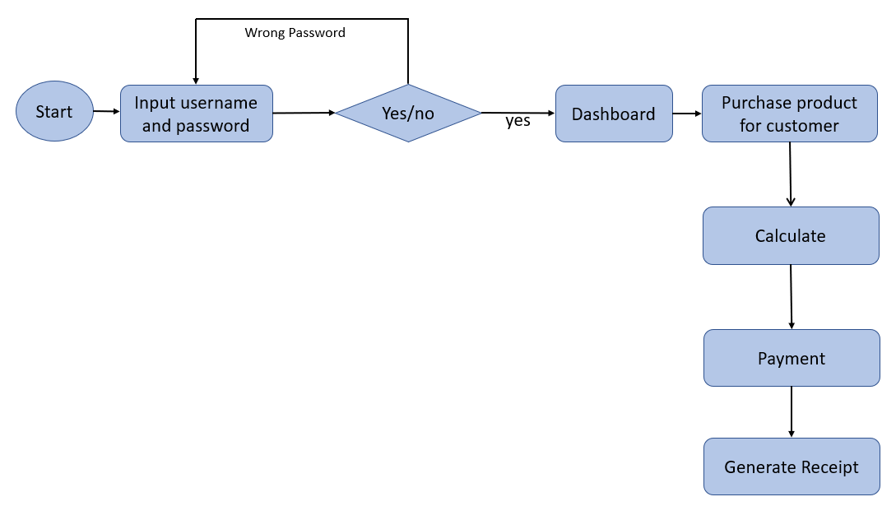
Point Of Sale System
Instructor: Dr. Shamim H Ripon
Group Member: Md. Jusef(2017-2-60-160)
Md. Salauddin Mozumder(2017-2-60-167)
Use Case Diagram
Activity Diagram
The system that is going to be developed is POS System
This system has two panels (Admin & Staff)
In this documentation it shows how the system work along with diagrams (UC,WF,AD,UF) for clear understanding.
For accessing store sale’s history and analytics in one place, we need point of sale system.
To provide instant pricing and faster checkout
Proper use of Point-of-sale systems will save you time that you can use in others area for growing another business.
For tracking operator sales report easily
System can register new staff
Wireframe
Admin Panel
User Flow
Conclusion
This system has some benefits to POS staffs. Currently they are keeping every records by written down in memo manually. At least this system will give them relieve from exhausted life.

