Slide 1

Upgrade2Achitect Program
Session #8
Transitioning into DevOps
EMPOWERING High Performance Technology Teams

Slide 2
Agenda for the Day
S.No. | Schedule | Item | Duration
1 | 09.00 to 09.50 a.m. | Transitioning into DevOps | 50 Mins
2 | 09.50 to 10.00 a.m. | Break | 10 Mins
3 | 10.00 to 10.40 a.m. | Real time examples of DevOps Transitions | 40 mins
4 | 10.40 to 11.00 a.m. | Interaction Time for Q&A | 20 mins

Slide 3


Slide 4
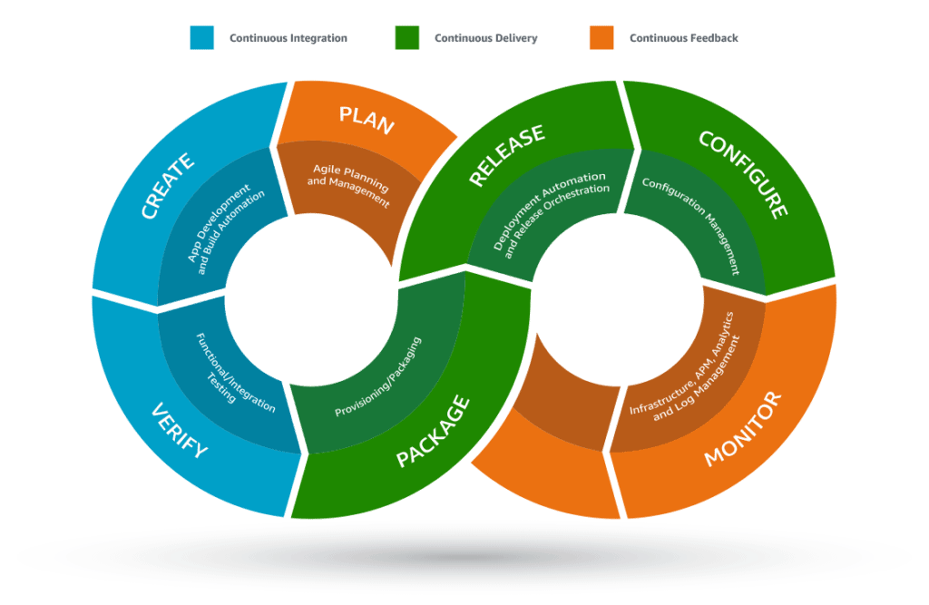

Slide 5
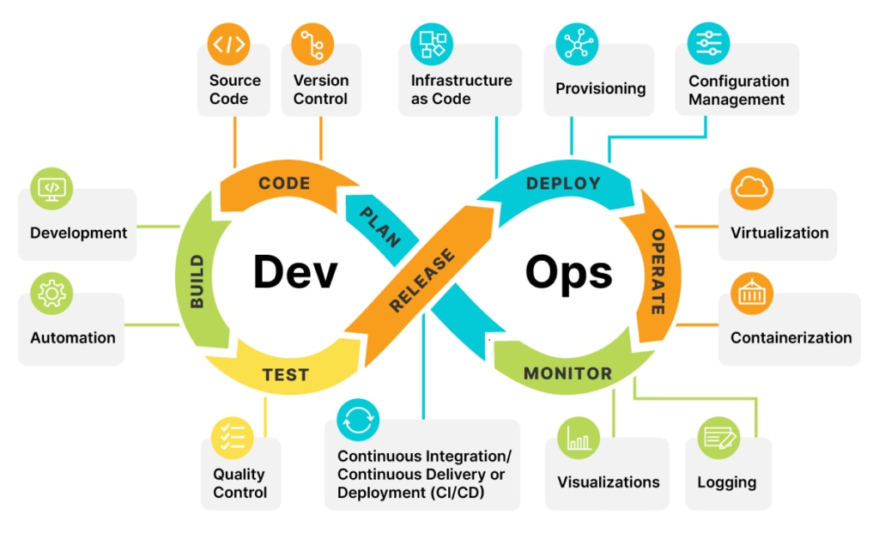

Slide 6
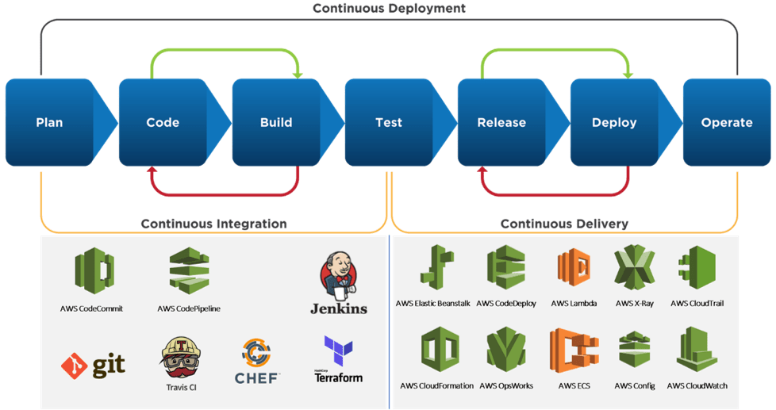


Slide 7
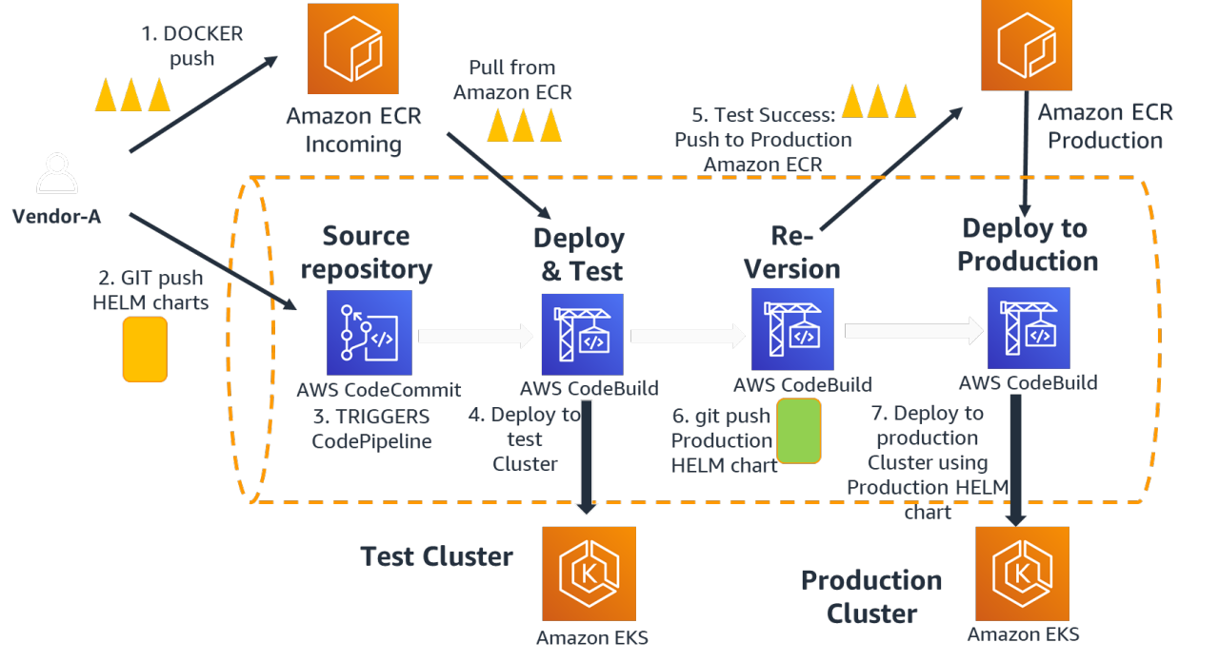

Slide 8
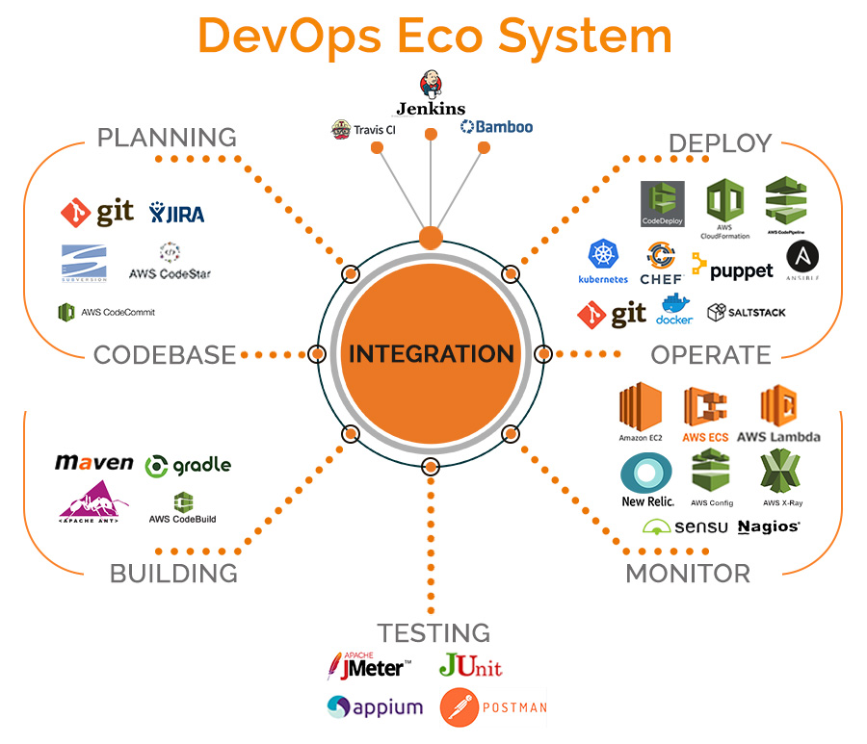

Slide 9
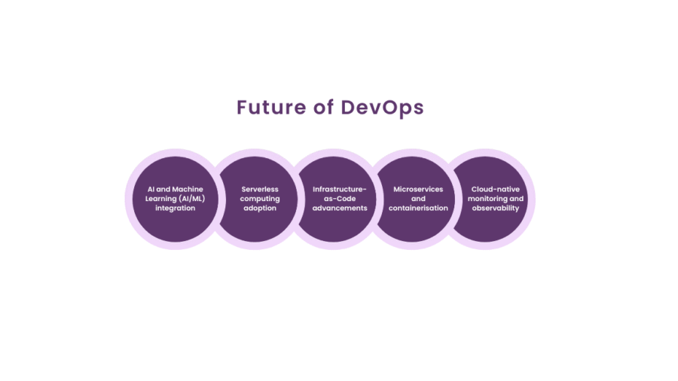

Slide 10
THANK YOU

