Slide 1
Legacy Modernization
By : 2267152

Slide 2
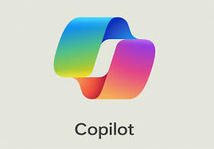
Actual
VSCode/IntelliJ with
Legacy Application Code on repository
Migrated Application Code on repository but different space with new name
3
1
2
Import the code into IDE – Legacy code is the input here
Developer will work on the code (physical migration) with the help of CoPilot by using Prompt Engineering Skills by considering the theory of ‘How migration should be done ?’
Migrated code is the output here
3. Migrated code goes on repository

Slide 3


Expectation
Legacy Modernization Factory
Factory Code
Legacy Application Code
2
Migrated Application Code
3
1
or
Upload the code (which is underlined for migration) into factory as zip format
Factory will do code migration where all the factory code has been developed with the help of CoPilot by using Prompt Engineering Skills. All the aspects of ‘How migration should be done ?’ is taken care while writing the factory
3. Migrated code in the form of zip format gets download

