Slide 1
RAY TRACING
Md Limon apu

Slide 2

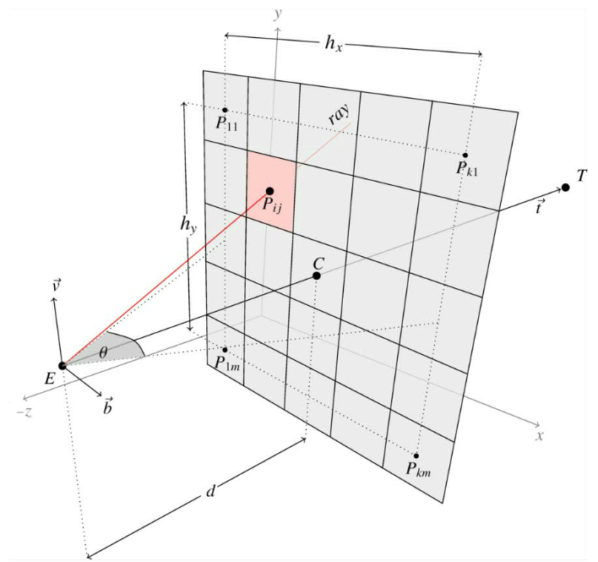
What is ray tracing
Ray tracing is a method used to simulate the path of waves.
Generates photorealistic 3D images
Calculates reflections and refractions
Uses complex algorithms for rendering
This Photo by Unknown Author is licensed under CC BY-SA

Slide 3

Ray-Environment Interactions
1. LOS: Direct path to the receiver.
2. Reflection: Bounces off surfaces.
3. Refraction: Bends through mediums.
4. Diffraction: Bends around edges.
5. Diffuse Scattering: Scatters on rough surfaces.

Slide 4
Types of method
Shooting and Bouncing rays (SBR) Method
Image Method
Supports up to 100 path reflections and two edge diffractions.
The SBR method is generally faster than the image method.
Calculates an approximate number of propagation paths.
Supports up to two path reflections.
Calculates an exact number of propagation paths.
Includes effects from reflection.

Slide 5
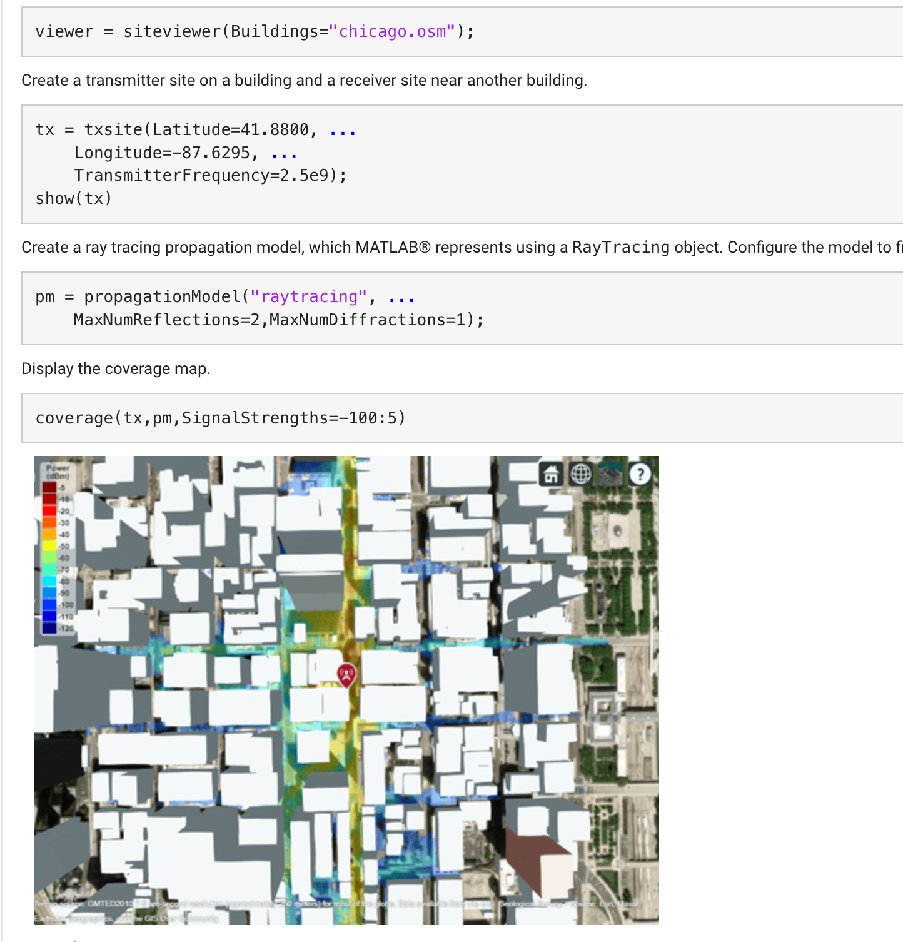

Slide 6
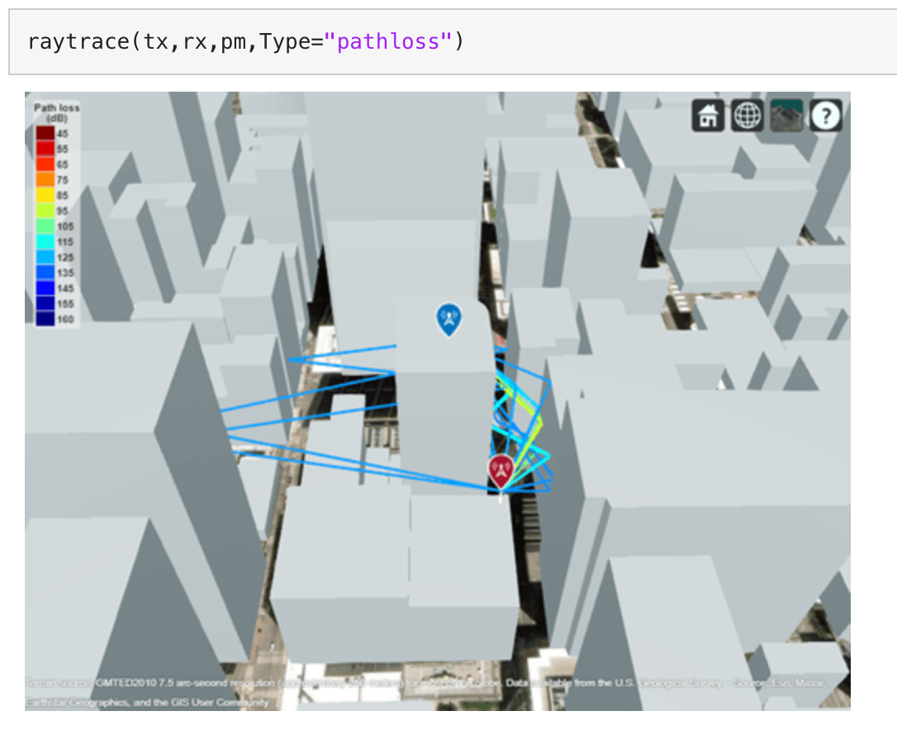
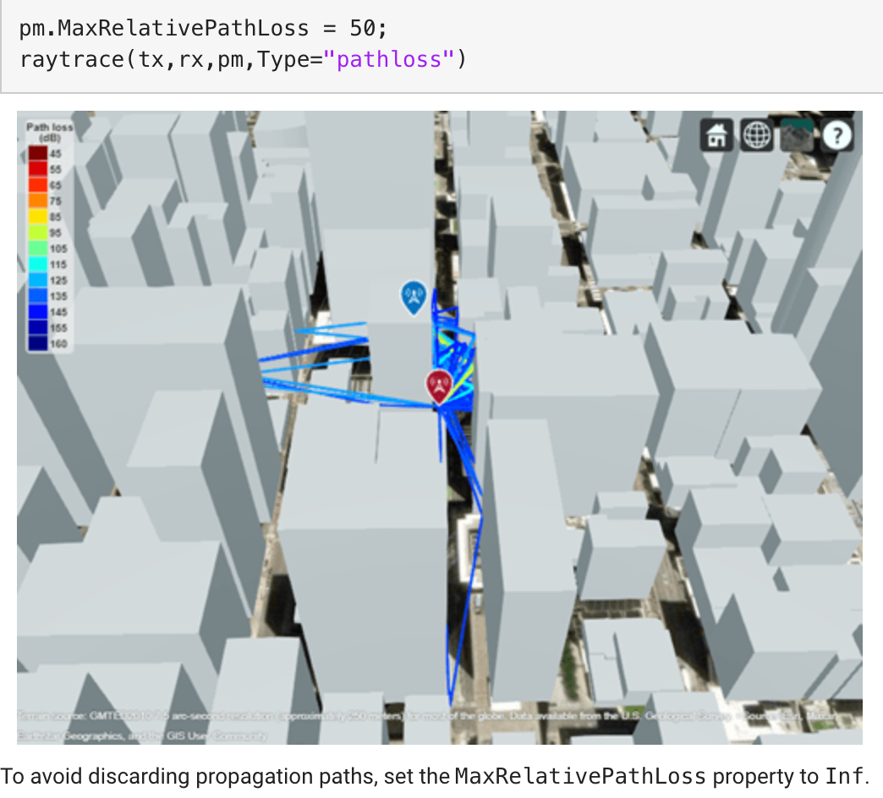
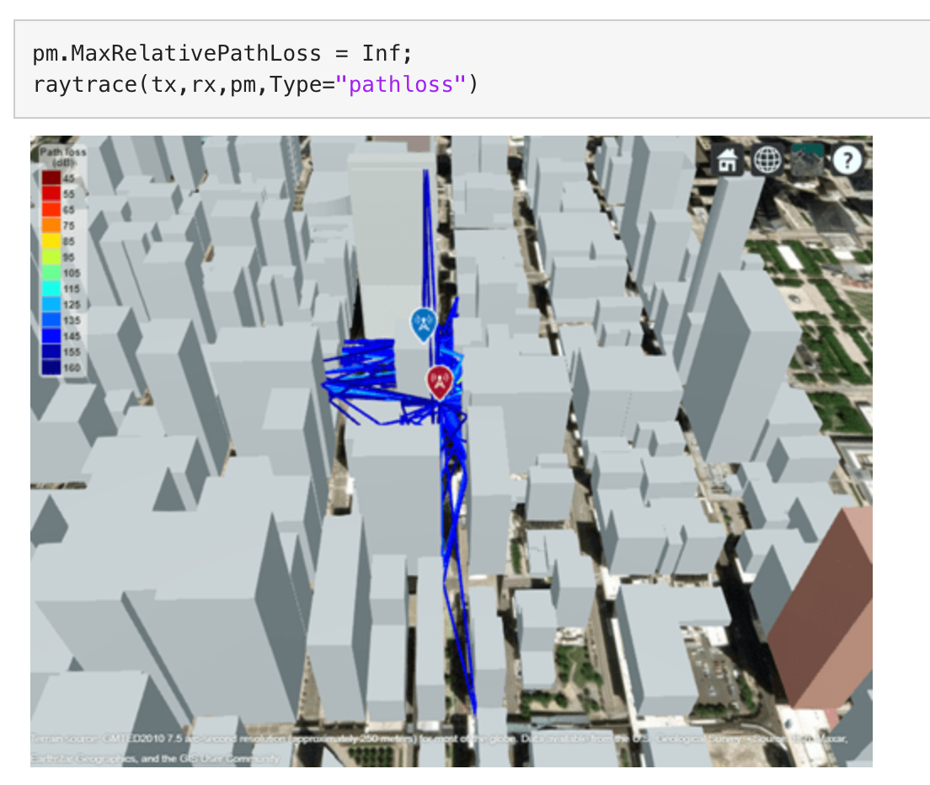
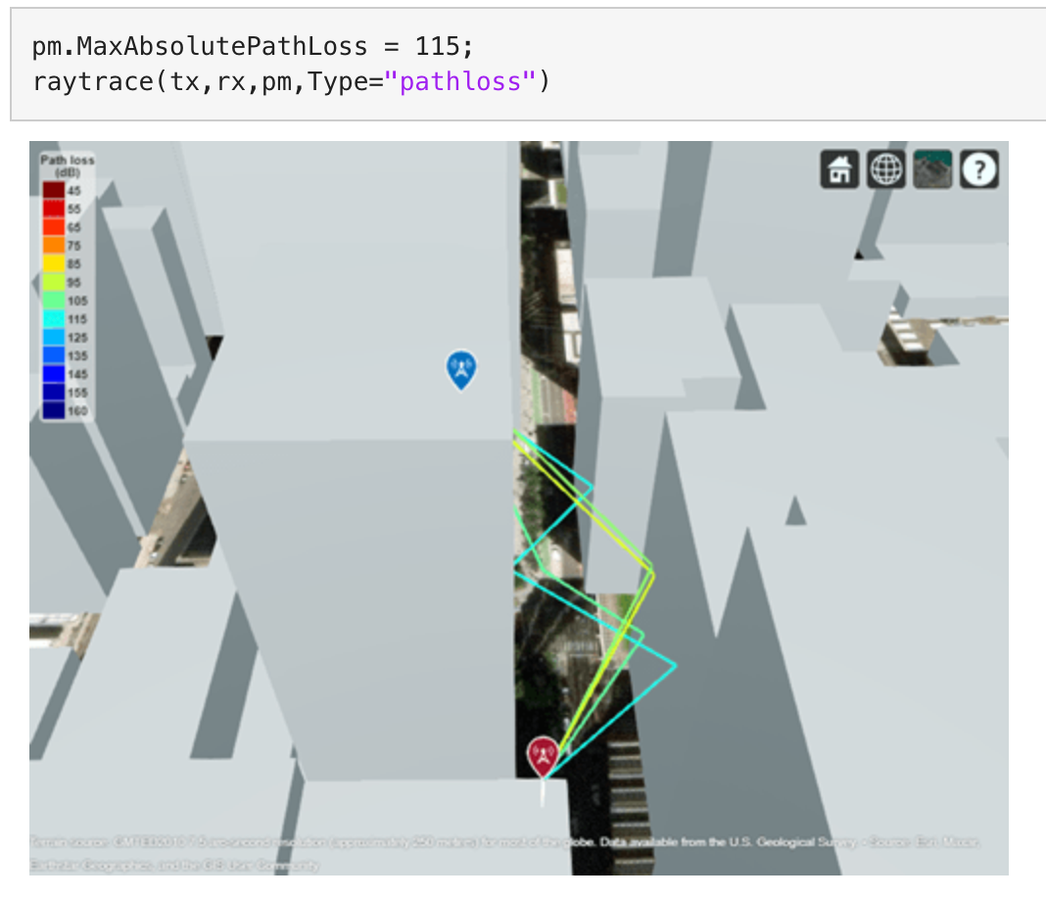

Slide 7
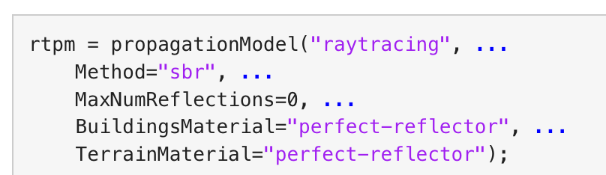
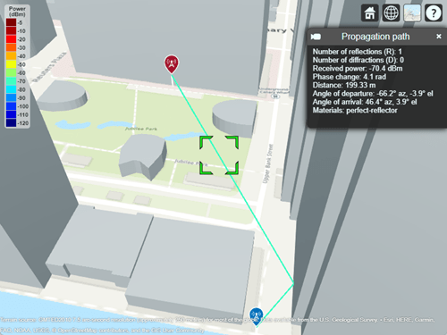
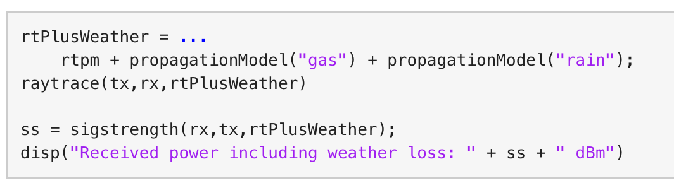

Slide 8
Next agenda
Learn more about the Beam Steering to Enhance Received Power in urban area.
Create a model for propagation.
Simulate on HSHL area.
Learn more on transmission on Ray.

