Slide 1
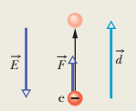
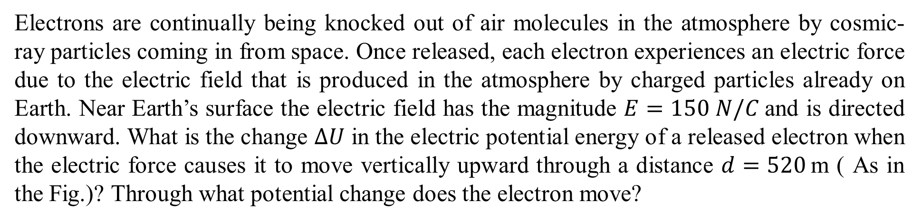
Electrons are continually being knocked out of air molecules in the atmosphere by cosmic-ray particles coming in from space. Once released, each electron experiences an electric force due to the electric field that is produced in the atmosphere by charged particles already on Earth. Near Earth’s surface the electric field has the magnitude $E=150 N/C$and is directed downward. What is the change $∆U$ in the electric potential energy of a released electron when the electric force causes it to move vertically upward through a distance $d=520$m ( As in the Fig.)? Through what potential change does the electron move?

Slide 2
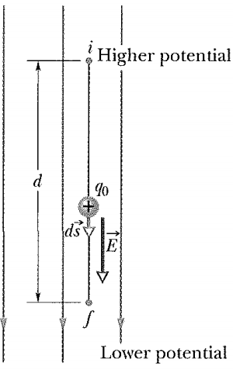
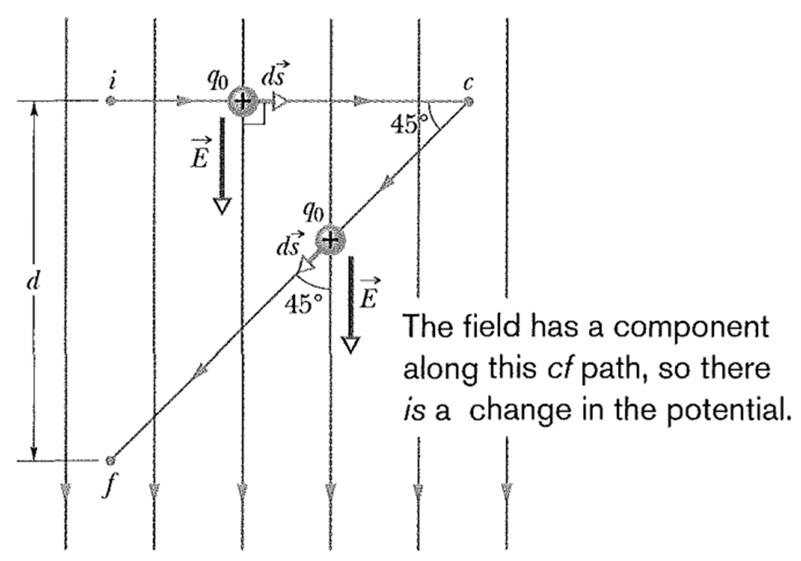
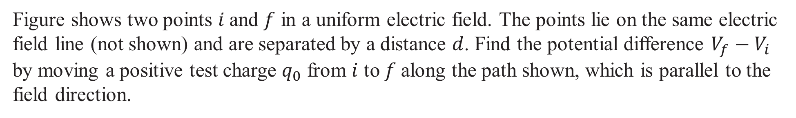
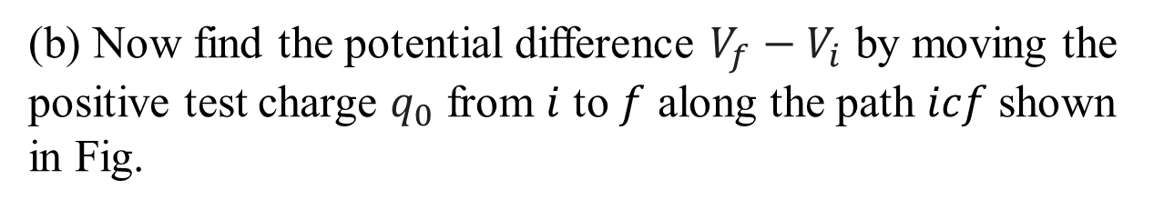
Figure shows two points $i$and $f$ in a uniform electric field. The points lie on the same electric field line (not shown) and are separated by a distance $d$. Find the potential difference $V_{f}−V_{i}$ by moving a positive test charge $q_{0}$ from $i$ to $f$along the path shown, which is parallel to the field direction.
(b) Now find the potential difference $V_{f}−V_{i}$ by moving the
positive test charge $q_{0}$ from $i$ to $f$ along the path $icf$shown in Fig.

Slide 3
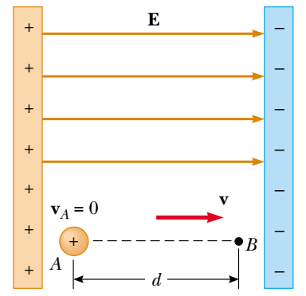
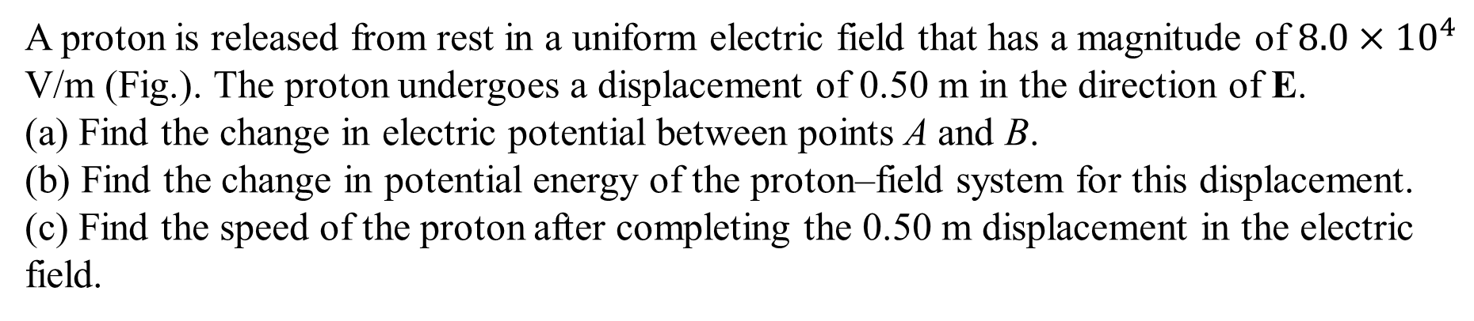
A proton is released from rest in a uniform electric field that has a magnitude of ${8.0×10}^{4}$ V/m (Fig.). The proton undergoes a displacement of 0.50 m in the direction of E. (a) Find the change in electric potential between points A and B.
(b) Find the change in potential energy of the proton–field system for this displacement. (c) Find the speed of the proton after completing the 0.50 m displacement in the electric field.

Slide 4
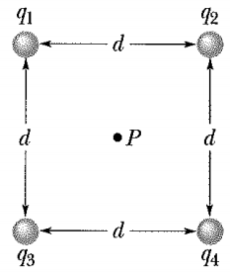
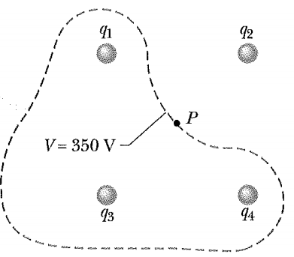
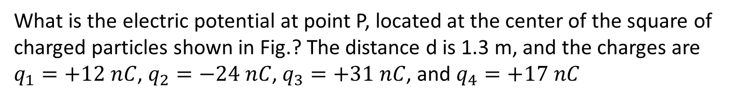
What is the electric potential at point P, located at the center of the square of charged particles shown in Fig.? The distance d is 1.3 m, and the charges are $q_{1}=+12 nC$, $q_{2}=−24 nC$, $q_{3}=+31 nC$, and $q_{4}=+17 nC$
Close to any of the three positively charged particles in Fig., the potential has very large positive values. Close to the single negative charge, the potential has very large negative values. Therefore, there must be points within the square that have the same intermediate potential as that at point P. The curve in Fig.- b shows the intersection of the plane of the figure with the equipotential surface that contains point P.

Slide 5
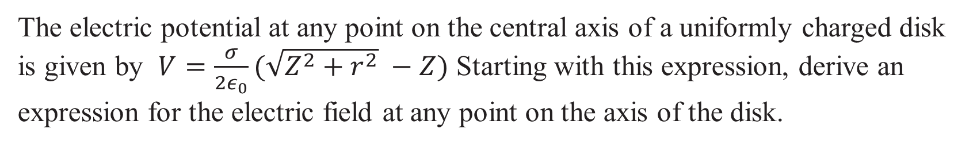
The electric potential at any point on the central axis of a uniformly charged disk is given by $V=\frac{σ}{2ε_{0}}(\sqrt{Z^{2}+r^{2}} −Z)$ Starting with this expression, derive an expression for the electric field at any point on the axis of the disk.

Slide 6
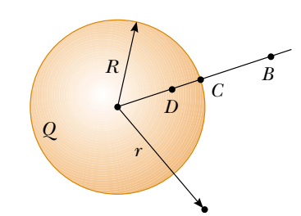
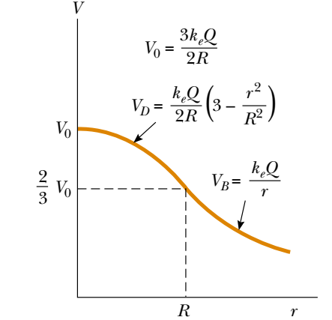
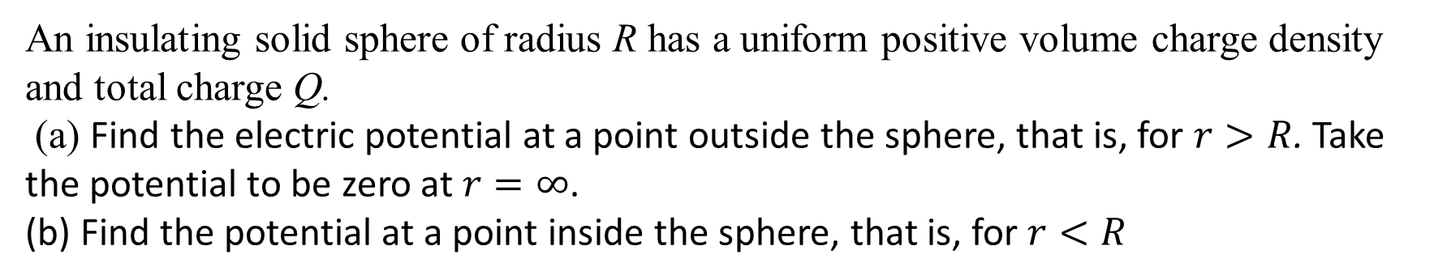
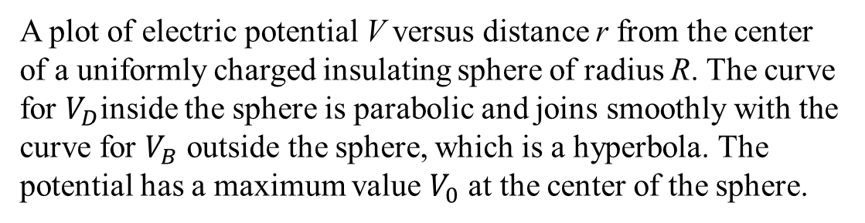
An insulating solid sphere of radius R has a uniform positive volume charge density and total charge Q.
(a) Find the electric potential at a point outside the sphere, that is, for $r>R$. Take the potential to be zero at $r=∞$.
(b) Find the potential at a point inside the sphere, that is, for $r<R$
A plot of electric potential V versus distance r from the center of a uniformly charged insulating sphere of radius R. The curve for $V_{D}$inside the sphere is parabolic and joins smoothly with the curve for $V_{B}$ outside the sphere, which is a hyperbola. The potential has a maximum value $V_{0}$ at the center of the sphere.

