Slide 1
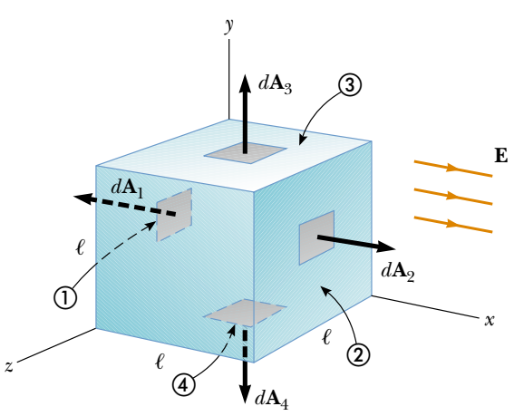
What is the electric flux through a sphere that has a radius of 1.00 m and carries a charge of $+1.0 μC$ at its center?
Consider a uniform electric field E oriented in the x direction. Find the net electric flux through the surface of a cube of edge length $l$, oriented as shown in Figure.

Slide 2
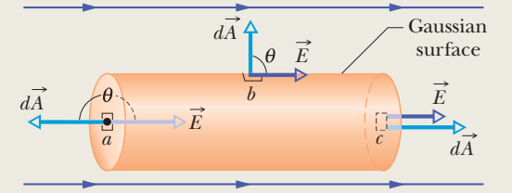
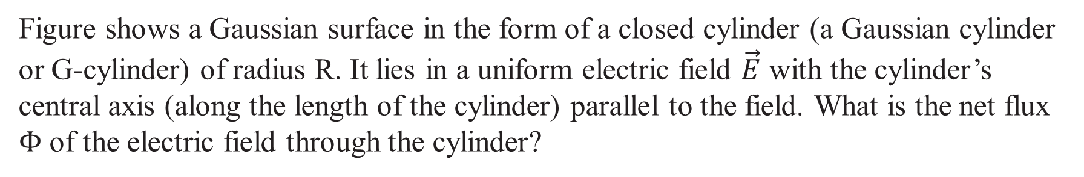
Figure shows a Gaussian surface in the form of a closed cylinder (a Gaussian cylinder or G-cylinder) of radius R. It lies in a uniform electric field $\vec{E}$ with the cylinder’s central axis (along the length of the cylinder) parallel to the field. What is the net flux $Φ$ of the electric field through the cylinder?

Slide 3
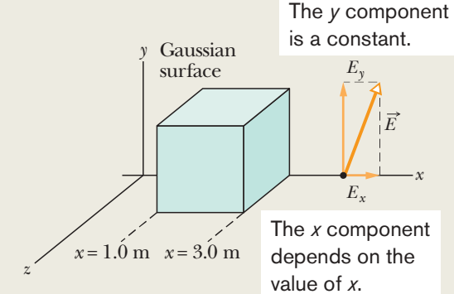
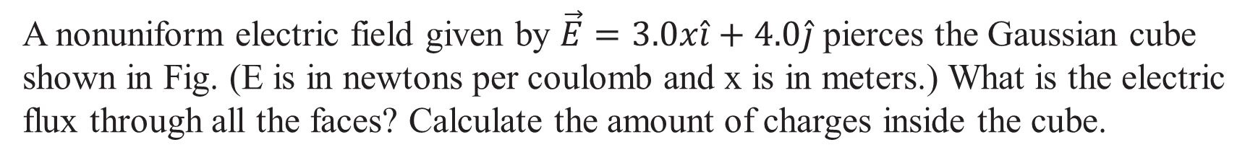
A nonuniform electric field given by $\vec{E}=3.0x\hat{i}+4.0\hat{j}$ pierces the Gaussian cube shown in Fig. (E is in newtons per coulomb and x is in meters.) What is the electric flux through all the faces? Calculate the amount of charges inside the cube.

Slide 4
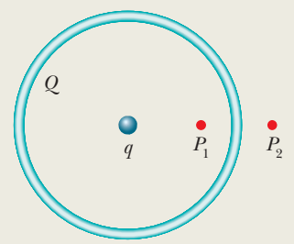
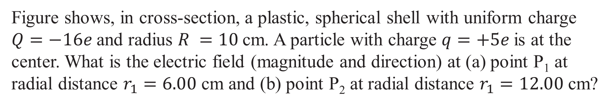
Figure shows, in cross-section, a plastic, spherical shell with uniform charge $Q=−16e$and radius $R =10$cm. A particle with charge $q=+5e$is at the center. What is the electric field (magnitude and direction) at (a) point P₁ at radial distance $r_{1}=6.00$ cm and (b) point P₂ at radial distance $r_{1}=12.00$ cm?

Slide 5
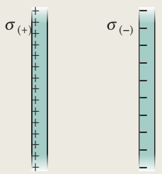
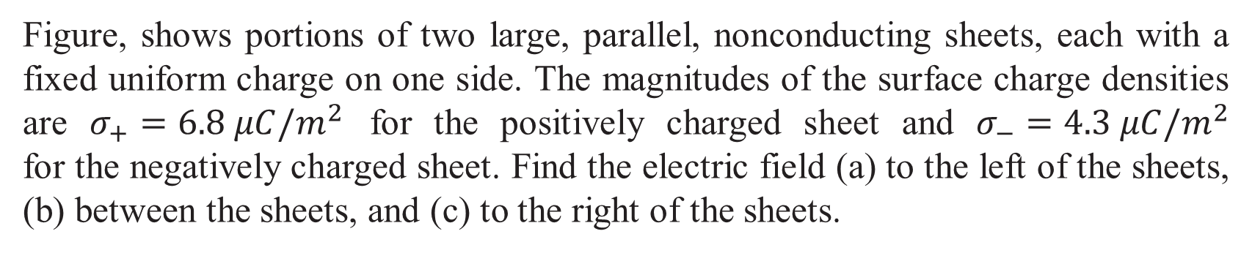
Figure, shows portions of two large, parallel, nonconducting sheets, each with a fixed uniform charge on one side. The magnitudes of the surface charge densities are $σ_{+}=6.8 μC/m^{2}$ for the positively charged sheet and $σ_{−}=4.3 μC/m^{2}$ for the negatively charged sheet. Find the electric field (a) to the left of the sheets, (b) between the sheets, and (c) to the right of the sheets.

Slide 6
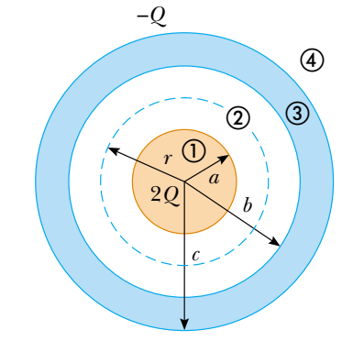
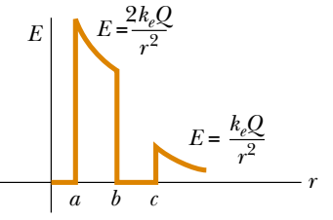
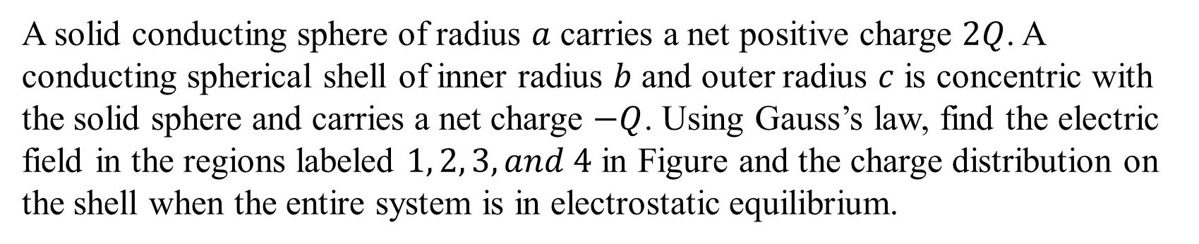
A solid conducting sphere of radius $a$ carries a net positive charge $2Q$. A conducting spherical shell of inner radius $b$ and outer radius $c$ is concentric with the solid sphere and carries a net charge $−Q$. Using Gauss’s law, find the electric field in the regions labeled $1, 2, 3, and 4$ in Figure and the charge distribution on the shell when the entire system is in electrostatic equilibrium.

