Slide 1
Mathematical Induction II

Slide 2
This Lecture
We will continue our discussions on mathematical induction.
The new elements in this lecture are a few variants of induction:
  Strong induction
  Well Ordering Principle
  Invariant Method

Slide 3
Unstacking Game
Start: a stack of boxes
Move: split any stack into two stacks of sizes a,b>0
Scoring: ab points
Keep moving: until stuck
Overall score: sum of move scores
a+b
a
b

Slide 4
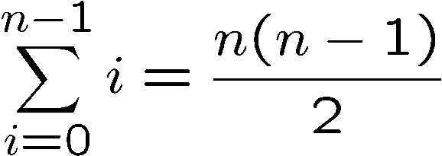
Unstacking Game
(n-1).1= n-1
What is the best way to play this game?
n
n-1
1
Suppose there are n boxes.
What is the score if we just take
the box one at a time?
(n-2).1 = n-2
n-2
1
1.1 = 1
1
1

Slide 5
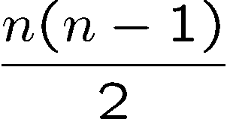
Unstacking Game
What is the best way to play this game?
2n
n
n
Suppose there are n boxes.
What is the score if we cut the stack into half each time?
Say n=8, then the score is 1x4x4 + 2x2x2 + 4x1 = 28
Not better than the first strategy!
first round
second
third
Say n=16, then the score is 8x8 + 2x28 = 120

Slide 6
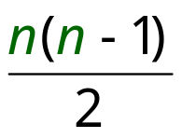
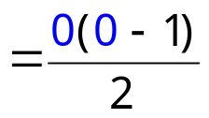
Unstacking Game
Claim: Every way of unstacking gives the same score.
Claim: Starting with size n stack, final score will be
Proof: by Induction with Claim(n) as hypothesis
Base case n = 0:
score = 0
Claim(0) is okay.

Slide 7
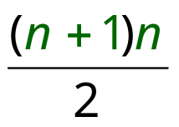
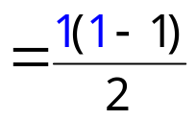
Unstacking Game
Inductive step. assume for n-stack,
and then prove C(n+1):
(n+1)-stack score =
Case n+1 = 1. verify for 1-stack:
score = 0
Why did we need to verify this?
See next slide…
Put n+1 = 1 and hence n = (1-1) in above
C(1) is okay.

Slide 8
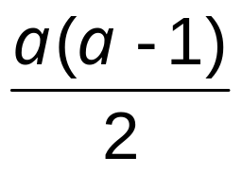
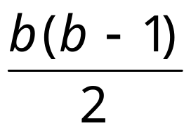
We cannot meaningfully split, unless n+1 > 1.
Unstacking Game
Case n+1 > 1. So split into an a-stack and b-stack,
where a + b = n +1.
(a + b)-stack score = ab + a-stack score + b-stack score
by induction:
a-stack score =
b-stack score =

Slide 9
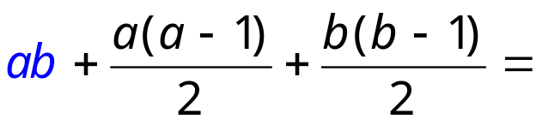
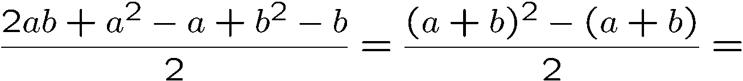
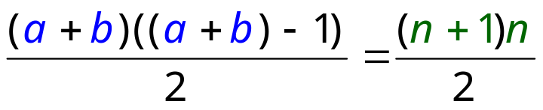
Unstacking Game
(a + b)-stack score = ab + a-stack score + b-stack score
so C(n+1) is okay.
We’re done!

Slide 10
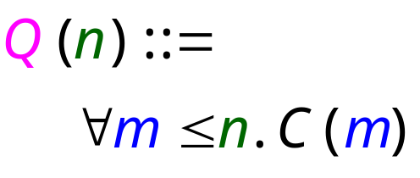
Induction Hypothesis
Wait: we assumed C(a) and C(b) where 1  a, b  n.
But by induction can only assume C(n)
the fix: revise the induction hypothesis to
In words, it says that we
assume the claim is true
for all numbers up to n.
Proof goes through fine using Q(n) instead of C(n).
So it’s OK to assume C(m) for all m  n to prove C(n+1).

Slide 11
Strong Induction
Strong induction
Prove P(0).
Then prove P(n+1) assuming all of
P(0), P(1), …, P(n) (instead of just P(n)).
Conclude n.P(n)
equivalent
Ordinary induction
0 → 1, 1 → 2, 2 → 3, …, n-1 → n.
So by the time we got to n+1, already know all of
P(0), P(1), …, P(n)
The point is: assuming P(0), P(1), up to P(n), it is often easier to prove P(n+1).

Slide 12
Divisibility by a Prime
Theorem. Any integer n > 1 is divisible by a prime number.
Let n be an integer.
If n is a prime number, then we are done.
Otherwise, n = ab, both are smaller than n.
If a or b is a prime number, then we are done.
Otherwise, a = cd, both are smaller than a.
If c or d is a prime number, then we are done.
Otherwise, repeat this argument, since the numbers are
getting smaller and smaller, this will eventually stop and
we have found a prime factor of n.
Remember this slide?
Now we can prove it
by strong induction
very easily. In fact
we can prove a
stronger theorem
very easily.
Idea of induction.

Slide 13


Prime Products
Theorem. Any integer n > 1 is divisible by a prime number.
Theorem: Every integer > 1 is a product of primes.
ACTUALLY:
Theorem: Every integer n > 1 is either a prime or can be written as a product of its prime factors.
Proof: (by strong induction)
Base case is easy.
Suppose the claim is true for all 2 <= i < n.
Consider an integer n.
If n is prime, then we are done.
So n = k·m for integers k, m where n > k,m >1.
Since k,m smaller than n,
By the induction hypothesis, both k and m are product of primes
        k = p₁⋅ p₂⋅ ⋅ ⋅ p₉₄
        m = q₁⋅ q₂⋅ ⋅ ⋅ q₂₁₄

Slide 14
Prime Products
Theorem: Every integer > 1 is a product of primes.
…So
n = k⋅ m = p₁⋅ p₂⋅ ⋅ ⋅ p₉₄⋅ q₁⋅ q₂⋅ ⋅ ⋅ q₂₁₄
is a prime product.
∴ This completes the proof of the induction step.

Slide 15
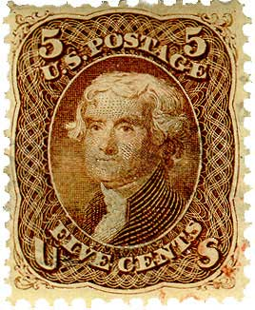

Postage by Strong Induction
Available stamps:
5¢
3¢
What amount can you form?
Theorem: Can form any amount ≥ 8¢
Prove by strong induction on n.
P(n) ::= can form n¢.

Slide 16
Postage by Strong Induction
Base case (n = 8):
8¢:
Inductive Step: assume m¢ for 8 m < n,
then prove n¢
cases:
n=9:
n=10:

Slide 17
Postage by Strong Induction
case n ≥ 11: let m =n − 3.
now n ≥ m ≥ 8, so by induction hypothesis have:
+
= n
3
n −3
We’re done!
In fact, use at most two 5-cent stamps!

Slide 18
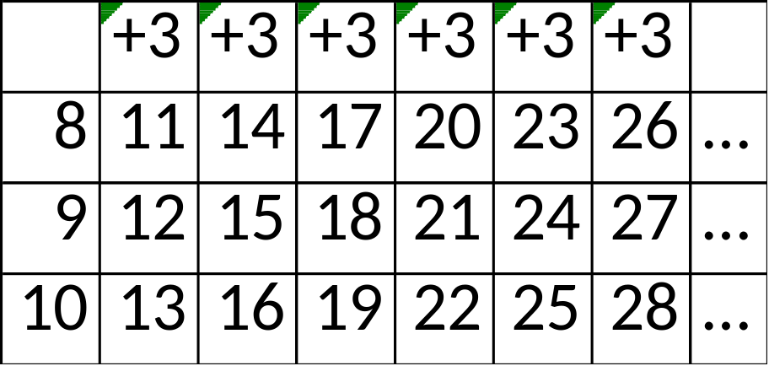
In fact, use at most two 5-cent stamps!

Slide 19
Postage by Strong Induction
Given an unlimited supply of 5 cent and 7 cent stamps,
what postages are possible?
Theorem: For all n >= 24,
it is possible to produce n cents of postage from 5¢ and 7¢ stamps.

Slide 20
This Lecture
  Strong induction
  Well Ordering Principle
  Invariant Method

Slide 21
Well Ordering Principle
Every nonempty set ofnonnegative integers
has a least element.
Axiom
This is an axiom equivalent to the principle of mathematical induction.
Note that some similar looking statements are not true:
Every nonempty set of positive rationals
has a least element.
NO!
Every nonempty set of nonnegative integers
has a least element.
NO!

Slide 22


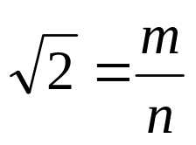
Proof by Contradiction
Theorem: is irrational.
Proof (by contradiction): [sketch of the proof]
Suppose was rational.
Choose m, n integers without common prime factors (always possible) such that
Show that m and n are both even, thus having a common factor 2,
a contradiction!

Slide 23


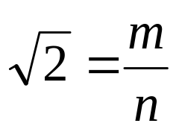

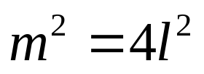
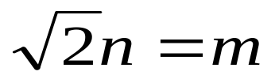
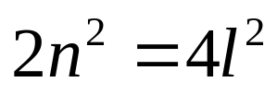

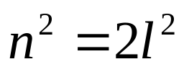

Proof by Contradiction
m, n integers without common prime factors (always possible)
Theorem: is irrational.
Proof (by contradiction):
Want to prove both m and n are even.
so can assume
so m is even.
so n is even.
For an integer n, n is even if and only if n² is even.

Slide 24
Well Ordering Principle
Prove that √2 is irrational
Suppose, √2 =m/n; m, n positive integers,
Using WOP we can ensure that n is the least among possible denominators.
Now, we have 2 = m^2/n^2
2n^2 = m^2
Now LHS is even; So, RHS is also even. So, m^2 is even
Hence m is even; let m = 2k for an integer k.
Then we have,
2n^2 = m^2 = (2k)^2 = 4k^2
n^2 = 2k^2
RHS is even; so LHS is also even. So, n is even.
let n = 2r for an integer r.
So, √2 =m/n = 2k/2r = k/r
Since m and n are positive, so are k and r.
And r = n/2 < n
CONTRADCTON!

Slide 25
Well Ordering Principle in Proofs
To prove ``nN. P(n)’’ using WOP:
Define the set of counterexamples
C ::= {n N | ¬P(n)}
2. Assume C is not empty.
3. By WOP, have minimum element m₀  C.
4. Reach a contradiction (somehow) –
usually by finding a member of C that is < m₀ .
5. Conclude no counterexamples exist. QED

Slide 26
Well Ordering Principle
Prove that √2 is irrational
Suppose, √2 =m/n; m, n positive integers,
Steps 1-3
Using WOP we can ensure that n is the least among possible denominators.
Now, we have 2 = m^2/n^2
2n^2 = m^2
Now LHS is even; So, RHS is also even. So, m^2 is even
Hence m is even; let m = 2k for an integer k.
Then we have,
2n^2 = m^2 = (2k)^2 = 4k^2
n^2 = 2k^2
RHS is even; so LHS is also even. So, n is even.
let n = 2r for an integer r.
Steps 4
So, √2 =m/n = 2k/2r = k/r
Since m and n are positive, so are k and r.
And r = n/2 < n
CONTRADCTON!

Slide 27
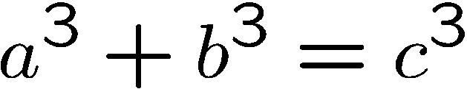
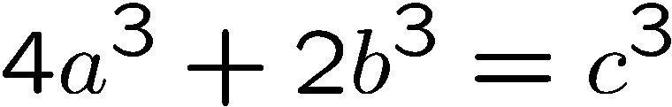
Non-Fermat Theorem
It is difficult to prove there is no positive integer solutions for
Fermat’s theorem
But it is easy to prove there is no positive integer solutions for
Non-Fermat’s theorem
Hint: Prove by contradiction using well ordering principle…

Slide 28
Non-Fermat Theorem
Suppose, by contradiction, there are integer solutions to this equation.
By the well ordering principle, there is a solution with |a| smallest.
In this solution, a,b,c do not have a common factor.
Otherwise, if a=a’k, b=b’k, c=c’k,
then a’,b’,c’ is another solution with |a’| < |a|,
contradicting the choice of a,b,c.
Claim A. There is a solution in which a,b,c do not have a common factor.

Slide 29
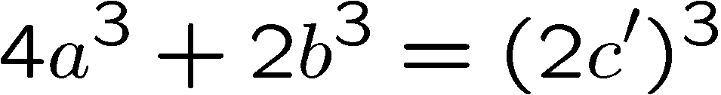
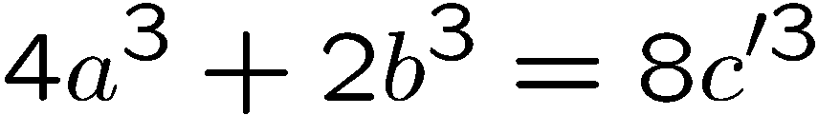
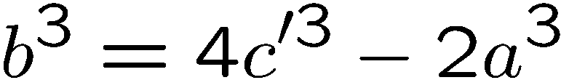
Non-Fermat Theorem
On the other hand, we prove that every solution must have a,b,c even.
This will contradict Claim A, and complete the proof.
First, since c³ is even, c must be even.
(because odd power is odd).
a. Proposition: for an odd number m, m^{i} is odd for all non-negative integer i.
b. If m is an odd number, then m^{i} is odd for all non-negative integer i.
c. If m^{i} is NOT odd then m is NOT odd
Let c = 2c’, then

Slide 30
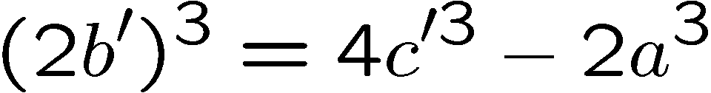
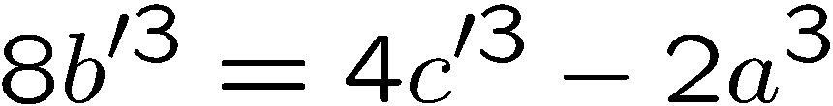
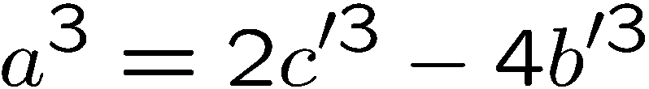
Non-Fermat Theorem
Since b³ is even, b must be even. (because odd power is odd).
Let b = 2b’, then
Since a³ is even, a must be even. (because odd power is odd).
There a,b,c are all even, contradicting Claim A

Slide 31
This Lecture
  Strong induction
  Well Ordering Principle
  Invariant Method

Slide 32

A Chessboard Problem
A bishop can only move along a diagonal
Can a bishop move from its current position to the question mark?
 |  | ?

Slide 33

A Chessboard Problem
A bishop can only move along a diagonal
Can a bishop move from its current position to the question mark?
 |  | ?
Impossible!
Why?

Slide 34
A Chessboard Problem
Invariant!
 |  | ?
The bishop is in a red position.
A red position can only move to a red position by diagonal moves.
The question mark is in a white position.
So it is impossible for the bishop to go there.
This is a simple example of the invariant method.

Slide 35
Domino Puzzle
An 8x8 chessboard, 32 pieces of dominos
Can we fill the chessboard?

Slide 36
Domino Puzzle
An 8x8 chessboard, 32 pieces of dominos
Easy!

Slide 37
Domino Puzzle
An 8x8 chessboard with two holes, 31 pieces of dominos
Can we fill the chessboard?
Easy??

Slide 38
Domino Puzzle
An 4x4 chessboard with two holes, 7 pieces of dominos
Can we fill the chessboard?
Impossible!

Slide 39
Domino Puzzle
An 8x8 chessboard with two holes, 31 pieces of dominos
Can we fill the chessboard?
Then what??

Slide 40
Domino Puzzle
An 8x8 chessboard with two holes, 31 pieces of dominos
Can we fill the chessboard?

Slide 41
Domino Puzzle
Invariant!
Each domino will occupy one white square and one red square.
There are 32 red squares but only 30 white squares.
So it is impossible to fill the chessboard using only 31 dominos.
This is another example of the invariant method.

Slide 42
Invariant Method
Find properties (the invariants) that are satisfied throughout the whole process (by induction).
Show that the target do not satisfy the properties.
Conclude that the target is not achievable.
In the bishop example, the invariant is
the colour of the position of the Bishop.
In the domino example, the invariant is that
any placement of dominos will occupy the same
number of red positions and white positions.
Very useful in analysis of algorithms.

Slide 43
Quick Summary
Induction is perhaps the most important proof technique in computer science.
For example it is very important in proving the correctness of an algorithm
(by invariant method) and also analyzing the running time of an algorithm.
There is no particular example that you should remember.
The point here is to understand the principle of mathematical induction
(the way that you “reduce” a large problem to smaller problems),
and apply it to the new problems that you will encounter in future!
Possibly the only way to learn this is to do more exercises!

