Slide 1
Set Theory
A
B
C

Slide 2
This Lecture
We will first introduce set theory before we do counting.
Basic Definitions
Operations on Sets
Set Identities
Russell’s Paradox

Slide 3
Sets
A set is a collection of mathematical objects,
with the collection treated as a single mathematical object.
Examples:
real numbers, 
complex numbers, C
integers, 
empty set, 

Slide 4
Defining Sets
A set is just a collection of objects.
Sets can be defined directly:
e.g. {1,2,4,8,16,32,…},
{CSC1130,CSC2110,…}
Order, number of occurence are not important.
e.g. {A,B,C} = {C,B,A} = {A,A,B,C,B}
A set can be an element of another set.
{1, {2}, {3,{4}} }

Slide 5
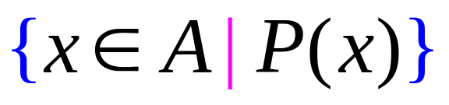
Defining Sets by Predicates
The set of elements, x, in A such that P(x) is true.
The set of prime numbers:

Slide 6

Membership
The most important question in set theory is whether an element is in a set.
x is an element of A
x is in A
Examples:
π/2  {7, “Albert”,π/2, T}
π/3  {7, “Albert”,π/2, T}
14/2  {7, “Albert”,π/2, T}
7 
2/3  

Slide 7


Containment
A is a subset of B
A is contained in B
Every element of A is also an element of B.
A
B
A is a proper subset of B

Slide 8


Examples
R,
{3} {5,7,3}
  every set,
A  A
prime odd
{a, {b}, c} {a, b, c}
{{b}} ≠ {b}

Slide 9
This Lecture
Basic Definitions
Operations on Sets
Set Identities
Russell’s Paradox

Slide 10
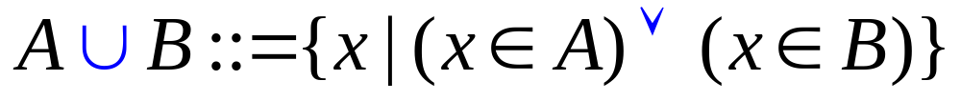
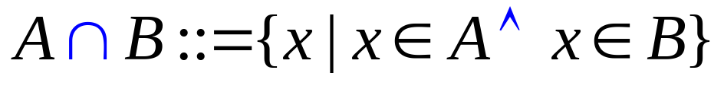
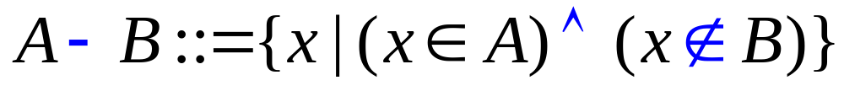
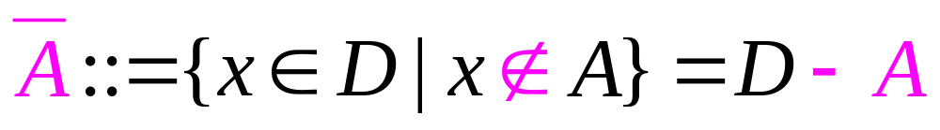
Basic Operations on Sets
union:
intersection:
difference:
complement:
Complement can be defined only if the domain is defined

Slide 11



Examples
A = {1, 3, 6, 8, 10} B = {2, 4, 6, 7, 10}
A B = {6, 10}, A B = {1, 2, 3, 4, 6, 7, 8, 10} A-B = {1, 3, 8}
prime even = {2}, even odd = 
A = { x | x = 2k for some integer k}, B = { x | x = 3k for some integer k}
A B = { x | x = 6k for some integer k}
A B = { x | x is either a multiple of 2 or a multiple of 3 (or both) }
A – B = { x | x is even but not a multiple of 3 }
Let D (i.e. the domain) be the set of integers, then

Slide 12
Partitions of Sets
Two sets are disjoint if their intersection is empty.
A collection of nonempty sets {A₁, A₂, …, A_{n}} is a partition of a set A
if and only if
and A₁, A₂, …, A_{n} are mutually disjoint.

Slide 13
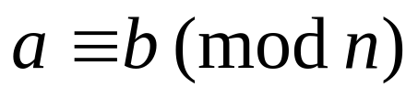
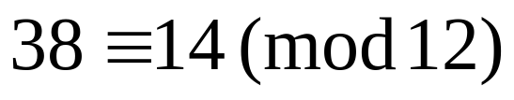
Partitions of Sets
Two sets are disjoint if their intersection is empty.
A collection of nonempty sets {A₁, A₂, …, A_{n}} is a partition of a set A
if and only if
and A₁, A₂, …, A_{n} are mutually disjoint.
For a positive integer n, two integers a and b are said to be congruent modulo n, if their difference a − b is an integer multiple of n. The number n is called the modulus of the congruence.
congruence of a and b can also be thought of as asserting that these two numbers have the same remainder after dividing by the modulus n
Notes:
What is meaning a ≡ b mod n?
This establishes a natural congruence relation on the integers. For a positive integer n, two integers a and b are said to be congruent modulo n (or a is congruent to b modulo n), if a and b have the same remainder when divided by n (or equivalently if a − b is divisible by n ). It can be expressed as a ≡ b mod n.

Slide 14
Partitions of Sets
Two sets are disjoint if their intersection is empty.
A collection of nonempty sets {A₁, A₂, …, A_{n}} is a partition of a set A
if and only if
and A₁, A₂, …, A_{n} are mutually disjoint.
Example. Let A be the set of integers.
A₁ be the set of integers  1 (mod 3)
A₂ be the set of integers  2 (mod 3)
A₃ be the set of integers  0 (mod 3)
{A₁, A₂, A₃} is a partition of A

Slide 15
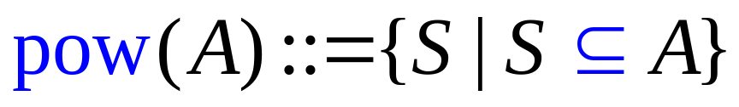
Power Sets
power set:
pow({a,b}) = {, {a}, {b}, {a,b}}
pow({a,b,c}) = {, {a}, {b}, {c}, {a,b}, {a,c}, {b,c}, {a,b,c}}
pow({a,b,c,d}) = {, {a}, {b}, {c}, {d},
{a,b}, {a,c}, {b,c}, {a,d}, {b,d}, {c,d},
{a,b,c}, {a,b,d}, {a,c,d}, {b,c,d}, {a,b,c,d}}
If A has n elements, then the pow(A) has 2^{n} elements.

Slide 16
P(n) = If A has n elements, then the pow(A) has 2^{n} elements.
Basis: P(0) is true, as the set with 0 elements has 1 subset (itself) and 2⁰ = 1.
Inductive step: Prove P(k) → P(k+1)
Let T be a set such that |T| = k+1 and T ={e₁,e₂,...e_{k},e_{k+1}}.
Let S={e₁,e₂,...e_{k}}. Then |S|=k, so, S has 2^{k} subsets (by induction).
Note that T =S∪{e_{k+1}}, so every subset of S is also a subset of T.
Any subset of T either contains the element e_{k+1}, or it doesn’t contain e_{k+1}. If a subset of T doesn’t contain e_{k+1}, then it is also a subset of S, and there are 2^{k} of those subsets.
On the other hand, if a subset of T does contain the element e_{k+1}, then that subset is formed by including e_{k+1} in one of the 2^{k} subsets of S, so T has 2^{k} subsets containing e_{k+1}.
We have shown that T has 2^{k} subsets containing e_{k+1}, and another 2^{k} subsets not containing e_{k+1}, so the total number of subsets of T is 2^{k} + 2^{k} = (2) 2^{k} = 2^{k+1}
^{[QED]}

Slide 17
Cartesian Products
Given two sets A and B, the Cartesian product A x B is the
set of all ordered pairs (a,b), where a is in A and b is in B.
Ordered pairs means the ordering is important, e.g. (1,2) ≠ (2,1)
e.g. A = {x,y} B = {1,2,3}
A x B = { (x,1), (x,2), (x,3), (y,1), (y,2), (y,3) }
If A has n elements and B has m elements, then A x B has mn elements.
The definition can be generalized to any number of sets.
e.g. A = {1,2}, B = {x,y}, C = {T,F}
A x B x C = { (1,x,T), (1,x,F), (1,y,T), (1,y,F),
(2,x,T), (2,x,F), (2,y,T), (2,y,F) }

Slide 18
This Lecture
Basic Definitions
Operations on Sets
Set Identities
Russell’s Paradox

Slide 19


Set Identities
Some basic properties of sets

Slide 20
Set Identities
Distributive Law:
(1)
(2)
A
B
A
B
C
C
(1)
(2)

Slide 21

Set Identities
Distributive Law:
If you insist on proving this law more formally…
S₁
S₂
A
S₃
B
S₄
S₅
S₆
S₇
C

Slide 22



Set Identities
De Morgan’s Law:

Slide 23

Set Identities
De Morgan’s Law:

Slide 24
Exercises

Slide 25
This Lecture
Basic Definitions
Operations on Sets
Set Identities
Russell’s Paradox

Slide 26
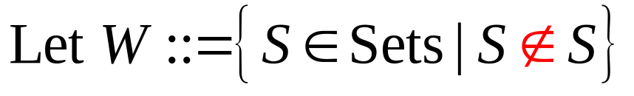
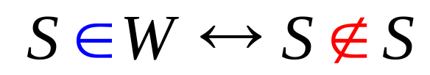
Russell’s Paradox
so
Is W in W?

Slide 27
Russell’s Paradox
"abnormal“ set: if it is a member of itself
"normal" set: otherwise.
Example:
  take the set of all squares S.
  S is not itself a square
  S is "normal".
  the complementary set that contains all non-squares, S`
  that set is itself not a square
  so S` is "abnormal".

Slide 28
Russell’s Paradox
Now we consider the set of all normal sets, R.
Now, try to determine whether R is normal or abnormal
Case 1: R is a normal set:
  it would be contained in the set of normal sets (itself),
  and therefore be abnormal;
Case 2: R is abnormal:
  it would not be contained in the set of normal sets
  So, it would not be contained in itself
  and therefore be normal.
This leads to the conclusion that R is neither normal nor abnormal: Russell's paradox.

Slide 29
Barber’s Paradox
There is a male barber who shaves all those men,
and only those men,
who do not shave themselves.
Does the barber shave himself?

Slide 30
This Lecture
Just make sure you understand the basics of set theory.
Basic Definitions
Operations on Sets
Set Identities

