Slide 1
Relation-Part 1
Mahmuda Naznin
CSE 103

Slide 2
Relations and Properties.
The most direct way to express a
relationship between elements of two sets
is to use ordered pairs.
For this reason, sets of ordered pairs are
called binary relations.
Example 1-
A : the set of students in your school.
B : the set of courses.
R = { (a, b) : a∈A, b∈B, a is enrolled in course b }

Slide 3
Set and Relation
Def .1.a. Let A and B be sets. A binary relation
from A to B is a subset R of A×B.
( Note A×B = { (a,b) : a∈A and b∈B } )
Def. 1.b. We use the notation aRb to denote
that (a, b)∈R, and aRb to denote that
(a,b)∉R.
Moreover, a is said to be related to b
by R if aRb.

Slide 4
Example. Let A={0, 1, 2} and B={a, b},
then {(0,a),(0,b),(1,a),(2,b)} is a relation R
from A to B. This means, for instance, that
0Ra, but that 1Rb
A
R ⊆ A×B = { (0,a) , (0,b) , (1,a)
(1,b) , (2,a) , (2,b)}
B
0
a
∈R
∈R
1
b
2
R

Slide 5
Relations vs. Functions
Note. Relations vs. Functions
A relation can be used to express a 1-to-many
relationship between the elements of the sets
A and B. (For function it can not be 1 to many output)
Def. 2. A relation on the set A is a subset of A × A
( i.e., a relation from A to A ).

Slide 6
Example. Let A be the set {1, 2, 3, 4}. Which ordered pairs are in the relation R = { (a, b)| a divides b }?
Example– Relation
Sol :
1
1
2
2
3
3
4
4
R = { (1,1), (1,2), (1,3), (1,4),
(2,2), (2,4),
(3,3),
(4,4) }

Slide 7
Example . Consider the following relations on Z.
R₁ = { (a, b) | a ≤ b }
R₂ = { (a, b) | a > b }
R₃ = { (a, b) | a = b or a = −b }
R₄ = { (a, b) | a = b }
R₅ = { (a, b) | a = b+1 }
R₆ = { (a, b) | a + b ≤ 3 }
Which of these relations
contain each of the pairs
(1,1), (1,2), (2,1), (1,−1),
and (2,2)?
 | (1,1) | (1,2) | (2,1) | (1,−1) | (2,2)
R₁ | x | x |  |  | x
R₂ |  |  | x | x
R₃ | x |  |  | x | x
R₄ | x |  |  |  | x
R₅ |  |  | x
R₆ | x | x | x | x

Slide 8
Def. 3. A relation R on a set A is called reflexive if (a,a)∈R for every a∈A.
Reflexive Relation
Example. Consider the following relations on
{1, 2, 3, 4} :
R₂ = { (1,1), (1,2), (2,1) }
R₃ = { (1,1), (1,2), (1,4), (2,1), (2,2), (3,3), (4,1), (4,4) }
R₄ = { (2,1), (3,1), (3,2), (4,1), (4,2), (4,3) }
which of them are reflexive ?
Sol :
R₃

Slide 9
Reflexive Relation
Example. Which of the relations
are reflexive ?
Sol :
R₁, R₃ and R₄
R₁ = { (a, b) | a ≤ b }
R₂ = { (a, b) | a > b }
R₃ = { (a, b) | a = b or a = −b }
R₄ = { (a, b) | a = b }
R₅ = { (a, b) | a = b+1 }
R₆ = { (a, b) | a + b ≤ 3 }

Slide 10
Symmetric, Antisymmetric Relation
Def. 4.
(1) A relation R on a set A is called symmetric
if for a, b∈A, (a, b)∈R ⇒ (b, a)∈R.
(2) A relation R on a set A is called antisymmetric if for a, b∈A,
(a, b)∈R and (b, a)∈R ⇒ a = b.

Slide 11
Example– Symmetric and Antisymmetric Relation
Example . Which of the relations from
are symmetric or antisymmetric ?
R₂ = { (1,1), (1,2), (2,1) }
R₃ = { (1,1), (1,2), (1,4), (2,1), (2,2), (3,3), (4,1), (4,4) }
R₄ = { (2,1), (3,1), (3,2), (4,1), (4,2), (4,3) }
Sol :
R₂, R₃ are symmetric
R₄ are antisymmetric. [(2,1) but no (1,2)…so on]

Slide 12
Def. 5. A relation R on a set A is called transitive if for a, b, c ∈A, (a, b)∈R and (b, c)∈R ⇒ (a, c)∈R.
Transitive Relation

Slide 13
Example– Transitive Relation
Example- Which of the relations are transitive ?
R₂ = { (1,1), (1,2), (2,1) }
R₃ = { (1,1), (1,2), (1,4), (2,1), (2,2), (3,3), (4,1), (4,4) }
R₄ = { (2,1), (3,1), (3,2), (4,1), (4,2), (4,3) }
Sol :
R₂ is not transitive since (2,1) ∈ R₂ and (1,2) ∈ R₂ but (2,2) ∉ R₂.
R₃ is not transitive since (2,1) ∈ R₃ and (1,4) ∈ R₃ but (2,4) ∉ R₃.
R₄ is transitive.

Slide 14
Operations on Relation
Example . Let A = {1, 2, 3} and B = {1, 2, 3, 4}.
The relation R₁ = {(1,1), (2,2), (3,3)}
and R₂ = {(1,1), (1,2), (1,3), (1,4)} can be
combined to obtain
R₁ ∪ R₂ ={(1,1), (2,2), (3,3), (1,2), (1,3), (1,4)}
R₁ ∩ R₂ = {(1,1)}
R₁ － R₂ = {(2,2), (3,3)}
R₂ － R₁ = {(1,2), (1,3), (1,4)}
R₁ ⊕ R₂ = {(2,2), (3,3), (1,2), (1,3), (1,4)}

Slide 15
Example– Relation
Example - Let A = {1,2,3}, find a relation R on A s.t.
R is both symmetric and antisymmetric, but
not reflexive.
Sol :
R = { (1,1), (2,2) } [(3, 3) is missing]

Slide 16
Representing Relations by Matrices
Matrices
Suppose that R is a relation from A={a₁, a₂, …, a_{m}}
to B = {b₁, b₂,…, b_{n} }.
The relation R can be represented by the matrix
M_{R} = [m_{ij}], where
1, if (a_{i},b_{j})∈R
m_{ij} =
0, if (a_{i},b_{j})∉R

Slide 17
Example . Suppose that A = {1,2,3} and B = {1,2} Let R = {(a, b) | a > b, a∈A, b∈B}. What is M_{R} ?
Relation Representation Using Matrix
B
Sol :
1
2
1
0
0
A
2
1
0
3
1
1

Slide 18
Symmetric Relation Using Matrix
The relation R is symmetric iff (a_{i},a_{j})∈R ⇒ (a_{j},a_{i})∈R. This means m_{ij} = m_{ji}

Slide 19
Reflexive Relation Using Matrix
Let A={a₁, a₂, …,a_{n}}. A relation R on A is reflexive iff (a_{i},a_{i})∈R,∀i.
i.e.,
a₁
a₂
…
…
a_{n}
a₁
a₂
:
:
a_{n}

Slide 20
AntiSymmetric Relation Using Matrix
The relation R is antisymmetric iff (a_{i},a_{j})∈R and i ≠ j ⇒ (a_{j},a_{i})∉R.
This means that if m_{ij}=1 with i≠j, then m_{ji}=0.
i.e.,

Slide 21
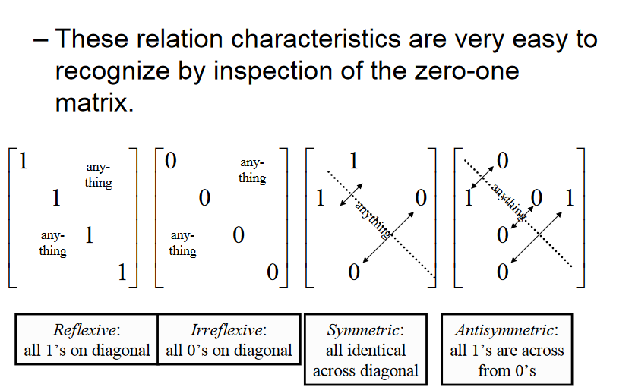
Relations in 0-1 Matrix

Slide 22
Relation Using 0-1 Matrix
Example . Suppose that the relation R on a set is represented by the matrix
Is R reflexive, symmetric, and / or antisymmetric ?
Sol :
reflexive, symmetric, not antisymmetric.

Slide 23
Examples of Relations Using Matrix
Example. Suppose that S={0,1,2,3} Let R be a relation containing (a, b) if a ≤ b, where a ∈ S and b ∈ S. Is R reflexive, symmetric, antisymmetric ?
Sol :
0
1
2
3
0
∴ R is reflexive and
antisymmetric,
not symmetric.
1
2
3

Slide 24
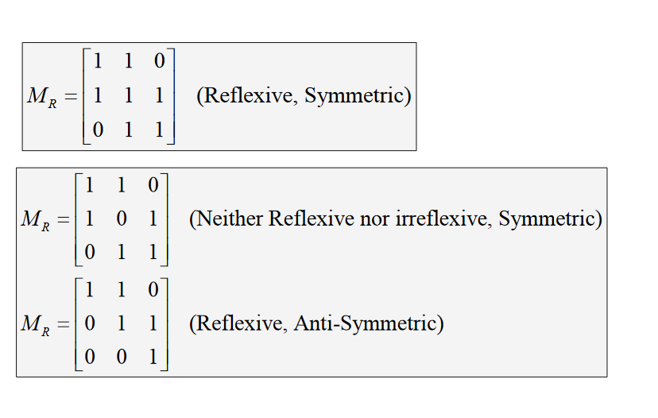
Examples of Relations Using Matrix

Slide 25
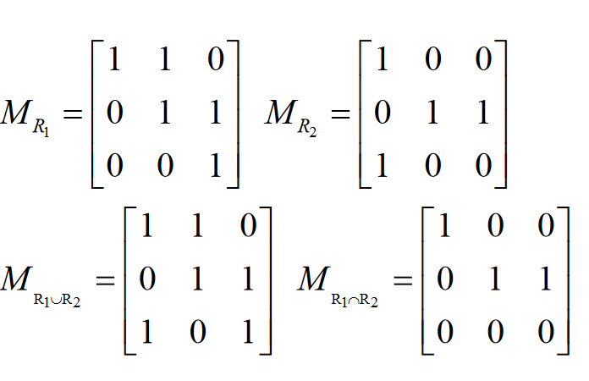
Union and Intersection Operations on Relations Using Matrix

Slide 26
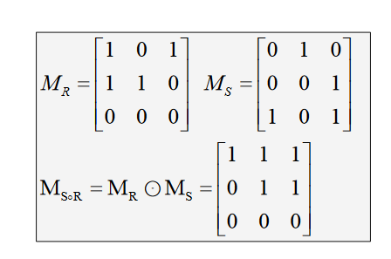
Composite Operations of Relations Using Matrix
Set A={1,2,3}, Relations R and S
R={(1,1),(1,3),(2,1),(2,2)}
S={(1,2), (2,3), (3,1), (3,3)}
R.S={1→1, 1→2= (1,2)
1→3, 3→1= (1,1)
2→1, 1→2= (2,2)
1→3, 3→3= (1,3)
2→2, 2→3= (2,3)}
So, Composite R.S={(1,1), (1,2), (1,3), (2,2), (2,3)}

Slide 27
Representing Relations Using Digraphs. (Directed Graphs)
Example. Show the directed graph (digraph)
of the relation R={(1,1),(1,3),(2,1),(2,3),(2,4),
(3,1),(3,2),(4,1)} on the set {1,2,3,4}.
Sol :
1
2
vertex : 1, 2, 3, 4
edge : 1→1, 1→3, 2→1
2→3, 2→4, 3→1
3→2, 4→1
4
3

Slide 28
Reflexive and Symmetric Relation Using Digraph
The relation R is reflexive iff for every vertex,
(loop)
The relation R is symmetric iff
⇒
x
y
x
y

Slide 29
Transitive Relation Using Graph
The relation R is transitive iff for a, b, c ∈A, (a, b)∈R and (b, c)∈R ⇒ (a, c)∈R.
This means:
a
b
a
b
⇒
d
c
d
c

Slide 30
Example. Determine whether the relations R and S are reflexive, symmetric, antisymmetric, or transitive
a
b
Sol :
S
reflexive,
not symmetric,
not antisymmetric,
not transitive
(a→b, b→c, a→c)
R :
a
c
d
not reflexive,
symmetric
not antisymmetric
not transitive
(b→a, a→c, b→c)
b
c
(a,b), (b,c),(c,b),(a,a)
(b,b),(c,c),(c,a)
(a,b), (b,a),(a,d),(d,a)
(a,c),(c,a),(b,b)

Slide 31
Acknowledgement
Kenneth Rosen
Susanna S. Epp (Reading Materials)
R.S.Chang, CSIE, NDHU

